Slide 1



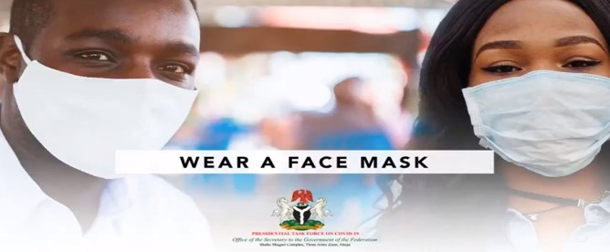
Presidential Task Force on COVID-19
End of Year Report
December 2020
Prepared by the PTF Secretariat and PricewaterhouseCoopers

Slide 2

Agenda
Contents
Table of
EXECUTIVE SUMMARY
07
INTRODUCTION
27
PTF MID-TERM REVIEW RETREAT
34
ACHIEVEMENTS
39
STAKEHOLDER ENGAGEMENT
63
RESOURCE MANAGEMENT
72
CHALLENGES AND LESSONS LEARNT
81
TRANSITION PLAN – POST PTF
87
APPENDIX
99

Slide 3

GLOSSARY - LIST OF ABBREVIATIONS
SN | Abbreviations | Full Term
1. | AFENET | African Field Epidemiology Network
2. | AIC | Aeronautical Information Circulars
3. | AOL | All Operator Letters
4. | API | Active Pharmaceutical Ingredients
5. | BiPAP | Bilevel Positive Airway Pressure
6. | BON | Broadcasting Organisations of Nigeria
7. | CACOVID | Coalition Against Covid-19
8 | CBO | Community-Based Organisation
9. | CDC | Centre for Disease Control
10. | CEO | Chief Executive Officer
11. | CHAI | Clinton Health Access Initiative
12. | CMC | Crisis Management Committee
13. | CMD | Chief Medical Director
14. | COVID-19 | Coronavirus Disease/ 2019 Novel Coronavirus
15. | CRS | Catholic Relief Services
16. | CSO | Chief Security Officer
17. | DFID | Department for International Development
18. | DG | Director General
19. | DRASA | Dr. Ameyo Stella Adadevoh (Drasa) Health Trust
20. | DRL | Defence Reference Laboratory
21. | DSS | Department of State Services
22. | EBS | Emergency Broadcast System
23. | ECOWAS | Economic Community of West African States
24. | EOC | Emergency Operations Centre
25. | EPI | Epidemiology
26. | EU | European Union
27. | FAAN | Federal Airports Authority of Nigeria
28. | FCT | Federal Capital Territory
29. | FCTA | Federal Capital Territory Authority
30. | FEMA | Federal Capital Territory Emergency Management Agency
31. | FFS | Federal Fire Service
32. | FGM | Female Genital Mutilation
33. | FGN | Federal Republic of Nigeria
34. | FIIAPP | International and Ibero-American Foundation for Administration and Public Policies
35. | FMARD | Federal Ministry of Agriculture and Rural Development
36. | FMH360 | Family Health International
37. | FMHDSD | Federal Ministry of Humanitarian Affairs Disaster Management and Social Development
38. | FMIC | Federal Ministry of Information and Culture
39. | FMOH | Federal Ministry of Health
40. | FRCN | Federal Radio Corporation of Nigeria
41. | FRSC | Federal Road Safety Corps
42. | FTHI | Federal Tertiary Health Institutions
43. | GBV | Gender-Based Violence
44. | GEEP | Government Enterprise and Empowerment Programme
45. | GISCOR | Grassroots Initiative for Strengthening Community Resilience
46. | GIZ | German Agency for International Cooperation
47. | HAI | Healthcare Associated Infections
48. | HCW | Healthcare Workers
49. | HF | Health Facility
50. | HGSFP | Home Grown School Feeding Programme

Slide 4
GLOSSARY - LIST OF ABBREVIATIONS
SN | Abbreviations | Full Term
51. | HRH | Human Resources for Health
52. | IAP | Industrial Arbitration Panel
53. | IATA | International Air Transport Association
54. | ICAO | International Civil Aviation Organisation
55. | ICU | Intensive Care Unit
56. | IDEC | Import Duty Exemption Certificate
57. | IDP | Internally Displaced Persons
58. | IEC | Information, Education, and Communication
59. | IFRC | International Federation of The Red Cross
60. | IHR | International He alth Regulations
61. | IHVN | Institute of Human Virology
62. | INGO | International Non-Governmental Organisation
63. | IOM | International Organisation for Migrations
64. | IPC | Infection Prevention and Control
65. | IRC | International Rescue Committee
66. | JHPIEGO | Johns Hopkins Program for International Education in Gynaecology and Obstetrics
67. | JSCD | Joint Supply Chain and Distribution Team
68. | KNCV | KNCV Tuberculosis Foundation
69. | LASIAMA | Lagos State Infrastructure Asset Management Agency
70. | LGA | Local Government Areas
71. | LGAHMT | Local Government Health Management Authority
72. | LSMOH | Lagos State Ministry of Health
73. | M&E | Monitoring and Evaluation
74. | MAN | Manufacturers Association of Nigeria
75. | MDA | Ministries, Departments and Agencies
76. | MLSCN | Medical Laboratory Science Council of Nigeria
77. | MMIA | Murtala Muhammed International Airport
78. | MNI | Membership of The National Institute
79. | MOD | Ministry of Defence
80. | MOFA | Ministry of Foreign Affairs
81. | MSH | Management Sciences for Health
82. | MT | Megatonne
83. | NACA | National Agency for The Control Of AIDS
84. | NACCIMA | Nigerian Association of Chamber of Commerce, Industry, Mines and Agriculture
85. | NAFDAC | National Agency for Food and Drug Administration and Control
86. | NAIA | Nnamdi Azikiwe International Airport
87. | NANTS | National Association of Nigerian Traders
88. | NAPTIP | National Agency for The Prohibition of Trafficking in Persons
89. | NARD | National Association of Resident Doctors
90. | NARTO | National Association of Road Transport Owners
91. | NASME | National Association of Small and Medium Enterprises
92. | NASSI | National Association of Small-Scale Industrialists
93. | NCAA | Nigerian Civil Aviation Authority
94. | NCDC | Nigeria Centre For Disease Control
95. | NCoS | Nigerian Correctional Service
96. | NCRC | National COVID-19 Response Centre
97. | NCS | Nigeria Customs Service
98. | NEDC | North East Development Commission
99. | NEMA | National Emergency Management Agency
100. | NEOC | National Emergency Operations Centre

Slide 5
GLOSSARY - LIST OF ABBREVIATIONS
SN | Abbreviations | Full Term
101. | NESG | Nigerian Economic Summit Group
102. | NGF | Nigeria Governors Forum
103. | NGO | Non-Governmental Organisations
104. | NIMASA | Nigerian Maritime Administration and Safety Agency
105. | NIMR | Nigerian Institute of Medical Research
106. | NIPRD | National Institute for Pharmaceutical Research and Development
107. | NIS | Nigeria Immigration Service
108. | NISRN | National Integrated Specimen Referral Network
109. | NMOD | Nigerian Ministries of Defence
110. | NOA | National Orientation Agency
111. | NOTAM | Notice to Airmen
112. | NPA | Nigerian Ports Authority
113. | NPF | Nigeria Police Force
114. | NPHCDA | National Primary Health Care Development Agency
115. | NPI | Non-Pharmaceutical Interventions
116. | NPRC | National Pandemic Response Centre
117. | NRL | National Reference Laboratory
118. | NSCDC | Nigeria Security and Civil Defence Corps
119. | NTA | Nigerian Television Authority
120. | NTBLCP | National Tuberculosis and Leprosy Control Programme
121. | NURTW | National Union of Road Transport Workers
122. | ONSA | Office of The National Security Adviser
123. | PCP | Physically Challenged Persons
124. | PCR | Polymerase Chain Reaction
125. | PHC | Primary Health Care Workers
126. | PHE | Public Health England
127. | PHEIC | Public Health Emergency of International Concern
128. | PHIA | Port Harcourt International Airport
129. | PHS | Port Health Services
130. | PLAC | Policy and Legal Advocacy Centre
131. | PMG | Pharmaceutical Manufacturers Group
132. | POE | Point of Entry
133. | POI | Person of Interest
134. | PPE | Personal Protective Equipment
135. | PR | Pillar Response
136. | PRP | Pandemic Response Plan
137. | PTF | Presidential Task Force on COVID-19
138. | PwC | PricewaterhouseCoopers
139. | RCCE | Risk Communication and Community Engagement
140. | RCTWG | Risk Communication Technical Working Group
141. | RILO | Regional Intelligence Liaison Office
142. | RMCC | Resource Mobilisation and Coordination Committee
143. | RRT | Rapid Response Team
144. | SEMA | State Emergency Management Agency
145. | SGBV | Sexual and Gender Based Violence
146. | SGF | Secretary to The Government of the Federation
147. | SHMB | State Hospital Management Board
148 | SMOH | State Ministry of Health
149. | SMS | Short Message Service
150. | SON | Standards Organisation of Nigeria

Slide 6
GLOSSARY - LIST OF ABBREVIATIONS
SN | Abbreviations | Full Term
151. | SOP | Standard Operating Procedure
152. | SORMAS | Surveillance Outbreak Response Management and Analysis System
153. | SPHCB | State Primary Health Care Board
154. | SPHCDA | State Primary Health Care Development Agency
155. | SRH | Sexual and Reproductive Health
156. | SUNMAP2 | Support to The National Malaria Programme
157. | TA | Technical Advisor
158. | TAT | Turnaround Time
159. | TC | Treatment Centres
160. | TOR | Terms of Reference
161. | ToT | Training of Trainers
162. | TRANEX | Trans-Nationwide Express Plc
163. | UK | United Kingdom
164. | UKAID | United Kingdom Aid
165. | UN | United Nations
166. | UNAIDS | Joint United Nations Programme On HIV/AIDS
167. | UNCT | United Nations Country Team
168. | UNDP | United Nations Development Programme
169. | UNFPA | United Nations Population Fund
170. | UNHCR | United Nations High Commissioner for Refugees
171. | UNICEF | United Nations International Children's Fund
172. | UNODC | United Nations Office on Drugs and Crime
173. | US | United States
174. | USAID | United States Agency for International Development
175. | USCDC | United States Centers for Disease Control and Prevention
176. | USD | United States Dollar
177. | USG | United States Government
178. | VAT | Value Added Tax
179. | VOA | Voice of Africa
180. | VTM | Viral Transport Media
181. | W4H | Women for Health
182 | WARDS | West African Disease Surveillance Program
183. | WASH | Water, Sanitation and Health
184. | WCO | World Customs Organisation
185. | WFP | World Food Programme
186. | WHO | World Health Organisation
187. | WRAIR | Walter Reed Army Institute of Research

Slide 7
EXECUTIVE SUMMARY
1

Slide 8
Forward
The rapid increase in the number of global COVID-19 cases and the declaration of the WHO of the COVID-19 outbreak as a pandemic underscored the need for a coordinating body to oversee the COVID-19 response efforts in Nigeria. In this vein, President Muhammadu Buhari constituted the Presidential Task Force on COVID-19 (PTF), which was inaugurated on 17th March 2020, to coordinate and oversee Nigeria’s multi-sectoral inter-governmental efforts to contain the spread and mitigate the impact of the COVID-19 pandemic in Nigeria.
This coordinating body was to be in effect for a period of six months, but with growing concerns around the ongoing outbreaks in Nigeria, President Buhari then approved the extension of the PTF mandate till December 2020. This document captures the details of the performance of the task force from 17th March through December 2020 as well as the PTF transition plans for its functionalities and resources beyond the End-Term date.
In July 2020, the PTF conducted a two-day Mid-Term Review (MTR) meeting where members of the PTF and key stakeholders assessed the progress of the National Response and identified ways of strengthening the overall response. The review was conducted on reports submitted by Federal Government Ministries, Departments, and Agencies (MDAs) and reports submitted by donors and partners.
Following the MTR, a detailed and revised action plan was developed for each of the Pillars, which served as the foundation of the PTF’s roadmap in the subsequent months. As September has rolled around and we have slowly entered the last month of the PTF, it has become even more critical that a review be conducted on the performance of the PTF and to determine the next course of action for the sustainability of the gains made in its response. To this end, an End of Year Review was held on December 14 to identify gaps in the PTF response; to further strengthen the transition plan; and to ensure Government and partner/stakeholder buy-in and support during the response. This review was followed by a Press Conference to highlight both the achievements and challenges experienced by the PTF and to chart a way forward for fortifying Nigeria’s long-term response plans for future outbreaks in the country.
This document is pivotal as it serves as a template for responding to emergencies in the country. The document will ensure that the investments made to combat COVID-19 contributes to the response of future outbreaks through a body of work that will systematically transition the processes, functionalities and resources, and lessons learned into future response efforts.
I sincerely appreciate the chairmen of the relevant Committees on Health in the Senate and House of Representatives, Ministries, representatives from the Office of the Vice President, the Nigeria Governors’ Forum, the diplomatic community, the development partners and every other stakeholder who have contributed to Nigeria’s COVID-19 response efforts. Their commitment in providing the technical, financial, and other forms of support to the PTF and its Secretariat and to the entire PTF implementation process is forever strewn in the humanity of this era.

Slide 9
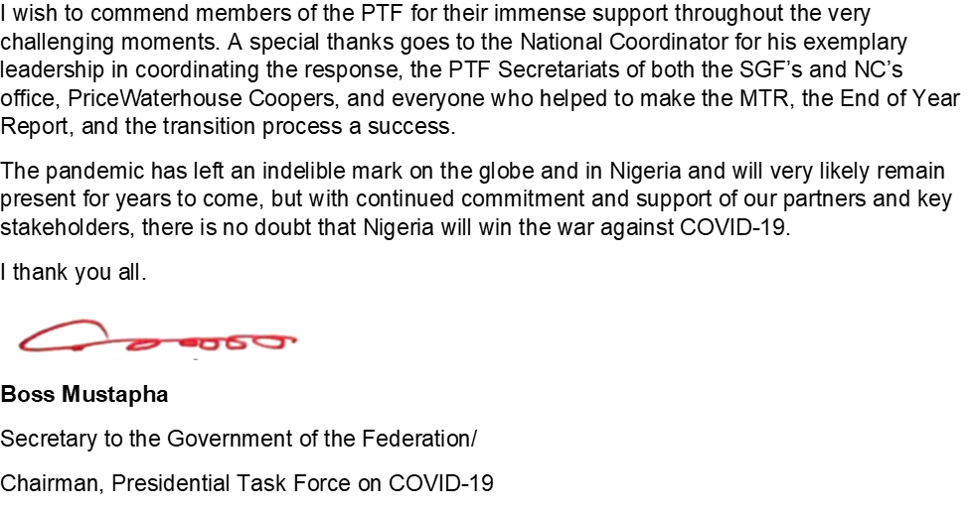
Forward

Slide 10
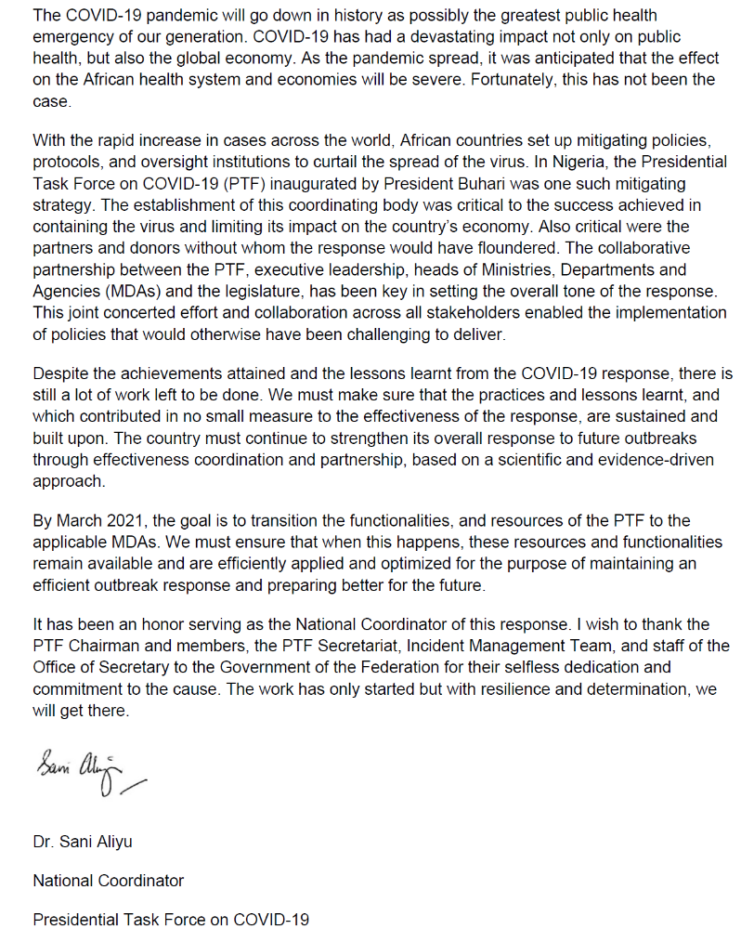
Forward

Slide 11
EXECUTIVE SUMMARY
Purpose of this report
The purpose of this report is to present key proceedings and outcomes of the activities of the Presidential Task Force for COVID-19 (PTF) at the end of 2020. The report highlights the PTF’s achievements, key challenges encountered, lessons learned, recommendations for consideration, and contributions of key stakeholders (donors and partners) as well as the transition plan for the continued management of Nigeria’s COVID-19 pandemic response.
Nigerian Healthcare Sector prior to COVID-19 Pandemic
Similar to other developing countries, the Nigerian health sector’s preparedness for disease outbreaks have been inadequate. Prior to the advent of COVID-19 , the health sector had for years suffered from neglect, primarily as most of its policies and laws laid dormant without implementation. Nigerians have in the past few years dealt with several disease outbreaks such as Ebola, Lassa fever, cholera, monkeypox – with subsequent loss of lives. Prevailing challenges of the healthcare sector such as limited funding, poor healthcare infrastructure, low disease surveillance rate amongst other factors have over the years been identified as factors contributing to the low level of preparedness for disease outbreak in the country.
% of Nigeria’s Budget Appropriated to Healthcare
2020
2021
*Abuja Declaration 2001
4.16%
4.5%
15%
Source: World Bank, NBS, WHO
*Expected % contribution to health sector by African Union countries
Before COVID-19, the healthcare infrastructure and testing capacity for infectious diseases in the country was largely inadequate. This included the lack of adequately equipped isolation centers in the country. Prior to the index case on the 27th February 2020, there were only five (5) laboratories in four (4) states equipped with the relevant testing equipment to effectively test for the COVID-19 virus.
There were only two functional Infectious Disease Hospitals (Lagos and Port Harcourt) and of the two (2) hospitals, only one had a permanent containment facility for highly infectious disease in line with recommendation by the World Health Organization (WHO).

Slide 12
EXECUTIVE SUMMARY
Birth of the Presidential Task Force for COVID-19 (PTF)
The PTF was inaugurated as the focal point of government’s efforts to tackle the COVID-19 pandemic on 17th March 2020.
The responsibilities of the Presidential Task Force include:
Develop guidelines and best practices for COVID-19 response
Establish a national budget and determine funding sources for Nigeria’s response to COVID-19
Determine key nationwide policy and enforcement measures
Ensure national security throughout the response
Manage negative economic impact of the COVID-19 pandemic to the country
To achieve the mandate of the PTF, the Task Force developed the National COVID-19 Pandemic Multi-Sectoral Response Plan (NPRP) with the following strategic objectives:
Provide a coordinated and effective national and sub-national response to the COVID-19 pandemic
Reduce COVID-19 related morbidity and mortality
Mitigate pandemic-related impacts on critical, economic and health infrastructure
Facilitate post-pandemic recovery and rehabilitation operations
Overview of the PTF Leadership
The PTF members consists of the following individuals and heads of Ministries/Department/Agency (MDA):
PTF Chairman
Mr. Boss Mustapha
National Coordinator
Dr. Sani Aliyu
Hon. Minister of Health
Dr. Osagie Ehanire
Hon. Minister of State for Health
Dr. Adeleke Mamora
Hon. Minister of Aviation
Mr. Hadi Sirika
Hon. Minister of Humanitarian Affairs, Disaster Management and Social Development
Hajia Sadiya Umar Farouk
Hon. Minister of Education
Mallam Adamu Adamu
Hon. Minister of State for Education
Mr. Chukwuemeka Nwajiuba
Hon. Minister of Foreign Affairs
Mr. Geoffrey Onyeama
Hon. Minister of Information & Culture
Alhaji Lai Mohammed
Hon. Minister of interior
Mr. Ogbeni Rauf Aregbesola
Hon. Minister of Environment
Dr. Mohammad M. Abubakar
Director-General Centre for Disease Control
Dr. Chikwe Ihekweazu
Executive Director NPHCDA
Dr. Faisal Shuaib
Director-General Directorate of State Services
Mr. Yusuf B. Magaji
WHO Country Representative
Dr. Walter Mulombo
Overview of the PTF Incident Management Structure, Pillars (Functional Working Groups), Partners/Donors and MDAs
The PTF national incident command under the National Coordinator serves as the technical and operational arm of the PTF and its activities; centre mostly on ensuring that the overall response is coordinated and aligned into a single response. This was achieved through the establishment of a single command and control structure that operates within the National Pandemic Response Centre (NPRC). To drive the implementation of the Pandemic Response Plan, the PTF established NPRC which serves as the implementation unit and is headed by a National Coordinator. The NPRC created ten (10) functional pillars and one (1) sub-group, overseen by a National Incident Manager, while the secretariat is led by a Chief of Secretariat Unit.
In addition, the NPRC also collaborated with Partners/Donors and Ministries, Departments and Agencies (MDAs) in delivering its objective. The pillars as listed, were established with the overarching goal of implementing the National Pandemic Response Plan (NPRP), determining policies and ensuring effective communication and collaboration towards the delivery of the PTF’s mandate.

Slide 13
EXECUTIVE SUMMARY
Functional Pillars
Case Management
Epidemiology & Surveillance
Infection, Prevention and Control
Laboratory
Point of entry
Resource Mobilisation
Risk Communication and Community Engagement
Security, Logistics and Mass Care
State Coordination and Govt. Relations
Research
Sustainable Production Sub-Group
The PTF Mid-Term Review
The PTF as the focal point of the government’s efforts to tackle the COVID-19 pandemic was inaugurated on 17th March 2020 with an initial mandate of six (6) months. At the end of the first four months, there was a mid-term review of the activities of the PTF. The review covered the performance of the PTF, its Pillars and supporting MDAs viz-a-viz set objectives. As part of the review, the PTF organized a two-day retreat on 9th and 10th July 2020.
The retreat brought together several stakeholders with the aim of re-strategizing and strengthening its efforts in tackling the pandemic over the next three months and beyond. Stakeholders in attendance at the retreat included:
Legislators (including the Chairmen of the relevant Committees on Health in the Senate and House of Representatives)
Ministers
Representatives from the Office of the Vice President
The Nigeria Governors’ Forum
Diplomatic Community
Development Partners
To obtain feedback and stakeholders’ perception on the performance of the Presidential Task Force on COVID-19 (PTF) in ensuring that the Federal Republic of Nigeria emerges from the COVID-19 pandemic with minimal negative impact to the population, health systems and the economy, an online survey was deployed to the PTF’s Donors/Partners.
The survey responses revealed that stakeholders expressed satisfaction with the PTF’s role in coordinating the national response against COVID-19 as shown in the table below:
S/N | Performance Areas | Survey Rating
1 | Coordination of the national response | 4.0
2 | Collaboration with stakeholders | 3.8
3 | Provision of preventive guidance and awareness | 3.5
4 | Provision of adequate mechanism to mobilise resources | 3.3
5 | Communication, Testing, Contact Tracing, Isolation, Treatment, IPC, Social Support, Economic Support, Enforcing Preventive Measures. | 3.1
6 | Mitigation of socio-economic impact | 2.7
7 | Provision of guidelines on the different phases of response | 2.6
Scale of 1 to 5 (5 being the highest and 1 being the lowest).

Slide 14
EXECUTIVE SUMMARY
The mid term review also defined the Roadmap for the next three (3) to six (6) months. The key initiatives and activities were outlined and agreed by Pillar Leads and relevant stakeholders.
Pillars | Pillar Objectives (Agreed Next Steps)
Epidemiology and Surveillance | Enhance Community-based Surveillance for COVID-19 to improve active case handling and sample collection
 | Improve contact tracing after identification of a confirmed case
Laboratory | Strengthen national laboratory supply chain monitoring and forecasting
Laboratory | Place GeneXpert in hospitals for better triage and turnaround time
 | Develop and implement a national quality assurance program to monitor laboratory testing and performance
 | Improve real time data collation and analysis through the development of data pipeline and dashboard and hiring of data analysts
 | Increase human resources and work hours for labs to enable them to conduct more tests in each day (especially night shifts)
 | Procure Automated extraction systems
Point of Entry | Ensure every entry point has the capacity to collect samples for testing
 | Expand Border Security Patrols
 | Ensure sustainability of implementation of all public health guidelines and protocols at points of entry
 | Improve contact tracing facilities
 | Consider premium payments to secure spots in the procurement queue
 | Prioritise and allocate funds for procurement of essential lab reagents and supplies
 | Explore other molecular based diagnostic techniques and new technologies i.e., NAAT – Nucleic Acid Amplifications Test
 | Increase human resources and work hours for labs to enable them to conduct more tests in each day (especially night shifts)
 | Place Gene Expert in hospitals for better triage and turnaround time
Case Management | Provide technical assistance and epistemological support to states to enforce the case management guidelines for home care;
 | Review and revise existing algorithms and guidelines for case management
 | Strengthen the mechanisms of observation isolation centres and screening
 | Conduct further training of staff
 | Conduct regular meetings with key stakeholders
 | Lead advocacies for the Federal Ministry of Health (FMoH) to support the implementation of its home-based care protocol across all states
 | Empower states to take control of their case management situation and establish clear reporting lines to the FMOH

Slide 15
EXECUTIVE SUMMARY
Pillars | Pillar Objectives (Agreed Next Steps)
Infection, Prevention and Control | Embed and strengthen functional IPC programmes across the country
 | Enforce National Primary Healthcare Development Agency (NPHCDA) guidelines for Public Health Care/World Health Organisation’s minimum requirements for IPC
 | Define clear career paths for IPC professionals
Risk Communications | Set up a network of COVID-19 Survivors to drive the campaign to change the narrative around stigmatization
 | Start massive house-to-house campaign on Immunization (EPI) structure to promote interpersonal communication between volunteers and households to engender behaviour change
 | Sustain discussions around COVID-19 by floating a live radio discussion programme on COVID-19 across the country to ensure dialogue between experts, religious leaders, COVID-19 survivors, care givers, etc. and the public
 | Continuously work with its partners to undertake research with a view to addressing the key drivers of the challenges to behaviour change;
 | Review messages being disseminated on COVID-19 and incorporate threat and efficacy element into future messages
Security, Logistics, Mass Care Pillar | Develop standards and criteria for enforcement of protocols/sanctions
 | Develop a seamless PTF multi sectoral structure at the state level which cascades to the Federal Government
 | Create a special security intervention fund for emergency
State Government Relations | Support states in revenue mobilization and effective utilization of funds
 | Facilitate a more proactive and coordinated engagement with the States’ Task Force on COVID-19 (to facilitate state ownership and sustainability of response)
Resource Mobilization | Gain the confidence of MDAs and leadership of the PTF to ensure MDAs share information to all Pillar leads, as when needed
 | Ensure that there is sustainable funding for the COVID-19 response even when partners are not there
Sustainable Production Sub-Group | Ensure long term uptake from Government and credible investors
 | Ensure standard quality guidelines for specific COVID-19 products meet International Market Standard
 | Ensure collation of accurate supply chain/stock status/utilisation reports from the Pillars periodically for up-to-date response to needs

Slide 16
EXECUTIVE SUMMARY
Highlights of the PTF’s Achievements
The PTF since inception till date has achieved several accomplishments through its different pillars, MDAs and partners. These achievements cut across fund mobilization, policy formulation, public and private sector collaboration to enforce preventive measures, provision of healthcare infrastructure, capacity development among others. The PTF’s achievements from inception were categorized into eight (8) levers.
Funding
Healthcare
Capacity Building
Social Welfare
Communication
Economic Support
Economic Reopening
Surveillance
Funding
A total of ₦178,800,260,723 in monetary resources was available for the COVID-19 response as shown below. About 79% of funds from donors and partners were used directly to support activities without passing through the PTF or government account.
₦ 141.1b
₦ 15.6b
₦ 22.2b
* Source UNDP dashboard, OSGF, Resource Mobilisation Pillar

Slide 17




EXECUTIVE SUMMARY
Healthcare
As of 6th December 2020, the PTF through the NCDC and other partners had successfully conducted 812,598 tests. There were 3,184 active cases and 64,774 cases had been managed/discharged.
812,598
3,184
64,774
Total number tested and given results
Total Number of Active Cases
Managed / discharged cases
Capacity Building
In the wake of the COVID-19 outbreak, capacity development was required to equip frontline healthcare workers with necessary skills and infrastructure for managing suspected cases and to ensure adherence to safety protocols and procedures.
The focus on capacity development was in three categories:
Facilities
Testing
Training
Facilities
The PTF in collaboration with partner, successfully set up and accredited 130 isolation/treatment centres with a total capacity of 7,296 beds across the country over a period of six (6) months.
130
7,296
Total Number of Isolation/Treatment Centres Accredited
Total bed capacity in all Treatment Centres

Slide 18

EXECUTIVE SUMMARY
COVID-19 Testing Capacity
The PTF through the NCDC achieved its mandate to expand laboratory capacity for COVID-19 testing to ensure 100% geographic coverage and test turnaround time (TAT) of 24 hours by decentralizing testing capacity. As at Decemebr 6, 68 of the labs are government owned and the remaining are private/ corporate sector labs (30). A few labs have 2-3 testing platforms (equipment). Some of the notable achievements under testing capacity include the activation of various platforms to conduct molecular testing:
72 PCR equipment
22 GeneXpert equipment
2 Corbus equipment
2 Abbott equipment
Training
From inception through 5th December 2020, over 35,500 healthcare workers (HCW) were trained in appropriate infection prevention and control practices, including personal protective equipment (PPE) donning and doffing, and hygiene.
Healthcare Workers Trained
Doctors
5,500
Nurses
Total Number of HCW Trained
6,000
Allied Health Workers
35,500
20,000
Communication
The Risk communication pillar successfully maintained regular communication with relevant stakeholders and conducted stakeholder engagements with partners/donors, MDAs and the general public. Awareness about the COVID–19 pandemic and Nigeria’s response was created through the production of various communication and advocacy materials. The PTF leveraged both traditional and digital media in communicating with members of the general public.
Some of the areas covered include:
General Information on COVID-19
Use of Face Masks
Burial Protocol
Testimonial from survivors
Mass Gathering
Social Distancing
Fake News
School and NYSC reopening

Slide 19
EXECUTIVE SUMMARY
Social Welfare
Social welfare programmes were aimed at aiding individuals and households in need i.e., vulnerable parts of the population.
Several donors, partners such as CACOVID, MDAs (e.g., FMHDSD) and pillars supported the provision and distribution of palliatives to the vulnerable population: poor, Internally Displaced Persons (IDPs), Physically Challenged Persons (PCPs), women, children, elderly among others to cushion the socio-economic and psychological impact of the COVID-19 pandemic.
These palliatives were in two key categories:
FOOD ITEMS
CASH TRANSFERS
Food
Food items comprising Garri, Maize, Millet and Sorghum were approved for delivery to frontline states.
So far, a total of 70,000 (MT) of food items were distributed to 8,827,129 households in 24 states.
Cash Transfers
Cash disbursement was made to 1,289,405 beneficiaries in 34 States and the FCT from June 2020 to October 2020
Economic Support
Support to individuals and small scale/medium businesses in the form of loans and empowerment were made through the Federal Government’s Economic Program:
The aim was to cushion the effect of the lockdown on individuals and small-scale business owners. The following were achieved:
Government Enterprise and Empowerment Programme (GEEP):
Trader and Market Moni loans:
Rapid Expansion of the National Social Register:
The GEEP successfully sensitised over 5 million small scale traders captured on Government Enterprise and Empowerment Programme (GEEP) database regarding COVID-19 pandemic, granted moratorium to 2.2 million existing GEEP beneficiaries for three months and completed 99% loan disbursement target
Loans were disbursed to 43,117 beneficiaries in 11 states and the FCT (Lagos, FCT, Ogun, Plateau, Bauchi, Yobe, Zamfara, Katsina, Edo, Cross River, Enugu and Imo)
The National Social Register was updated to include previously unidentified vulnerable citizens. The National Social Register now comprises 3.6 million households in 36 States and the FCT

Slide 20
EXECUTIVE SUMMARY
Economic Reopening
Following the outbreak of COVID-19 pandemic in Nigeria, various sectors including travel & tourism, education, etc. were closed in order to safeguard the health and general wellbeing of the citizens. As the lockdown eased and business, schools and other places of social gathering began to operate, measures were implemented as well as the setting of guidelines by the government for the safe and efficient reopening of the Nigerian economy in line with the Economic Sustainability Plan under the Office of the Vice President.
Surveillance
The PTF through its Surveillance and Epidemiology pillar in collaboration with other pillars and partner MDAs intensified surveillance activities to facilitate early COVID-19 case detection, timely reporting of cases including community transmission of COVID-19 and supported the coordination of the outbreak response and roll-out strategies.
The response was conducted in three phases:
Prevention & Preparedness
Containment
Control & Mitigation
End of Year Review
For the end of year report, an online survey was deployed to obtain stakeholder feedback and perception on the performance of the Presidential Task Force on COVID-19 (PTF) in ensuring that the country emerges from the COVID-19 pandemic with minimal negative impact to the population, health systems and the economy
Stakeholder Engagement: Partner Feedback
An online survey was deployed to obtain feedback from PTF partners on perception on the performance of the Presidential Task Force on COVID-19 and the proposed PTF transition process.
Survey Respondent Demography:
54
14
Total number of recipients (organisations)
Number of respondents (organisations)
MUST DOs to ensure the mandate of the PTF is sustained during and beyond the transition period
  Provide adequate funds to support and sustain ongoing and projected activities
  Foster collaboration between MDAs, private bodies and development partners
  Develop and implement a Transition Plan with clearly defined timelines, responsible parties and cost implications
MUST AVOID in order to ensure sustainability of the PTF Mandate
  Decentralizing of the national response and transferring of responsibility and resources completely to states
  Dissolving the PTF without clearly defining next steps, transition plan and responsible parties
  Multiple decision-making points/handover in policy formulation and implementation

Slide 21
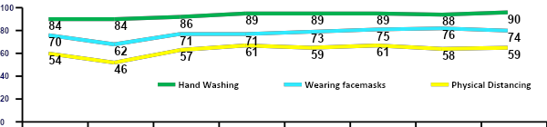
EXECUTIVE SUMMARY
Citizens Feedback
Nationwide surveys were conducted for a duration of 24 weeks by NOI Polls starting from 15th May 2020 to 20th November 2020. These polls were made up of weekly national polls where state quotas were assigned to ensure that every state was proportionately represented and individual states namely, Kano, Enugu, Lagos, Kogi, Borno, Zamfara, Abia, Adamawa, Kebbi, Rivers, FCT, Edo, Bayelsa, Ogun, Oyo, Plateau, Ondo, Cross River, Imo, and Kaduna were also polled during the same period. The surveys were conducted to understand citizen’s perceptions, barriers, behaviors and concerns regarding Covid-19 as well as understand citizen’s trust in Government measures to combat the virus.
The surveys were conducted at different periods and they focused on assessing citizens perception in 5 key areas:
Trust and Concern
Channels and recall of messaging
Preventive behaviors
Palliatives
Misinformation and testing
Survey Respondent Demography:
36,000
1,500
Total Sample over 24 weeks
Weekly Sample size
Trust and Concern
Over the course of polling, trust in Government rose from 54% to 63%, a 9% increase demonstrating citizen confidence in the measures taken to combat the virus
There was a significant link between vulnerability to misinformation and recall of messages; those who saw preventative advice were much more likely to follow advised measures.
Key Findings
Communication Monitoring
% of citizens that saw advertising, publicity or other information about COVID-19 from FG or NCDC
Citizens who saw information on Coronavirus in the last 7 days reached a peak of 89% at the height of the first wave, dropping to 46% by December; however this has climbed again as the world moves into the second wave.
TV and radio were by far the most effective platforms, though a smaller percentage of citizens reported receiving information via social media
Trusted figures were routinely community leaders, religious leaders and healthcare workers. who had the greatest influence on people’s views
Misinformation
Average levels of disbelief in the virus nationwide have been around 18%; this has stayed relatively constant though there are regions with much higher vulnerability (especially the Southern areas)
Misinformation is strongly linked to levels of trust; the most prevalent rumours were linked to the virus being scam and /or not being real in Nigeria
6% reported to have taken or tried to take a test for Corona virus and their experience was at least satisfactory (85%)
Adherence to preventative behaviors

Slide 22
EXECUTIVE SUMMARY
Resource Utilisation
To achieve its mandate, the PTF through the Resource Mobilization Pillar collaborated with MDAs, development partners, private sector and other key stakeholders to ensure the availability of adequate funding and resources for the effective implementation of the COVID-19 Pandemic response. Donations were received from multilateral, bi-laterals, public and private sector organisations including; the Coalition Against COVID-19 (CACOVID), the World Health Organization, UNICEF, the United States Government (CDC, USAID, WRAIR), the UK Department for International Development, the Government of Japan etc.
Donations received have been categories as shown below:
Monetary Resources
Technical Support
Medical Donations & Supplies
Monetary Resources
Monetary resources were donated to ensure the effective implementation of the COVID-19 pandemic response. These resources were made available from two (2) key sources:
The Federal Government of Nigeria (FGN)
Partners and Donors
A total of ₦178,800,260,723 in monetary resources was available for the COVID-19 response as shown below. The 79% of funds from donors and partners were used by them directly to support activities without passing through the PTF or government account.
₦ 141.1b
₦ 15.6b
₦ 22.2b
* Source UNDP dashboard, OSGF, Resource Mobilization Pillar

Slide 23
EXECUTIVE SUMMARY
Monetary Resources Received from Partner and Donors
The table below details the list of all donations and contributions from the government and other donor agencies in relation to the COVID-19 response in Nigeria.
Contributions Received from Partners and Donors as of December 6, 2020
S/N | States/MDAs | Amount Donated (N)
1 | *UN Basket Fund | 22.6 b
2 | **CACOVID | 43.2 b
3 | Oil and Gas Industry | 21.4 b
4 | DPG-H | 42.9 b
5 | Private Donations to FG COVID-19 Account | 2.0 b
6 | Other Donations | 9.0 b
Total amount Received from Partners and Donors as of 6 December 2020 |  | 141.1 b
*Note: All figures indicated above are based on schedules received from the Office of the Secretary to the Government of the Federation OSGF. Funds from donors and partners were used by them directly to support activities without passing through the PTF or government account, except the private donations used to support the response
.
** The information relating to CACOVID represents actual contribution received from CACOVID in funds, material and food palliatives as indicated by the CBN press release and not passed through the PTF.
Technical Support
Partners also contributed to the availability of resources for Nigeria's COVID-19 response by providing adequate technical support and expertise to various areas. These areas include; technical guidance on infection prevention control measures, communication around mitigating the spread of the disease, data analysis and logistic distribution acumen, monetary donations to fund the technical expertise etc.
The table below shows a list of all the technical assistance (areas of intervention) received from the respective participating agencies quantified in financial terms as at the time of the report.
S/N | Areas of Intervention | Participating Agencies | Amount (N) | Amount ($)
1 | Clinical case planning, case management, modelling and deployment of diagnostic tools; technical and administrative support to the PTF Secretariat. | Bill and Melinda Gates Foundation (BMGF) | 3,300,000,000 | 9,200,000
2 | Surveillance and POE screening | Department for International development (DFID) | 737,300,000 | 2,000,000
3 | Laboratories, infection prevention and control. | GF | 1,800,000,000 | 5,000,000
4 | EPI Surveillance, Laboratory, provision of training to NCDC staff | US Center for Decease Control (USCDC) | 2,700,000,000 | 7,400,000
5 | Coordination of infection prevention and control, Epidemiology and Surveillance | United States Agency for International development (USAID) | 10,900,000,000 | 30,300,000
Total |  |  | 19,437,300,000 | 53,900,000
* Source: UNDP and NESG dashboards

Slide 24
EXECUTIVE SUMMARY
Medical Donations and Supplies
Medical donations and supplies relate to medical equipment, consumables, building and infrastructure items donated by donor partners to the PTF.
The data below shows a snapshot of items donated and the respective Ministries Department Agencies (MDA’s) and the state governments to which the donated items were allocated as of the 6th of December 2020. Full details of donations are in the appendix or the PTF website dashboard, which can be found as follows:
NESG: https://covid-19response.ng/dashboard
UNDP: https://ngcovid19resourcetracker.info/
Medical donations and supplies have been grouped into three (3) key categories:
Medical Equipment
Consumables
Medical Building and Infrastructure
Medical Equipment
S/N | Description | Donors | Quantity | Unit
1 | 11 ICU Beds fitted with Ventilators | RCCG Christian Social Responsibility | 11 | ICU beds with ventilators
2 | Airway Guedel(Sterile Single Use (Range Size) | UNDP | 300 | Pieces
3 | Airway Guedel(Sterile Single Use (Range Size) | UNDP | 100 | Pieces
4 | Ambulance | Nigerian Oil and Gas Industry | 26 | Vehicle
5 | Ambulance | NNPC/Aieto | 5 | Vehicle
6 | Ambulance | United Nations | 5 | Vehicle
7 | Ambulance | Nigerian Maritime Administration and Safety Agency | 1 | Vehicle
8 | Ambulance | IHS Towers | 4 | Vehicle
9 | Ambulance | Government of Japan | 3 | Vehicle
10 | Ambulance | The Securities and Exchange Commission | 1 | Vehicle
* Source: UNDP dashboard

Slide 25
EXECUTIVE SUMMARY
Consumables
S/N | Description | Donors | Quantity | Unit
1 | Mattress & Pillows to the Isolation centers | Vitafoam | 100 | Mattresses with pillows
2 | Disposable medical masks | CCECC | 250,000 | Pieces
3 | Disposable Gloves Non-Powder | INTERNATIONAL ATOMIC ENERGY AGENCY | 25 | Cartons
4 | Knapsack Sprayers for Disnfection (pcs) | JUBAILI AGROTEC | 50 | Pieces
5 | Face Shield | UNDP | 10000 | Pieces
6 | Gloves(Examination) | UNDP | 415000 | Pieces
7 | Goggles (Protective) | UNDP | 240 | Pieces
8 | Surgical Mask | UNDP | 20000 | Pieces
9 | Gown (Single use Fluid Resistant Disposable) | UNDP | 8000 | Pieces
10 | Alcohol -Base Hand rub (Bottle 100ml & 500ml) | UNDP | 960 | Pieces
* Source: UNDP dashboard
Medical Equipment and Infrastructure
S/N | Description | Donors | Quantity | Unit
1 | Laboratory construction | GAC | 1 | Buildings
2 | Refurbishment, upgrading, equipment supply, modernization and management of six pilot teaching hospitals, one per geopolitical | CPL Medical Group Ltd | 6 | Buildings
3 | Donation of facilities at Onne Seaport | Intels | 2 | Buildings
4 | ICU Facilities | UBA Heirs Holdings Healthcare Subsidiary Avon Medical Hospital |  | Buildings
5 | Medical Facilities Across 57 Dioceses | Catholic Bishops Conference Of Nigeria | 453 | Buildings
6 | 1000 Bed Medical Facilities | Dangote | 1 | Buildings
7 | 500 Bed Medical Facilities | Dangote | 1 | Buildings
8 | 210 Bed Medical Facilities | Dangote | 1 | Buildings
9 | 200 Bed Medical Facilities | Dangote | 1 | Buildings
10 | 200 Bed Medical Facilities | Dangote | 1 | Buildings
11 | Ventilators | USAID | 200 | Equipment
* Source: UNDP dashboard

Slide 26
EXECUTIVE SUMMARY
Challenges and Lessons Learnt
Challenges
Despite the successes recorded during the review period, the PTF had to deal with some challenges:
Delay in PPE supply
Inadequate healthcare infrastructure
Lack of structured data
Disrupted supply chain
Pandemic fatigue
Difficulty sourcing specialised medical equipment and supplies
Increased cost of procurement
Shortage of technical staff
Inadequate cooperation from some States
Delay in release of funds
Logistics challenges
Lessons Learnt
In fighting against the novel COVID-19 pandemic, several initiatives/decisions if implemented early enough, may have led to a reduction in the number of imported cases from returnees and possibly the overall number of cases.
Several lessons were learned, and these lessons will result in the efficient management of future outbreaks/ pandemics such as COVID-19.
The following interventions should have been implemented early :
Early involvement of Ministry of Education
Increased focus on economic recovery
Early closure of borders (international/local)
Tracking and monitoring of returnees
Early distribution of medical equipment
Increased testing capacity
Proactive health response approach
Enforcement of NPIs

Slide 27
EXECUTIVE SUMMARY
Transition Plan
To sustain the gains made in the COVID-19 control and prevention response and to maintain a reasonable level of readiness in preparation for a potential second wave of the pandemic, there is need to ensure the transition of key PTF roles and functions to relevant Government institutions and structures. In view of this, relevant Ministries, Departments and Agencies (MDAs) have been identified for this transition.
The COVID-19 Steering Committee
The current PTF roles and responsibilities will be transitioned at some point in the immediate future to the COVID-19 Steering Committee” (CSC), a Committee “that will continue to coordinate the multisectoral national response through 2021. The CSC will be chaired by the Secretary to the Government of Federation (SGF) and the members will be drawn from key Ministries, Departments and Agencies (MDAs) listed below that are critical to the ongoing response, however other MDAs will be coopted as needed.:
Federal Ministry of Health (Ministers)
Federal Ministry of Aviation (Minister)
Federal Ministry of Foreign Affairs (Minister)
Federal Ministry of Information and Culture (Minister)
Nigeria Center for Disease Control and Prevention (Director General)
National Primary Health Care Development Agency (Executive Director)

Slide 28
INTRODUCTION
2

Slide 29
INTRODUCTION
Background
On the 31st of December 2019, the World Health Organization (WHO) was alerted to several cases of pneumonia in Wuhan City, Hubei Province of China. Following the rapid escalation of the outbreak and spread to countries outside China, on 30th January 2020, the WHO declared the outbreak a ‘Public Health Emergency of International Concern’ (PHEIC); and on the 11th of March, the COVID-19 outbreak was declared a pandemic.
On 27th February 2020, the Federal Ministry of Health confirmed the first case of the coronavirus disease (COVID-19) in Lagos State, Nigeria. The index case was an Italian citizen who returned from Milan, Italy to Lagos state, Nigeria. He was confirmed by the Virology Laboratory of the Lagos University Teaching Hospital, part of the Laboratory Network of the Nigeria Centre for Disease Control.
In response to the growing pandemic in Nigeria, President Buhari inaugurated the Presidential Task Force on COVID-19 (PTF) in March 2020 to coordinate a multisectoral response effort in Nigeria. Since then, the Federal Government of Nigeria through the PTF has strengthened the management of existing and newly identified cases and curtailed the further spread of the virus in the country.
Snapshot of COVID – 19 in Nigeria:
Cases of COVID-19 have been recorded in 36 states and the FCT since inception
Updates as at 6 December 2020:
Sokoto
Katsina
Samples Tested
Zamfara
Kano
Jigawa
Yobe
812,598
Kebbi
Borno
Bauchi
Gombe
Confirmed Cases
Niger
Kaduna
Adamawa
69,255
Kwara
FCT
Nasarawa
Plateau
Active Cases
Oyo
Osun
Ekiti
Kogi
Taraba
3,184
Ogun
Ondo
Benue
Discharged Cases
Edo
Enugu
Lagos
Anambra
Ebonyi
Delta
Imo
Abia
Cross River
64,774
Bayelsa
Rivers
Akwa Ibom
Death
1,180
Source: Nigeria Centre for Disease Control (NCDC)

Slide 30
INTRODUCTION
Nigerian Healthcare Sector prior to COVID-19 Pandemic
Similar to what entails in other developing countries, the Nigerian health sector’s preparedness for disease outbreaks has been inadequate. Prior to the advent of COVID-19 , the health sector had for years suffered from neglect, primarily as most of its policies and laws laid dormant without implementation. Nigerians have in the past few years dealt with several disease outbreaks such as Ebola, Lassa fever, cholera, monkeypox - all of which have claimed many lives. Prevailing challenges of the healthcare sector such as limited funding, poor healthcare infrastructure, low disease surveillance rate amongst other factors have over the years been identified as factors contributing to the low level of preparedness for diseases outbreak in the country.
Benchmarking % of Nigeria’s GDP allocated to healthcare against other countries
United States
United Kingdom
South Africa
Nigeria
2015
16.8%
9.69%
8.20%
3.5%
2016
17.02%
9.70%
8.10%
3.65%
2017
17.06%
9.63%
8.11%
3.76%
Source: World Bank, NBS

Slide 31
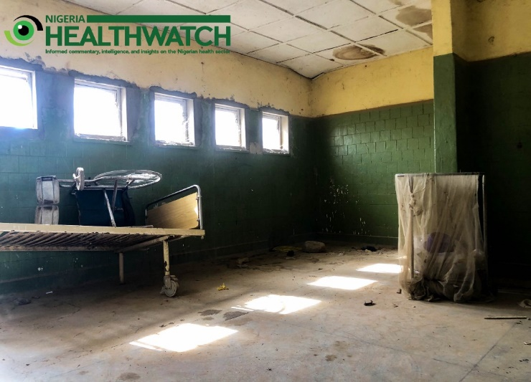
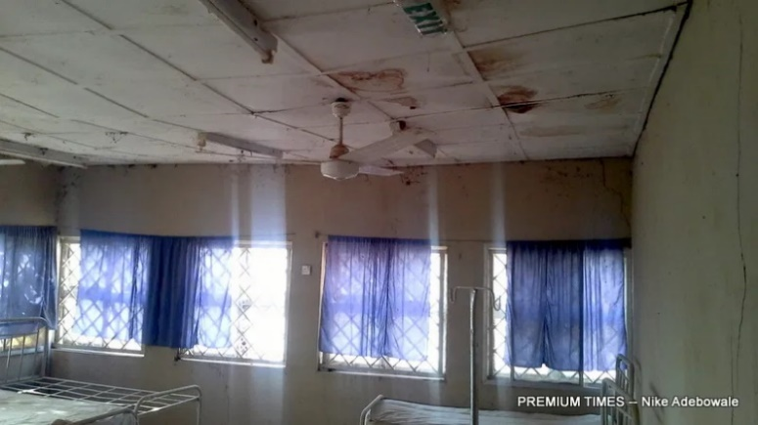
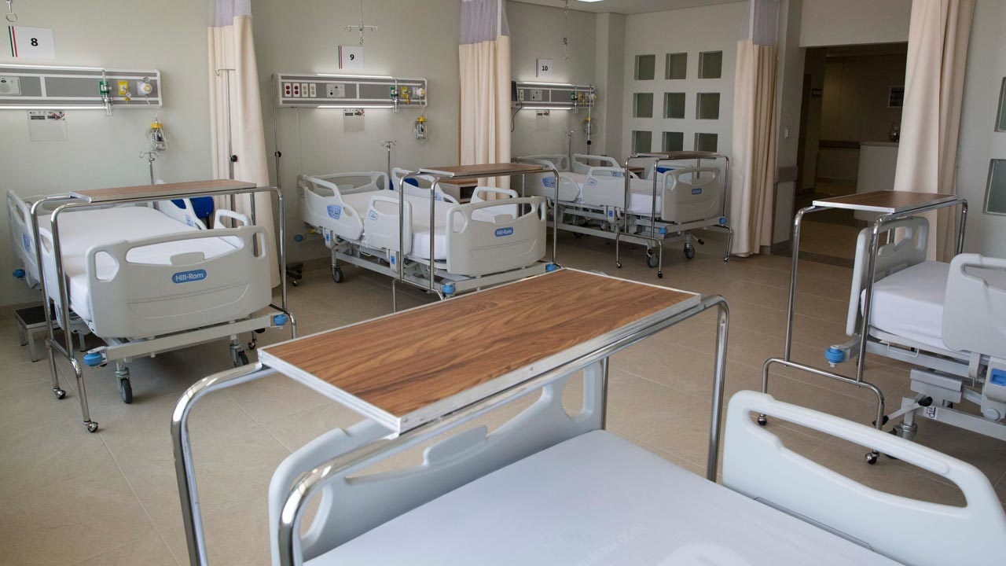
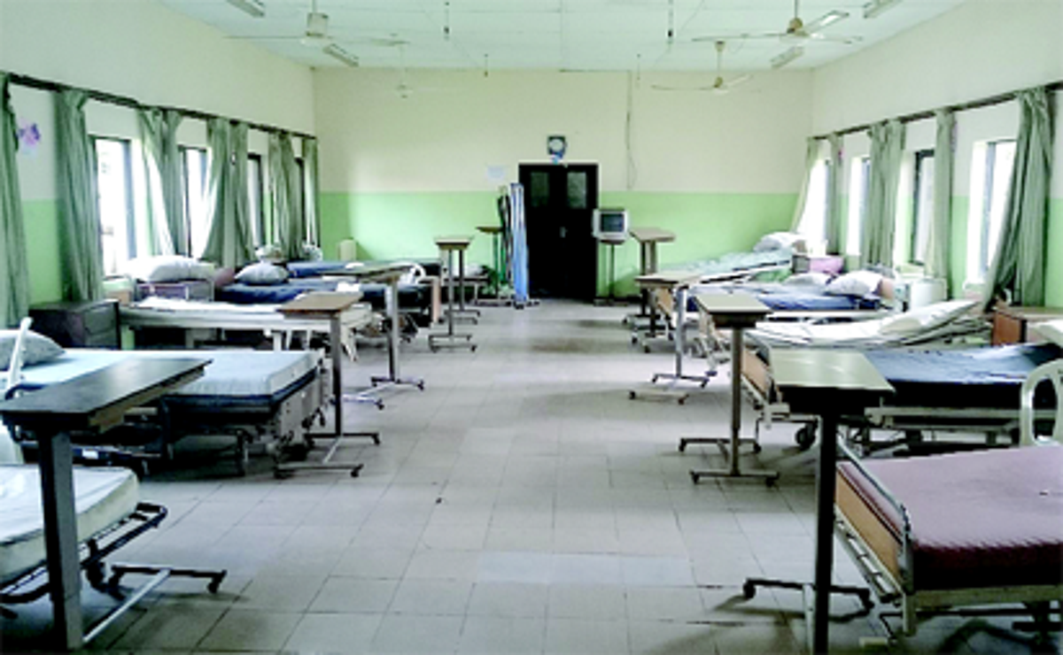
INTRODUCTION
Percentage of Nigeria’s Budget Appropriated to Health
2020
2021
*Abuja Declaration 2001
4.16%
4.5%
15%
Source: World Bank, NBS, WHO
*Expected % contribution to health sector by African Union countries
Before COVID-19, the healthcare infrastructure and testing capacity for infectious diseases in the country was inadequate. Prior to the index case on the 27th February 2020, there were five (5) laboratories in four (4) states equipped with the relevant testing equipment to effectively test for infectious diseases like the COVID-19 virus.
There were only two functional Infectious Disease Hospitals (Lagos and Port Harcourt) and of the two (2) hospitals, only one had a permanent containment facility for highly infectious disease in line with recommendation by the World Health Organization (WHO).
Isolation Centers in Nigeria before COVID-19 and the establishment of the PTF;
Isolation Centres in Nigeria during the COVID-19 Response

Slide 32
INTRODUCTION
Birth of the Presidential Task Force for COVID-19 (PTF)
On March 17, 2020, the Presidential Task Force for COVID-19 was inaugurated as the main coordinating body for Nigeria’s COVID-19 pandemic response.
The responsibilities of the Presidential Task Force include:
Development of guidelines and best practices for COVID-19 response
Development of a national budget and determination of funding sources for Nigeria’s response to COVID-19
Formation of key nationwide policies and enforcement measures
Coordination of national security throughout the response
Mitigation of the negative economic impact of the COVID-19 pandemic
To achieve the mandate of the PTF, the Task Force developed the National COVID-19 Pandemic Multi-Sectoral Response Plan (NPRP) with the strategic objectives to:
Provide a coordinated and effective national and sub-national response to the COVID-19 pandemic
Reduce COVID-19 related morbidity and mortality
Mitigate pandemic-related impacts on the economy and critical/ health infrastructure
Facilitate post-pandemic recovery and rehabilitation operations
Overview of the PTF Leadership
The PTF Leadership consists of sixteen individuals. Ministries/Department/Agency heads were later co-opted to the original leaders.
PTF Chairman
Mr. Boss Mustapha
National Coordinator
Dr. Sani Aliyu
Hon. Minister of Health
Dr. Osagie Ehanire
Hon. Minister of State for Health
Dr. Adeleke Mamora
Hon. Minister of Aviation
Mr. Hadi Sirika
Hon. Minister of Humanitarian Affairs, Disaster Management and Social Development
Hajia Sadiya Umar Farouk
Hon. Minister of Education
Mallam Adamu Adamu
Hon. Minister of State for Education
Mr. Chukwuemeka Nwajiuba
Hon. Minister of Foreign Affairs
Mr. Geoffrey Onyeama
Hon. Minister of Information & Culture
Alhaji Lai Mohammed
Hon. Minister of Interior
Mr. Ogbeni Ra’uf Aregbesola
Hon. Minister of Environment
Dr. Mohammad Abubakar
Director-General Nigeria Centre for Disease Control
Dr. Chikwe Ihekweazu
Executive Director NPHCDA
Dr. Faisal Shuaib
Director-General Directorate of State Services
Mr. Yusuf B. Magaji
WHO Country Representative
Dr. Walter Mulombo

Slide 33
INTRODUCTION
Overview of the PTF Incident Management Structure
Birth of the Presidential Task Force for COVID-19 (PTF)
The PTF national incident command under the National Coordinator serves as the technical and operational arm of the PTF. Its key role is to ensure that the overall response is coordinated, and that MDAs align their activities into a single response. This was achieved through the establishment of a single command and control structure that operates within the National Pandemic Response Centre (NPRC).
The PTF Incident Management Command (IMC) is headed by a National Incident Manager and has ten functional pillars and a subgroup. The various pillars were composed of members from MDAs, technical partners of donor agencies as well as NGOs supporting similar activities. The IMC interfaces regularly with the state task forces, the state commissioners of Health as well the state Emergency Operation Centers (EOCs) to develop and review specific incident action plans/reports as well as to provide guidance for the response. State specific support provided to all states included fast-tracking the setting-up of diagnostic laboratories, providing guidance on setting-up isolation facilities, intensifying case search, strengthening contact tracing of suspects and Persons of Interest (POI), deployment of Rapid-Response Teams (RRT), implementation of LGA hotspot strategy, capacity building for infection Prevention and Control and Case Management. The IMC also reviewed and provided technical recommendations to the PTF through the National Coordinator regarding key implementation strategies.
The IMC coordinates the activities of the various pillars and provides regular reports to the PTF.
Overview of Pillars (Functional Working Groups), Partners/Donors and MDAs
To drive the implementation of the Pandemic Response Plan, the PTF established the NPRC run by a chief of secretariat that oversees the finance, supply chain/logistics, and overall coordination. The NIM oversees the pillars , with overall leadership provided by the National Coordinator. The NPRC interacts through ten (10) functional pillars and a subgroup. In addition, the NPRC also collaborated with Partners/Donors and Ministries, Departments and Agencies (MDAs) in delivering its objective.
Pillars
The ten (10) pillars and a subgroup were established with the overarching goal of implementing the Incident Action Plan (IAP), determining policies and ensuring effective communication and collaboration towards the delivery of the PTF’s mandate.
Case Management
Epidemiology & Surveillance
Infection, Prevention and Control
Laboratory
Point of entry
Resource Mobilisation
Risk Communication and Community Engagement
Security, Logistics and Mass Care
State Coordination and Govt. Relations
Research
Sustainable Production
Subgroup

Slide 34
INTRODUCTION
The 10 pillars and sub-group are as below:
Case Management: responsible for slowing down and progressively interrupting the community transmission of COVID-19 in Nigeria through effective and efficient case finding, testing, isolation and management of cases as well as strengthening the capacity of Health workers (including frontline Health workers in the health system) to diagnose, treat and manage complications of COVID-19 cases.
Epidemiology & Surveillance: responsible for surveillance, early detection and timely reporting of community transmission of COVID-19 and; coordinating the outbreak response and rolling-out strategies for effective and efficient management of the outbreak.
Infection, Prevention and Control (IPC): responsible for enhancing IPC practices in communities and health facilities to prevent disease transmission and reduce Health care Associated Infections (HAI) in testing laboratories and treatment centres.
Laboratory: responsible for expanding laboratory capacity for COVID-19 testing to ensure 100% geographic coverage and quick turn-around time.
Point of Entry (PoE): responsible for preventing cross-border transmission of COVID-19 and responding to health events at points of entry (POE) for effective containment of COVID-19.
Resource Mobilization: responsible for working with Ministries, Departments and Agencies (MDAs), Development Partners/Donors, Private Sector and other key stakeholders to ensure the availability of adequate resources for the effective implementation of the COVID-19 Pandemic Response Plan and providing oversight to the Joint Supply Chain and Distribution Team (JSCD) which consists of experts from FMOH, NCDC, NGF, PTF supply chain team, UNICEF and CHAI.
Risk Communication and Community Engagement: responsible for providing timely and accurate information to the public about government actions for containing COVID-19 outbreak in a transparent manner and facilitating rapid sharing of accurate actionable information among individuals, families, communities, healthcare workers, media, partners and policy makers.
Security, Logistics and Mass Care (SLMC): responsible for coordinating Security, Logistics and Mass Care among stakeholders for efficient and effective national and local level response to the COVID-19 pandemic, facilitating the delivery of Federal Government’s humanitarian assistance to vulnerable citizens in order to reduce and mitigate the socio-economic impact of COVID-19 pandemic.
State Coordination and Government Relations: responsible for supporting the National Coordinator in achieving the PTF’s goal of coordination and harmonization of the COVID-19 response at National and sub-national levels of government.
Research: responsible for conducting scientific, clinical, anthropological and socio-economic research to provide the evidence base for guiding decision making in COVID-19 planning and response in Nigeria.
Sustainable Production Sub-Group: responsible for ensuring sustained supply of raw materials and other critical inputs for manufacturing of essential commodities (including imported materials) and facilitating delivery of essential commodities across the country during the pandemic.
Birth of the Presidential Task Force for COVID-19 (PTF)

Slide 35
PTF MID-TERM REVIEW
3

Slide 36
INTRODUCTION
The PTF as the focal point of government’s efforts to tackle the COVID-19 pandemic was inaugurated on 17th March 2020 with an initial mandate of six (6) months. At the end of the first three (3) months, there was a mid-term review of the activities of the PTF. The review covered the performance of the PTF its Pillars and supporting MDAs viz-a-viz set objectives. As part of the review, the PTF organised a two-day retreat on 9th and 10th July 2020.
The retreat brought together several stakeholders with the aim of re-strategizing and strengthening its efforts in tackling the pandemic over the next three months and beyond. Stakeholders in attendance at the retreat included:
Legislators (including the Chairmen of the relevant Committees on Health in the Senate and House of Representatives)
Ministers
Representatives from the Office of the Vice President
The Nigeria Governors’ Forum
Diplomatic Community
Development Partners
To obtain feedback and stakeholders’ perception on the performance of the Presidential Task Force on COVID-19 (PTF) in ensuring that the Federal Republic of Nigeria emerges from the COVID-19 pandemic with minimal negative impact to the population, health systems and the economy, an online survey was deployed to PTF’s Donors/Partners
Survey Respondent Demography:
120
56
Total Survey Recipient
Total Respondents
Respondent Category
State Government
15
Partner
16
Donor
15
Others
10
The survey responses revealed that stakeholders expressed satisfaction with the PTF’s role in coordinating the national response against COVID-19.
PTF’s performance was categorized into eight key performance areas and questions were asked and rated across these areas on a scale of 1 to 5 (with 5 being the highest).
S/N | Performance Areas | Survey Rating
1 | Coordination of national response | 4.0
2 | Collaboration with stakeholders | 3.8
3 | Provision of preventive guidance and awareness | 3.5
4 | Provision of adequate mechanism to mobilise resources | 3.3
5 | Communication, Testing, Contact Tracing, Isolation, Treatment, IPC, Social Support, Economic Support, Enforcing Preventive Measures. | 3.1
6 | Mitigation of socio-economic impact | 2.7
7 | Provision of guidelines on the different phases of response | 2.6
Scale of 1 to 5 (5 being the highest and 1 being the lowest).

Slide 37




INTRODUCTION
Survey respondents identified areas of strengths in the performance of PTF as follows:
Effective communication of the approach to response and other essential information to Nigerians.
Engagement and inclusion of donors and other external stakeholders.
Seamless coordination of states and MDAs across the federation
Implementation of all pillar activities in line with WHO’s stipulations.
Development of a comprehensive plan which included emergency, short, medium and long-term response and costing.
Effective awareness creation and advocacy on COVID 19
At the retreat, key donors and partners were present and a select number of them spoke on their support for Nigeria in its response to the COVID-19 pandemic. Their feedback was incorporated in the PTF’s roadmap for the next three – six months.
Key comments from partners are highlighted below:
“The 9th assembly will work hand-in-hand with the executive to ensure effectiveness… We have to seize this opportunity to rebuild healthcare structures and ensure that the country is prepared for an uncertain future.”
“Some key questions need to be asked, such as: How can the PTF change perception, alter attitudes and engage with external stakeholders to drive progress in the fight against COVID-19?”
“We need to encourage states to take control of the outbreak through precision interventions, it is important that states are making these decisions based on reliable and accurate data.”
“How best can we continue to implement a national strategy and context; maintain access to essential services in the health care sector; and ensure the protection of vulnerable groups in an easily verifiable manner?”

Slide 38
INTRODUCTION
The performance review also covered defining the Roadmap for the next three (3) to six (6) months. The key initiatives and activities were outlined and agreed by Pillar Leads and relevant stakeholders.
Pillars | Pillar Objectives (Agreed Next Steps)
Epidemiology and Surveillance | Enhance Community-based Surveillance for COVID-19 to improve active case handling and sample collection
 | Improve contact tracing after identification of a confirmed case
Laboratory | Strengthen national laboratory supply chain monitoring and forecasting
Laboratory | Place GeneXpert in hospitals for better triage and turnaround time
 | Develop and implement a national quality assurance program to monitor laboratory testing and performance
 | Improve real time data collation and analysis through the development of data pipeline and dashboard and hiring of data analysts
 | Increase human resources and work hours for labs to enable them to conduct more tests in each day (especially night shifts)
 | Procure Automated extraction systems
Point of Entry | Ensure every entry point has the capacity to collect samples for testing
 | Expand Border Security Patrols
 | Ensure sustainability of implementation of all public health guidelines and protocols at points of entry
 | Improve contact tracing facilities
 | Consider premium payments to secure spots in the procurement queue
 | Prioritise and allocate funds for procurement of essential lab reagents and supplies
 | Explore other molecular based diagnostic techniques and new technologies i.e. NAAT – Nucleic Acid Amplifications Test
 | Increase human resources and work hours for labs to enable them to conduct more tests in each day (especially night shifts)
 | Place Gene Expert in hospitals for better triage and turnaround time
Case Management | Provide technical assistance and epidemiological support to states to enforce the case management guidelines for home care;
 | Review and revise existing algorithms and guidelines for case management
 | Strengthen the mechanisms of observation isolation centres and screening
 | Conduct further training of staff
 | Conduct regular meetings with key stakeholders
 | Lead advocacies for the Federal Ministry of Health (FMoH) to support the implementation of its home-based care protocol across all states
 | Empower states to take control of their case management situation and establish clear reporting lines to the FMOH

Slide 39
INTRODUCTION
Pillars | Pillar Objectives (Agreed Next Steps)
Infection, Prevention and Control | Embed and strengthen functional IPC programmes across the country
 | Enforce National Primary Healthcare Development Agency (NPHCDA) guidelines for Public Health Care/World Health Organisation’s minimum requirements for IPC
 | Define clear career paths for IPC professionals
Risk Communications | Set up a network of COVID-19 Survivors to drive the campaign to change the narrative around stigmatisation
 | Start massive house-to-house campaign on Immunization (EPI) structure to promote interpersonal communication between volunteers and households to engender behaviour change
 | Sustain discussions around COVID-19 by floating a live radio discussion programme on COVID-19 across the country to ensure dialogue between experts, religious leaders, COVID-19 survivors, care givers, etc. and the public to further educate the people on COVID-19 and the preventive measures.
 | Continuously work with its partners to undertake research with a view to addressing the key drivers of the challenges to behaviour change;
 | Review messages being disseminated on COVID-19 and incorporate threat and efficacy element into future messages
Security, Logistics, Mass Care Pillar | Develop standards and criteria for enforcement of protocols/sanctions
 | Develop a seamless PTF multi sectoral structure at the state level which cascades to the Federal Government
 | Create a special security intervention fund for emergency
State Government Relations | Support states in revenue mobilisation and effective utilisation of funds
 | Facilitate a more proactive and coordinated engagement with the States’ Task Force on COVID-19 (to facilitate state ownership and sustainability of response)
Resource Mobilization | Gain the confidence of MDAs and leadership of the PTF to ensure MDAs share information to all Pillar leads, as when needed
 | Ensure that there is sustainable funding for the COVID-19 response even when partners are not there
Sustainable Production Sub- Group | Ensure long term uptake from Government and credible investors
 | Ensure standard quality guidelines for specific COVID-19 products meet International Market Standard
 | Ensure collation of accurate supply chain/stock status/utilization reports from the Pillars periodically for up-to-date response to needs

Slide 40
ACHIEVEMENTS
4

Slide 41
ACHIEVEMENTS
The PTF through its different pillars, MDAs and partners attained several accomplishments including fund mobilization, policy formulation, public and private sector collaboration to enforce preventive measures, provision of healthcare infrastructure, capacity development, among others. The PTF achievements from inception to date (March 17 to December 5, 2020) were categorized into eight (8)) sections.
Funding
Healthcare
Capacity Building
Social Welfare
Communication
Economic Support
Economic Reopening
Surveillance
Funding
In order to deliver on its mandate of coordinating Nigeria’s COVID-19 pandemic response and finance its operations (activities of various Pillars and MDAs), the PTF developed a budget and engaged various stakeholders (Government Agencies, International partners, NGOs, Private Sector etc.) to raise the financial resources required to fight the epidemic.
Funds were donated to ensure the effective implementation of the COVID-19 pandemic response from two (2) key sources:
The Federal Government of Nigeria (FGN)
Partners and Donors
A total of ₦178,800,260,723 in monetary resources was available for the COVID-19 response as shown below. About 79% of funds from donors and partners were used directly to support activities without passing through the PTF or government account
₦ 141.1b
₦ 15.6b
₦ 22.2b
* Source UNDP dashboard, OSGF, Resource Mobilization Pillar

Slide 42
ACHIEVEMENTS
Healthcare
The PTF in its fight against COVID-19; allocated adequate resources towards enhancing the healthcare system in the country in order to continuously reduce the spread of the COVID-19 pandemic, effectively manage identified cases and develop the capacity of healthcare workers.
As of 6th December 2020, the PTF through the NCDC and other partners had successfully conducted 812,598 tests. There were 3,184 active cases and 64,774 cases had been managed/discharged.
812,598
3,184
64,774
Total number tested and given results
Total Number of Active Cases
Managed / discharged cases
Capacity Building
In the wake of the COVID-19 outbreak, capacity development was required to equip frontline healthcare workers with necessary skills and infrastructure for managing suspected cases and to ensure adherence to the safety protocols and procedures.
The focus on capacity development was in three categories:
Facilities
Testing
Training
Facilities
The PTF in collaboration with partners, successfully set up and accredited 130 isolation/treatment centres with a total capacity of 7,296 beds across the country over a period of six (6) months.
131
7,296
Total Number of Isolation/Treatment Centres Accredited
Total bed capacity in all Treatment Centres

Slide 43
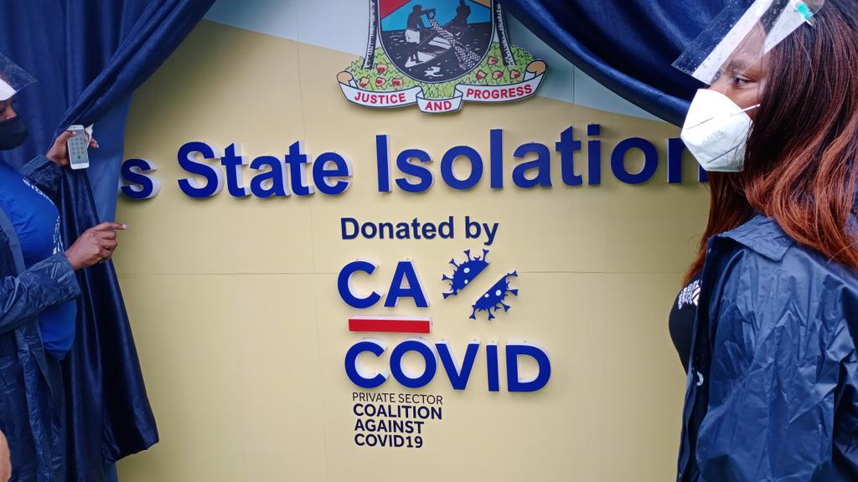
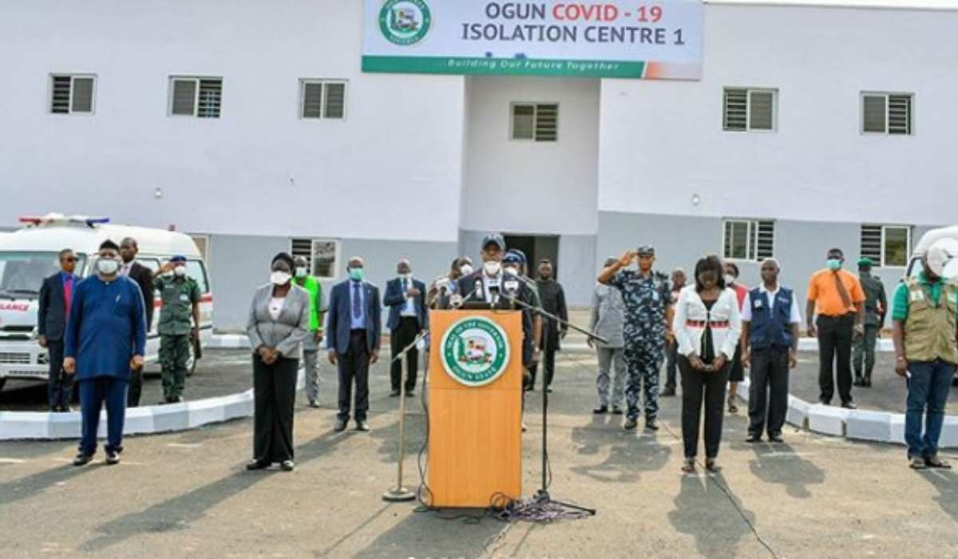
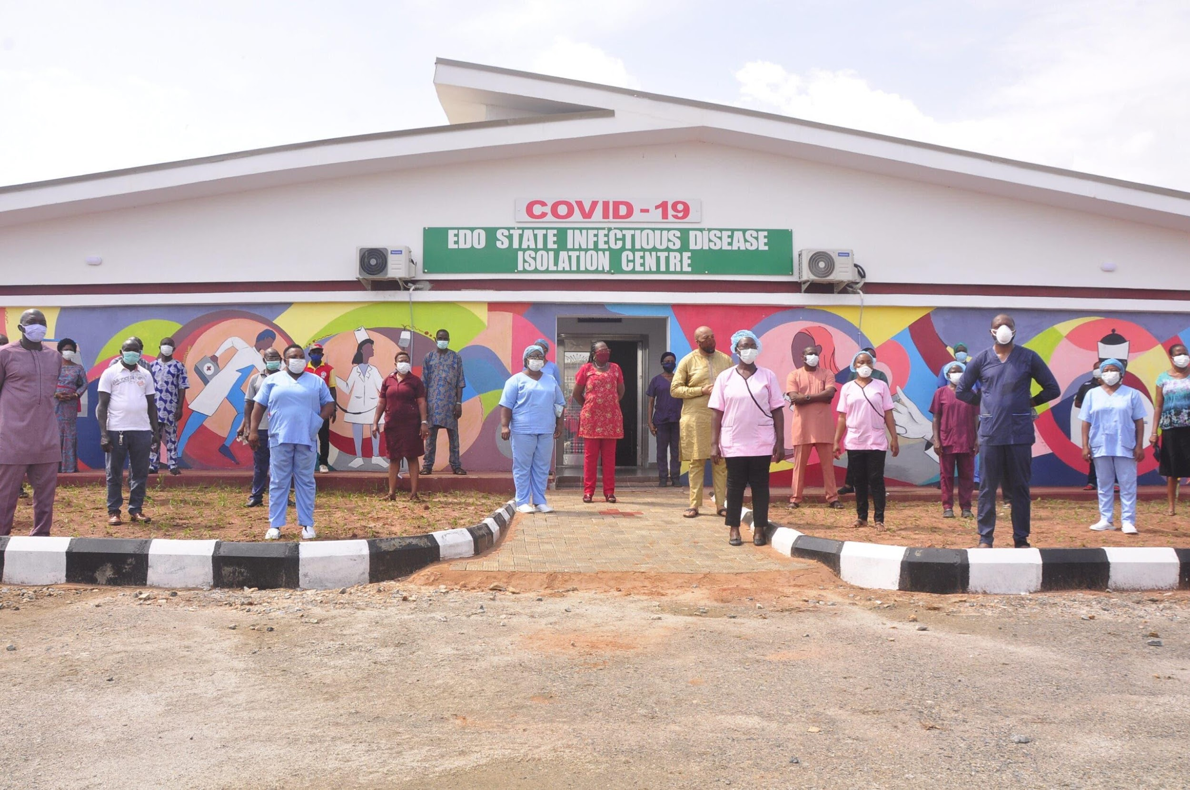
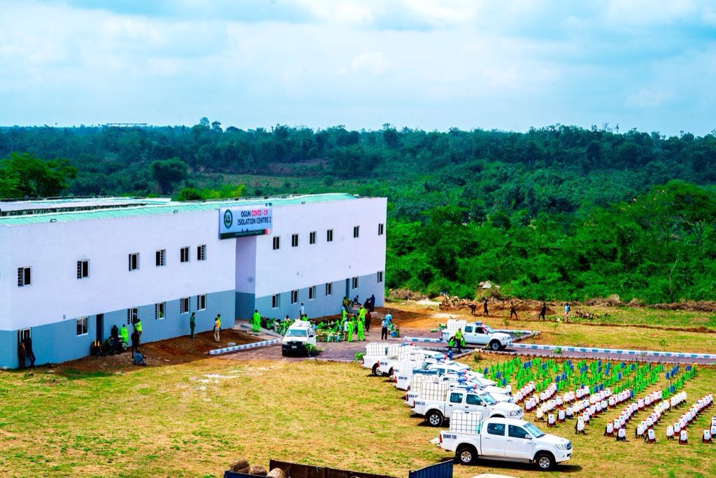
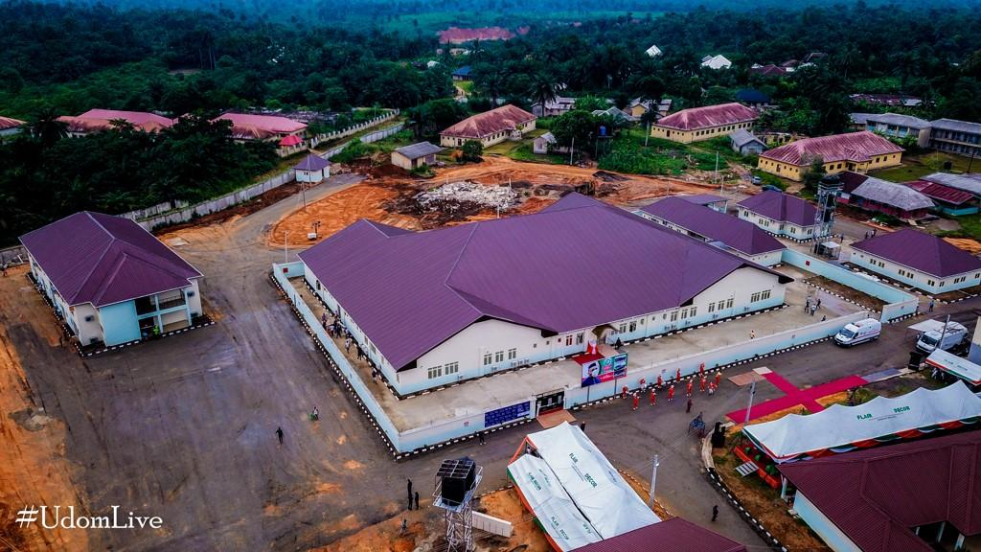
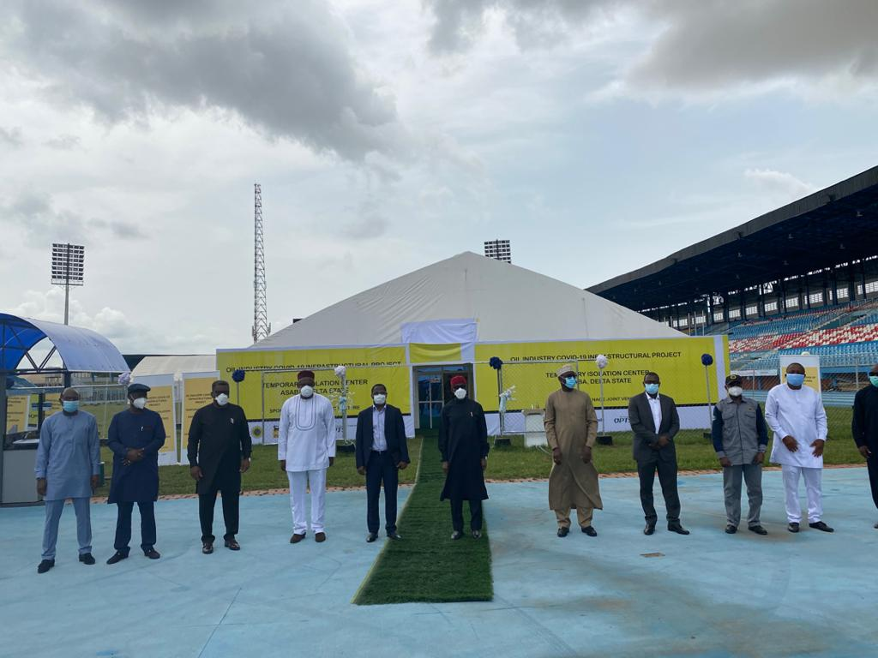
ACHIEVEMENTS
The isolation/treatment centres were categorized into three levels based on their level of sophistication and ability to manage cases:
LEVEL 1 & 2
LEVEL 3
These are hybrid Isolation/treatment centres established by the state governments. Level 1 & 2 Isolation facilities are available in 34 states and the FCT
These centres are for quarantine purposes and for the management of asymptomatic/mild cases
These are Federal Tertiary Hospitals equipped with Intensive Care Units (ICU) and critical care management facilities:
22 Federal Teaching Hospital and 20 Federal Medical Centres
These centres are for the management of moderate to severe cases
Isolation and Treatment Centers Established

Slide 44
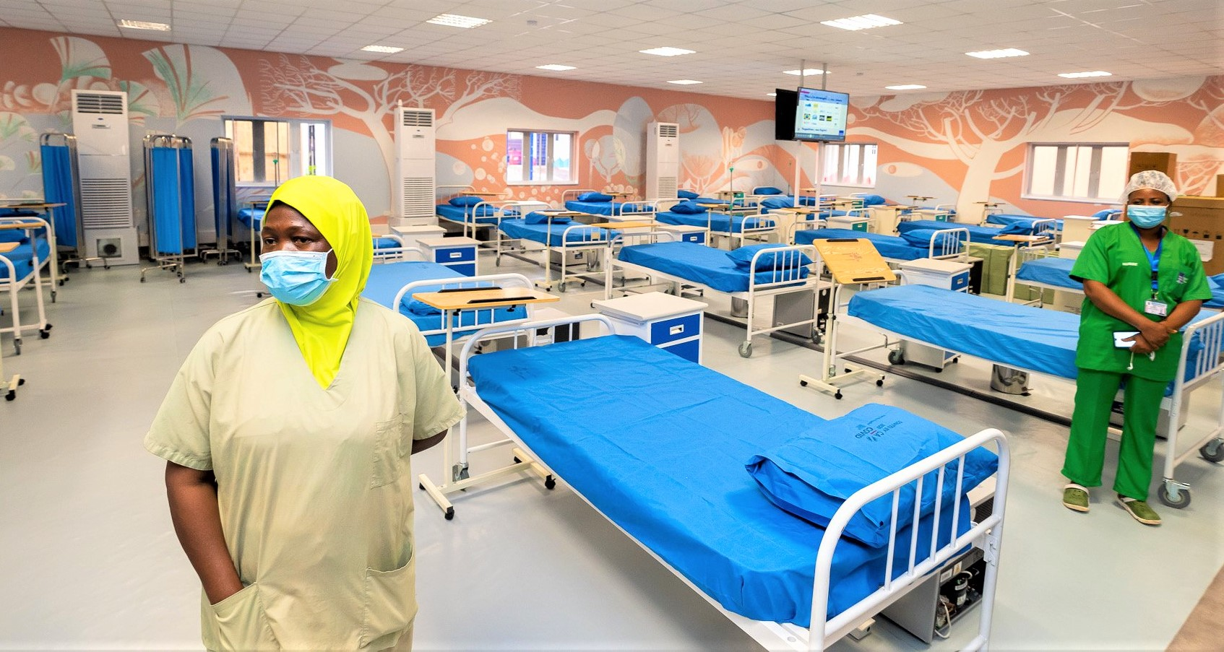
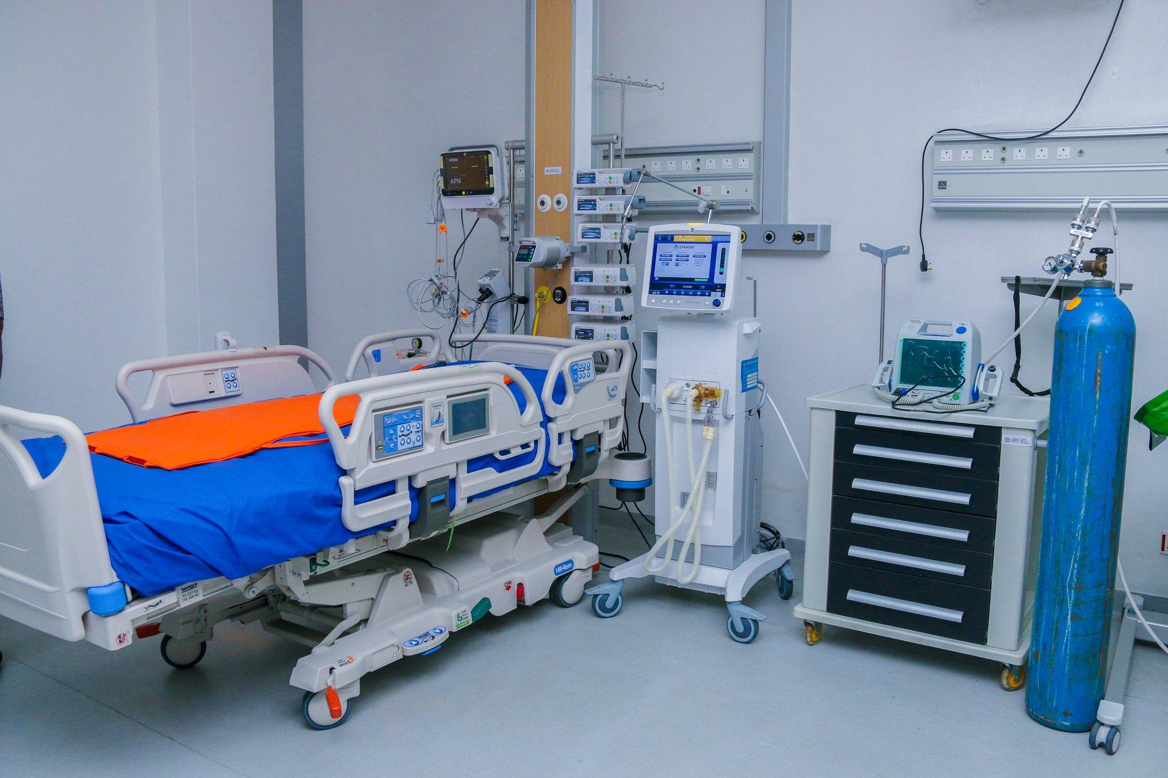
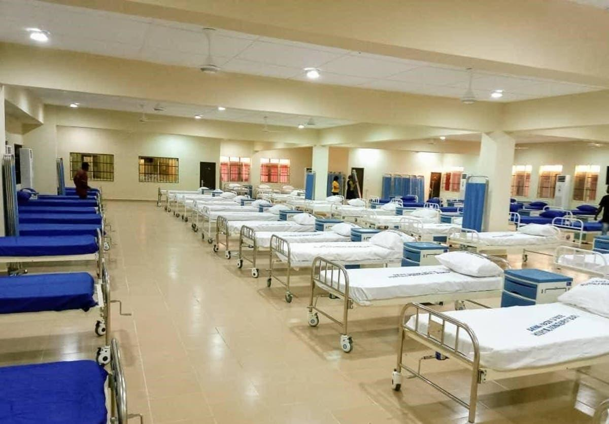
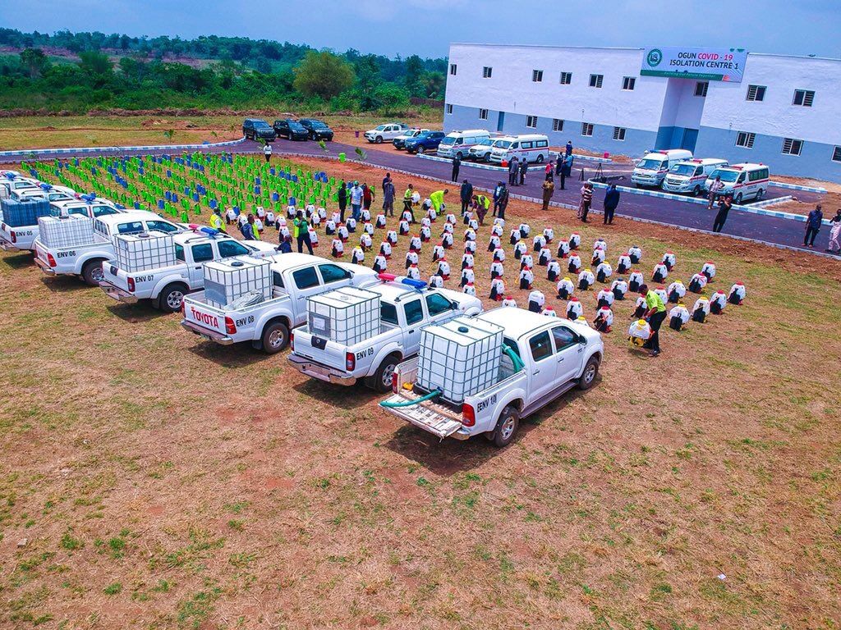
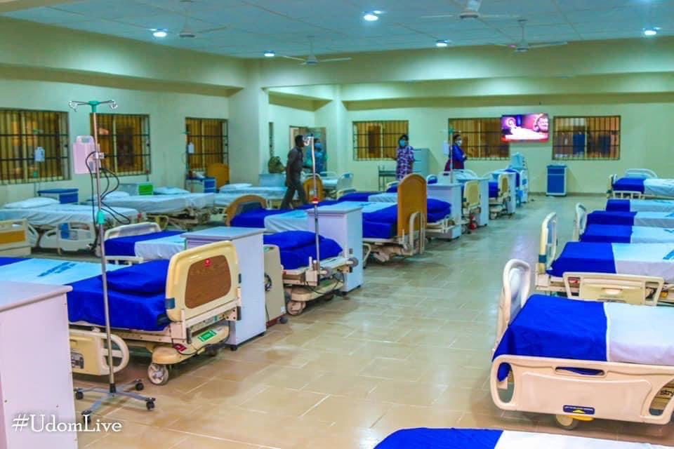
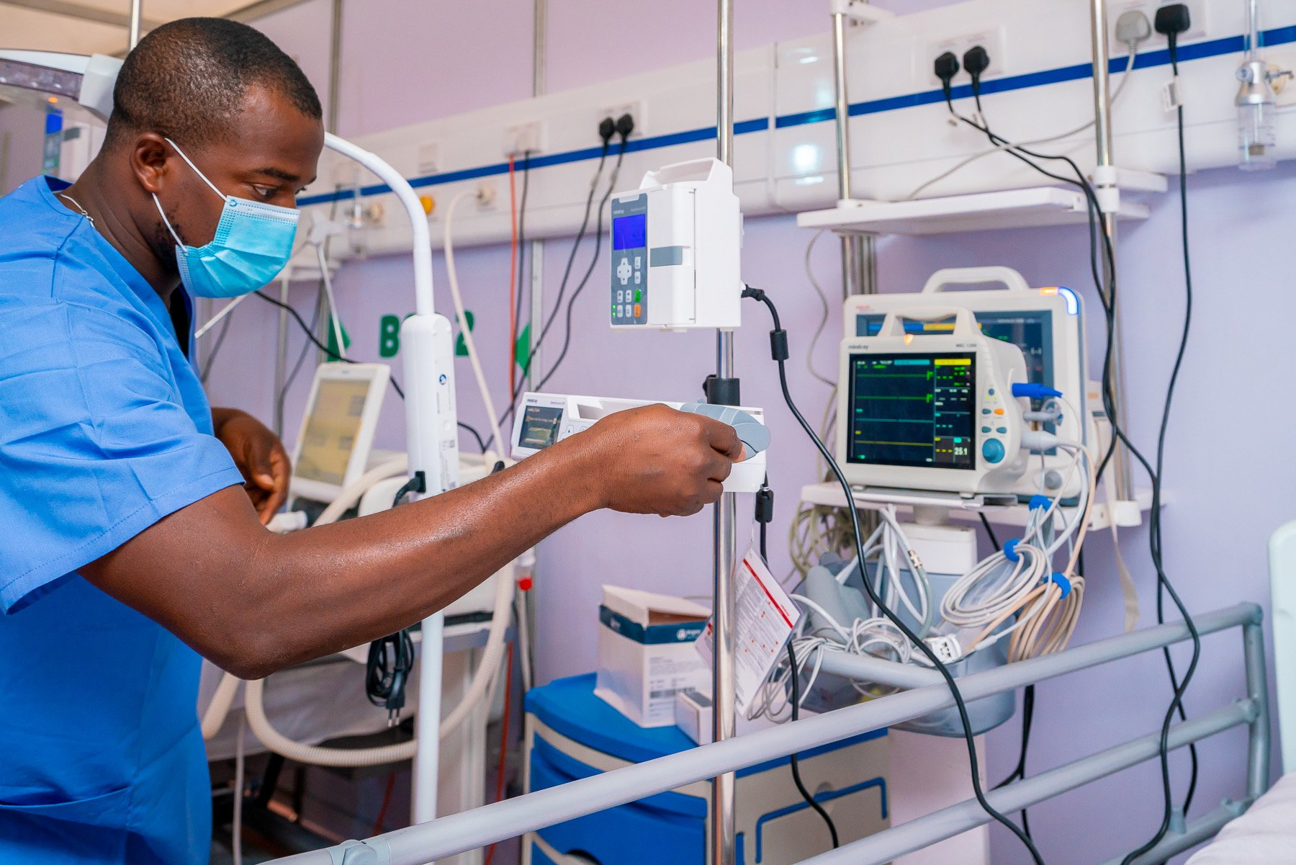
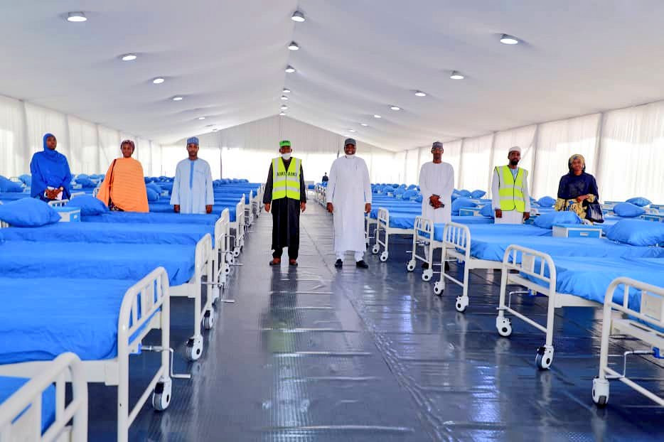
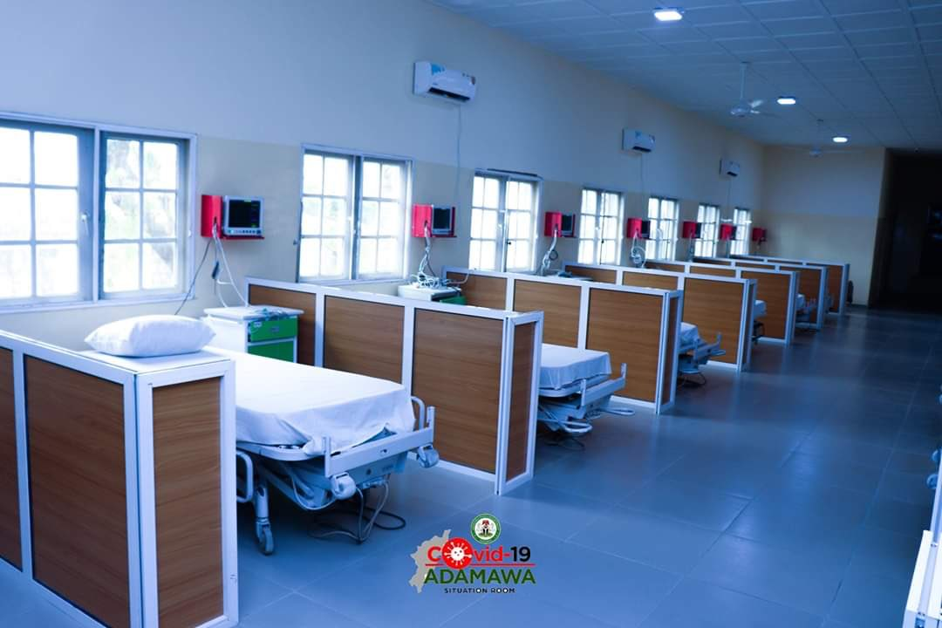
ACHIEVEMENTS
Isolation and Treatment Centers Established

Slide 45
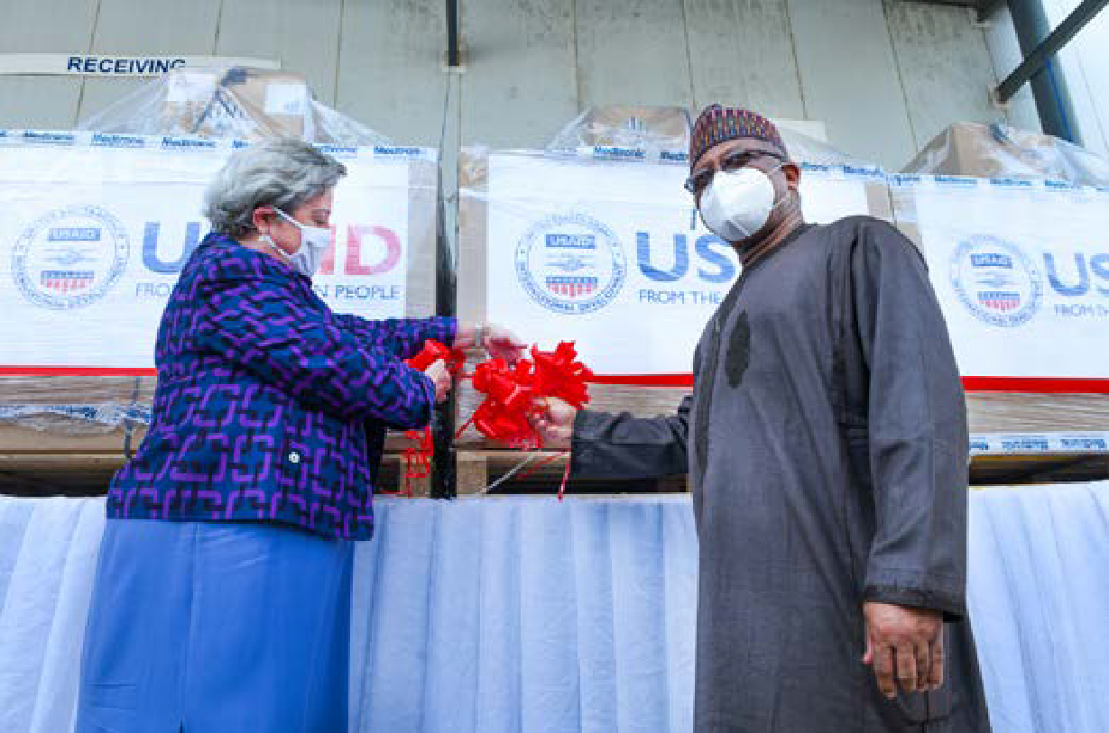
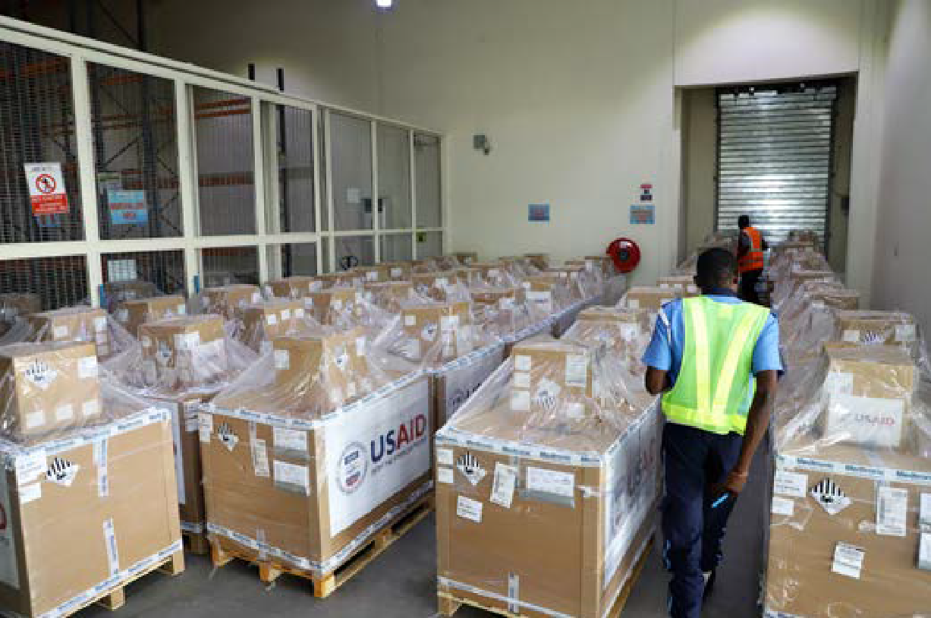
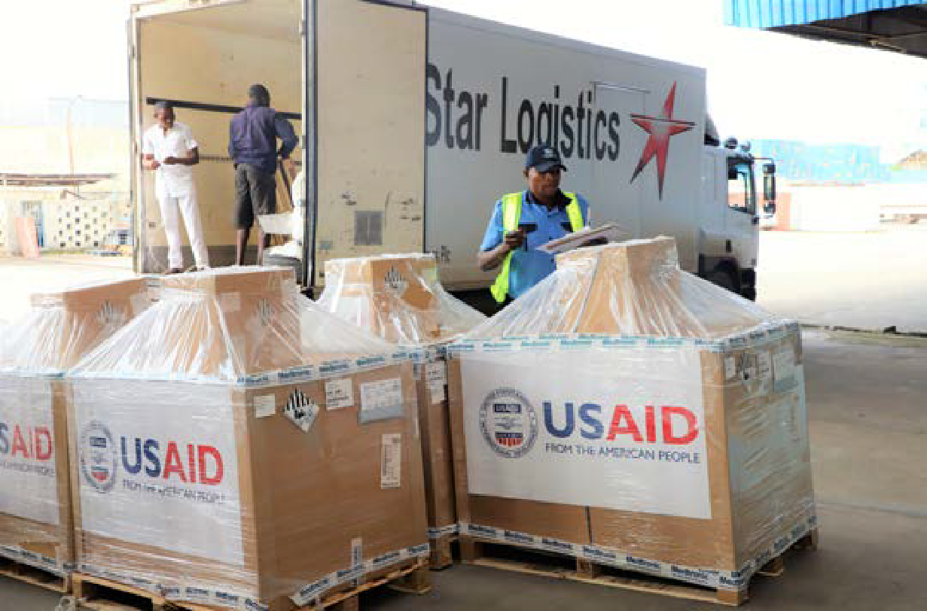
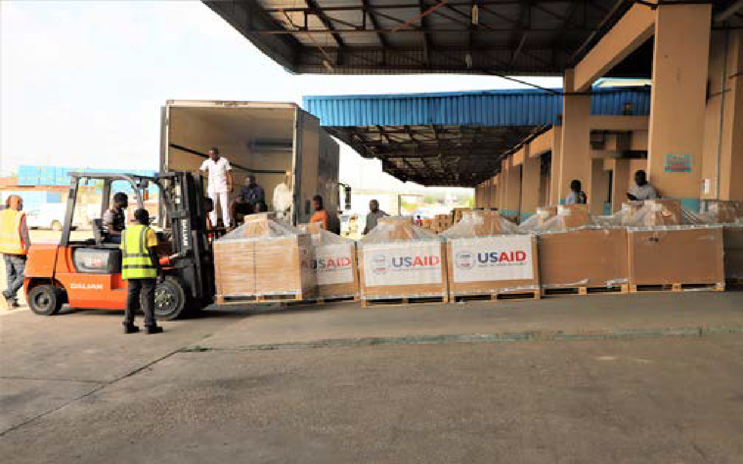
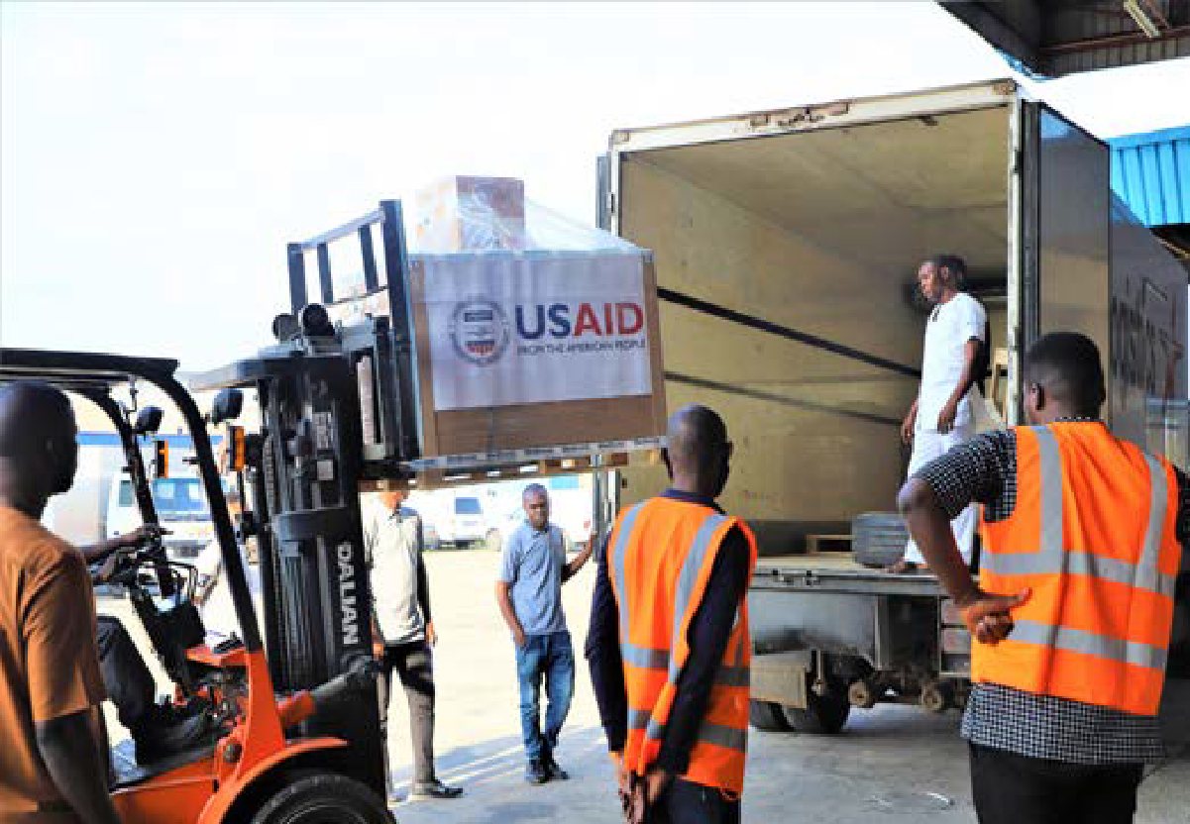
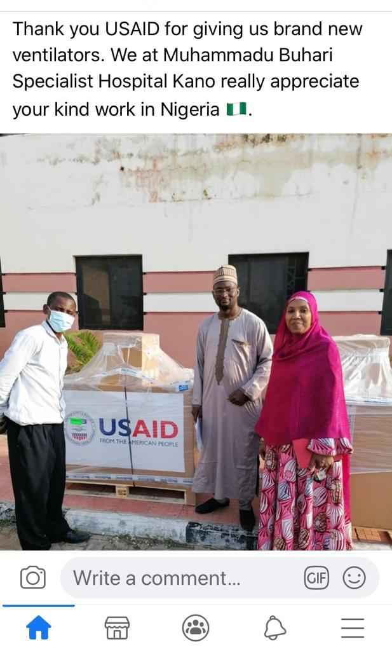
ACHIEVEMENTS
Delivery of 200 Ventilators donated by USAID to FGN for COVID-19 Response
The ventilators were distributed, with training and maintenance support( 1 year ) to 88 tertiary and secondary facilities (some receiving 2 or more, where they had not benefitted from past donations )

Slide 46
ACHIEVEMENTS
COVID-19 Testing Capacity
The PTF through the NCDC achieved its mandate to expand laboratory capacity for COVID-19 testing to ensure 100% geographic coverage and test turnaround time (TAT) of 24 hours by decentralizing testing capacity. As at December 6, 68 of the labs are government owned and the remaining are private/ corporate sector labs (30). A few labs have 2-3 testing platforms (equipment). Some of the notable achievements under testing capacity include the activation of various platforms to conduct molecular testing:
72 PCR equipment
22 GeneXpert equipment
2 Corbus equipment
2 Abbott equipment
Training
From inception through 6th December 2020, the PTF trained over 35,500 healthcare workers (HCW) in appropriate infection prevention and control practices, including personal protective equipment (PPE) donning and doffing, and hygiene.
Nigeria's performance against the WHO estimate of training resources required by countries is as follows:
Key Assumptions | Date Source | Sub-Total
WHO estimated number of resources required to be trained for up to 100 cases | WHO guidelines | 428
Number of confirmed cases in Nigeria (NCDC @December 6, 2020) | NCDC @ December 6, 2020 | 69,255
Estimated number of active cases over a three-month period | PwC Analysis - Estimated number of active cases – Total number of inactive cases *Please see Appendix for more detail | 5,379
Estimated number of HCW expected to be trained (based on WHO Recommendations) | PwC Analysis - (WHO estimates resources/100 cases) * estimated number of active cases over a three-month period *Please see Appendix for more detail | 23,023
Number of HCWs trained | PTF | 35,500

Slide 47
ACHIEVEMENTS
Healthcare Workers Trained
Doctors
5,500
Nurses
6,000
Total Number of HCW Trained
Allied Health Workers
35,500
20,000
The training sessions were tailored to fit the specific needs of the different cadre of the healthcare workers. These training sessions were categorised into three levels:
LEVEL 1
LEVEL 2
LEVEL 3
A one-day IPC training which emphasised how IPC interacts with their daily tasks.
A two-day IPC training conducted by the Rapid Response Team (RRT) to focal persons in health facilities in the states where outbreaks were reported. This covered detailed IPC modules developed by the NCDC
A three-day comprehensive training that covered all the IPC modules
All training sessions were conducted by NCDC IPC unit staff with support from partners and network of IPC experts drawn from different parts of the country.
Other capacity development achievements include:
Development and deployment of IPC online training platform with over 6,000 participants
Establishment of functional and resourceful IPC programs, committees and teams across 36 states
Establishment of Database of Trainers across all States
Establishment of systems for tracking healthcare worker infections
Standardisation of processes for identification and management of cases in treatment centres
Deployment of IPC focal persons across treatment centres (TCs) in Lagos, Abuja and sample collection centres in Abuja to ensure compliance with guidelines and minimise disease transmission in health care settings
Training of Master Trainers and End Users on Ventilator use

Slide 48
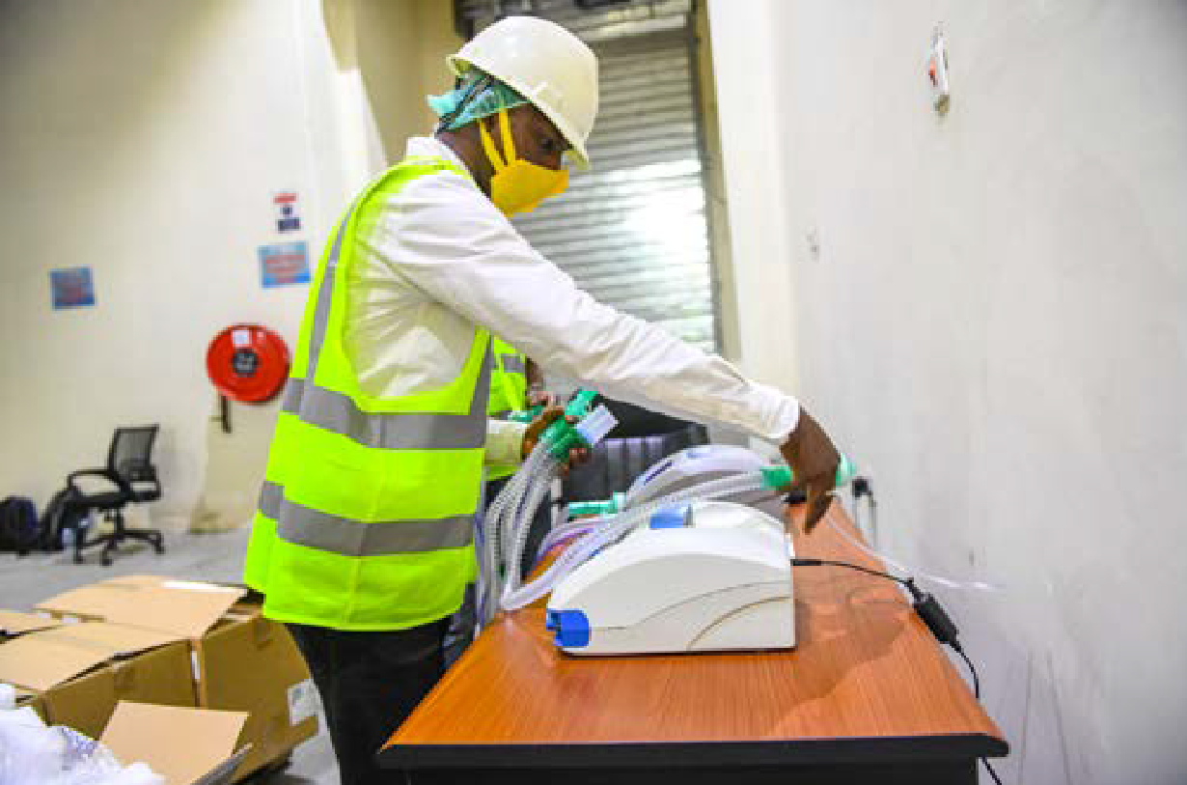
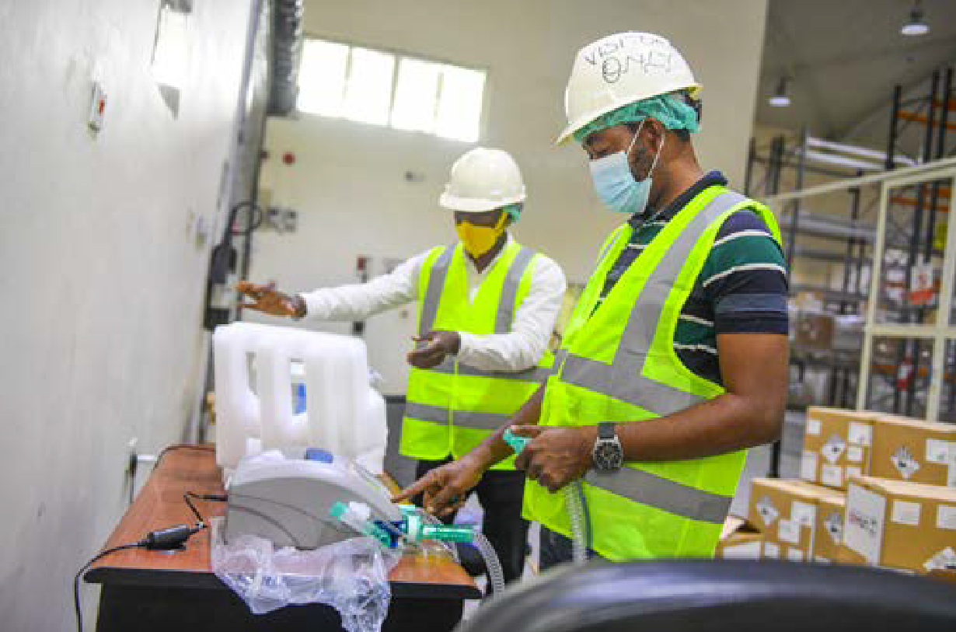
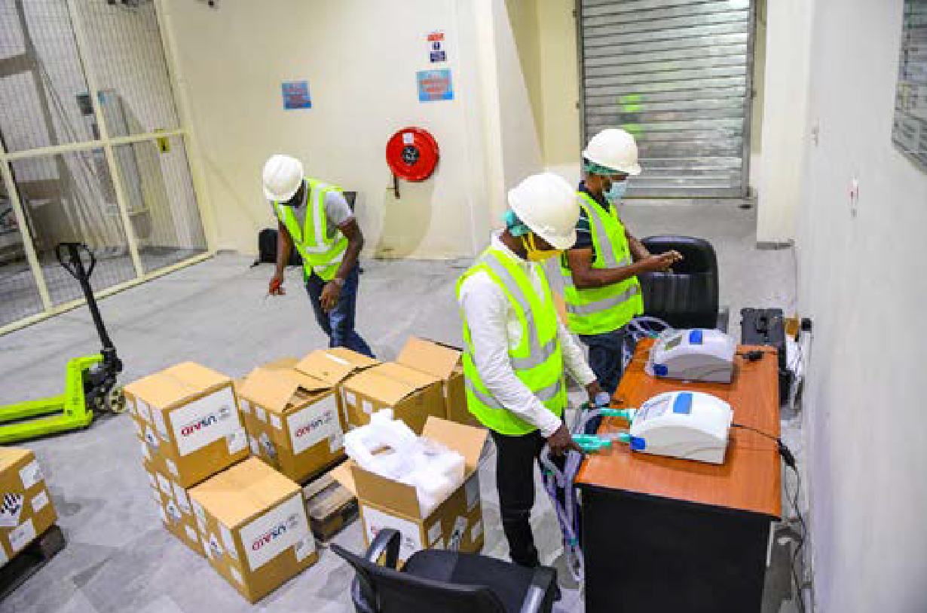
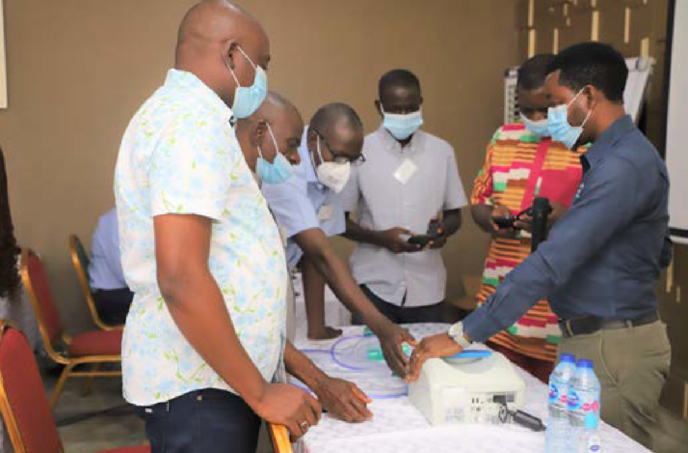
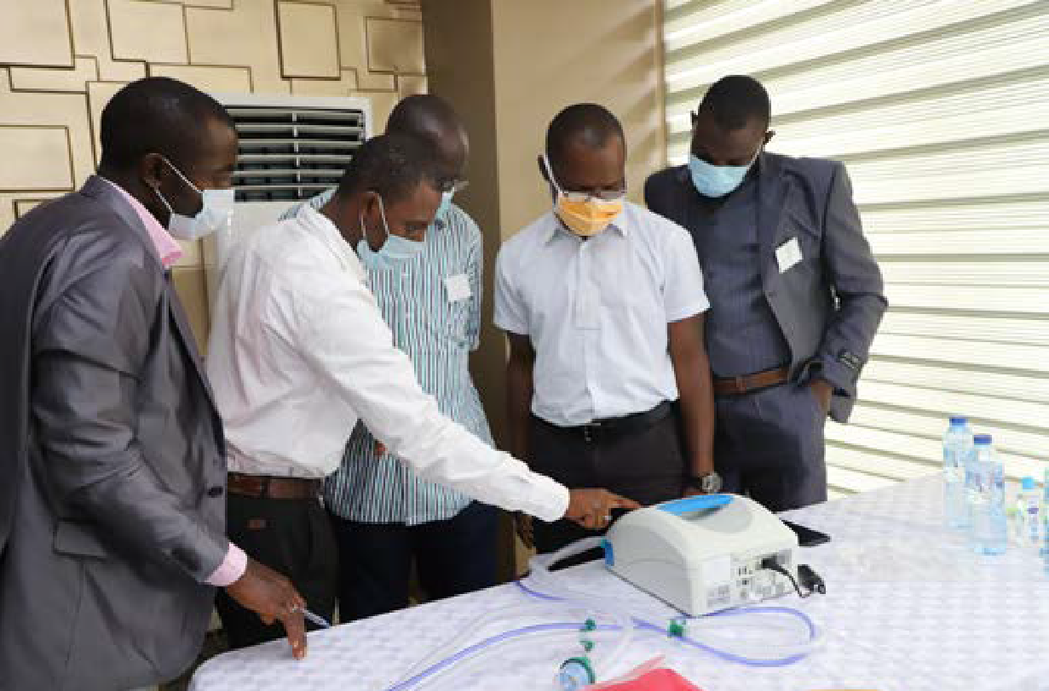
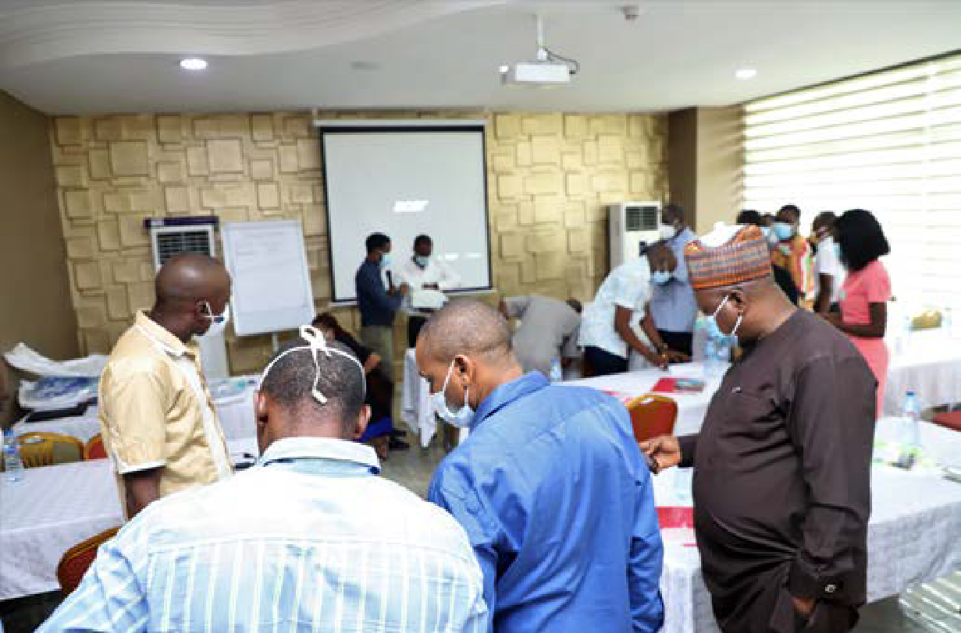
ACHIEVEMENTS
Training of Master Trainers on Ventilator Use and Installation
Lagos and Abuja (Sept. 2020)

Slide 49
ACHIEVEMENTS
Communication
The PTF successfully maintained regular communication with relevant stakeholders and conducted stakeholder engagements with partners/donors, MDAs and the general public. Awareness about the COVID–19 pandemic and Nigeria’s response was created through the production of various communication and advocacy materials. The PTF leveraged both traditional and digital media in communicating with members of the general public.
Some of the areas covered include:
General information on COVID-19
Use of face masks
Burial protocol
Testimonial from survivors
Mass gathering
Social distancing
Fake news
School & NYSC reopening
The PTF successfully obtained the buy-in of numerous stakeholders in the multimedia industry: Television and Radio service providers alike.
Notable achievements relating to communication include:
Deployment of surveys to citizens and partners to obtain feedback on the performance of the FG in it’s fight against COVID-19
Development of National Database of survivors to drive campaign to change the narrative around stigmatization.
Capacity building of 133 COVID-19 survivors on using their stories to promote behavioral change in the community. A technical dialogue was also held with the survivors.
Implementation of house-to-house campaigns with over 19,000 volunteer community mobilizers (VCMs); communicating COVID-19 prevention messages integrated into routine immunization messages. Community platforms used for polio campaigns for UNICEF were recruited and trained for this exercise.
Development and distribution of IPC IEC materials, job aids and workplace reminders for educating patients and sensitising communities
Establishment of a Rapid Response Communication channel (WhatsApp) for a 24- hour daily update with the Chief Medical Directors (CMDs) and Managing Directors (MDs) of all Federal Tertiary Health Institutions (FTHIs) that are responsible for the Level 3 Isolation /Treatment Centres for critically ill COVID-19 patients.
Production of over 60 television and radio jingles by the Federal Ministry of Information and Culture in thematic areas including: general information of COVID-19, use of face masks, burial protocol, mass gathering and testimonials by COVID-19 survivors as part of efforts to check stigmatization.
Production of 30 television and radio jingles by the National Orientation Agency (NOA), which were translated into some of the major languages in the country. Also, the State Directorates of NOA produced radio jingles in some of the major languages spoken in their respective states of operation.
Engagement of over 60 TV and Radio On-Air-Personalities (OAPs) in a technical dialogue with the PTF across the country on 30th October 2020

Slide 50










ACHIEVEMENTS
Television
Jingles produced by the Federal Ministry of Information and Culture, supporting MDAs and Communication Consultants were aired by ten (10) television channels shown below:
AIT
OnTV
Zee World
TVC
Liberty TV - Yoruba
StarTimes Guide
Nigbati TV
Isimbido TV
Dadin Kowa
Liberty TV - English
Radio
Radio Interaction Programs
Live Radio Interaction Programs were launched on four (4) major stations across geopolitical zones featuring experts, survivors and covering key and emerging topics in relation to COVID-19 prevention and COVID-19 response.
The programs provided information to the public on the travel portal, school re-opening, NYSC camp re-opening, need for testing and several other topical issues. The program was launched on the following radio stations:
Human Rights Radio 101.1 – FCT
Radio Kano – Kano
Correct FM – Enugu
Wazobia Radio – Lagos

Slide 51
ACHIEVEMENTS
Radio Jingles
Jingles produced by the Federal Ministry of Information and Culture, supported by MDAs and Communication Consultants were also aired daily by 40 radio stations across the country as shown below:
Geopolitical Zones | Radio Stations
North Central | Wazobia FM Abuja | Suleja, Jatto FM
 | Human Rights Radio (Brekete Family) | Okenne, Sobi FM
 | Platinum Radio | Ilorin
 | Lafia, Zuma FM | Rhythm FM, Jos
North East | Dandal Kura Radio International | Taraba State Radio
 | Yobe Radio AM/FM | Gotel Radio
 | Raypower Bauchi | Progress FM
North West | Freedom Radio, Kano | Vision Radio, Katsina
 | Express Radio, kano | Vision Radio, Birnin Kebbi
 | Liberty Radio, Kaduna | Alu YaGode Radio, Sokoto
 | Nagarta Radio, Kaduna | Jigawa Radio, Dutse
South East | Sound city, Enugu | Orient Radio, Owerri
 | African Vision Radio, Umuahia | Blaze FM, Oraifite, Anambra State
South West | Wazobia Radio, Lagos | Sound city, Lagos,
 | Ayoba FM, Ekiti | Adaba Radio, Akure
 | Raypower, Ibadan | Rave FM, Osogbo
South South | Wazobia Radio, Port Harcourt | Raypower, Port Harcourt
 | Correct FM, Calabar | Hot FM, Asaba
 | Raypower, Benin | Raypower, Yenagoa
 | Inspiration FM, Uyo

Slide 52








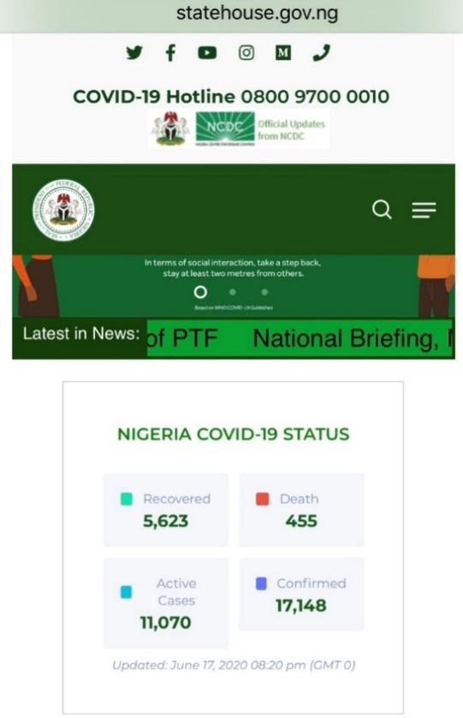
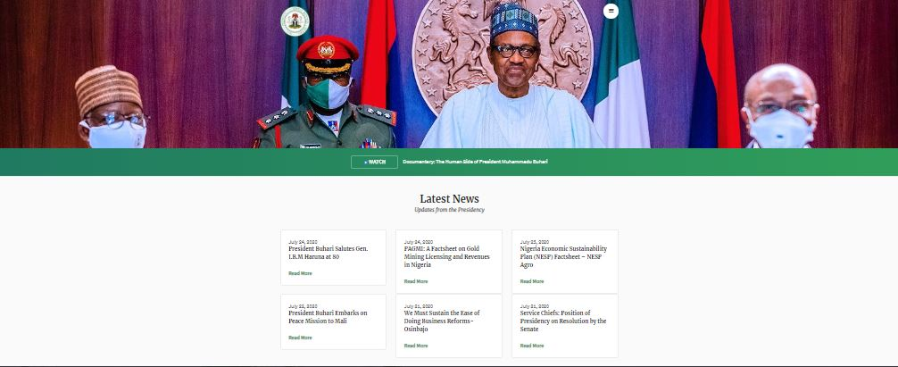
ACHIEVEMENTS
Print
The revised Ease of Lockdown protocol by the Presidential Task Force on COVID-19 was published in newspapers across the geopolitical zones as shown below:
Social Media/PTF Website
The social media publicity and engagement for the Presidential Task Force took place via the State House and the Federal Ministry of Information and Culture social media handles.
A comprehensive site which hosted information about the PTF, COVID-19 updates, FAQs, guidelines and protocols, etc. was created as a subdomain on the State House website: https://statehouse.gov.ng/covid19
Mask On Naija
The PTF in collaboration with CACOVID and first-line traditional and religious leaders across all northern states launched the #MaskOnNaija Campaign in October 2020. The campaign launched with photos of leaders holding up #COVID19StopsWithMe signs and video recordings of leaders on social media various television stations.
The PTF launched a Wear A Mask challenge in collaboration with CACOVID to enjoin captains of industry and corporate Nigeria to drive citizen action.

Slide 53
ACHIEVEMENTS
Social Welfare
The PTF liaised with several donors, partners, FMHDSD, various FMDAs and pillars to support the provision and distribution of lifesaving and life-sustaining palliatives to the vulnerable part of the population: poor, internally displaced persons (IDPs), Physically Challenged Persons (PCPs), women, children and elderly, among others; to cushion the socio-economic and psychological impacts of the pandemic.
These palliatives were in two key categories:
FOOD ITEMS
CASH TRANSFERS
Food Items
Food items comprising Garri, Maize, Millet and Sorghum were approved for delivery to frontline states.
So far, a total of 70,000 (MT) of food items were distributed to 8,827,129 households in 24 states. The food items were distributed between April and June 2020
TARGET BENEFICIARIES
Total Population~ 200m
Target Beneficiaries 26.5%
Average Persons/Household ~ 6
Total Number of Beneficiaries~ 8.8m
8,827,129 Households
*Note: The target beneficiaries represent the poorest and most vulnerable households of the Nigerian population amidst the COVID 19 pandemic that has deeply affected the livelihoods of many Nigerians.
2,015.2 (MT)
23,873.7 (MT)
3,979.5 (MT)
20,659.4 (MT)
Garri
Maize
Millet
Sorghum

Slide 54
ACHIEVEMENTS
Distribution of Food Items
Phase 1
Phase 2
Phase 3

Slide 55






ACHIEVEMENTS
National Home-Grown School Feeding Programme(HGSFP)
The National Home-Grown School Feeding Programme (NHGSFP) is the government led school feeding programme aimed at improving the health and educational outcomes of public primary school pupils.
To sustain the NHGSFP initiative, a “Take Home Ration” model was adopted for households
FCT:
Schools: 404
Cooks: 895
Pupils: 88,826
Households: 29,609
Lagos:
Schools: 866
Cooks: 1,419
Pupils: 112,767
Households: 37,589
Ogun:
Schools: 1,589
Cooks: 3,577
Pupils: 181,172
Households: 60,391
3
States Reached
Take Home Ration Package:
Rice
5kg
Beans
5kg
Salt
500mg
Vegetable Oil
500ml
Palm Oil
750ml
Eggs
15pcs
Tomato Paste 140gm
Conditional Cash Transfer Scheme
The Conditional Cash Transfer Scheme ensured the provision of money to individuals and households as emergency relief to address their basic needs. The PTF supported the conditional transfer scheme by liaising with the National Cash Transfer Office to sensitize citizens and ensure the availability of necessary funds.
A total of 755,375 beneficiaries in 23 States and the FCT (Adamawa, Anambra, Bauchi, Benue, Ekiti, Cross river, FCT, Gombe, Imo, Nasarawa, Niger, Sokoto, Rivers, Osun, Oyo, Yobe, Jigawa, Katsina, Kano, Plateau, Taraba, Kaduna, Kogi and Kwara) were sensitized on COVID-19.
Cash disbursement was made to 1,289,405 beneficiaries in 34 States and the FCT from June 2020 to October 2020

Slide 56
ACHIEVEMENTS
Economic Support
The PTF provided mechanisms of support to individuals and small scale/medium businesses in the form of loans and empowerment schemes were made through the Federal Government Economic program
The aim was to cushion the effect of the lockdown on individuals and small-scale business owners. The following were achieved
Government Enterprise and Empowerment Programme (GEEP):
Trader and Market Moni loans:
Rapid Expansion of the National Social Register:
The GEEP successfully sensitised over 5 million small scale traders captured on Government Enterprise and Empowerment Programme (GEEP) database regarding COVID-19 pandemic, granted moratorium to 2.2 million existing GEEP beneficiaries for three months and completed 99% loan disbursement target
Loans were disbursed to 43,117 beneficiaries in 11 states and the FCT (Lagos, FCT, Ogun, Plateau, Bauchi, Yobe, Zamfara, Katsina, Edo, Cross River, Enugu and Imo)
The National Social Register was updated to include previously unidentified vulnerable citizens. The National Social Register now comprises 3.6 million households in 36 States and the FCT

Slide 57
ACHIEVEMENTS
Economic Reopening
Following the outbreak of COVID-19 pandemic in Nigeria, various sectors including travel & tourism, education, etc. were closed in order to safeguard the health and general wellbeing of the citizens. As the lockdown eased and business, schools and other places of social gathering began to operate, measures were implemented for the safe and efficient reopening of the Nigerian economy in line with the Economic Sustainability Plan under the Office of the Vice President.
Below are a few measures undertaken to ensure the safe reopening of some key sectors in the Nigerian economy:
Education
As part of its efforts to ensure the safe reopening of schools across the country, the PTF in collaboration with the Ministry of Education and other key stakeholders developed the guideline for schools and learning facilities reopening.
The guideline included a gradual and phased approach to reopening whereby priority learners who were vulnerable, had reduced access to distance learning or were in examination classes were asked to resume first.
Prior to school resumption, relevant MDAs and the PTF were required to:
Review existing policies, practices and risk mitigation strategies.
Provide national policy guidelines/parameters for decision making and actions on safe school opening
Develop safe school reopening checklist
Develop detailed protocols to ensure schools maintain prescribed hygiene standards and practices which included hand washing, access to adequate toilet facilities, cross ventilation of classrooms, use of face masks, proper food preparation and handling/disposal of waste
Provide learner-support materials to learners especially those with disabilities, low-income families and those living on rural, remote and conflict affected communities, etc.
Conduct a rapid assessment to determine funding requirement for upgrading infrastructure and facilities
Allocate grants to schools and learning facilities to procure soaps and buckets
Partner with donors to produce and distribute PPE materials to schools
Schools and learning facilities had to adhere to the guidelines which included:
Disinfection and fumigation of facilities, including hostel accommodations
Provision of WASH facilities and water points in line with WASH guidelines and prescribed standards
Sensitization and training of teachers, administrators and other education personnel to ensure compliance with school COVID-19 preventive measures
Adherence to social distancing such that learners stayed at least two meters apart. Also, areas of gathering such as dining halls, classrooms, staff rooms were required to have enough space to allow for two meters separation between individuals
Implementation of alternative learning models such as outdoor learning, staggered attendance (where learners will arrive at different times), alternate attendance (were schools alternated attendance days per week), platooning (dividing classes to morning and afternoon shifts), creative delivery (involving the use of various learning environments and media for distance learning) etc.
Ensure temperature checks with non-contact thermometers at school entrances for all staff, learners and visitors
Ensure school clinics were equipped to attend to sick people, etc.
Development of a communication plan to inform parents in the event of a COVID-19 confirmed case

Slide 58
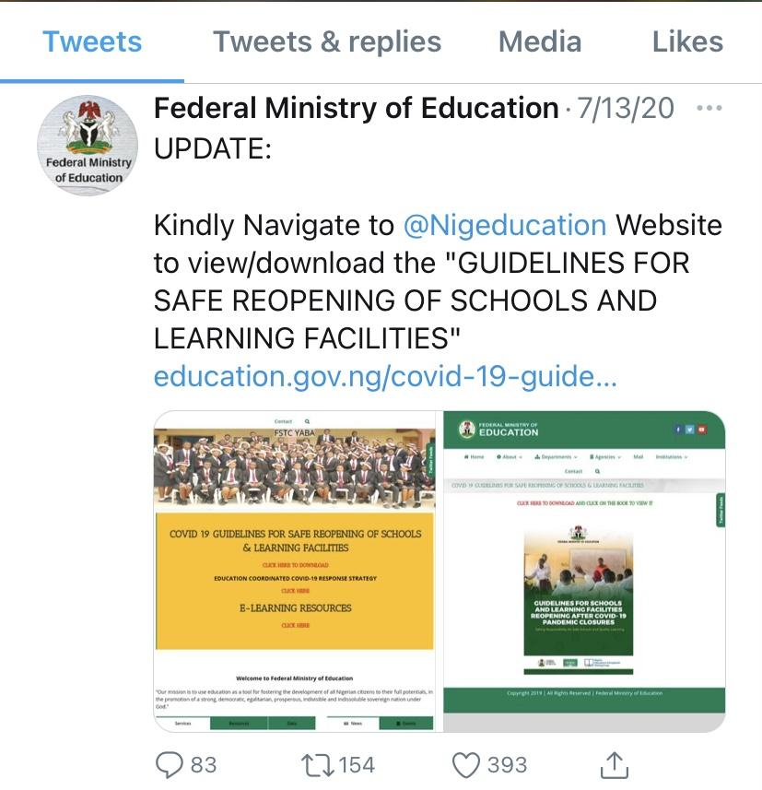
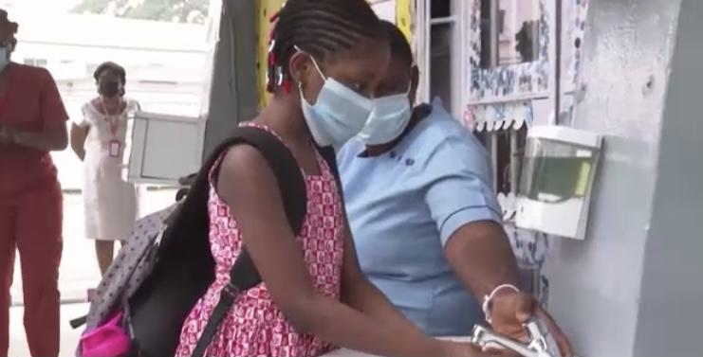
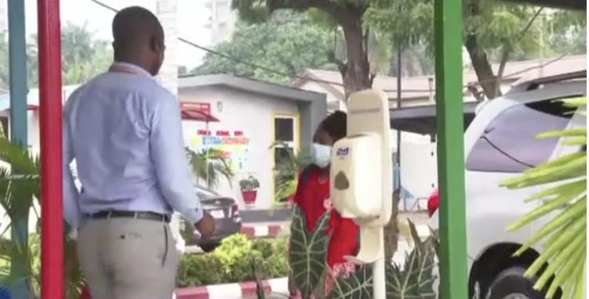
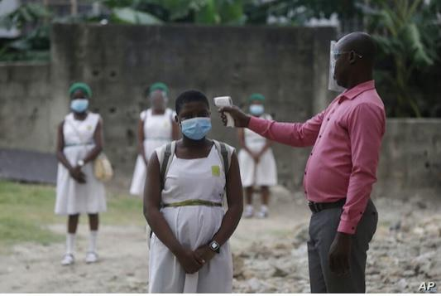
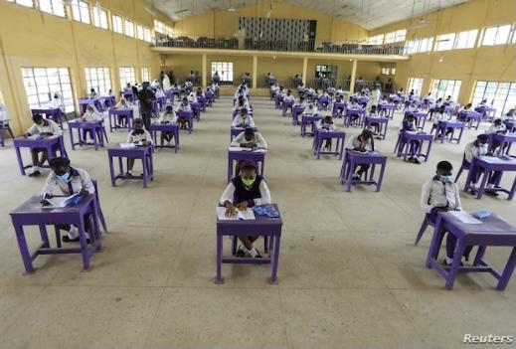
ACHIEVEMENTS
Education

Slide 59
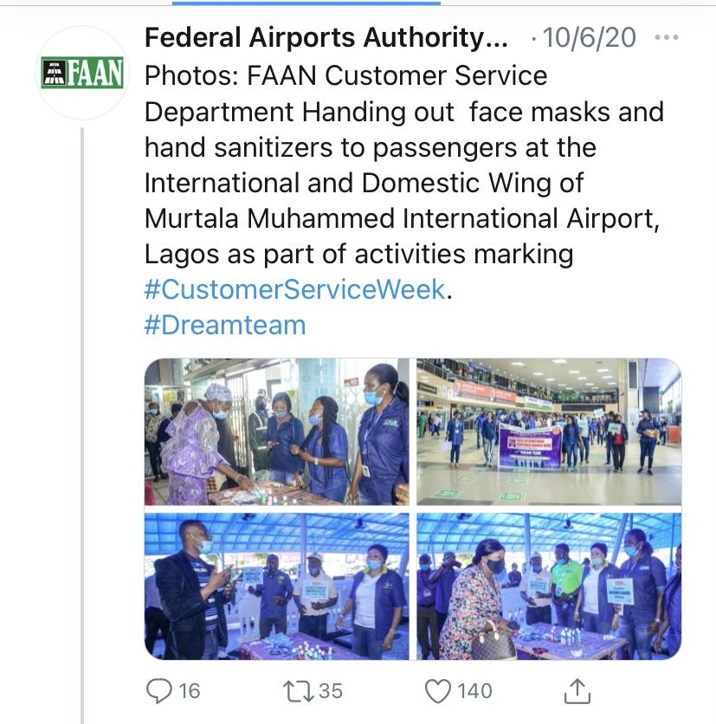
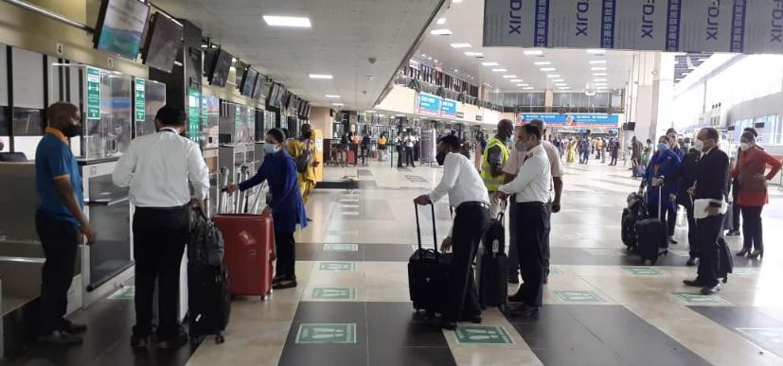
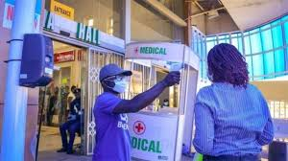
ACHIEVEMENTS
Air Travel
As the lockdown eased, the PTF in collaboration with relevant MDAs (FAAN, NIS, NCAA) and in line with WHO, ACI, ICAO, IATA protocols and aviation best practices, implemented certain measures to facilitate seamless transition from the lockdown to resumption of air travel activities.
This was achieved by the implementation of various measures and development of protocols and guidelines to safeguard the health of inbound and outbound passengers.
These guidelines/measures included:
Submission of post COVID-19 Standard Operating Procedures (SOPs) for approval by airline & airport operators. The SOPs were required to include:
Plans for the fumigation and disinfection of the airport/terminal prior to commencement of operations
Procedures for routine cleaning and disinfection of frequently touched/exposed surfaces, airline offices and security equipment including trays
Measures to protect screeners/security personnel and passenger/staff during operations to reduce the spread of the COVID-19 pandemic
Procedures for handling suspect cases who might have failed temperature checks and require further medical attention
Installation of protective barriers in five (5) international airports by the Nigeria Immigration Service
Continuous review of Points of Entry protocols by the PTF to ensure adequacy
Enforcement of online process for Visa on Arrival to reduce overcrowding at the centres, as well as migration of temporary Work Permit and passport application to an online platform, etc.
Provision of adequate Personal Protective Equipment (PPE) for screeners/security personnel before resumption
Training of relevant personnel on new requirements for safe operations during outbreaks of communicable disease by the national health authorities
Provision of hand sanitizers and disinfection products at designated points in the airport/terminal prior to commencement of operations
Restriction of the number of people in the terminals to travellers only
Ensuring temperature check at points of entry at the airports
Provision of baggage disinfectant equipment and ensuring all baggage are disinfected before entry to the airports
Floor markings at the airports to ensure physical distancing

Slide 60
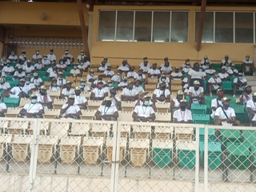
ACHIEVEMENTS
National Youth Service Corps (NYSC) Orientation Camps
The Federal Government approved the reopening of NYSC orientation camps. Prior to commencement of the orientation programme, various measures were implemented by relevant stakeholders for the safe reopening of the orientation camps across Nigeria. These measures included:
Assessment of the control measures put in place at the NYSC orientation camps by teams from NCDC, the PTF, and NYSC to ensure the safety of NYSC corps members
Provision of public health guidance for safe reopening of the NYSC camps across the country
Provision of rapid diagnostic test kits for screening corps members
Testing all Corp members for COVID-19
Provision of IPC Vanguards to support compliance with the COVID-19 preventive measures at each NYSC camp
The National Youth Service Corps official also took various measures which included:
Fumigation of the orientation camps prior to the commencement of camp activities
Provision of WASH facilities at the orientation camps across the country
Development of an online self-reporting form completed by each corps member prior to reporting at the orientation camp
Provision of step-by-step guideline to ensure corps members stay safe while in camp
Ensure living arrangements in the camps comply with the two meters spacing
Ensuring Corp members are tested and certified COVID-19 free at the orientation camps before registration at the camps
Continuous communication through the NYSC communication channels including the NYSC radio stations to sensitize the public and NYSC community on measures being implemented
As part of the efforts to ensure safe reopening of orientation caps, teams from NCDC, the PTF, NYSC and Federal Capital Territory Administration (FCTA) assessed control measures put in place at the NYSC orientation camps to ensure the safety of NYSC corps members

Slide 61
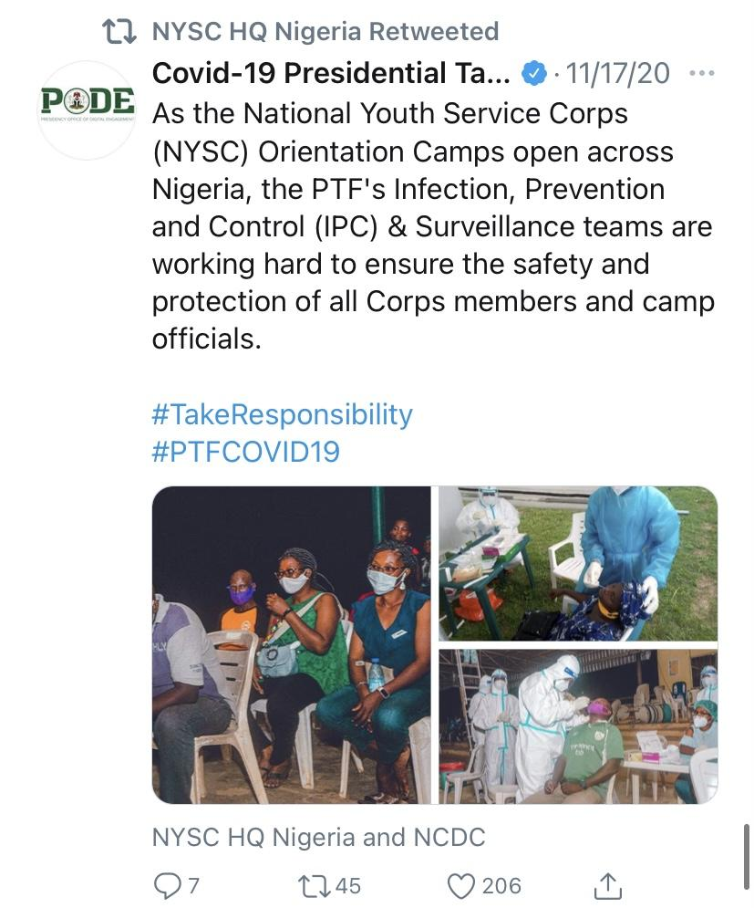
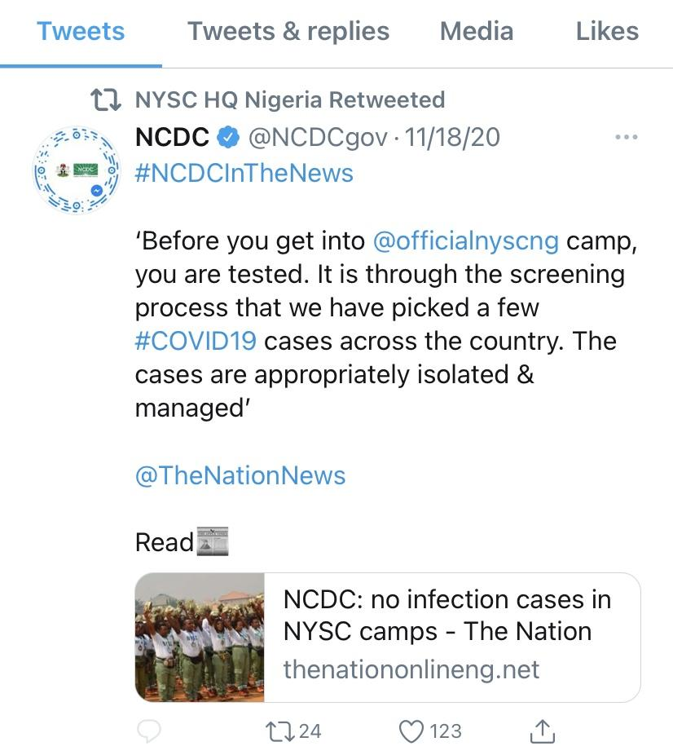
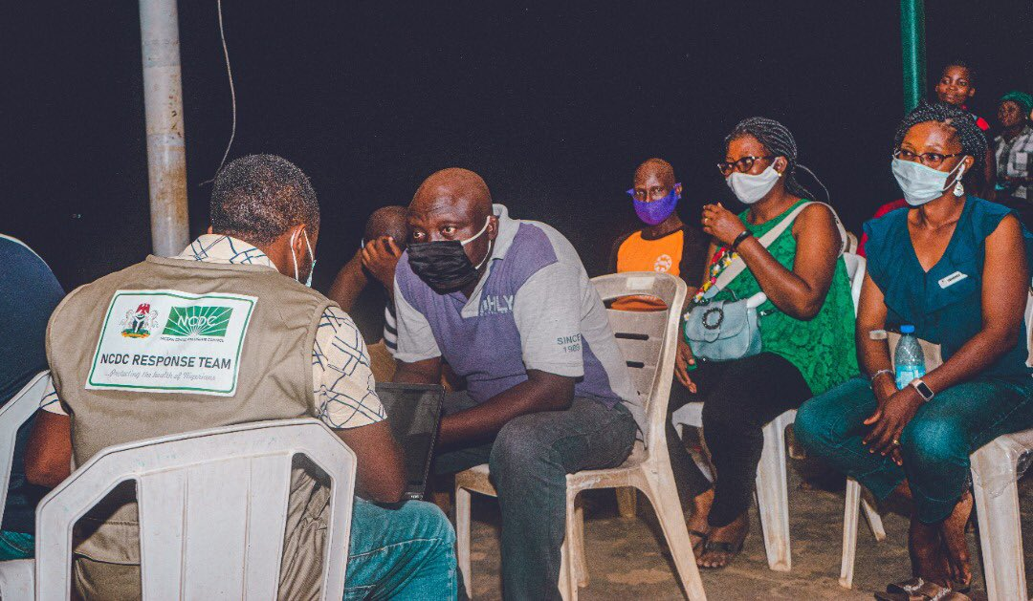
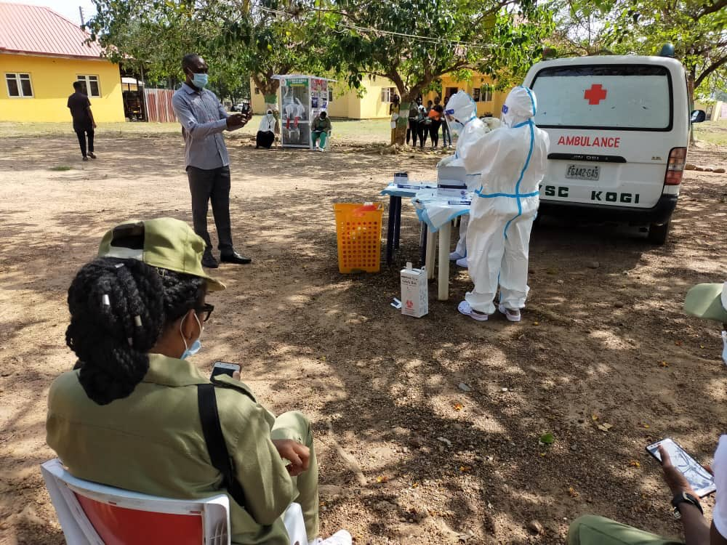
ACHIEVEMENTS
Religious/Social Gathering, Hotels & Event Centres
After the announcement of the PTF on the reopening of places of religious/social gatherings, the NCDC released guidelines to reduce the risk of infections in places of worship, social gatherings, hotels and event centres. These guidelines included:
Enforcement of the use face masks for all attendees, religious leaders before entry to the centres
Temperature screening at the point of entry and no entry to sick people
Provision of hand washing facilities and hand sanitizers at point of entries and strategic points
Total capacity of a third (1/3) of the seating capacity of the Event centres
Adherence to physical distancing of at least two meters apart
Adherence to no physical touching standards such as handshakes, hugs
Limit programs to activities that do not require sharing of materials
Disinfection of centres before and after programs

Slide 62
ACHIEVEMENTS
Surveillance
The PTF through its Surveillance and Epidemiology pillar in collaboration with the Point of Entry Pillar and partner MDAs intensified surveillance activities to facilitate early COVID-19 case detection, timely reporting of cases including community transmission of COVID-19 and supported the coordination of the outbreak response and roll-out strategies.
The response was conducted in three phases:
Prevention & Preparedness
Containment
Control & Mitigation
Phase 1 – Prevention and Preparedness
Prior to school resumption, relevant MDAs and the PTF were able to achieve the following:
Train Healthcare Workers and Community volunteers on COVID-19 surveillance and case finding
Train over 40 Rapid Response Teams (RRT) and deploy them to facilitate case detection and contact tracing across affected states
Designate 131 Treatment Centers across the country
Establish and implement Point of Entry (PoE) surveillance
  Achieved over 90% follow-up for Persons of Interest (POI) by enhancing contact tracing activities
Develop guidelines and data collection tools
Develop National and State Pre-Incident Action Plans
Develop and disseminate case definition materials for surveillance at health facilities and POEs
Develop guidelines and Standard operating procedures (SOPs) including COVID-19 surveillance guidelines, Case definitions (standard and community case definitions), and strategy documents to improve surveillance and case finding
Develop and disseminate updated case definition, contact tracing and management protocols to enhance case finding and testing
Phase 2 – Containment (Importation and sporadic cases)
Contact tracing
Provision of logistics for contact tracing (people, equipment, PPEs, telephones etc.)
Deployment of additional people for contact tracing and active case finding by collaborating with ACDC, ICRC and UNAIDs and communities
Conduct screening at various Points of Entries and contact tracing activities in high priority states
Point of Entry
Provision of more than 6000 traveler’s kits to Persons of Interest returning to Nigeria
Review of Passenger Self Reporting Forms (PSRF) to track exposure history or indicative symptoms, temperature screening and visual observation
Conduct secondary screening (History taking and triage of suspects)
Transfer of suspected cases to testing, quarantine or treatment centers
Develop and monitor implementation of entry screening guidelines at POEs
Collation of contact information for contact tracing and surveillance
Engagement of surge capacity personnel to handle screening at POEs

Slide 63
ACHIEVEMENTS
Surveillance
Phase 2 – Containment (Importation and sporadic cases)
Case Reporting
Support and facilitate ramping up of testing capacity by 50% in most states
Enhancement of signal monitoring activities through the 24-hour hotline and maintenance of adequate signal logs
Escalation of 6,868 COVID-19 alerts from 294,097 successful calls nationwide as of June 30, with 830 (12.1%) escalated alerts confirmed as positive COVID-19 cases
Intensification of institutional surveillance activities e.g., schools, NYSC, prisons
Screening
Screened 1,238,205 travelers with 49 suspect cases identified at interstate borders between 15 April 2020 and 1 June 2020
Supported the screening of arriving passengers at Nnamdi Azikiwe International Airport (NAIA) and MMIA as well as seaports and ground crossings
  Airport Result: 341,939 screened, 2,390 suspected cases, 41 confirmed cases
  Seaport: 30,966 screened, 64 suspected cases, 16 confirmed cases
  Ground Crossing: 16,079 screened, 36 suspected cases and 19 confirmed cases
2001 returnees were quarantined between 6 May 2020 and 12 June 2020
34 crew members were quarantined at Bonny and Warri Seaports between January 2020 and June 2020
Phase 3 – Control and Mitigation
Implementation of community active case search
Enforcement of mandatory institutional quarantine and testing for international Returnees and high-risk contacts
Identification of hotspots in various LGAs and intensify efforts to contain community transmission
  Risk assessment in identified hotspot LGAs/wards, development and implementation of appropriate intervention strategies
  Establishment of a system for conducting case finding through house-to-house case search and engagement of HCWs in 20 Hotspot LGAs
Digitalization of results and harmonization of data for quality improvement and data driven strategy reviews
  Roll out of Surveillance Outbreak Response Management and Analysis System (SORMAS) to all states including the FCT and deployed Surveillance Support Officers and Data Clerks to enhance data entry and quality of data
  Establishment of Advanced Passenger Information Systems (APIs)
  Development of data systems for POE specific requirements
  Procurement of data management hardware and software for NAIA and MMA to manage real time information
  Documentation of passenger contact details using Passenger Self Reporting Forms (PSRFs) for ease of contact tracing

Slide 64
STAKEHOLDER ENGAGEMENT
5

Slide 65
STAKEHOLDER ENGAGEMENT
An online survey was deployed to obtain stakeholder feedback and perception on the performance of the Presidential Task Force on COVID-19 in ensuring that the Federal Republic of Nigeria emerges from the COVID-19 pandemic with minimal negative impact to the population, health systems and the economy
Partner Feedback
An online survey was deployed to obtain feedback from PTF partners on perception on the performance of the Presidential Task Force on COVID-19 (PTF) and the proposed PTF transition process.
Overview of Survey
Survey Respondent Demography:
54
14
Total number of recipients (organisations)
Number of Organisations that Responded
Analysis of Survey Response
The survey asked questions which the respondents had the following responses to:
List the things that the Nigerian government MUST DO to ensure the mandate of the PTF is sustained during and beyond the transition period
Provision of adequate funds to support and sustain ongoing and projected activities
Foster collaboration between MDAs, private bodies and development partners
Develop and implement a Transition Plan with clearly defined timelines, responsible parties and cost implications
Top three (3) things that the Nigerian government MUST AVOID to ensure the sustainability of the PTF mandate during and beyond the transition period
Decentralising the national response and transferring the responsibility as well as resources completely to states
Dissolving the PTF without clearly defining next steps, transition plan and responsible parties
Multiple decision-making points/handover in policy formulation and implementation

Slide 66
STAKEHOLDER ENGAGEMENT
How can your organization support the PTF’s transition process?
S/N | Name | Area of Support/Initiative
Most of the organizations expressed readiness to support the PTF transition process
1 | Bill and Melinda Gates Foundation | Assist in developing a Transition Plan, including develop a functional coordination structure and sustainable financing Document lessons learned and success story of the Nigeria PTF in spearheading response.
2 | Clinton Health Access Initiative | Provide support with the development of the Transition Plan
3 | EU | Extend support through the UN Basket Fund and other on-going projects
4 | FCDO | Provide technical support
5 | Global Fund | Provide support in the development of frameworks and plans
6 | IOM | Provide technical Support to MDAs
7 | OAU | Provide technical support by regularly educating personnel about the transition process
11 | USAID | Support the Federal and State levels to incorporate aspects of COVID-19 response within annual operational plans of the PHC system and help the EOC’s support the five IHP focus states to ensure strategic use of financial resources allocated to them
12 | USG | Provide ongoing TA to the PTF for the visioning, crafting and finalization of a post PTF transition plan and coordination framework Embed staff – on a part time, definite time basis – in support of the lean operations of the post- PTF transitioning team/secretariat Support the development of a plan to move the COVID response from an emergency to routine healthcare

Slide 67
STAKEHOLDER ENGAGEMENT
How can your organization support the COVID-19 response post PTF?
S/N | Name | Area of Support/Initiative
Most of the organizations also confirmed their readiness to continue to support Nigeria’s COVID-19 response post PTF
1 | Bill and Melinda Gates Foundation | Provide technical support
2 | Clinton Health Access Initiative | Extend support to MDAs to ensure smooth transition
3 | EU | Develop innovative programmes from 2021 – 2027
4 | FCDO | Provide technical support
5 | Global Fund | Make funds available for national priorities across pillar
6 | IOM | Provide technical support
7 | OAU | Implement community led monitoring
11 | USAID | Provide additional resources to facilitate ongoing logistics and risk communication
12 | USG | Provide technical assistance and expertise directly to lead MDAs across all pillars of the response Mobilize resources and fund implementing partners to support specific gaps or emerging priorities with the response at national and subnational levels Provide technical assistance to the different pillars for implementation at the national and sub-national levels

Slide 68
STAKEHOLDER ENGAGEMENT
Citizens Feedback
24 rounds of nationwide and state specific surveys were conducted for a duration of 24 weeks by NOI Polls from May to November 2020. State quotas were assigned to ensure that every state was proportionately represented in the nationwide surveys. The surveys were conducted to assess the success, performance and achievements of the PTF and the impact of COVID-19 from the citizens perspective as well as their behaviours and concerns. Overall, more than 36,000 Nigerians were surveyed over this period.
The surveys focused on assessing citizens perception in 5 key areas:
Trust and Concern
Communication Monitoring
Preventive Measures
Palliatives
Misinformation and Testing
Survey Respondent Demography:
36,000
1,500
Total Sample over 24 weeks
Weekly sample size
Mode of Interview
Language of Interview
Telephone Interviews
English
Hausa
Yoruba
Pidgin English
Igbo

Slide 69
STAKEHOLDER ENGAGEMENT
Analysis of Survey Response
Trust and Concern
The Federal and State Governments put in place several measures, guidelines and resources to fight against the virus, particularly, to curb further spread of the virus. The survey sought to obtain feedback from the citizens on the effectiveness of these measures, guidelines and activities as well as to measure the citizens’ confidence in the Government’s effort to tackle a pandemic.
Rating of Federal Government’s efforts in fighting the virus
Average rating across the country
49%
% of citizens that are confident the Federal Government can cope with COVID-19
Average % of respondents that are confident in the FG across the country
61%
% of citizens that are worried about the spread of the virus
Average % of respondents that are worried about the spread of the virus across the country
67%
The average rating for the efforts of the Federal Government in its fight against the virus across the nation was 49%. This revealed that a reasonable proportion of the citizens believed that the FG’s efforts largely influenced the behaviour of citizens in reacting to the virus as well as adhering to preventive measures and guidelines
Interactions with citizens revealed that 61% are confident that the Federal Government can cope with Covid-19 or any other pandemic
The survey also revealed that only 67% of citizens are worried about the spread of the virus. Further interactions with citizens revealed that the top reason among those who are not worried about the spread of the virus is because ‘the spread has always been insignificant”
Key Findings

Slide 70
STAKEHOLDER ENGAGEMENT
Communication Monitoring
Since the onset of the pandemic, there were good efforts in communicating with citizens on the existence of the virus, preventive measures, daily updates about testing, active cases and recovered cases etc. The survey sought to obtain feedback from citizens on the effectiveness of these messages and how the information shared by the Federal Government and the PTF helped to influence behaviours of citizens.
% of citizens that saw advertising, publicity or other information about COVID-19 from FG or NCDC
Average % of citizens that saw advertising, publicity or other information about COVID-19
55%
Further analysis revealed that common sources of information were
TV – 52%
Radio – 43%
NCDC Text Messages – 17%
Key Findings
In your opinion, do you think Corona virus is real in Nigeria?
An average of 67% of Nigerian citizens surveyed believe that the virus is real in Nigeria
Further analysis revealed that the response to whether the virus is real varied with age as follows:
20% of citizens in the age range of 18- 35 years do not believe it is real
10% of citizens in the age range of 36 – 60 years do not believe the virus is real
Citizens above 60 years do not think the outbreak is real at all
Citizens gave their reasons for this belief as follows:
21% say it is because Government lies and 12% say it is because it is a scam
27% of those who do not think the virus is a risk to their health and potentially fatal do so because they think the virus is curable
Key Findings

Slide 71
STAKEHOLDER ENGAGEMENT
Palliatives Distribution
In order to ease the burden of the lockdown (temporary closure of business, borders etc.) on the vulnerable population, the Federal Government made provisions for the distribution of palliatives to the citizens. The survey sought to obtain feedback from the citizens to know if they received any of the palliatives distributed as well as ease of accessibility to the palliatives.
Have you received any messages on how to access palliatives from any of the bodies listed?
The survey revealed that there was no adequate communication regarding how to access palliatives with 96% of respondents confirming that they did not receive message/information from any of the bodies.
Further analysis revealed the following:
71% of respondents define palliatives as foodstuffs
Only 53% of respondents were aware of Federal Government’s socio-economic interventions. Of the 53%:
46% were aware of the distribution of Grains
50% were aware of the National Home Group School Feeding program
57% were aware of Trader/Farmer moni and
56% were aware of GEEP
Key Findings
Have you received any palliatives from the listed bodies since the outbreak of Corona virus in Nigeria?
Response to having received palliatives by citizens was low. Only 2% of the respondents confirmed that they had received any form of palliatives
Further analysis revealed the following:
  Most of the respondents confirmed that they did not know who to trust to distribute palliatives. 16% mentioned religious leaders as their preferred option
  93% of business owners or self-employed citizens were concerned about the negative impact of Covid-19 outbreak on their businesses
  35% of the citizens that responded preferred that the Government provided food items as palliatives while 20% preferred cash related assistance
Key Findings

Slide 72
STAKEHOLDER ENGAGEMENT
Preventive Measures
Following gradual ease of the lockdown, the Federal Government communicated directives on preventive measures including but not limited to physical distancing, use of face masks, hand washing, use hand sanitizers etc. The survey sought to obtain feedback from the citizens on the effectiveness of theses directives and how the citizens adjusted to the “new normal”.
Rating Federal Governments efforts in fighting the virus
The survey revealed that physical distancing is the most challenging preventive measure. With 17% of citizens confirming that they rarely or never practice it.
32% of the respondents confirmed that it is difficult to practice when compared to handwashing and wearing facemasks
59% of the respondents also confirmed that the market is the most difficult place to practice physical distancing
Key Findings
Misinformation and Testing
The survey sought to obtain feedback from citizens regarding accuracy of information they received about the virus as well as their perception on the FG’s efforts regarding testing.
They survey revealed the following:
The level of misinformation among citizens has reduced. Only 10% reported having heard or seen that facemasks are not safe for children within the past 7 days
6% reported to have taken or tried to take a test for Coronavirus and their experience was at least satisfactory (85%)

Slide 73
RESOURCE MANAGEMENT
6

Slide 74
RESOURCE MANAGEMENT
To achieve its mandate, the PTF collaborated with MDAs, Development Partners, private sector and other key stakeholders to ensure the availability of adequate funding and resources for the effective implementation of the COVID-19 Pandemic response. Donations were received from public and private sector organizations including; the Coalition Against COVID-19 (CACOVID), the World Health Organization, UNICEF, the United States Government (CDC, USAID, WRAIR), the UK Department for International Development, the Government of Japan and several other donors/ partners.
Donations received have been categorized as shown below:
Monetary Resources
Technical Support
Medical Donations & Supplies
Monetary Resources
Monetary resources were donated to ensure the effective implementation of the COVID-19 pandemic response. These resources were made available from two (2) key sources:
The Federal Government of Nigeria (FGN)
Partners and Donors
A total of ₦178,800,260,723 in monetary resources was available for the COVID-19 response as shown below. Seventy nine percent (79%) %) of funds came from donors and partners and were used directly to support activities without passing through the PTF or government account.
₦ 141.1b
₦ 15.6b
₦ 22.2b
* Source UNDP dashboard, OSGF, Resource Mobilisation Pillar

Slide 75
RESOURCE UTILISATION
Federal Government of Nigeria (FGN)
Detailed below are the monetary contributions of the FGN to the COVID-19 pandemic response:
Federal Government Monetary Resources Received by the PTF
Detailed below are the cash disbursed into the PTF special account and directly to MDAs as of 6th December 2020 and the breakdown of expenses incurred by the PTF as at 6 December 2020.
₦15,637,130,312
₦22,163,130,411
AMOUNT RELEASED DIRECTLY TO MDAs
AMOIUNT RELEASED INTO THE PTF SPECIAL ACCOUNT
The Presidential Task Force on COVID-19 estimated the sum of NGN 83.9 billion for the COVID-19 response in Nigeria, however, the sum of NGN 22.16 billion and NGN 15.63 billion was disbursed from the CBN account in to the PTF Special account and directly to the various MDAs accounts respectively for the management of the pandemic.

Slide 76
RESOURCE UTILISATION
Agency | Approved Budget (₦) | Amount Released by FGN to the PTF and MDAs (₦)¹
Health Infrastructure | 48,926,123,085 | -
Federal Medical Center (FMC) Keffi | - | 60,000,000
Federal Medical Center (FMC) Bayelsa | - | 34,000,000
Nigeria Centre for Disease Control (NCDC) | - | 583,400,000
Federal Medical Center (FMC) Ebutte Metta | - | 400,000,000
Federal Medical Center (FMC) Makurdi | - | 43,000,000
Federal Ministry of Health (FMoH) Headquarters | - | 2,722,086,329
National Primary Health Care Development Agency (NPHCDA) | - | 10,590,006,183
Health Operations | 21,639,869,976 | 15,147,908,983
Immigration Service | 225,000,000 | 135,000,000
National Emergency Management Agency (NEMA) | 4,458,566,666 | 983,547,074
The Office of the National Security Advisor (ONSA) | - | 12,500,000
Defense Headquarters | - | 393,271,009
Nigeria Police Force | - | 114,650,000
Department of State Security (DSS) | - | 282,006,500
Nigeria Security and Civil Defense Corps (NSCDC) | - | 98,437,500
Min Agric & Rural Development | - | 160,000,000
Federal Road Safety Corps (FRSC) | - | 98,583,750
Federal Fire Services | - | 86,287,500
Ministry of Aviation | 652,000,000 | 326,000,000
Ministry of Information | 1,427,612,700 | 1,213,470,795
Federal Ministry of Humanitarian affairs, Disaster Management (FMHDS) | 551,416,000 | 165,424,800
Foreign Affairs | 500,000,000 | 250,000,000
Nigerian Maritime Administration and Safety Agency (NIMASA) | 6,890,000 | 2,067,000
Ministry of Environment | 493,000,000 | 147,900,000
Nigerian Ports Authority (NPA) | 22,111,000 | 6,633,300
Federal Ministry of Industry Trade and Investment (FMITI) | 430,000,000 | 129,000,000
Ministry of Defense (MOD) | 43,700,000 | 43,700,000
Presidential Task Force (PTF) | 4,518,850,000 | 3,571,380,000
Grand Totals | 83,895.139427 | 37,800,260,723
Note that all figures indicated above are based on information from the OSGF’s office
¹ % of the funds went either directly to the MDA, the PTF, or was from the MDA’s 2020 budget to support COVID-19 response

Slide 77
RESOURCE UTILISATION
As at the 31st December 2020, the PTF had expended the sum of N8,734,654,038 from the N22,163,130,411 released to it through the PTF Special Account maintained at the Central Bank of Nigeria (CBN) and managed by the Office of the Secretary to the Government of the Federation (OSGF). An additional sum of N4,523,396,187 has also been committed for the NCDC Emergency Procurement of Laboratory Equipment and Consumables as approved by the Federal Executive Council bringing total amount expended/committed to the sum of N13,258,050,224 as at that date.
Schedule of Expenditure as at 31st December 2020
S/N | Description | Amount Expended (N)
1 | Security Agencies | 1,220,736,259
2 | Ministry of Foreign Affairs | 213,147,162
3 | Ministry of Information and Culture | 621,286,235
4 | Ministry of Defence | 43,553,400
5 | PTF Secretariat Expenses | 1,005,651,678
6 | Health Operations | 5,630,279,304
 | Total Expenditure from the PTF Special Account as of 31st December 2020 | 8,734,654,038
*Note that all figures indicated above are based on schedules received from the Office of the Secretary to the Government of the Federation (OSGF)
Monetary Resources Directly Contributed by Partners and Donors towards Activities
The table below details the list of all donations and contributions from the government and other donor agencies in relation to the COVID-19 response in Nigeria.
Contributions Received from Partners and Donors as at 6 December, 2020
S/N | States/MDAs | Amount Donated (N)
1 | *UN Basket Fund | 22.6 b
2 | **CACOVID | 43.2 b
3 | Oil and Gas Industry | 21.4 b
4 | DPG-H | 42.9 b
5 | Private Donations to FG COVID-19 Account | 2.0 b
6 | Other Donations | 9.0 b
Total amount Received from Partners and Donors as of 6 December 2020 |  | 141.1 b
*Note that all figures indicated above are based on schedules received from the Office of the Secretary to the Government of the Federation (OSGF). The donations are spent directly by the donors and not sent to the PTF except for the private donations above.
** The information relating to CACOVID represents actual contribution received from CACOVID in funds, material and food palliatives as indicated by the CBN press release.

Slide 78
RESOURCE UTILISATION
The donations received from the UN basket funds have been further broken-down into the respective sub-donor organisations that make up the UN basket funds.
S/N | *UN Basket Donor Partner | Amount Donated (N)
1 | UN country Team | -
2 | AP Maersk | 72,000,000
3 | Aliko Dangote Foundation | 1,368,000,000
4 | European Union | 19,550,000,000
5 | Government of Switzerland | 144,000,000
6 | Bill and Melinda Gates Foundation | 360,000,000
7 | Macarthur Foundation | 144,000,000
8 | Government of Norway | 36,000,000
9 | Government of Canada | -
10 | World food Programme | 45,000,000
11 | UNFPA | 103,500,000
12 | UNAIDS | 19,800,000
13 | UNHCR | 22,500,000
14 | UN Women | 20,250,000
15 | UNICEF | 67,500,000
16 | UNESCO | 13,500,000
17 | UNDP | 630,000,000
18 | IOM | 45,000,000
19 | ILO | 11,250,000
20 | FAO | 19,800,000
Total |  | 22,672,100,000
Note that all figures indicated above are based on information from the UNDP dashboard
Funds are used directly by the donors and not deposited to the PTF
Budget Breakdown for PTF Special Account
Agency | Budget | 2020 Budget Release | PTF Special Account/Levy | %
Health Infrastructure | ₦ 48,926,123,085 | ₦ 14,432,492,512 |  | 58.32%
Health Operations | ₦ 21,639,869,976 |  | ₦ 15,147,908,983 | 25.79%
Immigration Service | ₦ 225,000,000 |  | ₦ 135,000,000 | 0.27%
NEMA | ₦ 4,458,566,666 |  | ₦ 2,229,283,333 | 5.31%
Aviation | ₦ 652,000,000 | ₦ 326,000,000 |  | 0.78%
Information | ₦ 1,427,612,700 | ₦ 427,612,700 | ₦ 785,858,095 | 1.70%
FMHDS | ₦ 551,416,000 | ₦ 165,424,800 |  | 0.66%
Foreign Affairs | ₦ 500,000,000 |  | ₦ 250,000,000 | 0.60%
NIMASA | ₦ 6,890,000 | ₦ 2,067,000 |  | 0.01%
Environment | ₦ 493,000,000 | ₦ 147,900,000 |  | 0.59%
NPA | ₦ 22,111,000 | ₦ 6,633,300 |  | 0.03%
FMITI | ₦ 430,000,000 | ₦ 129,000,000 |  | 0.51%
MOD (Omitted) | ₦ 43,700,000 |  | ₦ 43,700,000 | 0.05%
Task Force | ₦ 4,518,850,000 |  | ₦ 3,571,380,000 | 5.39%
Grand Total | ₦ 83,895,139,427 | ₦ 15,637,130,312 | ₦ 22,163,130,411 | 100.00%
The 2020 budget represents the amount FGN released to MDAs as part of their annual budget to support the response.
Of the N32billion budgeted for MDAs under the PTF Special Account/Levy, N22billion representing 68% was released.
* Source: UNDP dashboard

Slide 79
RESOURCE UTILISATION
Technical Support
Partners also contributed to the availability of resources for Nigeria's COVID-19 response by providing adequate technical support and expertise is various areas. These areas include; technical guidance on infection prevention control measures, communication around mitigating the spread of the disease, data analysis and logistic distribution, monetary donations to fund the technical expertise etc.
As of December 6, 2020, the partner agencies had allocated NGN19.5 billion for technical support in the following areas:
Capacity building of healthcare workers in case management and outbreak response
Infection prevention and control
Risk communication and community engagement
Strengthening state level operational capacity in surveillance
Engagement with Civil Society Organizations to reverse the negative impact of COVID-19 on sustaining access to essential health services.
The table below shows a list of all the technical assistance received from the respective participating agencies quantified in financial terms.
S/N | Area of Intervention | Participating Agencies | Amount (N) | Amount ($)
1 | Clinical case planning, case management, modelling and deployment of diagnostic tools, support for the PTF Secretariat | Bill and Melinda gates foundations (BMGF) | 3,300,000,000 | 9,200,000
2 | Surveillance and POE screening | Department for International development (DFID) | 737,300,000 | 2,000,000
3 | Laboratories, infection prevention and control. | GF | 1,800,000,000 | 5,000,000
4 | EPI Surveillance, Laboratory, provision of training to NCDC staff | US Center for Decease Control (USCDC) | 2,700,000,000 | 7,400,000
5 | Coordination of infection prevention and control, Case Management support, Logistic/ supply chain supports, Epidemiology and Surveillance | United States Agency for International development (USAID) | 10,900,000,000 | 30,300,000
Total |  |  | 19,437,300,000 | 53,900,000
* Source: UNDP dashboard

Slide 80
RESOURCE UTILISATION
Medical Donations and Supplies
Medical donations and supplies relate to medical equipment, consumables, building and infrastructure items donated by donor partners to the PTF.
The data below shows the donor, items donated and the respective Ministries Department Agencies (MDA’s) and the state governments to which the donated items were allocated as of the 6th of December 2020.
Medical donations and supplies have been grouped into three (3) key categories:
Medical Equipment
Consumables
Medical Building and Infrastructure
The tables below is an extract of some of the key medical equipment, consumables and buildings donated during the period under review. Full details of contributions are available on the PTF dashboards: https://ngcovid19resourcetracker.info/
Medical Equipment
S/N | Description | Donors | Quantity | Unit
1 | 11 ICU Beds fitted with Ventilators | RCCG Christian Social Responsibility | 11 | ICU beds with ventilators
2 | Airway Guedel(Sterile Single Use (Range Size) | UNDP | 300 | Pieces
3 | Airway Guedel(Sterile Single Use (Range Size) | UNDP | 100 | Pieces
4 | Ambulance | Nigerian Oil and Gas Industry | 26 | Vehicle
5 | Ambulance | NNPC/Aieto | 5 | Vehicle
6 | Ambulance | United Nations | 5 | Vehicle
7 | Ambulance | Nigerian Maritime Administration and Safety Agency | 1 | Vehicle
8 | Ambulance | IHS Towers | 4 | Vehicle
9 | Ambulance | Government of Japan | 3 | Vehicle
10 | Ambulance | The Securities and Exchange Commission | 1 | Vehicle
* Source: UNDP dashboard

Slide 81
RESOURCE UTILISATION
Consumables
S/N | Description | Donors | Quantity | Unit
1 | Mattress & Pillows to the Isolation centers | Vitafoam | 100 | Mattresses with pillows
2 | Disposable medical masks | CCECC | 250,000 | Pieces
3 | Disposable Gloves Non-Powder | INTERNATIONAL ATOMIC ENERGY AGENCY | 25 | Cartons
4 | Knapsack Sprayers for Disnfection (pcs) | JUBAILI AGROTEC | 50 | Pieces
5 | Face Shield | UNDP | 10000 | Pieces
6 | Gloves(Examination) | UNDP | 415000 | Pieces
7 | Goggles (Protective) | UNDP | 240 | Pieces
8 | Surgical Mask | UNDP | 20000 | Pieces
9 | Gown (Single use Fluid Resistant Disposable) | UNDP | 8000 | Pieces
10 | Alcohol -Base Hand rub (Bottle 100ml & 500ml) | UNDP | 960 | Pieces
* Source: UNDP dashboard
Medical Infrastructure and Equipment
S/N | Description | Donors | Quantity | Unit
1 | Laboratory construction | GAC | 1 | Buildings
2 | Refurbishment, upgrading, equipment supply, modernization and management of six pilot teaching hospitals, one per geopolitical | CPL Medical Group Ltd | 6 | Buildings
3 | Donation of facilities at Onne Seaport | Intels | 2 | Buildings
4 | ICU Facilities | UBA Heirs Holdings Healthcare Subsidiary Avon Medical Hospital |  | Buildings
5 | Medical Facilities Across 57 Dioceses | CATHOLIC BISHOPS CONFERENCE OF NIGERIA | 453 | Buildings
6 | 1000 Bed Medical Facilities | Dangote | 1 | Buildings
7 | 500 Bed Medical Facilities | Dangote | 1 | Buildings
8 | 210 Bed Medical Facilities | Dangote | 1 | Buildings
9 | 200 Bed Medical Facilities | Dangote | 1 | Buildings
10 | 200 Bed Medical Facilities | Dangote | 1 | Buildings
11 | Ventilators distributed to 88 Health facilities across 36+1 states | USAID | 200 | Equipment
* Source: UNDP dashboard

Slide 82
CHALLENGES AND LESSONS LEARNT
7

Slide 83
CHALLENGES AND LESSONS LEARNT
Key Challenges
Despite the remarkable success recorded over the period, the PTF had to deal with some challenges including; logistics bottlenecks, shortages of Personal Protective Equipment (PPE), high cost involved in procurement, lack of testing capacity, difficulty testing suspected individuals and traced contacts among others.
The challenges faced by the PTF can be categorized across these areas:
Delay in the supply of PPE
Inadequate healthcare infrastructure
Lack of structured data
Disrupted supply chain
Pandemic fatigue
Difficulty sourcing specialised medical equipment and supplies
Increased cost of procurement
Shortage of technical staff
Inadequate cooperation from some States
Delayed release of funds
Logistics challenges
Delay in the Supply of Personal Protective Equipment
Healthcare workers rely on personal protective equipment to protect themselves and their patients from being infected and infecting others. The limited access to supplies such as gloves, medical masks, respirators, goggles, face shields, gowns, and aprons left doctors, nurses and other frontline workers ill-equipped to care for COVID-19 patients. The shortages resulted from various factors such as long importation lead time, interstate travel restrictions, interception by border authorities and low PPE inventory levels
Inadequate Healthcare Infrastructure
A rapid needs assessment was conducted by the Department of Hospital Services, Federal Ministry of Health at the beginning of the COVID-19 pandemic. The results showed that Nigeria had low supplies of ventilators (less than 1000) and other critical supplies such as Isolation/Treatment centers, testing facilities, ambulances, dialyzers, ICU beds and body bags to safely dispose corpses.
The country also experienced slow testing rate as a result of limited number of test kits, trained staff and delayed shipment of equipment to conduct molecular testing. As at the 22nd of July 2020 only about 218,000 test had been conducted in a population of more than 200 million.
Lack of structured data
Reports on the patient levels and the pandemic situation to assist in making daily recommendations to the relevant stakeholders were not readily available and accessible. This was largely due to lack of Laboratory Information Management System (LIMS) within testing laboratories and limited technical skills required for data management.

Slide 84
CHALLENGES AND LESSONS LEARNED
Disrupted Supply Chain
As a result of the COVID-19 pandemic, procurement and delivery of essential items were impacted. Nigeria is highly import dependent and purchases raw materials/products from leading export countries like China, Germany, etc. Due to the pandemic, countries were forced to close their borders and shut down production which affected importation activities in Nigeria. This eventually led to reduced inventory levels of essential medical and non-medical supplies. This also led to an increase in the cost of essential goods and services required to cushion the effect of the COVID-19 pandemic.
Pandemic Fatigue
Sensitisation programmes were organised to engage the community and create awareness on the COVID-19 pandemic. Despite this effort, there was still a lack of compliance to safety protocols such as getting tested if ill, social distancing, quarantine and wearing of face masks among the citizens. It was observed that the citizens were resistant to sampling and testing, some confirmed cases refused to be evacuated to the designated treatment centres, and most returnees who were expected to get tested and self-isolate for a period failed to comply.
This was caused by a general lack of trust in the government and misinformation among groups regarding the COVID-19 pandemic.
Difficulty Sourcing Specialised Medical Equipment and Supplies
The COVID-19 pandemic has disrupted international trade as global and domestic supply chains struggle with reduced trade volumes and inadequate supplies of medical goods, including Personal Protective Equipment, medical equipment and pharmaceuticals. Demand for medical equipment has increased around the globe and obtaining COVID-19 related medical equipment is difficult during this period of the pandemic.
Increased Cost of Procurement due to Naira Devaluation
The COVID-19 pandemic has had an adverse impact on the country’s exchange rate resulting in a forced devaluation of the currency against the dollar. The impact of COVID-19 resulted in declined oil prices and supply in the global markets. Nigeria mainly depends on revenues from oil to fund the external reserves, finance government spending and supply forex for the imports of goods and services.
The devaluation has caused the price of imported items such as essential medical supplies and equipment to increase.
Unarguably, oil price affects FX reserves since it is used to build the reserves with dollar proceeds from crude oil. Therefore, a rise in oil price appreciates the Naira while a fall results in depreciation. This susceptibility to oil means that the country typically may not have enough US dollar reserves to protect the currency when global oil prices are low, due to lower crude oil proceeds.
Shortage of Technical Staff
An effective response to the COVD-19 pandemic requires an adequate supply of technical staff for case management, contact tracing and testing. There was a lack of technical staff to support contact tracing and active case findings at community level in some States.
The technical capacity of the IPC focal persons across the country varied greatly, affecting the ability to develop quality Incident Action Plans with respect to the COVID-19 pandemic. This led to a delayed response in the impacted States as well as some of the key outcomes of the State programs.
Inadequate Cooperation from some States
The buy-in to the National COVID-19 pandemic response plan was insufficient in some States. The poor cooperation by some State governments was shown by implementation difficulties faced by IPC focal persons, lack of feedback on the implementation of the hotspot strategy, absence IPC focal persons in several health facilities and non-compliance with the provisions of MOU signed with private labs hindering the COVID-19 response.

Slide 85
CHALLENGES AND LESSONS LEARNED
Delayed Release of Funds
Several pillars experienced difficulties implementing initiatives due to funding challenges. There were delays in the release of funds as well as an actual lack of funds for certain activities such as Federal Government-owned media organisations and the National Orientation Agency.
This resulted in strains to the budget of the Federal Government media organisations, delays in payment of special hazard and inducement allowance to frontline health workers in some states and limited execution of several activities.
Logistics Challenges
The PTF operations were affected by several logistics challenges resulting in lags in the execution of several activities. There were delays in shipment of samples from collection point to laboratories and in distribution of Medical and Non-Medical items. This was as a result of lack of dedicated vehicles for the states’ epidemiology team, and initial lack of “PASS” for TRANEX (logistics company handling transportation of COVID-19 test samples) which limited delivery of COVID-19 samples due to the movement restrictions imposed across States.
Other challenges include:
Lack of visibility on medical and non-medical items supplied to States because the items were taken directly to Federal Medical Centers. This was resolved with the establishment of a centralized information center on COVID-19 supplies in the office of the State Director of Pharmaceutical Services
Occupational exposure of security agents and other stakeholders to COVID-19 due to inadequate training on basics of infectious diseases prevention and control. This was resolved by conducting IPC training for security and other non-medical stakeholders
Communication gaps between the response committees of the Federal and State Governments
Insufficient focus on the economic impact of the pandemic on businesses
Inability to monitor compliance with self-isolation protocols
Non-compliance with 7-day testing guideline by some returnees
Low compliance with daily reporting guidelines by case managers due to low level of state-wide acceptance of the dedicated online platform
Lessons Learned
In fighting against the novel COVID-19 pandemic, several initiatives/decisions if implemented early enough, may have led to a reduction in the number of imported cases from returnees and possibly the overall number of cases.
Several lessons were learned, and these lessons will result in the efficient management of future outbreaks/ pandemics such as COVID-19.
The following interventions should have been implemented early:
Early involvement of Ministry of Education
Increased focus on economic recovery
Early closure of borders (international/local)
Tracking and monitoring of returnees
Early distribution of medical equipment
Increased testing capacity
Proactive health response approach
Enforcement of NPIs

Slide 86
CHALLENGES AND LESSONS LEARNT
Early Involvement of the Federal Ministry of Education (FMoE):
The educational sector was greatly impacted by the COVID-19 pandemic in the country. In planning for the COVID-19 pandemic response, early involvement of the Federal Ministry of Education would have mitigated the impact of the pandemic on the educational sector. Prior to the pandemic, the country struggled to ensure young children (majorly in the rural areas) stayed in school and had access to proper education. As a result of the pandemic, children in these communities were left behind as the schools, students and teachers are not equipped to transition to new methods of learning.
Involving the Federal Ministry of Education early would have led to the development of an online curriculum for students of all classes, training and equipping of teachers on adapting digital tools and better preparation in responding to the pandemic.
Increased Focus on Economic Recovery:
While a total lock down in the country was a good response to curb the spread of the COVID-19 pandemic, it had several economic consequences. Economic activities were frozen, resulting in job losses and supply chain disruptions. More importantly, the country’s reliance on oil as a major source of revenue and foreign exchange was a great risk to the economy in the face of dwindling global oil demand and price.
The post-pandemic economic recovery plan such as policies for business recovery strategies, enhancement of export activities, creation of jobs in key areas like agriculture, promotion of manufacturing and local production etc.; were not clearly defined in the National Pandemic Response Plan to mitigate social and economic disruptions.
Early Closure of Local and International Borders
While the government’s response in declaring a total lockdown in high-risk states in the country was good, a quicker reaction would have been the early closure of the country’s borders to human traffic as soon as the index case was confirmed. It took the government three weeks after the first confirmed case to restrict air travel within and outside the country. This resulted in the influx of individuals arriving from countries with high rate of COVID-19 infection into the country.
Locally, an early enforcement of a nation-wide lockdown and inter-state travel restriction not only across high-risk areas (such as Abuja, Lagos and Ogun) would have prevented or reduced the spread of the virus across states.
Tracking and Monitoring of Returnees
An initial response to the COVID-19 pandemic by the government was the implementation of a sample testing and compulsory 14-day quarantine for all returnees in the country. Due to the high cost involved, returnees could go home and self-isolate. However, it was discovered that returnees did not comply with these instructions. This resulted from the lack of effective measures for monitoring returnee movement and activities and the lack of enforcement on the mandatory quarantine and testing procedures.
Government could have considered using public properties such as government training institutes with boarding facilities and government institutions such as university hostels to quarantine the returnees rather than renting hotels. This would have created the opportunity to renovate and upgrade the selected public infrastructures to serve as isolation centres.

Slide 87
CHALLENGES AND LESSONS LEARNT
Early Distribution of Medical Equipment
The distribution of medical items to some facilities were delayed. In addition, the installation of medical items like ventilators and other medical equipment were delayed in some locations. This resulted in some facilities being ill-equipped to handle some cases of the COVID-19 pandemic in the early stages of the pandemic. Early distribution of medical supplies could have mitigated against fatalities.
Increased Testing Capacity across States
The number of people tested relative to the population showed a lag in testing capacity across States. Although testing capacity has now increased, Nigeria is still lagging behind compared to other African countries such as Egypt, Ghana and South Africa. Increasing the testing capacity across states would have helped give a true picture of the impact of the pandemic in the country
Reactionary Health Response Approach
The Health Sector Response Plan was reactive rather than proactive. The plan was prepared after the pandemic had spread in the country. States Governments and Healthcare Facilities would have been more adequately prepared for the pandemic if the Response Plan was prepared before COVID-19 pandemic spread to Nigeria.
Non-enforcement of NPIs
Although the FG communicated non-pharmaceutical interventions to the general public which included regular hand washing, hand sanitizing, social distancing, wearing of face masks etc.; these were not enforced with sanctions, penalties for non-compliance etc. Enforcement of these would have mitigated the spread of the COVID-19 virus across the country.

Slide 88
TRANSITION PLAN
8

Slide 89
TRANSITION PLAN
To sustain the gains made in the COVID-19 control and prevention response and to maintain a reasonable level of response in a second wave of the pandemic and beyond, there is need to ensure the transition of key PTF roles and functions to relevant Government institutions and structures. In view of this, relevant Ministries, Departments and Agencies (MDAs) have been identified for this transition.
The COVID-19 Steering Committee
The current PTF roles and responsibilities will be transitioned in the immediate future to the COVID-19 Steering Committee” (CSC), a Committee “that will continue to coordinate the multisectoral national response through 2021. The CSC will be chaired by the Secretary to the Government of Federation (SGF) and the members will be drawn from key Ministries, Departments and Agencies (MDAs) that are critical to the ongoing response, namely:
Federal Ministry of Health (Minister)
Federal Ministry of Aviation (Minister)
Federal Ministry of Foreign Affairs (Minister)
Federal Ministry of Information and Culture (Minister)
Nigeria Center for Disease Control and Prevention (Director General)
National Primary Health Care Development Agency (Executive Director)
The Ministries and Agencies will be expected to co-opt additional agencies under them that are needed to implement actions. For example, the Ministry of Information and Culture will be expected to co-opt the National Orientation Agency. Other agencies/ MDAS will advice the CSC accordingly on other Federal Government bodies that need to be included.
The CSC will meet regularly but at the minimum once a month, to review ongoing/emerging issues and make decisions that will ensure sustained robust response to the pandemic. The CSC will ensure smooth multisectoral coordination of all activities within the responsible MDAs.
Activities/Tasks
All activities or tasks will remain within the responsible MDAs. Coordination within the MDAs especially for the Point of Entry (POE) that has 5 MDAS and Resource mobilization (2 MDAs) must be ensured. The summarized activities of the MDAs are outlined in the Transition Matrix and the CSC secretariat activities/ organogram, which are listed below.
The Coordinating Steering Committee Secretariat (CSCS)
The proposed new structure of the PTF will be serviced by a Secretariat Team made up of a fusion of the teams from PTF Political and Policy Leadership and the NCRC, in a constricted format. The team will include an administrative arm and a technical arm and will include the following personnel:
Presidential Task Force Consultant (PTC)
National Incident Manager (NIM)
Deputy National Incident Manager (DNIM)
Finance Lead
Nigerian Governor’s Forum Liaison Lead

Slide 90
TRANSITION PLAN
The CSC Secretariat will report to the SGF and below is the organogram
The proposed admin lead (Presidential Task Force Transitional Consultant (PTC) and Technical lead (NIM) will work together and report to the SGF on a regular basis to review key technical issues and decisions needed to be done by the CSC.
It is expected that the finance lead will review budgets and follow-on actions with NIM, DIM and the Permanent Secretary General Services Office (PSGSO) who is the main and permanent lead with the SGF. Additional staff will support the PTF.
CSC Secretariat Organogram
SGF
Admin Lead: PTC
PSGSO
Technical Lead: NIM
DIM
NGF
Finance
CSC Working Groups
The PTF was structured into Functional Working Groups referred to as “Pillars”. This structure facilitates effective coordination with the respective Government MDAs. The pillars were made up of and led by staff of the MDAs, who are currently involved in the implementation of their respective sector response plans.
For the Transition period, a logical transition of the pillar roles and functions to the relevant MDAs will facilitate continuity and sustainability of resources and functionalities. The implementing bodies will be called working groups within the MDAS.
The MDAs will continue to ensure the implementation of COVID 19 prevention and control measures in the country under the new structure of the CSC. The transition of the Pillars functions and roles to MDAs are mapped out in the “Transition Matrix” below. (See enclosed).
The technical team under the CSC, led by the NIM will work closely with the key representatives of the working groups of the different agencies. There will be representatives selected from the 4 MDAs and 2 agencies that will work closely with the technical lead to ensure implementation of the activities of each agency. They will meet at least once a week to review various actions and will be free to coopt other agencies under their ministries as needed.

Slide 91
TRANSITION PLAN
The CSC Secretariat will be expected to do the following:
Assist the SGF/Chairman in coordinating the activities of the CSC.
Support the meeting(s) of the CSC.
Interface with the Bureaucracy in the management of processes, administrative and financial matters as well as engagements with external entities.
Support and advice on current and historical financial transactions related to the PTF.
Support and document engagements with oversight bodies such as National Assembly and the Office of the Auditor General of the Federation.
Support the coordination and finalization of all pending assignments by the PTF within the transition period in a timely manner.
Coordinate the activities of the MDAs to ensure implementation of activities at the highest quality level to avoid and address bottlenecks in carrying out their duties. This includes activities of the pillars especially point of entry, resource mobilization, financial oversight, case management etc.
Engage with all relevant MDAs and in particular with NPHCDA to ensure coordination of vaccine rollout
Carry out continuous holistic review of the pandemic response, identify potential issues, recognize gaps/areas of weakness, hold strategic planning sessions with relevant MDAs and redesign/develop new plans.
Supervise the transfer of responsibilities and resources where applicable back to MDAs as outlined in the transition matrix (attachment 1)
Provide continuous planning, implementation, monitoring and coordination support at institutional, administrative, financial, and technical levels to the CSC
Serve as the operational arm of the CSC through the coordination and monitoring of activities carried out by MDAs and providing necessary linkages for the operations of the various health and non-health MDAs at the national level;
Keep the CSC updated on the implementation of key activities, the pandemic situation and on any major challenges.
State Level Transition
Transition of assets and responsibilities from National to State and from temporary activities/ systems to permanents ones will be key to ensuring maintenance of more permanent structures that can respond to the ongoing COVID-19 pandemic and future epidemics/outbreaks.
At the state level, the priority is to relocate the equipment and infrastructure in the various temporary isolation centers built either by the government or by the private sector into existing public health facilities. Ultimately, it is envisaged that each of the states will have a well-equipped Isolation Centre and a publicly owned molecular laboratory, thus improving the readiness of each State to quickly respond to a potential second wave and future disease outbreaks.
The CSC in collaboration with the Nigeria Governors Forum (NGF) will also firm up its ongoing activities to institute accountability mechanisms in each of the States for effective monitoring of all COVID-19 funds received by the State Governments.

Slide 92
TRANSITION PLAN
CSC Transition Matric Activities
Details of activities and expectations of the MDAs are listed in the table below
Pillar / Working Group | MDAs | Goal | Critical Assets/Structures for Transition | Priority Actions to be Transitioned | Responsible MDA Post PTF
Case Management | Department of Hospital Services, Federal Ministry of Health (DHS- FMOH) | Mitigating the health impact of COVID-19 pandemic in Nigeria by reducing morbidity and mortality through early diagnosis, timely evacuation and treatment of confirmed cases in line with global best practices. | Standalone treatment & Isolation centers with various equipment | Nationwide audit and transfer/handover of the standalone sites to state governments | State ministries of Health (SMOH) and Federal Ministries of Health
 |  |  | Critical supplies such as Personal Protective Equipment, Isolation/Treatment centers, Ambulances, dialyzers and ICU beds in the Federal Tertiary Health Institutions | Inventory database for critical health infrastructure available at the Federal Tertiary Health Institutions | Department of Hospital Services Federal Ministry of Health (DHS- FMOH)
 |  |  | Mobenzi platform approved by the Federal Ministry of Health as a tool for patient level data collection, collation, summarization, analysis and dissemination | Formal evaluation of Mobenzi EMR and institutionalization of suitable EMR for case management of highly infectious diseases | DHS-FMOH
 |  |  | Rapid Response Communication channel/Coordination Mechanism with the CMDs and MDs of all FTHIs for all Level III treatment facilities | Sustain FTHI/Facility Level III Coordination Mechanism to monitor COVID-19 case management at the level III facilities
 |  |  | Establishment of the Community of Practice (COP) for COVID-19, as part of the functions of the Hospital Response Committee | Designation of desk officer to sustain the CoP for COVID-19 case management and provide secretariat function for the partners coordination mechanism

Slide 93
TRANSITION PLAN
Pillar / Working Group | MDAs | Goal | Critical Assets/Structures for Transition | Priority Actions to be Transitioned | Responsible MDA Post PTF
Surveillance and Epidemiology | Nigeria Centre for Disease Control (NCDC) | Intensify surveillance for early detection and timely reporting of community transmission of COVID-19 as well as develop and roll-out strategies for effective and efficient outbreak management | Deployment of human resource to all states (Surveillance officers -SSOs) and Laboratories (data clerks) to support improved data management & data quality | Sustain deployed surveillance officers | NCDC
 |  |  | e-Surveillance system (SORMAS) rolled out to all the states | Maintain hardware and software at the state and LGA levels Improve the quality of SORMAS data Integrate SORMAs with other platforms such as LMIS
Infection Prevention and Control (IPC | Nigeria Centre for Disease Control (NCDC) | Implement the WHO core components of IPC to support and strengthen the Nigeria Health System during and post COVID-19 outbreak | Establishment of IPC Focal persons and committees at the state level and for uniformed services | Sustain coordination mechanism for state IPC leads/focal persons/committees | NCDC
 |  |  | Development and deployment of IPC online training platform | Maintain and update material on the Online learning platform Scale up IPC trainings to Healthcare Workers

Slide 94
TRANSITION PLAN
Pillar / Working Group | MDAs | Goal | Critical Assets/Structures for Transition | Priority Actions to be Transitioned | Responsible MDA Post PTF
Laboratory | Laboratory Services Department, Nigeria Centre for Disease Control (NCDC) | Increase capacity for sample collection, diagnostic testing, data and information management and quality diagnostic testing | Establishment of a network of 98 (public and private) laboratories in 36 States and FCT with 1084 trained personnel trained in molecular diagnostics for COVID-19 | - Support and maintain the COVID-19 molecular laboratory network and leverage for other diseases. - Sustain the quality of Lab test at both public and private labs | NCDC FMOH Private sector
 |  |  | Development and deployment of online training modules for COVID-19 testing | Maintain and update material on the Online learning platform | NCDC MLSCN
 |  |  | Specimen transport system developed with a network of over 1600 trained personnel across the 36 states and FCT | Support and maintain the Nigerian Integrated Specimen Referral network and leverage for other diseases | NCDC DHS-FMOH
 |  |  | Procurement of laboratory supplies for sample collection, diagnostic test kits and PPEs with real-time quantification, forecasting and supply chain system in place. | Sustain system for quantification, forecasting, procurement of laboratory supplies | NCDC

Slide 95
TRANSITION PLAN
Pillar / Working Group | MDAs | Goal | Critical Assets/Structures for Transition | Priority Actions to be Transitioned | Responsible MDA Post PTF
Point of Entry (POE) | Port Health Services, FMoH, NCDC & Ministry of Aviation, NCAA, FAAN, NIS | Prevention of importation / cross-border transmission of COVID-19 through the prevention, detection, assessment and response to health events at Points of Entry (POE) | Procurement of stockpiles of PPE and IPC materials for POEs with real-time quantification, forecasting and supply chain system in place. | Sustain the procurement and supply chain systems for PPEs and IPC materials at the POEs | PHS-FMOH
 |  |  | Electronic Data system for POE-specific data management developed-SaferPorts | Institutionalization and use of the safe ports software and maintenance of hardware at the POEs
 |  |  | Online Learning Management System for Port Health Services (PHS) staff | Maintain and update material on the Online learning platform
 |  |  | Functional International Travel Portal https://nitp.ncdc.gov.ng/onboarding/homepage | Maintain and update the travel portal | NCDC
 |  |  | Establishment of the National Public Health Emergency Response Committee for POE | Support the activities of the NPHERC-POE to support COVID-19 and other epidemic prone disease surveillance at POEs | PHS-FMOH

Slide 96
TRANSITION PLAN
Pillar / Working Group | MDAs | Goal | Critical Assets/Structures for Transition | Priority Actions to be Transitioned | Responsible MDA Post PTF
Risk Communication and Community Engagement | NOA; Federal Ministry of Information and Culture. | Real time sharing of information, exchange of opinions and advice between experts, frontline health providers, community outreach workers and the community members facing the threat of Covid-19 | National database of COVID-19 survivors and registration of national association of COVID-19 survivors | Finalize establishment of COVID-19 survivors association | NOA
 |  |  | Database of 19,000 volunteer community mobilizers (VCMs) in 17 States | Maintain database of volunteers | NOA NPHCDA
 |  |  | Advocacy committee of Northern Traditional leaders Council set up | Support ongoing engagement with community and traditional leaders | NOA NPHCDA
 |  |  | Database of risk communication materials, IEC materials, job aids and workplace reminders and community mobilization messages for COVID-19 | Maintain and update community messaging based on emerging evidence | NCDC NOA NPHCDA FMOH
 |  |  | Continuous Citizens engagement through polls | Continue to support the polls | NOA
 |  |  | Call centers established at the national level and states | Support software and HR at the call centers | NCDC FMOI SMOI
Security Logistics and Mass Care | National Emergency Management Authority (NEMA) | facilitate the delivery of Federal Government ‘s humanitarian assistance to vulnerable population | System for Procurement, Warehousing, Enumeration and Distribution of Presidential Palliatives | Maintain accountable system for distribution of relief materials in emergencies Engage the CSOs and other community structures in palliative distribution | NEMA
 |  |  | Database of Indigent and most vulnerable populations benefiting from Conditional cash transfers | Expand database of indigent and vulnerable populations

Slide 97
TRANSITION PLAN
Pillar / Working Group | MDAs | Goal | Critical Assets/Structures for Transition | Priority Actions to be Transitioned | Responsible MDA Post PTF
Resource Mobilization | Office of the Secretary General of the Federation (OSGF) | Coordinate all resources for the national response from various sources (Government, private, local & International Donors/Partners) | Electronic Asset Database of goods and services received from all sources for the COVID-19 response - The Donations Tracker | Maintain the Donations Tracker | OSGF
 |  |  | Online transparency portals for financial and commodity distribution: - Incidence Tracker and Response Dashboard supported by NESG - https://covid-19response.ng/dashboard - Resource Mobilization Dashboard supported by UNDP - https://ngcovid19resourcetracker.info | Maintain online transparency portals for financial and commodity distribution | FMoH/ NCDC/ State House-
State Coordination and Government Relations | Office of The Secretary General of the Federation. Nigeria Governors’ Forum (NGF) Secretariat | Ensure alignment and synergy between the activities of the various State Task Forces and the national response. | Coordination mechanisms for the sub-national response: Nigeria Governors’ Forum (NGF) National Economic Council Forum of the Commissioners of Health | Maintain the subcommittees of the NGF and NEC as standing committees focused on response to disasters and public health events | Nigeria Governors’ Forum (NGF) Secretariat
 |  |  | Independent mechanism to track the utilization of the FGN COVID-19 fund to the States Governments | Institutionalize the oversight function of the NGF on the implementation of funds for COVID 19 activities to the states. | Nigeria Governors’ Forum (NGF) Secretariat

Slide 98
TRANSITION PLAN
Pillar / Working Group | MDAs | Goal | Critical Assets/Structures for Transition | Priority Actions to be Transitioned | Responsible MDA Post PTF
Research | Research and Knowledge Management Division, Department of Health Planning Research and Statistics, Federal Ministry of Health | Conduct scientific, clinical, anthropologic and socio-economic research to provide the evidence base for guiding decision making in COVID-19 planning and Response in Nigeria | Research registry for real-time updated and online inventory for COVID-19 related research studies in Nigeria | Support the maintenance of the COVID-19 research inventory | National COVID-19 Research Consortium
 |  |  | Commencement of the study on the 'Determination of the burden of COVID-19 based on nationwide community testing' | Completion of the research study | DHPRS-FMOH
Sustainable Production Sub-Group | Federal Ministry of Industry, Trade and Investment | Sustainability and free movement of essential commodities during the COVID-19 response | Market intelligence system to improve production and delivery of essential commodities | Maintain market intelligence system for essential medical supplies and critical commodities | FMITI
 |  |  | Database of local manufacturers of PPEs, ethanol, hand sanitizers and ventilators | - Maintain and expand database of local manufacturers of medical supplies and equipment - Promote Micro, Small & Medium Enterprise (MSME) and local market for PPEs

Slide 99
TRANSITION PLAN
Vaccine Working Group
In view of the anticipated shift to the next phase of the global efforts against COVID-19, the Vaccine Working Group led by National Primary Health Care Development Agency (NPHCDA) is being set up to lead the National Response on COVID-19 vaccine interventions. The table below summarizes the goal and task for the Vaccine Working Group.
Working Group | MDAs | Goal | Key Tasks | Responsible MDAs
Vaccine Working Group | NPHCDA, FMOH and MDAs, NOA; Federal Ministry of Information and Culture. And all other appropriate MDAs | Ensure access and uptake of COVID-19 vaccines, prioritizing the most at risk population (i.e., healthcare workers, persons aged >60 years, and persons with co-morbidity) | Work in collaboration with key stakeholders to adequately plan for, budget & fund COVID-19 vaccine and vaccine support conduct Behavioral Change Communication interventions to improve vaccine uptake ensure appropriate logistics/supply chain support including cold chain facilities ensure appropriate documentation and data management related to vaccine intervention expand the AEFI committee to include surveillance on adverse event following COVID-19 vaccination | NPHCDA
Transition Roadmap and Workplan

Slide 100
APPENDIX
9

Slide 101
APPENDIX
Summary of Pillar Achievements
The ten (10) Functional Pillars and Subgroup attained several accomplishments including an increased testing capacity of 98 laboratories across the country, optimized event-based surveillance, effective bi-directional communication between the States and the PTF, provision and distribution of palliatives to vulnerable persons and established infection prevention and control programs and focal persons in all States.
Pillar | Achievements
Case Management | Developed home-based care guidelines for the management of asymptomatic to moderately symptomatic COVID-19 patients Continuously reviewed and updated treatment guidelines. The guidelines were updated to reflect the psychosocial aspect of the disease and it was domesticated across the states Established channels for better communication and programmatic reviews between the pillar and the Federal Ministry of Health Introduced Community of Practice (COP), a multidisciplinary approach using the ECHO platform. This was integrated into the Hospital Response Committee and attracted participation of all Case Managers and Health Care Workers. Collected patient level data backlog across states through the support of Partners for easy tracking of managed cases. Developed a Case Management training database which captured information regarding participants and trainings conducted to ensure adequate trainings were provided and to avoid repeating the same training for previous attendees Conducted supervision visits across the 36 states including the FCT for baseline assessment of the pillar structure and to monitor implementation of the pillar’s roadmap. This was sponsored by partners (CHAI, WHO, UNICEF, USG) Developed a directory of all IM and CMP leads to enhance coordination, avoid bureaucratic issues and promote emergency response Inaugurated the Partners Coordination Forum comprising of CHAI, WHO, USAID, UNICEF, US CDC and UMB. The team collaborated with the Department of Hospital Services of the Federal Ministry of Health to provide technical support to the pillar Developed partner and resource mapping to create visibility of areas where resources were required to support the pillar Harnessed resources from some agencies to develop an evacuation plan of the COVID-19 response through Ambulance Developed an online platform for data management in collaboration with donor/partners for all isolation/treatment centers through Mobenzi real time and web-based platform

Slide 102
APPENDIX
Pillar | Achievements
Surveillance and Epidemiology | Prompt detection and reporting of suspected COVID-19 cases Deployed trained Rapid Response Team to all states to facilitate case detection and contact tracing Achieved over 90% follow-up for Persons of Interest (POI) by optimizing contact tracing activities Increased reporting and COVID-19 testing by 50% in most states Developed and disseminated cases definition (s) for surveillance at health facilities and POEs. Optimized Event Based Surveillance and call center operations Enhanced signal monitoring and maintained adequate signal logs through the management of 24-hour hotline Escalated 6,817 COVID-19 alerts from 294,097 successful calls nationwide and followed up with states for feedback. Developed and printed various surveillance data Developed and disseminated COVID-19 investigation forms and contact tracing guidelines and provided tablets for case investigation and contact tracing to states Provided more than 6000 traveler’s kits to Persons of Interest returning to Nigeria Strengthened data reporting, management, and quality improvement Deployed Surveillance Outbreak Response Management and Analysis System (SORMAS) data clerks to all states to enhance data entry and quality improvement Rolled-out SORMAS in Akwa Ibom, Imo and Niger states and built capacities Completed the deployment of SORMAS in all states plus the FCT and built capacities Conducted weekly data quality monitoring and engagement with state team Improved surveillance response strategies through effective M&E Monitored outbreak trend through review of daily sitreps from states and follow-up calls to the states where necessary for additional data collection Conducted and reported daily summary of cases and detailed weekly descriptive analysis providing information for action Reviewed surveillance case definition and contact tracing and management protocols to enhance case finding and testing based on M&E analysis Supported other pillars with relevant briefs and data (Laboratory and Risk Communication) Provided technical briefs to Risk communications pillar to develop press releases and public health advisories Participated in risk communication meetings with states and provided data-driven insights

Slide 103
APPENDIX
Pillar | Achievements
Infection Prevention and Control | Designed a strategy for enhancing healthcare worker safety across the country Selected 36 IPC Focal persons and committees Established IPC programs across uniformed services Health facilities Established programs across the Faith-based and Uniformed health services hospitals Developed and deployed IPC online training platform with 6000+ participants Trained 35000+ participants across the country Built a Database of Trainers across all States Investigated over 500 cases of healthcare worker infection Developed and disseminated COVID-19 HAI surveillance tool Monitored HAI through SORMAS weekly to enable initiation of investigation. Developed and deployed an IPC scorecard to monitor IPC in treatment centers Developed assessment tools- Health facility preparedness assessment, treatment center/facility assessments, IPC Assessment Framework (IPCAF) for Orange Network facilities, Hand hygiene baseline assessment, waste management capacities. Assessed Health facilities, treatment centers and other relevant settings (Schools, NYSC camps etc.) Developed 15+ IPC guidelines to improve public knowledge, assist Health workers and inform public measures on COVID-19 Disseminated IPC guidelines across all levels of healthcare Collaborated with relevant stakeholders and partners in developing guidelines to aid reopening of public and private institutions across the country Developed and disseminated IEC materials across various health facility levels in the country Utilized a multi-pronged approach to help improve practice for all IPC interventions Engaged IPC consultants at the onset of the outbreak to support the compliance with IPC protocols at the IDH Yaba Lagos and UATH Abuja treatment centers Quantified and procured IPC materials that were distributed across facilities Received support from development partners and MDAs including the WHO, UNICEF, USAID, CHAI, RKI, Africa CDC, NACA, NPHCDA and the Ministry of Environment Collaborated with CHAI to develop a partner map to keep track of the specifics of partner support and improve efficiencies. Established linkages with the Nigeria Military Health systems, Public and Private health systems.
Laboratory | Expanded the laboratory network to a total of 98 laboratories across the country Activated 18 GeneXpert laboratories across 14 states Activated high throughput laboratories (3 Corbus and 3 Abbott) across 5 states Performed validations for 15 test kits, 13 extraction kits and 3 isothermal Point of Care Equipment Expanded testing capacity to an average daily rate of 2,000-3,000 samples Trained 1,600 staff on sample collection across the country Distributed an average of 40,000 extraction kits and 40,000 test kits to states Ensured that over 70% of laboratories maintained 48hr TAT Procured critical supplies using Global funds and Gavi funding via UNICEF Ensured that lab reagents and supplies were always in stock following the release of FGN funds

Slide 104
APPENDIX
Pillar | Achievements
Point of Entry | Implemented entry screening protocols at POE. Key activities included: Review of Passenger Self Reporting Forms (PSRF) to track exposure history or indicative symptoms, temperature screening and visual observation Secondary screening (History taking and triage of suspects) Transfer of suspected cases to testing, quarantine or treatment centers Engaged in risk communication to travelers on self-isolation and self-reporting Developed and monitored implementation of entry screening guidelines at POEs Supported the screening of arriving passengers at Nnamdi Azikiwe International Airport (NAIA) and MMIA as well as seaports and ground crossings, Testing results as at the time of this report Airport: 341,939 screened, 2,390 suspected cases, 41 confirmed cases Seaport: 30,966 screened, 64 suspected cases, 16 confirmed cases Ground Crossing: 16,079 screened, 36 suspected cases and 19 confirmed cases Transferred all returnees to designated quarantine centers Screened 1,238,205 travelers with 49 suspect cases identified at interstate borders between 15 April 2020 and 1 June 2020 Developed and monitored the implementation of national guidelines for returning Nigerians Provided quarantine facilities for returning Nigerians in collaboration with the Ministry of Foreign Affairs and NCDC. 2001 returnees were quarantined between 6 May 2020 and 12 June 2020 34 crew members were quarantined at Bonny and Warri Seaports between January 2020 and June 2020 Facilitated capacity building and carried out oversight functions on POE frontline officers Conducted site specific IPC trainings at MMIA and NAIA Deployed DIY online Learning Management Systems for Port Health Services staff Enhanced remote and in-person supervision at POEs Collated contact information for contact tracing and surveillance Coordinated POE frontline agencies Instituted Infection Prevention and Control (IPC) measures at POEs Decontaminated conveyances and port premises at POEs Ensured increase in the number of POEs with sample collection capacity Engaged surge capacity personnel to handle screening at POE Reviewed and updated quarantine protocols in line with prevailing circumstances Established Advanced Passenger Information systems (APIs) Data systems for POE specific requirements were developed Data management hardware and software were procured for NAIA and MMA to manage real time information Passenger contact details were documented using Passenger Self Reporting Forms (PSRFs) for ease of contact tracing Increased visibility of health information on self-isolation to all arriving passengers Ensured staff motivation and commitment by advocating for prompt payment of surge staff salaries and payment of hazard allowance to PHS staff at POE.

Slide 105
APPENDIX
Pillar | Achievements
Risk Communication | Production of over 60 television and radio jingles by the Federal Ministry of Information and Culture. Production of 30 television and radio jingles by the National Orientation Agency (NOA), which were translated into some of the major languages in the country. Developed and distributed IPC IEC materials, job aids and workplace reminders for educating patients and sensitizing communities. The Risk Communication Pillar adopted the Communication Strategy developed by RCTWG made up of various MDAs, development partners and the private sector to drive the national media engagement and community mobilization on COVID 19. Weekly nationwide and state-specific polling and analysis With the support of the UK Cabinet Office, the Pillar conducts weekly public perception and opinion surveys on various emergency response initiatives and activities. Polling results and analysis have been instrumental in the shaping of PTF messaging and sensitization materials as well as public engagement. RCCE Partner Working Group The Pilar Established working group to implement the community engagement strategy comprising over 170 focal points with established community volunteer structures to drive PTF messaging down to the grassroots. The working group has over 800,000 community volunteers to conduct nationwide social mobilization on the COVID response. Partners include Red Cross, NOA, NACA, UNICEF, USAID, WHO, Yar’adua Foundation, Nigerian Interfaith Action Association. Between May 29 and 30th June, 4,574 community engagement activities were recorded across the country by the partners. Capacity Building for Media Professionals and other critical responders and community influencers The USAID, Breakthrough Action, NCDC and US CDC supported the virtual training for: 173 media editors and reporters on COVID-19 reporting and fact checking across the country 420 risk communication team members in 36 states and FCT 120 security personnel across all security agencies at military and security compromised areas 65 religious leaders and traditional rulers across the North with the support of the Emir of Kano. Media Stakeholder Engagements & Partnerships Engagement of all the public information organs to support aggressive public sensitization on multi-media platforms and live coverage of PTF Briefings. Partnerships include BON, Newspapers Proprietors Association of Nigeria, Nigerian Guild of Editors, BBC Hausa, VOA etc. resulting in placements on radio, TV, print and social media. Production of Information, Enlightenment and Communication Materials Production of digital and print enlightenment materials (jingles, advertorials, posters, e-flyers, etc.) in different languages in various thematic For example, over 350 television and radio jingles were produced by FMIC, FMoH, NCDC and partners and aired on about 80 radio stations, 10 TV Channels. Also included creative influencers from Nollywood, Kannywood, Yoruba Film Actors were included in the production of the jingles. Over 17,000 media engagements were recorded from April to 30th June on both public and private media channels.

Slide 106
APPENDIX
Pillar | Achievements
Risk Communication | Strategic Risk Communications Support for States The Pillar provided specialized communications support to Kano, Katsina, Plateau and Enugu states with consultations, advisory and provision of radio jingles and other awareness content for state and local government level community sensitization and mobilization. Conducted major media activity in Kano to bring live footage of COVID 19 patients in Treatment Centers, interviewed COVID 19 survivors and frontline health workers to address the perception that COVID is fake. PTF Website & Social Media platforms Launched interactive webpage on the State House website https://statehouse.gov.ng/covid19 Launch a PTF Twitter handle as the official platform: https://twitter.com/DigiCommsNG Recorded 27,000 new followers on Twitter & over 240,000 visits to the Twitter profile. State House, PTF and the Federal Ministry of Information Social Media platforms share updated information, advisories, guidelines & creative materials with about 5.9 million impressions. Established a network of COVID-19 Survivors to drive the campaign to change the narrative around stigmatization Developed a National database of COVID-19 survivors which is frequently updated. Captured 133 survivors in the National database in collaboration with the WHO Conducted a technical dialogue with the COVID-19 survivors on the 1st of September 2020 to build their capacity on how they can use their stories to promote behavioral change. Commenced massive house-to-house campaigns on Immunization (EPI) structure to promote interpersonal communication between volunteers and households to engender behavioral change Mobilized over 19,000 volunteer community mobilizers (VCMs) for the campaign and designed and printed job aids (flipcharts) in collaboration with NPHCDA for this purpose. Launched Live Radio Interaction Programs on four major stations across geopolitical zones – FCT (Human Rights Radio 101.1); Kano (Radio Kano), Enugu (Correct FM) and Lagos (Wazobia Radio). Convened a technical dialogue with over 60 TV and Radio OAPs across the country on October 20 Sustained the weekly NOI polls which collected data on message exposure and recall, knowledge, perceptions, and practice of key prevention behaviors. Completed a KAP survey through a research agency commissioned by UNICEF of 12 states across the country. Developed and launched the #MaskOnNaija Campaign and the social media Wear A Mask challenge in collaboration with CACOVID to enjoin captains of industry and corporate Nigeria to drive citizen action Broadcasted COVID-19 preventive messages on 10 television stations and 50 radio stations across the country.

Slide 107
APPENDIX
Pillar | Achievements
Security, Logistics and Mass Care | Mobilized over 50,000 security personnel from multiple security agencies including the Nigeria Police Force (NPF), Department of State Services (DSS), Office of the National Security Adviser (ONSA), Nigeria Immigration Service (NIS), Federal Road Safety Corps (FRSC), Nigeria Security and Civil Defence Corps (NSCDC) and a host of others to provide security. A total number of 176,000 security personnel were deployed. Established and coordinated the activities of a multi-agency Rapid Response Team (RRT) Enforced lockdown restrictions (inter/intra state) in high-burden states. These states include; FCT-Abuja, Lagos, Ogun, Kano etc. Facilitated the distribution of palliatives to vulnerable persons in the society such as the poor, Internally Displaced Persons (IDPs), Physically Challenged Persons (PCPs), children, elderly persons etc. This included the delivery and distribution of over 70,000MT of grains to vulnerable households across 24 states in the country Provided logistics support for response operations including the transportation and storage of medical /non-medical supplies, palliatives, etc. Provided emergency sheltering, feeding, reunification of families, distribution of emergency supplies and recovery information, before, during and after the COVID-19 pandemic movement restrictions
Resource Mobilization | Conducted Needs Assessment in April to determine immediate (3 Months) and long term (6 Months) health resource needs nationwide. Conducted Gap Analysis to determine resource gaps Established Joint Supply Chain and Distribution Team (JSCD) team to conduct nationwide needs assessment and periodically review resource gaps to support donor engagement Developed and circulated donor and MDAs bi-weekly reporting template for reporting on donations and procurements to PTF Developed and published donations guideline for in-kind and financial contributions to the COVID-19 response & Developed and disseminated flow chart for donations to COVID-19 Developed framework for speedy clearance of Covid19 medical supplies & equipment at airports & ports in collaboration with key stakeholders Facilitated two Donor investment meetings with key funders and development partners to highlight resource requirements across the major Pillars Developed policy guidelines for the receipt and acceptance of donations Established a platform between local and international Donors, local partners and government that encouraged effective dialogue Identified private sector companies to support the distribution of essential supplies and commodities across the country. Engagement ongoing Developed PTF COVID-19 Donations Database – Excel based tool (NOTE: All cash donations go through CACOVID/ CBN, UN BASKET FUNDS, NNPC OR FGN COVID support accounts) COVID-19 Basket Fund through which the different stakeholders (including UN, other multilateral and bilateral donors, as well as private sector donors, foundations and philanthropists) can channel their financial contributions Interactive tool for visualization of COVID-19 incidence and resource requirement focusing on 3 priority areas, Treatment, Isolation centers, test centers and contact tracing

Slide 108
APPENDIX
Pillar | Achievements
Government Relations and State Coordination | Established and maintained bidirectional communication between the Presidential Task Force and the State Governors Accelerated the development and submission of Incident Action Plans (and other requirements) for the 36 States and FCT for World Bank funding. Thirty-five (35) States and FCT have accessed the funding (Kogi State is still pending) Raised the profile of the RCCE Pillar by securing a resolution of the NGF to designate Honorable Commissioners of Information as RCCE Pillar lead in each of the States Improved coordination and communication between the NCRC and the State Commissioners of Information through the creation of a unified communication platform (e.g. WhatsApp) Instituted a mechanism for tracking funds released to States by engaging a Civil Society Organization, HERFON, to independently track the utilization of the FGN COVID-19 support to States
Research | Collated and archived over 300 COVID-19 related research studies conducted in Nigeria Evaluated over 20 research proposals related to COVID-19 that required funding Commissioned a research registry in addition to an online inventory of various research reports for real time updates Developed a score sheet for evaluation of research proposals and subsequent identification of priority proposals for funding and commissioning Developed protocols for the conduct of 3 research projects in the country
Sustainable Production Sub-Group | Resolved over 121 cases of supply disruptions across country Facilitated the clearance of medical additives during the lockdown by collaborating with Federal Airports Authority (FAAN) and Nigeria Aviation Handling Company Limited (NAHCOL) Provided linkages between end users and distributors and manufacturers of essential items such as hand sanitizer, bottle and caps. Secured waivers regarding payment of registration fees for manufacturers of PPEs Ensured that warehouses could operate in order to replenish stock of local stores Facilitated ‘Pass’ Issuance for the Manufactured Association of Nigeria (MAN), the Nigerian Association of Small and Medium Enterprises (NASME) supporting essential goods and services (Food, Drugs etc.) Registered over 200 SMES and Micro Enterprises that have capacity to produce essential COVID-19 PPEs and other items Facilitated Standards Organization of Nigeria (SON) and Nation Agency for Food and Drug Administration and Control (NAFDAC) Certification for over 80 locally manufactured products Made a case for local manufacturing of relief materials as part of the pandemic response. Engaged with Pharmaceutical Manufacturing Group of MAN to develop a roadmap to ensure pharmaceutical investments for locally produced active pharmaceutical ingredients (APIs) and drugs are bankable Partnered with the cotton textile and garments group, and the National Sugar Development Council for backward integration of PPE and Face Masks production including the production of ethanol as raw material for sanitizers Carried out assessment of local capacity for ventilator production

Slide 109
APPENDIX
Pillar Reports and Score Cards
Detailed information about the activities, achievements, challenges and score for pillars are captured in the tables below.
CASE MANAGEMENT
Pillar Lead: Dr. Bimpe Adebiyi
Overview:
The Pillar was established in March 2020 with the aim of reducing the morbidity and mortality rates associated with COVID-19 through early diagnosis, timely evacuation and treatment of confirmed cases in line with leading practices globally. In achieving its aim, the pillar developed guidelines, standard operating procedures, and protocols for clinicians. It also ensured that confirmed cases were effectively managed through clinical support and the provision of advisory. It also provided routine health services in addition to strengthening the referral system, data management reporting. The pillar was coordinated by the Department of Hospital Services in the Federal Ministry of Health.
Pillar Objectives:
To decrease the rate of community transmission through effective case management To build the capacity of frontline health workers in diagnosing and managing confirmed cases through trainings conducted in collaboration with partners (e.g. CHAI, UNICEF, WHO and CDC). To decrease morbidity and mortality rates through the introduction of psychosocial and palliative care models especially in level 3 Isolation/Treatment centres located in Federal Tertiary Health Institutions (FTHIs) To curtail the spread of the pandemic by collaborating with the National Ambulance Transport System for COVID 19 response to promptly transfer confirmed cases to Isolation/Treatment centres through an efficient and effective evacuation plan or to ensure that patients who meet select criteria are placed under home based care treatment To optimize inter-level Isolation/treatment referral system through collaborative mechanisms involving movement from point of testing to COVID-19 Isolation/Treatment Centers To strengthen the capability of the Nigeria health system using the Federal Tertiary Health Institutions to adapt to the changing needs of the Nigerian population and preparing the FTHIs to build capacity and readiness in responding in the event of future outbreak To collaborate with the states to ensure sustainable repositioning of the health sector through infrastructure upgrade and human resource for health across the 36 States & FCT
Pillar Approach to Response:
The pillar developed and published protocols which were constantly reviewed. The protocols covered the following areas:
Assessment and Accreditation
Training
Treatment guidelines
The response was also state led and each State Emergency Operations Centre had a Case Management Pillar
The pillar collaborated with the state Epidemiologist and the Ambulance team to ensure evacuation of confirmed cases to treatment centres

Slide 110
APPENDIX
Department of Hospital Services, Federal Ministry of Health Nigeria Centre for Disease Control (NCDC) National Primary Health Care Development Agency (NPHCDA) 22 Federal Teaching Hospitals 20 Federal Medical Centres 36 State Ministries of Health; Health & Human Services Secretariat, FCTA
Pillar Achievements
Developed home-based care guidelines for the management of asymptomatic to moderately symptomatic COVID-19 patients Continuously reviewed and updated treatment guidelines. The guidelines were updated to reflect the psychosocial aspect of the disease and it was domesticated across the states Established channels for better communication and programmatic reviews between the pillar and the Federal Ministry of Health Introduced Community of Practice (COP), a multidisciplinary approach using the ECHO platform. This was integrated into the Hospital Response Committee and attracted participation of all Case Managers and Health Care Workers. Collected patient level data backlog across states through the support of Partners for easy tracking of managed cases. Developed a Case Management training database which captured information regarding participants and trainings conducted to ensure adequate trainings were provided and to avoid repeating the same training for previous attendees Conducted supervision visits across the 36 states including the FCT for baseline assessment of the pillar structure and to monitor implementation of the pillar’s roadmap. This was sponsored by partners (CHAI, WHO, UNICEF, USG) Developed a directory of all IM and CMP leads to enhance coordination, avoid bureaucratic issues and promote emergency response Inaugurated the Partners Coordination Forum comprising of CHAI, WHO, USAID, UNICEF, US CDC and UMB. The team collaborated with the Department of Hospital Services of the Federal Ministry of Health to provide technical support to the pillar Developed partner and resource mapping to create visibility of areas where resources were required to support the pillar Established a workshop for the strategic teams under Case Management to review the Terms of Reference with respect to the current dynamics in the COVID-19 response Established the Accreditation and Training Committee which was decentralized to operate in all 36 states of the federation and the FCT Harnessed resources from some agencies to develop an evacuation plan of the COVID-19 response through Ambulance Developed an online platform for data management in collaboration with donor/partners for all isolation/treatment centers through Mobenzi real time and web-based platform
Pillar Support Agencies

Slide 111
APPENDIX
Conducted trainings in collaboration with NCDC for health workers working in the isolation/treatment centres on infection, prevention and control (IPC), ambulance and emergency operations as well as case management
Established a Rapid Response Communication Channel via WhatsApp for daily update from CMDs and MDs of all FTHIs responsible for level 3 Isolation/Treatment Centres
Engaged the public on effective ways of preventing and controlling the pandemic through the media interviews on Nigerian Television Authority (NTA) and Radio Nigerian programmes
Key Challenges Identified
Inadequate infrastructure including critical equipment and consumables (e.g., Isolation/Treatment centers, ventilators, PPE, ambulances, dialyzers, ICU beds etc.) Delays in distribution and installation of procured and donated equipment across the country Non-compliance with all provisions of the case management guidelines across states (e.g., use of chloroquine and azithromycin for treatment) Low level of preparedness to deal with eventualities which may arise due to second wave of the pandemic as a result of shut down of some treatment centers, complete ease of lockdown, resumption of international flights and resumption of schools across the country Difficulty in enforcing compliance with social distancing and other preventive measures such as hand hygiene and wearing of masks Increase in social menaces such as teenage pregnancies, child marriages and domestic violence in states and local governments that lacked basic infrastructure for remote schooling due to prolonged lock down measures Delays in payment of special hazard and inducement allowance to frontline health workers in some states leading to dampened morale Relatively low testing levels compared with increased testing capacity Low compliance with daily reporting guidelines by case managers due to low level of state-wide acceptance of the dedicated online platform (Mobenzi) Inadequate testing capacity, lack of ancillary testing facilities for handling hazardous samples, limited ICU facilities (e.g. ventilators, high flow nasal cannula, BiPAP systems etc.), inadequate supply of oxygen and lack of body bags for the safe disposal of corpses.
Lessons Learned
The level of coordination available affected the success rate of response activities. A unified global strategy would have bolstered response to the pandemic. Public health education and advocacy influenced the effectiveness of risk communication International collaboration through donations and knowledge sharing increased Nigeria’s capacity to respond to the pandemic. Existing insurance systems and policies were inadequate for health workers and will require significant improvements. Simulations and advance trainings may have increased the capacity of our health system in responding to the pandemic. The level of accountability of stakeholders in the health delivery system affected trust and inclusive decision making. The use of robots and artificial intelligence would have strengthened response to the pandemic.

Slide 112
APPENDIX
Recommendations for improvement
Strengthen collaboration with pillars such as the Risk Communication and Community Engagement to enlighten the public on IPC, rational use of PPE and other non-pharmaceutical measures such as wearing of face mask and basic hand hygiene Strengthen data management and reporting at national and sub national levels by integrating the SORMAS and MOBENZI platforms with the National Health Management Information System Foster effective and efficient management of cases by providing clinical support and advisory services to treatment centers and clinicians.

Slide 113
APPENDIX
SURVEILLANCE AND EPIDEMIOLOGY
Pillar Lead: Ms. Elsie Ilori
Overview:
The Surveillance and Epidemiology Pillar was established in March 2020. The objectives of the Pillar were: To Intensify surveillance for early detection and timely reporting of cases including community transmission of COVID-19 To support coordination of the outbreak response and roll-out strategies for effective and efficient management of the outbreak The pillar was coordinated by the Federal Ministry of Health through the Nigeria Centre for Disease Control (NCDC).
Pillar Support Agencies:
Federal Ministry of Humanitarian Affairs Disaster Management and Social Development National Primary Health Care Development Agency Federal Capital Territory Authority UNICEF World Health Organisation AFENET IHVN US CDC
Pillar Approach to Response:
The Pillar adopted a three-phased approach to achieving its objective: Phase 1 – Prevention and Preparedness Build staff capacity and deploy trained staff to support preparedness Designate treatment centres Establish Point of Entry (PoE) surveillance Facilitate multi-stakeholder simulation exercise Develop guidelines and data collection tools Phase 2 – Containment (Importation/sporadic cases) Conduct contact tracing Develop National and State Pre-Incident Action Plan

Slide 114
APPENDIX
Deploy Rapid Response Teams (RRTs) to support affected states Conduct screenings at various Points of Entries and contact tracing activities in high priority states Implement lockdown protocols for non-essential activities across states Implement internal and external travel restriction Phase 3 – Control and Mitigation (Cluster/community transmission) Revise the national case definition Implement community active case search Strengthen and expand COVID-19 treatment centers Enforce mandatory institutional quarantine and testing for international Returnees and high- risk contacts Identify hotspots in various LGAs and intensify efforts to contain community transmission Digitise results gathered and harmonise data for quality improvement and data driven strategy reviews
Pillar Achievements
Prompt detection and reporting of suspected COVID-19 cases Deployed trained Rapid Response Team to all states to facilitate case detection and contact tracing Achieved over 90% follow-up for Persons of Interest (POI) by optimising contact tracing activities Increased reporting and COVID-19 testing by 50% in most states Developed and disseminated cases definition (s) for surveillance at health facilities, POEs, communities etc. Optimised Event Based Surveillance and call center operations Enhanced signal monitoring and maintained adequate signal logs through the management of 24-hour hotline Escalated 6,817 COVID-19 alerts from 294,097 successful calls nationwide and followed up with states for feedback Developed and printed various surveillance data Developed and disseminated COVID-19 investigation forms and contact tracing guidelines and provided tablets for case investigation and contact tracing to states Provided more than 6000 traveler’s kits to Persons of Interest returning to Nigeria Strengthened data reporting, management, and quality improvement Deployed Surveillance Outbreak Response Management and Analysis System (SORMAS) data clerks to all states to enhance data entry and quality improvement Rolled-out SORMAS in Akwa Ibom, Imo and Niger states and built capacities Completed the deployment of SORMAS in all states plus the FCT and built capacities Conducted weekly data quality monitoring and engagement with state team

Slide 115
APPENDIX
Conducted and reported daily summary of cases and detailed weekly descriptive analysis providing information for action Reviewed surveillance case definition and contact tracing and management protocols to enhance case finding and testing based on M&E analysis Supported other pillars with relevant briefs and data (Laboratory and Risk Communication) Provided technical briefs to Risk communications pillar to develop press releases and public health advisories Participated in risk communication meetings with states and provided data-driven insights
Key Challenges
Citizen resistance to sample collection and evacuation – during the course of the year, there were reports of citizens suspected to be infected who refused to be tested and citizens confirmed to be infected who refused to be evacuated to designated treatment centres. There was also lack of cooperation from some states with some states giving directives to cease sample collection. E.g. Zamfara State Logistics challenges – there were delays in shipment of samples from collection point to laboratories due to the following: Lack of dedicated vehicles for the states’ epidemiology team, Initial lack of “PASS” for TRANEX (logistics company handling transportation of COVID-19 test samples) which limited delivery of COVID-19 samples Funding – initial difficulty in assessing funds despite World Bank grant to some states led to delay in implementation of proposed activities for Hotspot areas Human Resources – unavailability of adequate manpower to support contact tracing and active case findings at the community levels
Lessons Learned
Failure to test all persons of interest (POIs) that arrived Nigeria following the detection of the index case was a missed opportunity that would have mitigated the spread of the COVID-19 pandemic in the country Inadequate enforcement of movement restrictions during lockdown at the early phase of the outbreak fueled interstate transmission Decentralisation of sample collection to LGA and targeted health facility levels led an increase in sample collection of over 25% Utilising the incident-command system which leveraged the existing emergency operation centres at national and subnational levels was a great opportunity for the outbreak response Availability of skilled personnel from the Nigeria Field Epidemiology and Laboratory Training Program for quick deployment as rapid response teams facilitated contact tracing across the country
Recommendations for improvement
Fully integrate and strengthen COVID-19 surveillance in the IDSR (Integrated Disease Surveillance and Response) system. This will lead to stronger surveillance system for other epidemic prone diseases Continue active case finding through house-to-house case search and engagement of HCWs in 20 Hotspot LGAs with periodic review of risk assessment to re-prioritize hotspots Continue implementation of the COVID-19 Data Quality Improvement Plan (DQIP) on SORMAS to ensure availability of optimal data for informed decision making Facilitate increased sample collection across the country to enhance testing and case detection Conduct surveillance cascade trainings for pending states

Slide 116
APPENDIX
Develop innovative processes to continually monitor persons of interest entering Nigeria Strengthen subnational capacity for continued response and vigilance Continue routine in-depth data analysis and interpretation to drive National EOC Response decisions Continue engagement with state response teams on intensifying active case search, increasing sample collection and testing
Pillar Scorecard
Ratings of Pillar Achievement in line with identified next steps during midterm review
Pillar/FWG Objectives - Identified Next Steps/Roadmap | Status |  | Score (1 = Below 2 = Partially below, 3 = Avg, 4 = Partially meets, 5 = Meets)
 | % Achieved | Implemented Activities
Enhance Community-based Surveillance for COVID-19 to improve active case handling and sample collection | 90% | Carried out risk assessment in identified hotspot LGAs/wards and developed appropriate intervention strategies Implemented the strategies developed for “hotspot” LGAs and wards Carried out active case finding through house-to-house case search and engagement of HCWs in 20 Hotspot LGAs Developed guidelines and SOPs including COVID-19 surveillance guidelines, Case definitions (standard and community case definitions), strategy document to improve surveillance and case finding Decentralized sample collection Conducted COVID-19 surveillance training on case finding for HCWs and Community Volunteers Expanded event Based Surveillance and alert management at LGAs, Wards and Communities | 4

Slide 117
APPENDIX
 |  | Reviewed current ILI data and syndromic surveillance situation reports for ILI/SARI from sentinel sites Intensified institutional surveillance e.g. schools, NYSC, prisons
Improve contact tracing after identification of a confirmed case | 90% | Reviewed the SOP/guidelines for Contact tracing Provided logistics for contact tracing (people, equipment, PPEs, telephones) Worked with different partners to deploy additional human resource for contact tracing and active case finding including ACDC, ICRC and UNAIDs | 4
Data Management | 85% | Deployed trained personnel to all states (Surveillance officers -SSOs) and Laboratories (data clerks) to support data management improving data quality Completed SORMAS roll out to all states Developed SORMAS wireframes and COVID-19 specific dashboard to improve data use for Response decisions Implemented data quality improvement plan across States starting with harmonisation of lab. data and digitisation of lab result Built capacity and facilitated adoption of SORMAS Institutionalized SORMAS data at sub-national level Conducted routine data validation at state and LGA levels | 4
Modified/Dropped Objectives
Conduct routine sample collection outreaches in communities, markets and other public locations - This activity was dropped

Slide 118
APPENDIX
Rating of Pillar Achievements in line with set targets
S/N | Indicators | Description | Set Target Value (over 10 months) | Actual | Score (1 = Below 2 = Partially below, 3 = Avg, 4 = Partially meets, 5 = Exceeds)
1 | Proportion of contacts of POIs followed up for testing | This measures the effectiveness of contact tracing | 90% | 93.7% | 5
2 | Testing rates per million | This measures the number of people tested per million of the population | 10,000 | 3,579.5 (35.8%) | 2
3 | Number of COVID-19 related calls received in the call centres and escalated to States for follow up | This measures the effectiveness of triangulating calls from the public, disaggregating same by State, call status and report suspect case as to respective State team for follow up | 100% | 100% | 5
4 | Percentage completeness of data entered in SORMAS | This measures the completeness of data reporting | 90% | 96% | 5
5 | Proportion of State with SORMAS rolled out | This measures the geographical coverage of SORMAS as a holistic tool for outbreak response management | 100% | 100% (All 36 states and the FCT) | 5

Slide 119
APPENDIX
LABORATORY
Pillar Lead: Mrs. N Mba
Overview:
The Pillar was established in March 2020. As part of its response activities, it ensured that laboratories with PCR capacity were adequately equipped. The pillar also developed standard operating procedures for sample collection and transportation. The laboratory unit adopted a system thinking approach while working with other pillars as part of a united team.
Pillar Objectives:
To ensure that COVID-19 testing is accessible to the public/community in all the 36 states and FCT To improve the quality of lab testing and turn-around times To improve the testing platforms through research and innovative technology to include influenza and other viral respiratory pathogens.
Pillar Approach to Response:
Developed COVID-19 national testing strategy Developed national policies and guidelines Ensured real time monitoring of data Increased the workforce Enhanced technical capacity through trainings Improved biosafety and quality management Strengthened sample transportation Engaged the private sector for the procurement and availability of sample collection materials and test supplies Collaborated with the Medical Laboratory Science Council of Nigeria (MLSCN) Collaborated with Federal Agencies and Development Partners
Pillar Support Agencies
Nigeria Centre for Disease Control (Lead MDA) Federal Ministry of Health Ministry of Defence (MOD) Medical Laboratory Science Council of Nigeria (MLSCN) National TB & Leprosy Control Programme (NTBLCP) WHO USCDC UNICEF KNCV IHVN. USAID

Slide 120
APPENDIX
Pillar Achievements
Expanded the laboratory network to a total of 98 laboratories across the country Activated 18 GeneXpert laboratories across 14 states Activated high throughput laboratories (3 Cobas and 3 Abbott) across 5 states Performed validations for 15 test kits, 13 extraction kits and 3 isothermal Point of Care Equipment Expanded testing capacity to an average daily rate of 2,000-3,000 samples Trained 1,600 staff on sample collection across the country Distributed an average of 40,000 extraction kits and 40,000 test kits to states Ensured that over 70% of laboratories maintained 48hr TAT Sample transportation – <80% of States maintained <24Hr Procured critical supplies using Global funds and Gavi funding via UNICEF Ensured that lab reagents and supplies were always in stock following the release of FGN fund Participated in 90% of meetings with PTF and key stakeholders
Key Challenges Identified
Disruptions in supply chain leading to shortage of key laboratory items such as diagnostic kits, sample collection materials and consumables Limited investment in laboratory supplies by State Governments Dearth of technical staff to perform diagnostic testing and sample collection at State level Lack of incentives for lab personnel Non-compliance of States with the provisions of MOU signed with private labs Sub-optimal testing despite increased number of labs Movement restrictions made it difficult to distribute consumables and reagents across states simultaneously Inability of high throughput laboratories to ensure allocation of resources, equipment for COVID-19 for routine services Inadequate infrastructure and technical capacity at testing facilities Security challenges during distribution of laboratory commodities
Lessons Learned
Advance preparation would have increased the success level of response activities The public health diagnostic system would affect the general strength of the health system Media engagement influenced the effectiveness of response activities Availability of real time data affected the quality of planning and decision making Building capacity in data management nationally and within the laboratory system was essential Decentralisation of testing centres was important for the creation of better access Private sectors engagement was shown to be critical for strengthening laboratory activities
Recommendations for improvement
External quality assurance measures should be rolled out to testing labs across the country There should be adequate training of personnel Testing processes should be automated to boost turn-around time and supplement man-power deficiencies There should be increased commitment to providing reagents and consumables by State Governments Incentives should be provided for lab personnel either by payment of overtime allowance or improvement of the hazard allowance system

Slide 121
APPENDIX
Testing should be decentralized by engaging more private labs Best practices in sample collection, packaging and transportation should be enforced Molecular diagnostic capacity acquired by states should also be channelled towards other pathogens of public health interest Testing bias against state samples in labs located at Federal institutions should be prohibited and vice versa More resources should be provided to support NCDC National Reference Laboratory to lead the coordination of public health laboratories in the country Biosafety and Biosecurity should be improved through training and increased information dissemination within locations where sample management and storage are performed
Pillar Scorecard
Ratings of Pillar Achievement in line with identified next steps during midterm review
Pillar/FWG Objectives - Identified Next Steps/Roadmap | Status |  | Score (1 = Below 2 = Partially below, 3 = Avg, 4 = Partially meets, 5 = Meets)
 | % Achieved
Consider premium payments to secure spots in the procurement queue | 80% | Carried out procurement using Global funds & Gavi funding using UNICEF | 4
Prioritize and allocate funds for procurement of essential lab reagents and supplies | 90% | Utilised funds released by the FGN for stocking essential lab reagents and supplies. | 5
Explore other molecular based diagnostic techniques and new technologies i.e. NAAT – Nucleic Acid Amplifications Test | NIL
Increase human resources and work hours for labs to enable them to conduct more tests in each day (especially night shifts) | 20% | Partly implemented but jettisoned due to query by Federal auditors regarding payments made to incentivize testing. | 1
Place GeneXpert in hospitals for better triage and turnaround time | 20% | Activated only about 8 out of 22 GeneXpert sites due to unavailability of biosafety cabinet. | 1
Conduct regular meetings with key stakeholders | 90% | Participated in over 90% of all meetings with key stakeholder including EOC and special meetings convened by PTF | 5
Mail/Dropped Objectives
Alternative molecular based diagnostic techniques and new technologies such as NAAT – Nucleic Acid Amplifications Test was not explored further because the existing platforms were under-utilised due to poor uptake of COVID-19 testing in Nigeria communities The plan to increase human resources and work hours for labs was modified. Incentives were provided for specific projects that had budget line for additional renumeration for testing staff The plan to place GeneXpert in hospitals for better triage and turnaround time was modified. GeneXpert were only used in States were RT-PCR labs could not be set up quickly. NCDC procured Biosafety cabinets to support their activities in such states.

Slide 122
APPENDIX
Rating of Pillar Achievements in line with set targets
S/N | Indicators | Description | Set Target Value (over 10 months) | Actual | Score (1 = Below 2 = Partially below, 3 = Avg, 4 = Partially meets, 5 = Exceeds)
1 | Number of functional laboratories optimized to provide COVID-19 testing | This measures the number of laboratories that have been enhanced to provide COVID-19 testing at different states. | >80% of States | 100% | 5
2 | Number of suspects samples tested | This measures the number of samples tested in the laboratory per day irrespective of the results were delivered same day or not. | 80% | 80% | 3

Slide 123
APPENDIX
INFECTION PREVENTION AND CONTROL
Pillar Lead: Dr. Tochi Okwor
Description of Pillar:
Infection prevention and control is a basic requirement for outbreak preparedness and a critical element of readiness and response to the COVID-19 pandemic. Inadequate IPC measures may lead to transmission of infection to community, healthcare staff, patients and visitors to health facilities. The Infection Prevention and Control pillar is multi agency, multi partner pillar established in March 2020 that brings together all the IPC resources in country in response to the COVID- pandemic. The main strategic goals of the IPC response Enhance IPC practices in communities and health facilities to prevent transmission and Reduce Health Associated Infections (HAI) in testing laboratories and treatment centres. The longer-term outlook is to have all public health facilities in the country meet the WHO Minimum Requirements for IPC and Sustain IPC within all health facilities in the long term as part of health systems strengthening efforts.
Pillar Objectives:
Enhance IPC practices in communities and health facilities to prevent transmission Reduce Healthcare Associated Infections (HAI) in testing laboratories and treatment centers
Support Agencies:
Lead MDA – Nigeria Centre for Disease Control (NCDC) Federal Ministry of Environment National Agency for the Control of AIDS National Primary Healthcare Development Agency National Emergency Management Agency Nigerian Police Force Nigerian Customs service Nigerian Civil Defence Corps Partner agencies: WHO, Africa CDC, UNICEF, USAID and CHAI

Slide 124
APPENDIX
Pillar Achievements:
Technical Guidance and Audit Documents and Tools Developed and disseminated 12 COVID-19 IPC guidelines to guide IPC activities in Health facilities and communities. Developed and deployed 10 field audit tools to strengthen IPC Developed IPC score card to monitor IPC practices for continuous quality improvement IPC Capacity Building Developed and disseminated IPC training modules, Standard Operating Procedures and tools Training consisted of Regional Training of Trainers, State Training of Health Facility IPC Focal Persons, Training of Frontline Healthcare Workers Online IPC Training Platforms and Webinars Trained 17,436 participants as of June 30. This consisted of 4,129 Doctors, 3,761 Nurses, 1,281 Lab Scientists, 2,364 Cleaners and Attendants and 5,901 other response Staff Rapid Response Team Deployment Deployed RRT members to 33 states with clear TORs on strengthening State IPC systems Achieved state ownership of IPC, with all states now having an IPC focal person Healthcare Worker Infections Tracking and Follow-Up Set up systems of tracking HCW infections Conducted HCW infection investigations to understand underlying risk factors and address accordingly Supply of PPEs and Job Aids Supplied PPE to states for distribution to state managed treatment centres and to Teaching Hospitals Distributed IPC job aids and workplace reminders to all the states Set Up of Screening/Triage Areas Set up screening/triage stations and holding areas in all 50 public tertiary facilities across the country Set up triage areas in all treatment centers across the country
Key Challenges Identified:
Poor IPC Structures – IPC programs were largely non-functional across states and facilities at the start of response Inadequate IPC Capacity – General lack of IPC Human Resources in the country Difficulty to meeting PPE expectations of Non-COVID-19 treatment centres and health facilities including private facilities

Slide 125
APPENDIX
Pillar Scorecard: Rating of pillar achievements in line with set targets
S/N | Indicators | Description | Set Target Value (over 6 months) | Actual | Score (1 = Below, 3 = Meets, 5 = Exceeds)
1 | COVID-19 Infection among Healthcare Workers (HCW) | This measures the COVID-19 infection among all cadre of HCW in health facilities, laboratory and isolation centres | No targets set | N/A | N/A
2 | % of health facilities with functional triage systems per state | This measures the proportion of health facilities with functional triage systems across each state | Tertiary hospitals: 100% Treatment centre: 100% | Tertiary hospitals: 100% Treatment centre: 100% | 3 3
3 | % of HF with at least an IPC focal person with dedicated time and costed work plan | This measures the availability of IPC focal persons dedicated to IPC measures in health facilities | State level: 100% Treatment centre: 100% | State level: 100% Treatment centre: 64% | 3 2

Slide 126
APPENDIX
POINT OF ENTRY
Pillar Lead: Dr. M.O. Alex-Okoh
Overview:
The Point of Entry (POE) pillar was set up April 12, 2020 with the aim of preventing importation/cross-border transmission of COVID-19 through the Points of Entry (POE) in the country. The pillar strengthened and maintained capacity at all POE to identify and safely transfer to appropriate management or quarantine facilities, persons who may increase the risk of COVID 19. Response measures were implemented in line with national and international guidelines and regulatory standards.
Pillar Objectives:
To Prevent, detect, assess, and respond to health events at points of entry (POE) To Strengthen and increase surveillance and capacity at POE To provide health information on self-isolation to arriving passengers To ensure that adequate Infection Prevention and Control (IPC) measures are in place for all stakeholders at the POE To ensure that Port Health Services (PHS) and surge staff remain committed and motivated in the discharge of their duties To provide access form POE to COVID 19 quarantine, diagnostic and treatment centres
Pillar Approach to Response:
The pillar adopted a multi-disciplinary response approach which was guided by its Incident Action Plan as well as public health emergency contingency plans. The following activities were carried out: Coordination Developed, monitored and implemented screening guidelines across all POE including ground crossings Developed quarantine protocols for persons arriving in the country Coordinated the evacuation and quarantine of Nigerians stranded abroad during the lockdown Continued entry screening of crew and evacuees on essential and cargo flights during international flight restrictions Processed over five hundred (500) applications for flight approvals during the lockdown Conducted trainings, supervision and simulation exercises for POE frontline agencies Procured essential materials including thermal scanners and ambulances at key POE Commenced stockpiling IPC materials including personal protective equipment (PPE Communication Developed Passenger Self Reporting Forms (PSRF) for arriving travelers Facilitated continuous awareness and education of travelers and POE users on COVID-19 Developed and disseminated guidelines on COVID-19 for travelers and POE users Sensitized and raised awareness of border communities on COVID-19 prevention Operated national communication link between Point of Entry and health authorities at local, intermediate and national levels for communication of events Strengthened communication link with conveyance operators, travelers, service providers for health-related communication and with regards to operationalization and compliance with the COVID-19 Control Protocols. Collaboration Identified additional facilities for quarantine purposes in collaboration with NCDC and Ministry of Foreign Affairs Facilitated traveler linkages to facilities for COVID-19 testing and treatment Collated traveler information to facilitate contact tracing by in-country surveillance Facilitated screening, transfer and quarantine of passengers and conveyances at airports, seaports and ground crossings in collaboration with health authorities at local, intermediate and national levels Reviewed the multi-sectoral emergency plan which ensured effective coordination, collaboration and cooperation among various agencies and stakeholders

Slide 127
APPENDIX
The Pillar also coordinated the following meetings as part of its response approach: Inter-ministerial Committee meeting to outline a preparedness and response Plan for COVID—19. National Public Health Emergency Response Committee Meetings for POE to prepare for the Response to COVID-19 Public Health Emergency Management Team Meetings at Nnamdi Azikiwe International Airport, Murtala Mohammed International Airport (MMIA), Mallam Aminu Kano International Airport, Seme and Idiroko Ground Crossings
Pillar Support Agencies
Port Health Services (Lead MDA) Nation Centre for Disease Control Nigeria Civil Aviation Authority Federal Airports Authority of Nigeria Nigeria Immigration Service Nigeria Customs Service Nigeria Ports Authority NIMASA Ministry of Foreign Affairs – MOFA Office of the National Security Adviser – ONSA Lagos State Surveillance Team FCT Department of Public Health
Pillar Achievements
Implemented enhanced entry screening protocols at POE. Key activities included: Review of Passenger Self Reporting Forms (PSRF) to track exposure history or indicative symptoms, temperature screening and visual observation Secondary screening (History taking and triage of suspects) Transfer of suspected cases to testing, quarantine or treatment centers Provided risk communication to travelers on self-isolation and self-reporting Developed and monitored implementation of entry screening guidelines at POEs Supported the screening of arriving passengers at Nnamdi Azikiwe International Airport (NAIA) and MMIA as well as seaports and ground crossings: Airport Result: 341,939 screened, 2,390 suspected cases, 41 confirmed cases Seaport: 30,966 screened, 64 suspected cases, 16 confirmed cases Ground Crossing: 16,079 screened, 36 suspected cases and 19 confirmed cases Transferred all returnees to designated quarantine centers Screened 1,238,205 travelers with 49 suspect cases identified at interstate borders between 15 April 2020 and 1 June 2020 Developed and monitored the implementation of national guidelines for returning Nigerians Provided quarantine facilities for returning Nigerians in collaboration with the Ministry of Foreign Affairs and NCDC. 2001 returnees were quarantined between 6 May 2020 and 12 June 2020 34 crew members were quarantined at Bonny and Warri Seaports between January 2020 and June 2020 Facilitated capacity building and carried out oversight functions on POE frontline officers Sited specific IPC trainings at MMIA and NAIA Deployed DIY online Learning Management Systems for Port Health Services staff Enhanced remote and in-person supervision at POEs Collated contact information for contact tracing and surveillance Coordinated POE frontline agencies Instituted Infection Prevention and Control (IPC) measures at POEs Decontaminated conveyances and port premises at POEs

Slide 128
APPENDIX
Ensured increase in the number of POEs with sample collection capacity Engaged surge capacity personnel to handle screening at POE Reviewed and updated quarantine protocols in line with prevailing circumstances Updated guidelines became effective from September 5, 2020 Established Advanced Passenger Information systems (APIs) Data systems for POE specific requirements were developed Data management hardware and software were procured for NAIA and MMA to manage real time information Passenger contact details were documented using Passenger Self Reporting Forms (PSRFs) for ease of contact tracing Increased visibility of health information on self-isolation to all arriving passengers Ensured staff motivation and commitment by advocating for prompt payment of surge staff salaries and payment of hazard allowance to PHS staff at POE.
Key Challenges Identified
General Challenges Difficulties with operationalizing quarantine protocols at POE due to: Shortage of technical staff Insufficient holding areas/quarantine facilities Absent / unstable internet connection Resistance and interference from stakeholders Challenges with enforcing protocols at seaports and ground crossings Uncooperative diplomats Unruly deportees Inability to monitor compliance with self-isolation protocols Non-compliance with 7-day testing guideline Passengers with stale test results in excess of 120 hours Challenges with deciphering foreign languages used for PCR test results Submission of results for rapid test instead of PCR test Assault on Port Health staff Inadequate funding led to limited execution of the following activities: Continued retention of surge staff beyond initial 6-month period Engagement of centralized data management capacity to manage POE wide data Sustenance of screening measures at domestic airports and implementation of public health measures Institution of adequate infrastructure across air POEs Regular replenishment of PPE and IPC consumables Inadequate skilled personnel to implement and sustain crucial reforms achieved in the ongoing response to the pandemic Public health risks due to porous borders and illegal waterways POE Challenges Murtala Muhammed International Airport Space constraint at the arrival hall led to malfunctioning of thermal scanners due to overcrowding. Poor ventilation of arrival hall increased risk of transmission of COVID 19 Unconducive location of Port Health clinic Maze design at passenger lane created difficulties in enforcing social distancing Unconducive operational base at Akanu Ibiam International Airport, Enugu due to lack of furniture and partitioning to restrict access. Ground Crossings Lack of infrastructure e.g. holding area, internet facilities Difficulty in managing inhabitants of border communities at ground crossings due to factors such as level of literacy, sufficient identification etc Limited response of State governments to PHS requests to manage suspected cases at ground crossings

Slide 129
APPENDIX
Seaports Limited infrastructure Lack of compliance with 7-day repeat testing guideline due to fast turnaround time of vessels
Lessons Learned
Absence of Port Health Services (PHS) workforce strategy led to shortage of staff and dearth of qualified personnel Multi-sectoral collaboration promoted awareness and compliance with implemented measures The level of coordination between national and POE specific response approach influenced the effectiveness of measures put in place to curtail transmission The capacity of resources (human and non-human) to support regulatory compliance influenced the effectiveness of response activities. Establishing regular communication ensured sustained emphasis and implementation of evidence-based updates and best practices for COVID-19 prevention at POE The current structure of PHS as a division within Public Health Department hindered its ability to fully implement International Health Regulations, 2005 (IHR 2005)
Recommendations for improvement
Port Health Services should be restructured to become a full-fledged agency. In the interim, it should become a department of its own to enable it deliver on its roles and responsibilities A work force strategy should be developed and implemented in line with WHO JEE guidelines to ensure adequate staffing Surge capacity personnel should be engaged for a period of 6 to 12 months and high performing staff should be retained. A waiver should be granted by the Office of the Head of Civil Service to enable recruitment of qualified technical staff. Adequate funding should be provided for increased cross border surveillance at ground crossings through robust engagement of border communities Adequate funding should be provided for the development of a centralised data management system IPC materials and consumables should be procured and stockpiled. POE Specific Recommendations Murtala Muhammed International Airport The Federal Airports Authority of Nigeria should be engaged to take steps towards optimising the hall layout and design address issues around ventilation. The passenger lane should also be converted to straight lanes to support social distancing. The data management team should be relocated to the interlines to register passengers that did not visit the portal Release of passengers into the arrival hall should be determined by aviation security in collaboration with PHS. Akanu Ibiam International Airport Enugu Surge capacity personnel should be engaged. The dedicated operational space needs to be partitioned and furnished. Ground Crossings & Seaports COVID 19 protocols should be adapted to suit the peculiarities of ground crossings and seaports Rapid antigen test kits should be provided at seaports and ground crossings for travelers There should be stronger collaboration with State Governments to strengthen the implementation of COVID 19 protocols after positive cases are detected once rapid antigen tests are deployed.

Slide 130
APPENDIX
Pillar Scorecard
Ratings of Pillar Achievement in line with identified next steps during midterm review
Pillar/FWG Objectives - Identified Next Steps/Roadmap | Status |  | Modified/Dropped objectives
 | % Achieved
Ensure every entry point has the capacity to collect samples for testing | 56.5% | Guidelines were established to ensure travellers have negative test results 5 days before arrival in addition to repeat tests 7 days post arrival Surge staff were engaged to perform entry screening | Updates to sample collection model were reflected in Provisional Quarantine Protocols for air and seaports
Expand Border Security Patrols | Yet to be achieved | Conducted frequent advocacy, meetings, and training sessions to increase collaboration between personnel performing public health functions and security personnel at Air POE Trained security personnel at air POE on COVID-19 preventive measures | N/A
Engage surge capacity personnel for 6 months | 80% | Updated guidelines and quarantine protocols which were effective from September 5, 2020. Distributed PPE, IPC consumables and screening forms to 5 International Airports, 6 Seaports and 50 Ground crossings. Strengthened capacity of POE staff and frontline agencies' on COVID-19 mitigation measures, screening procedures and infection prevention and control measures. NCAA continuously assessed airports & airlines for compliance 3-week virtual POE COVID-19 Biosafety Seminar Series was organized by Sandia National Laboratories USA and the US defence Threat Reduction Agency’s BTRP Drills were conducted at MAKIA, PHIA and AIIA to assess readiness Full scale simulation exercises were conducted at NAIA and MMIA | N/A
Improve contact tracing facilities | 60% | Passenger contact details documented using the Passenger Self Reporting Forms (PSRFs) for ease of contact tracing Digitized traveler data collected at NAIA and MMIA for decision making . | N/A
Provide explicit health information for all arriving passengers on self- isolation | 75% | Explicit information displayed on self-isolation and repeat PCR tests on banners at international Arrival Halls IEC messages displayed by Federal Ministry of Health (HPD) and NCDC on key platforms | N/A

Slide 131
APPENDIX
Pillar Scorecard
Ratings of Pillar Achievement in line with identified next steps during midterm review
Pillar/FWG Objectives - Identified Next Steps/Roadmap |  | Status |  |  |  | Modified/Dropped objectives
 |  | % Achieved
 |  |  |  | Engaged and educated arriving passengers on quarantine/isolation protocols |  | N/A
Motivate and ensure the commitment of PHS and surge staff to COVID-19 response duties at points of entry |  | 75% |  | Conducted frequent advocacy, meetings, and training sessions to increase collaboration between personnel performing public health functions and security personnel at Air POE Trained security personnel at air POE on COVID-19 preventive measures |  | N/A
Engage surge capacity personnel for 6 months |  | 90% |  | Advocated for payment of hazard allowance to PHS staff at POE Continuously advocated for prompt payment of Surge Staff stipends Held regular meetings to coordinate/drive implementation of PTF protocols and other adopted strategies at the POE Advocated for payment of Hazard Allowance to PHS staff at POE Commenced bimonthly meetings between PHS HQ and POE OICs nationwide Coordinated POE stakeholders through the NPHERC-POE secretariat |  | N/A
Provide access from POE to in-country diagnostic and treatment centres for COVID -19 |  | 75% |  | Linkages were established and arrangements made through which Officers-in-Charge of the POE and Evacuation Teams can evacuate suspected and confirmed cases |  | N/A
Rating of Pillar Achievements in line with set targets
Indicators | Descriptions |  | Set target value ( over 10 months) |  | Actual |  | Score (1=Below 2= Partially below, 3= Avg 4= Partially meets, 5= Exceeds
Number of travelers (Entry and Exit) screened for COVID-19 Proportion of suspects/ill travelers further assessed | Inter-state border screening: - 15th April – 12th June, 2020 Mandatory quarantine phase 1 – 5th May – 6th June, 2020 |  | 100% screening Quarantine all arriving passengers (100%) |  | - Passengers: 1,257,560 -Conveyances: 744378 -Passengers: 1647 -Tested: 1640 - Positive: 155 - Positivity rate: 9% |  | 3 3

Slide 132
APPENDIX
Indicators | Description | Set Target Value (over 10 months) | Actual | Score (1 = Below 2 = Partially below, 3 = Avg, 4 = Partially meets, 5 = Exceeds)
Proportion of suspect/ill travelers successfully transferred to designated treatment centre Number of passengers screened, with Negative PCR results | Mandatory quarantine phase 2 – 8th June – 22nd August, 2020 5th September 2020 to date – | Transfer all detected ill travelers Screen all passengers with Negative PCR results | Passengers: 20508 -Tested: 16718 - Positive: 683 - Positivity rate: 4% - Conveyances: 820 - Passengers screened: 88658 -Tested: - Positive: 93 - Positivity rate: | 3 5
Number of POE with greater than minimum stock levels at all times Proportion of cleaners, ground handlers and other sanitation and hygiene staff at POE trained in IPC measures and use of PPE Proportion of travelers exposed to at least one risk communication material during travel facilitation at the POE Proportion of frontline officers at each POE trained on the basics of risk communication at POE | Calculated based on consumption trends Lead persons of ground handling companies and IPC teams trained at NAIA and MMIA. Several POE agencies including ground handling companies participated in a virtual COVID-19 biosafety training series that spanned 3 weeks. PHS trained Staff from Frontline agencies on risk communication at 5 international airports and during a virtual training series for POE personnel. | All POEs All lead persons & teams All travelers | 80% | 3 3 3
Proportion of Designated POE with functional PHEMTs Number of SSVs undertaken by NPHERC-POE members to identified POEs Number of POE scoring of over 70% on the NPHERC-POE SSV checklists | Multiple Supportive supervision visits by CU/TWG members from PHS HQ to all international airports during trainings. | All Designated POE |  | 1 3 1

Slide 133
APPENDIX
RISK COMMUNICATION & COMMUNITY ENGAEMENT
Pillar Lead: Mr. Joe Mutah
Overview:
To achieve a single national response for the control of the pandemic, Risk Communication and Community Engagement (RCCE) Pillar was established in March 2020. The objective of the pillar was to promote appropriate behavior change among the populace ensuring compliance to all protocols and regulations developed by the PTF for the combating of the Covid-19 pandemic. This was achieved through continuous public sensitization about best practices and ways to mitigate the COVID-19 pandemic. The pillar utilized public and private information channels including radio, television, social media and volunteers across communities to engage the populace and disseminate appropriate information on the novel COVID-19 virus. Other information channels used to promote community ownership of the COVID-19 response and engender behavior change include motorized campaign, IECs, street-to-street sensitization, use of creative influencers in the entertainment industry, religious leaders, traditional leaders, and community influencers. The integrated risk communication model had five key pillars: risk communication systems; internal and partner communication and coordination; public communication; communication engagement with affected households and communities; and dynamic listening and rumor management. The pillar was coordinated by the Federal Ministry of Information and Culture.
Pillar Objectives:
To promote appropriate behavior change among the populace ensuring compliance to all protocols and regulations developed by the PTF for combating the Covid-19 pandemic. To provide timely and accurate information to the public about government actions for containing COVID-19 outbreak in a transparent manner To facilitate the rapid sharing of accurate, actionable information among individuals, families, communities, healthcare workers, media, partners and policymakers. To promote community ownership of the response to engender large scale behaviour change and To continuously address emerging misconceptions, disinformation, misinformation, stigma, and risky behavior
Pillar Approach to Response:
In aligning to the single national response towards mitigating and controlling the virus, RCCE: Engaged those affected by COVID-19 and ensured they understood the risks they faced as well as involved them in response actions Provided information to enable communities and individuals make informed decisions to reduce health risks, mitigate the impact of threats and take actions that save lives and lead to recovery Engaged private and public media to promote community ownership of the COVID-19 response and behavioural change by: Coordinated activities and reported from the subnational level weekly to ensure synergy in response and utilisation of all available resources meant for response.
Pillar Support Agencies:
Federal Ministry of Information and Culture Federal Ministry of Health Nigeria Centre for Disease Control National Orientation Agency National Primary Health Care Development Agency National Agency for the Control of Aids FCT National Television Authority Federal Radio Corporation of Nigeria News Agency of Nigeria The Voice of Nigeria

Slide 134
APPENDIX
Pillar Achievements
The Federal Ministry of Information and Culture produced and aired over 60 television and radio jingles. The jingles covered areas such as, general information of COVID-19, use of face masks, burial protocol and testimonials by COVID-19 survivors, as part of efforts to curb stigmatization, and mass gathering. The National Orientation Agency (NOA) produced and aired 30 television and radio jingles, which were translated into some of the major languages in the country. The State Directorates of NOA also produced and aired radio jingles in some of the major languages spoken in their respective states. RCEE developed and distributed IPC IEC materials, job aids and workplace reminders for educating patients and sensitising communities. The Pillar developed a Risk Communication & Community Engagement (RCCE) Strategy and Implementation Plan which adopted the Communication Strategy developed by RCTWG made up of various MDAs, development partners and the private sector to drive the national media engagement and community mobilization on COVID 19. The Pillar with the support of the UK Cabinet Office, conducted weekly nationwide and state-specific polling and analysis which was geared at obtaining public perception on various emergency response initiatives and activities. The polling results and analysis were instrumental in shaping PTF’s messaging and sensitization materials as well as public engagement. Establishment of RCCE Partner Working Group to implement the community engagement strategy comprising of over 170 focal points with established community volunteer structures to drive PTF messaging down to the grassroots. The working group has over 800,000 community volunteers to conduct nationwide social mobilization on the COVID response. Partners include Red Cross, NOA, NACA, UNICEF, USAID, WHO, Yar’adua Foundation, Nigerian Interfaith Action Association. Between May 29 and 30th June, we recorded 4,574 community engagement activities across the country by the partners. Capacity Building for Media Professionals and Other Critical Responders and community influencers The USAID, Breakthrough Action, NCDC and USCDC supported the virtual training for: 173 media editors and reporters on COVID-19 reporting and fact checking across the country 420 risk communication team members in 36 states and FCT 120 security personnel across all security agencies at military and security compromised areas 65 religious leaders and traditional rulers across the North with the support of the Emir of Kano. Engaged public information organs to support aggressive public sensitization on multi-media platforms and live coverage of PTF Briefings. Partnerships entailed BON, Newspapers Proprietors Association of Nigeria, Nigerian Guild of Editors, BBC Hausa, VOA etc. resulting in placements on radio, TV, print and social media as well as dedicated programming. Produced and distributed digital and print enlightenment materials (jingles, advertorials, posters, e-flyers, etc.) in different languages in various thematic areas (lockdown guidelines, health advisories, etc.). E.g., over 350 television and radio jingles were produced by FMIC, FMoH, NCDC and partners and aired on about 80 radio stations, 10 TV Channels. We also included creative influencers from Nollywood, Kannywood, Yoruba Film Actors. Launched several social media and internet platforms including; an interactive webpage on the State House website, a PTF Twitter handle which recorded 27,000 new followers & over 240,000 visits Achieved 5.9million impressions on the State House, PTF and Federal Ministry of Information Social Media platforms which collectively shared update information, advisories, guidelines and creative materials Established a network of COVID-19 Survivors Established a network of COVID-19 Survivors to drive the campaign to change the narrative around stigmatization Developed a National database of COVID-19 survivors which is frequently updated. Captured 133 survivors in the National database in collaboration with the WHO Conducted a technical dialogue with the COVID-19 survivors on the 1st of September 2020 to build their capacity on how they can use their stories to promote behavioral change. Ongoing efforts to register National Association of the survivors with the Corporate Affair Commission.

Slide 135
APPENDIX
Pillar Achievements
Commenced massive house-to-house campaigns Commenced massive house-to-house campaigns on Immunisation (EPI) structure to promote interpersonal communication between volunteers and households to engender behavioural change Mobilised over 19,000 volunteer community mobilisers (VCMs) for the campaign and designed printed job aids (flipcharts) in collaboration with NPHCDA for this purpose. Sustained discussions around COVID-19 Launched Live Radio Interaction Programs on four major stations across geopolitical zones – FCT (Human Rights Radio 101.1); Kano (Radio Kano), Enugu (Correct FM) and Lagos (Wazobia Radio). Convened a technical dialogue with over 60 TV and Radio OAPs across the country on October 20 Continuously worked with Partners to undertake research Established and sustained the weekly NOI polls which collected data on message exposure and recall, knowledge, perceptions, and practice of key prevention behaviours. Developed and deployed a KAP survey through a research agency commissioned by UNICEF of 12 states across the country. The objective of the study was to identify barriers and opportunities to adoption of positive behaviours on COVID-19 prevention and control. The study validated weekly polls and provided insights into perceptions of threat vis a vis efficacy to practice behaviours. Collaborated with Partners to undertake research Developed and launched the #MaskOnNaija Campaign and the social media Wear A Mask challenge in collaboration with CACOVID and first-line traditional and religious leaders to enjoin captains of industry and corporate Nigeria to drive citizen action Broadcasted COVID-19 preventive messages Broadcasted COVID-19 preventive messages on 10 television stations and 50 radio stations across the country.
Key Challenges Identified:
Inadequate compliance to safety protocols despite the massive communication and community mobilization campaigns Misinformation, disinformation and fake news posed a challenge to the activities of the RCCE Pillar. Decline in reporting of activities by the state in the last three months. Delay in accessing funds for Risk Communication and Community Engagement in states despite the various allocation of funds to the states. Delay in the establishment of the subcommittee comprising of the NTLC, the PTF and the NPHCDA, which will strengthen the partnership towards curbing the spread of community transmission of COVID-19 in the community. Delay in engaging traditional rulers in the Southern part of the country. Lack of funding by the PTF of Federal Government-owned media organizations and the National Orientation Agency, which are expected to play a key role in the transition and the sustenance of public awareness and community mobilization. The line budgets of the organizations cannot sustain such a huge campaign.
Lessons Learned:
Non-inclusion of a human angle in the public communication at the beginning of the response made it difficult to convince some cynics that COVID-19 is real Risk Communication and Community Engagement activities if deployed early enough would have aided the early identification and mitigation of COVID-19 cases The establishment of multiples interactive live discussion programmes would have given the public the opportunity to engage with real people who have been affected by the pandemic or are part of the response. Community engagement should be more funded to par with information dissemination for current or future health threats by the States and Local Governments

Slide 136
APPENDIX
Recommendations for improvement
Set up a subcommittee comprising of the NTLC, the PTF and the NPHCDA, which will strengthen the partnership towards curbing the spread of community transmission of COVID -19 in the community is yet to the set up. Community engagement should be sustained with the advent and activation of the UN Basket Funds on COVID 19, which will give impetus to the mobilization drive. Adequately funding of the National Orientation Agency by the federal government, which is saddled with the responsibility of community mobilization and orientation in the 774 local government areas. Active involvement of traditional rulers as well as religious and opinion leaders in the response structure at the Federal Government level and not just at the level of state. State-specific media engagement and capacity building should be sustained. Strengthen on-going state and local government community mobilization structures through engagement with the Nigeria Governors Forum. Development and airing of more IECs on COVID-19 response should be sustained. Appropriate budgeting for risk communication and community engagement activities should be constantly made to combat current and future pandemic early.
Pillar Scorecard
Ratings of Pillar Achievement in line with identified next steps during midterm review
Pillar/FWG Objectives - Identified Next Steps/Roadmap | Status |  | Score (1 = Below 2 = Partially below, 3 = Avg, 4 = Partially meets, 5 = Exceeds)
 | % Achieved
Set up a network of COVID-19 Survivors to drive the campaign to change the narrative around stigmatization | 75% | Developed and frequently updated the National database of COVID-19 survivors. RCCE Pillar worked with WHO so far have captured 133 survivors in the National database. A Technical dialogue with the COVID-19 survivors was held on Sept 1, 2020 to build their capacity on how they can use their stories to promote behaviour change. RCCE is working on registering a National Association of the survivors with the Corporate Affair Commission. Subnational networks to be organically formed by COVORs (COVID survivors) with state RCCE Team. WHO launched the heroes/heroines campaigns of COVID 19 survivors in 3 states of Borno, Adamawa and Yobe. Plans are underway to launch the campaign in 8 more states. | 4
Review the dissemination of COVID-19 messages and incorporate threat and efficacy element into future messages | 100% | COVID-19 related messages were framed to incorporate perceptions of threat (i.e. risk of and susceptibility to COVID-19) and efficacy (ability to practice a prevention behavior). Messages were framed to increase perceptions of threat (where it is low) while increasing efficacy to act to protect self and loved ones. | 5

Slide 137
APPENDIX
Pillar Scorecard
Ratings of Pillar Achievement in line with identified next steps during midterm review
Pillar/FWG Objectives - Identified Next Steps/Roadmap | Status |  | Modified/Dropped objectives
 | % Achieved
Start massive house-to-house campaigns on Immunization (EPI) structure to promote interpersonal communication between volunteers and households to engender behavior change | 50% | Community platforms were used for polio campaigns by UNICEF. People were recruited, trained and equipped to implement house-to-house campaigns integrating COVID-19 prevention messages and routine immunization. Over 19,000 volunteer community mobilisers (VCMs) mainly women and other community health workers equipped with face and hand sanitizers are currently operating in 17 States. A job aids (flipcharts) were designed and printed in collaboration with NPHCDA for this purpose. WHO is carrying out house-to-house sensitization by AVADAR community informants, which were used during the polio campaign on COVID 19 key messages in Abia, Adamawa, Borno, Enugu, FCT, Imo, Kano, Kwara, Lagos, Sokoto, and Yobe States. The structure of the Northern Traditional Leaders Council, which was used for the polio campaign was effectively mobilized for the COVID 19 community mobilization. A session was held with the traditional rulers under the chairmanship of the Sultan of Sokoto, Alhaji Mohammed Sa’ad Abubakar, which was hosted by the NPHCDA in Abuja. The meeting agreed to set up a subcommittee comprising of the NTLC, the PTF and the NPHCDA to strengthen the partnership towards curbing the spread of community transmission of COVID-19. The RCCE Pillar also worked with the traditional rulers to produce messages on COVID-19 prevention, which ran on television and radio stations across the country. | 3
Broadcast Covid-19 Preventive Messages | 100% | The Pillar sustained the broadcast of COVID 19 preventive messages on 10 television stations and 50 radio stations across the country. | 5

Slide 138
APPENDIX
Pillar Scorecard
Ratings of Pillar Achievement in line with identified next steps during midterm review
Pillar/FWG Objectives - Identified Next Steps/Roadmap | Status |  | Modified/Dropped objectives
 | % Achieved
Continuously work with its partners to undertake research with a view to addressing the key drivers of the challenges to behavior change; | 100% | The pillar established and sustained weekly NOI polls which collected data on message exposure and recall, knowledge, perceptions, and practice of key prevention behaviors. Weekly polls also tracked misinformation and perceptions of topical issues. The NOI polls were augmented by the UNICEF U-Report which collected data mirroring NOI polls from a larger sample size via SMS. Additionally, a KAP survey of 12 states across the country was completed. Study validated weekly polls and provided insights into perceptions of threat vis a vis efficacy to practice behaviors. All the data acquired consistently informed prioritisation of messages and message framing, channel mix, and coverage of risk communication interventions/response. UNICEF also commissioned a research agency to carry out COVID-19 KAP Study. The objective of the study was to identify barriers and opportunities to adoption of positive behaviours on COVID-19 prevention and control. The study has been concluded and findings will be used to guide the partnership in development of evidence based COVID-19 RCCE interventions | 5
Sustain discussions around COVID-19 by floating a live radio discussion program on COVID-19 across the country to ensure dialogue between experts, religious leaders, COVID-19 survivors, care givers, etc. and the public to further educate the people on COVID-19 and the preventive measures | 100% | Live Radio Interaction Programs were launched on four major stations across geopolitical zones – FCT (Human Rights Radio 101.1); Kano (Radio Kano), Enugu (Correct FM) and Lagos (Wazobia Radio). Programs featuring experts, survivors and covering key and emerging topics in relation to COVID-19 preventions and COVID-19 response were aired for 13 weeks on each of these stations, The pillar convened a technical dialogue with over 60 TV and Radio OAPs across the country on October 20 | 5

Slide 139
APPENDIX
Pillar Scorecard
Ratings of Pillar Achievement in line with identified next steps during midterm review
Pillar/FWG Objectives - Identified Next Steps/Roadmap |  |  | Status |  | Modified/Dropped objectives
 |  |  | % Achieved
Expand Border Security Patrols |  |  | Yet to be achieved | Conducted frequent advocacy, meetings, and training sessions to increase collaboration between personnel performing public health functions and security personnel at Air POE Trained security personnel at air POE on COVID-19 preventive measures | N/A
Develop and launch #MaskOnNaija Campaign and the social media Wear A Mask challenge in collaboration with CACOVID to enjoin captains of industry and corporate Nigeria to drive citizen action |  |  | 100% | #MaskOnNaija campaign was launched in October with CACOVID and first-line traditional and religious leaders across all northern states. The Campaign was launched with photos of leaders (holding up #COVID19StopsWithMe signs) and video recordings of leaders on social media and television stations. The PTF RCCE members also recorded broadcast videos on the #MaskOnNaija campaign | 5
Modified/Dropped Objectives
N/A

Slide 140
APPENDIX
Rating of Pillar Achievements in line with set targets
Indicators | Descriptions | Set target value ( over 10 months) | Actual | Score (1=Below 2= Partially below, 3= Avg 4= Partially meets, 5= Exceeds
1 | Total number of states with active radio stations | The number of states the Pillar is intervening through radio stations for communicating messages on COVID 19 to the people. | 36+1 | 100%
2 | Total number of Local Governments with active community mobilizers | The number of LGAs with community mobilisers for house-to-house campaigns. Because of insecurity, there are some LGAs where community engagement is a challenge especially in North East. | 774 | 99.35%

Slide 141
APPENDIX
RESOURCE MOBILIZATION
Pillar Lead: Dr. Ibrahim Attah
Description of Pillar:
The Resource Mobilisation and Coordination Committee (RMCC) is one of the pillars of the Presidential Taskforce which was inaugurated by the President in March 2020. The pillar was established to ensure the availability and deployment of adequate resources for the effective implementation of the COVID19 Pandemic Response. The committee has adopted a multi-sectoral approach to ensure that a range of experts from different fields are involved in delivering on the committee’s mandate while also being responsive to the ever-changing landscape of the pandemic. The four thematic areas are resource planning, resource acquisition, resource allocation and deployment and resource tracking and reporting.
Pillar Objectives:
To work with MDAs, development partners, private sector and key stakeholders to mobilize resources for the effective implementation of the COVID19 Pandemic Response Plan. To ensure effective assessment of resource requirements and deployment nationwide by providing oversight to the Joint Supply Chain and Distribution Team (JSCD) which consist of experts from FMOH, NCDC, NGF, the PTF supply chain team and UNICEF & CHAI
Support Agencies:
Government Officials from Secretary to the Government of the Federation (SGF) Nigeria Centre for Disease Control (NCDC) Federal Ministry of Health Nigerian Government’s Forum Development partners from United Nations (UN) Clinton Health Access Initiative (CHAI) United States Agency for International Development (USAID) World Health Organisation (WHO) Nigerian Economic Summit Group (NESG)

Slide 142
APPENDIX
Pillar Achievements:
Conducted a needs assessment in April to determine immediate (3 Months) and long term (6 Months) health resource needs nationwide. May and June (ongoing) Gap Analysis conducted to determine resource gaps and is being used for donor engagement and advocacy Needs Assessment conducted in April to determine immediate (3 Months) and long term (6 Months) health resource needs nationwide. May and June (ongoing) Gap Analysis conducted to determine resource gaps and is being used for donor engagement and advocacy JSCD team established to conduct nationwide needs assessment and periodically review resource gaps to support donor engagement JSCD team developed a supply chain and distribution plan for essential commodities in collaboration with the FMOH, NCDC, WHO, UN and other partners which provides direction for the distribution and supply processes for commodities Developed and published donations guideline for in-kind and financial contributions to the COVID-19 response & Developed and disseminated flow chart for donations to COVID-19 Developed framework for speedy clearance of Covid19 medical supplies & equipment at airports & ports in collaboration with key stakeholders Identified private sector companies to support the distribution of essential supplies and commodities across the country. Engagement ongoing Developed the PTF COVID-19 Donations Database – Excel based tool (NOTE: ALL CASH DONATIONS GO THROUGH CACOVID/ CBN, UN BASKET FUNDS, NNPC OR FGN COVID SUPPORT ACCOUNTS) Established a COVID-19 Basket Fund through which the different stakeholders (including UN, other multilateral and bilateral donors, as well as private sector donors, foundations and philanthropists) can channel their financial contributions Interactive tool for visualisation of COVID-19 incidence and resource requirement focusing on 3 priority areas, treatment, isolation centres, test centres and contact tracing
Key Challenges Identified:
Poor investment opportunity information/ feedback from Donors and Partners Delayed submission of reports by donors & MDAs This has delayed the verification of data in the donations database, limited the accurate quantification of resource gaps and delayed launch of the UNDP public-facing dashboard. Resource Gap Aspects of the response require substantial investments in infrastructure and materials e.g. oxygen plants which are very costly Delayed release of Supply Chain information Information required (such as utilisation, distribution, and stock data) from pillars within the PTF structure often not provided in a timely manner

Slide 143
APPENDIX
Pillar Scorecard: Rating of pillar achievements in line with set targets
S/N | Indicators | Description | Set Target Value (over 6 months) | Actual | Score (1 = Below, 3 = Meets, 5 = Exceeds)
1 | Proportion of resources provided by the Private sector for COVID-19 | This measures the amount of money mobilised for COVID-19 intervention outside the FGN provision. This excludes the Federal and State government financial contribution. | N34 billion | >N144.8 billion (excluding funds to States) | 5
2 | Total of non – financial resources as outlined in the need’s assessment received | This measures the quantity of materials mobilised for COVID-19 intervention outside the FGN provision. This excludes the Federal and State government financial contribution. | Target for materials based on testing 4.1 million Nigerians and treating 6% of positive cases | https://www.ngcovid19resourcetracker.info https://covid-19response.ng/dashboard | 5

Slide 144
APPENDIX
SECURITY, LOGISTICS AND MASS CARE
Pillar Lead: Engr. James Akujobi
Overview
The Security, Logistics & Mass Care (SLMC) Pillar was established in March 2020. The objectives of the Pillar were: To coordinate and mobilise stakeholders towards an effective and efficient response to the COVID-19 response in relation to security, logistics and mass care To reduce COVID-19 related morbidity and mortality rate by providing adequate human and material resources To reduce the disruption to critical social and economic activities caused by COVID-19 Pandemic. To mitigate the impact of COVID-19 on the economy through timely and coordinated response strategy To facilitate post COVID -19 recovery activities The pillar was coordinated by the National Emergency Management Agency (NEMA)
Pillar Support Agencies
Federal Ministry of Humanitarian Affairs, Disaster Management and Social Development National Agency for Prohibition of Trafficking in Persons Office of the National Security Adviser Nigeria Police Force Nigeria Immigration Service Nigeria Armed Forces- (Nigeria Army, Air Force and Navy) Department of State Services (DSS) Federal Fire Service (FFS) Nigeria Cash Transfer Office National Red Cross Society Federal Ministry of Agriculture and Rural Development Federal Road Safety Corps State Emergency Management Agency Nigeria Security and Civil Defense Corps (NSCDC) Federal Ministry of Water Resources
Pillar Approach to Response:
The SLMC utilized an activity-based approach in achieving its mandate. These activities include: Ensure a coordinated and effective national and local level response through the deployment of security personnel across the country for enforcement of requisite guidelines and protocol enunciated by the PTF e.g., enforcement law and order, lock down, restriction of movements, social distancing etc. Establish Joint Security Agency Rapid Response Team Coordinate and facilitate regular inter-agency coordination and planning meetings Ensure compliance of states and individuals with directives, guideless and protocols defined by the PTF at each phase of the response

Slide 145
APPENDIX
Pillar Achievements
Mobilised over 50,000 security personnel from multiple security agencies including the Nigeria Police Force (NPF), Department of State Services (DSS), Office of the National Security Adviser (ONSA), Nigeria Immigration Service (NIS), Federal Road Safety Corps (FRSC), Nigeria Security and Civil Defense Corps (NSCDC) and a host of others to provide security. A total number of 176,000 security personnel were deployed. Established and coordinated the activities of a multi-agency Rapid Response Team (RRT) Enforced lockdown restrictions (inter/intra state) in high-burden states. These states include; FCT-Abuja, Lagos, Ogun, Kano etc. Facilitated the provision and distribution of palliatives to vulnerable persons in the society such as the poor, internally displaced persons (IDPs), physically challenged persons (PCPs), children, elderly persons etc. This included the delivery and distribution of over 70,000MT of grains to vulnerable households across 24 states in the country Provided logistics support for response operations including the transportation and storage of medical /non-medical supplies, palliatives, etc. Provided emergency sheltering, feeding, reunification of families, distribution of emergency supplies and recovery information, before, during and after the COVID-19 pandemic movement restrictions
Key Challenges Identified
Lack of clarity on appropriate response measures to be adopted at the initial phase of the pandemic Inadequate training for Security Agents and key Stakeholders responding to COVID-19 pandemic on basic pandemic/infectious diseases prevention and control leading to occupational infection. Inadequate provision of Personal Protective Equipment for health and non-health responders to the COVID-19 pandemic Poor communication between the Federal and States’ COVID-19 Response Committees Lack of funding for the Security, Logistics and Mass Care projects, plans and activities Limited focus on the socio-economic impact of COVID -19 pandemic on business, private and public sector enterprises (formal/Informal) Inadequate provision of palliatives due to limited resources
Lessons Learned
Advance planning is critical to the success of any emergency response Adequate Capacity building of all responders on Emergency/ disaster Management across stakeholders/ first responders. Including regular scenario-based simulation exercise would have reduced the occupational infection rate Provision of adequate funding for emergency /disaster preparedness and response would have been crucial for effective and coordinated prevention, mitigation, preparedness, response and recovery to disasters/emergency, especially during the COVID-19 pandemic Availability of adequate Personal Protection Equipment (PPE) would have improved the quality of response operations to the COVID-19 pandemic

Slide 146
APPENDIX
Recommendations for improvement
Establish a National Emergency Fund to support institutions saddled with the responsibility for Emergency Management and Humanitarian Assistance such as the National Emergency Management Agency (NEMA), Federal Ministry of Humanitarian Affairs, Disaster Management and Social Development Provide adequate capacity building for all categories of responders on various emergencies/disasters Expand the current training curriculum of security personnel to include training on: Pandemic prevention, mitigation, preparedness and response Improve citizen engagement at the grassroot level to engender trust in the government. Continue grass root mobilization through community-based organizations Introduce Basic Disaster Management / Security Awareness into Primary and Secondary School Curriculum
Pillar Scorecard
Ratings of Pillar Achievement in line with identified next steps during midterm review
Pillar/FWG Objectives - Identified Next Steps/Roadmap | Status |  | Score (1 = Below 2 = Partially below, 3 = Avg, 4 = Partially meets, 5 = Meets)
 | % Achieved | Implemented Activities
Develop a seamless PTF multi sectoral structure at the state level which cascades to the Federal Government | 70% | Establishment of 586 Inter-Agency Rapid Response Team Enforcement of lockdown and Restrictions as declared by the PTF in Lagos, Ogun, Kano States and FCT-Abuja Enforcement of compliance of Non-Pharmaceutical Interventions / Protocols across the States Procurement, Warehousing, Enumeration and Distribution of Presidential Palliatives of 70,000 MT of assorted food grains to all the states of the federation to over 5million households across the country Conditional Cash Distribution to indigent household Provision of Security at treatment, Sample Collection, and Isolation Centers across the States Provision of Logistics infrastructures including vehicles for response operations | 4
Modified/Dropped Objectives
Develop standards and criteria for enforcement of protocols/sanctions Create a special security intervention fund for emergency Need for the establishment of Committee of Experts to develop the framework for the establishment of National Emergency Fund for Nigeria like the Ecological fun

Slide 147
APPENDIX
STATE COORDINATION AND GOVERNMENT RELATIONS
Pillar Lead: Dr. Ahmad Abdulwahab
Overview:
To achieve a single national response for the control of the pandemic, the State Coordination and Government Relations Pillar was established in March 2020. The objective of the pillar was to ensure alignment and synergy between the activities of the various State Task Forces and the national response driven by the Presidential Task Force. The Pillar facilitated the alignment and coordination of the interventions implemented in the 36 States with the national response to ensure a single pandemic response for the country. Specifically, the Pillar supported the PTF to achieve a government-wide approach to the COVID-19 response. The pillar was coordinated by the Senior Health Advisor of the Nigeria Governors’ Forum (NGF) Secretariat through the NGF Secretariat’s COVID-19 Delivery Unit.
Pillar Objectives:
To ensure effective communication and synergy between the Presidential Task Force and the States Task Force in line with the PTF’s goal of achieving a single pandemic response across the country
Pillar Support Agencies:
Nigeria Governors’ Forum
Pillar Approach to Response:
The pillar adopted a four-pronged approach in achieving its objective: Effective communication by leveraging existing meeting platforms of the Government: The pillar leveraged existing meeting channels to ensure prompt dissemination of information and action points to the various State governments. These platforms include: Nigeria Governors’ Forum (NGF) National Economic Council Forum of the Commissioner of Health Direct engagement with State governors through the NGF Secretariat to resolve specific state related issues Engagement of Senior State Officials at the subnational level to reinforce implementation of pandemic response strategies at the subnational level Partnership with private sector and civil society organisations to support with monitoring of COVID-19 resources deployed to States
Pillar Achievements
Established and maintained bidirectional communication between the Presidential Task Force and the State Governors Accelerated the development and submission of Incident Action Plans (and other requirements) for the 36 States and FCT for World Bank funding. Thirty-five (35) States have accessed the funding (Kogi State and FCT are still pending) Raised the profile of the RCCE Pillar by securing a resolution of the NGF to designate Honorable Commissioners of Information as RCCE Pillar lead in each of the States Improved coordination and communication between the NCRC and the State Commissioners of Information through the creation of a unified communication platform (WhatsApp) Instituted a mechanism for tracking funds released to States by engaging a Civil Society Organization, HERFON, to independently track the utilization of the FGN COVID-19 support to States

Slide 148
APPENDIX
Key Challenges Identified
Delay in release of funds by the Federal Government – there was a delay between the submission of COVID-19 priority activities to be funded (June 2020) and actual release of the funds by the Federal Government (September 2020) Delay in actual execution of the COVID-19 priority activities after release of funds as the funds were initially transferred to the States’ FAAC accounts rather than the dedicated States’ COVID-19 accounts. Lack of visibility on medical/non-medical items supplied to States as the items were taken directly to Federal health facilities. This was resolved with the establishment of a centralised information centre on COVID-19 supplies in the office of the State Director of Pharmaceutical Services Concerns with some provisions of the World Bank Regional Disease Surveillance Systems Enhancement (REDISSE) Grant Agreement particularly the approval process which stipulates that the State Epidemiologists (not Permanent Secretary or State Commissioner of Health) shall be responsible for providing the final approval for release of the REDISSE funds Lack of capacity of some States to develop quality Incident Action Plans with respect to the COVID-19 pandemic. This led to delayed response in those States
Lessons Learned
Establishment of NEC subcommittee (comprising of Governors and Ministers) provided a good platform for interactions between the Federal Government and the States in a bid to achieve a unified national response Increased frequency of meetings of the Nigeria Governors’ Forum provided an opportunity for prompt decision making regarding issues that were common to all the States e.g., lockdown protocols, reopening of the economy, schools’ resumption etc. Delayed disbursement of funds to the States resulted in missed opportunities to reinforce strategic interventions very early in the pandemic. Early release of funds would have been essential for the successful implementation of the pandemic response interventions Early mobilization of key stakeholders in some of the communities led to increased community sensitization and ownership among the citizens
Recommendations for improvement
Funds released to States should be used for improving the healthcare infrastructure (establish fully equipped healthcare facilities for current and future pandemics) and strengthening human capacity The PTF and the NCRC should learn and document lessons from the disbursement and utilization of the REDISSE fund and incorporate same into the design of the upcoming CoPREP funding. The major focus of the upcoming WB CoPREP fund should be more on building sustainable legacies that would prepare the States for future epidemics and less on financing operational activities.

Slide 149
APPENDIX
Pillar Scorecard
Ratings of Pillar Achievement in line with identified next steps during midterm review
Pillar/FWG Objectives - Identified Next Steps/Roadmap | Status |  |  | Score (1 = Below 2 = Partially below, 3 = Avg, 4 = Partially meets, 5 = Meets)
 | % Achieved | Implemented Activities | Modified/Dropped Object
Support states in revenue mobilisation and effective utilisation of funds | All 36 States accessed the FGN funding | Supported States in finalising their Incident Action Plan and other requirements for accessing World Bank REDISSE fund Provided guidelines for accessing and utilising the FGN fund Engaged HERFON to track the utilisation of the FGN funds disbursed to States Regularly followed up with Governors and Senior Government officials to address any identified gaps | NA | 5
Facilitate a more proactive and coordinated engagement with the States’ Task Force on COVID-19 (to facilitate state ownership and sustainability of response) | 100% | Regularly presented COVID-19 updates at NGF and NEC meetings Created a NEC subcommittee on COVID-19 Facilitated meetings between Honorable Commissioners of Health and the PTF Created a platform for Honorable commissioners of Information to share real time information and updates | NA | 5

Slide 150
APPENDIX
 |  | Reviewed current ILI data and syndromic surveillance situation reports for ILI/SARI from sentinel sites Intensified institutional surveillance e.g. schools, NYSC, prisons
Improve contact tracing after identification of a confirmed case | 90% | Reviewed the SOP/guidelines for Contact tracing Provided logistics for contact tracing (people, equipment, PPEs, telephones) Worked with different partners to deploy additional human resource for contact tracing and active case finding including ACDC, ICRC and UNAIDs | 4
Data Management | 85% | Deployed trained personnel to all states (Surveillance officers -SSOs) and Laboratories (data clerks) to support data management improving data quality Completed SORMAS roll out to all states Developed SORMAS wireframes and COVID-19 specific dashboard to improve data use for Response decisions Implemented data quality improvement plan across States starting with harmonisation of lab. data and digitisation of lab result Built capacity and facilitated adoption of SORMAS Institutionalized SORMAS data at sub-national level Conducted routine data validation at state and LGA levels | 4
Modified/Dropped Objectives
Conduct routine sample collection outreaches in communities, markets and other public locations - This activity was dropped

Slide 151
APPENDIX
RESEARCH
Pillar Lead: Dr. Geoffrey Okatubo
Overview:
The Pillar was established to generate and disseminate scientific evidences to guide COVID-19 response in Nigeria. Consequently, the pillar was made responsible for conducting scientific, clinical, anthropologic and socio-economic research to provide evidence base insight to guide decision making for COVID-19 planning and Response in Nigeria. The pillar consisted of 16 members drawn from National research institutions, international development partners and representatives across the 6 geopolitical zones.Response measures were implemented in line with national and international guidelines and regulatory standards.
Pillar Objectives:
To coordinate all research activities related to COVID-19 in Nigeria. To provide regular updates to the National COVID-19 Research Consortium (NCRC) on research progress To define the agenda for COVID-19 research in Nigeria To prepare specific guidelines for accessing research funds by individuals and institutions To evaluate research proposals and Commission specific research by institutions and monitor implementation To ensure compliance to ethical standards in the design and implementation of research activities To disseminate research findings
Pillar Approach to Response:
In responding to the pandemic, the Pillar adopted the approach highlighted below: Weekly online meetings were organized to deliberate on action plans required to fulfil its mandate COVID-19 related researches were collated across the country through collaboration with the National Health Research Ethics Committee (NHREC), the various State Health Research Ethics Committee (SHREC) and Representatives of the 6 geo-political zones Request for Proposals on COVID-19 related researches was released for evaluation and selection of proposals. Also, a score sheet was adapted from the NCRC for evaluating proposals received. The Pillar collaborated with the Incident staff of the PTF in addition to the Surveillance and Laboratory pillar for the execution of the selected research project proposal A sub-team was established to develop the protocols for the selected research study and to train other members of the group on carrying out supervision of the research project. The research pillar members played supervisory roles for the research, and organised state and local government level training for the State Epidemiologists, Directors of Public Health, Disease Surveillance Notification Officers, etc.
Pillar Support Agencies
Federal Ministry of Health National Agency for Food and Drug Administration and Control (NAFDAC) National Institute of Medical Research (NIMR) National Institute of Pharmaceutical Research and Development (NIPRD) United States Center for Disease Control (US CDC) Center for Infectious Disease Research (CIDR) Nigeria Center for Disease Control (NCDC) National Bureau of Statistics (NBS) World Health Organization (WHO) National Health Research Ethics Committee (NHREC)

Slide 152
APPENDIX
Pillar Achievements
Collated and archived over 300 COVID-19 related research studies conducted in Nigeria Evaluated over 20 research proposals related to COVID-19 that required funding Commissioned a research registry in addition to an online inventory of various research reports for real time updates Developed a score sheet for evaluation of research proposals and subsequent identification of priority proposals for funding and commissioning Developed protocols for the conduct of 3 research projects in the country
Key Challenges Identified
Limited time frame for the execution of its mandate due to delay in the establishment of the Pillar Inadequate budget provision with respect to research funding. Delays in accessing funds required to support its operations
Lessons Learned
The execution of key tasks were delayed as a result of bureaucratic bottlenecks arising from complex administrative procedures.
Recommendations for improvement
Adequate funds should be provided to aid the commissioning of Covid-19 related research projects in the country Research studies of National importance should be prioritized (e.g. Acceptability and willingness to pay for COVID-19 vaccine)
Pillar Scorecard
Ratings of Pillar Achievement in line with identified next steps during midterm review
Pillar/FWG Objectives - Identified Next Steps/Roadmap | Status |  | Score (1 = Below 2 = Partially below, 3 = Avg, 4 = Partially meets, 5 = Exceeds)
 | % Achieved
Coordination of all research activities related to COVID-19 in Nigeria |  | Collated over 300 Covid-19 related researches across the country including studies at development stage Commenced activities regarding the development of a national research registry and online inventory of researches Organised over 16 virtual meetings to deliberate on strategies for achieving its mandate
Evaluation of research proposals and commissioning of specific researches |  | Reviewed over 20 Covid-19 research proposals and selected 3 for immediate attention. The following were selected: Determination of the burden of COVID-19 based on nationwide community testing Assessment of the Implementation and utilization of clinical and public health services for the prevention and treatment of COVID-19 pandemic in Nigeria Acceptability and willingness to pay for COVID-19 vaccine in the country using the Surveillance Outbreak Response Management and Analysis System

Slide 153
APPENDIX
SUSTAINABLE PRODUCTION SUB-GROUP
Pillar Lead: Engr. Battah Y. Ndirpaya
Overview:
The pillar was established in May 2020 to ensure the free movement of essential commodities during the different phases of the country’s response to the pandemic. In achieving this objective, it expedited the clearance of imported raw materials at the relevant points of entry. It also ensured that essential workers adhered to safety guidelines during production processes in addition to facilitating the certification of products by the relevant agencies.
Pillar Objectives:
To facilitate unhindered delivery of essential commodities across the country, especially points of critical need, during the pandemic. To facilitate sustained supply of raw materials and other critical inputs for manufacturing of essential commodities including imported materials and to expedite clearance at ports and airports. To work with key stakeholders to establish a robust monitoring and evaluation system to track/report implementation of this strategy. To establish a market intelligence system that will promptly detect and stimulate production and delivery of essential commodities across the country.
Pillar Approach to Response:
. The pillar’s response activities were based on the following: Sensitisation Inspection Procurement
Pillar Support Agencies
Federal Ministry of Industry, Trade and Investment Standard Organisation of Nigeria (SON) Manufactures Association of Nigeria (MAN) Nigerian Association of Chamber of Commerce, Industry, Mines and Agriculture (NACCIMA) Nation Association of Nigerian Traders (NANTS) Pharmaceutical Manufactures Group (PMG) National Association of Road Transport Owners (NARTO) National Union of Road Transport Workers (NURTW) National Association of Small and Medium Enterprises (NASME) National Association of Small-Scale Industrialists (NASSI) Commerce and Industry Correspondents Association of Nigeria (CICAN)
Pillar Achievements
The pillar achieved the following: Resolved over 121 cases of across the country Facilitated the clearance of medical additives during the lock down by collaborating with Federal Airports Authority (FAAN) and Nigeria Aviation Handling Company Limited (NAHCOL) Provided linkages between end users and distributors and manufacturers of essential items such as hand sanitizer, bottle and caps. Secured waivers regarding payment of registration fees for manufacturers of PPEs Reduced extortion cases of drivers and unlawful delay of movement of essential commodities and persons by Intervening through phone calls and coordination with senior security officers Ensured that warehouses were allowed to operate in order to replenish stock of local stores

Slide 154
APPENDIX
Facilitated ‘Pass’ Issuance for the Manufactured Association of Nigeria (MAN), the Nigerian Association of Small and Medium Enterprises (NASME) and supporting entities for goods and services essential (Food, Drugs etc.) Registered over 200 SMES and Micro Enterprises that have capacity to produce essential COVID-19 PPEs and other items Facilitated Standards Organisation of Nigeria (SON) and Nation Agency for Food and Drug Administration and Control (NAFDAC) Certification for over 80 locally manufactured products Made a case for local manufacturing of relief materials (10-25%) as part of the pandemic response. Engaged with Pharmaceutical Manufacturing Group of MAN to develop a roadmap to ensure pharmaceutical investments for locally produced Active Pharmaceutical Ingredients (APIs) and drugs are bankable Partnered with the cotton textile and garments group, and the National Sugar Development Council for backward integration of PPE and Face Masks production including the production of ethanol as raw material for sanitizers Conducted assessment of local capacity for Ventilator Producers
Key Challenges Identified
High cost of energy needed during production Low priced counterfeit products placed manufacturers of genuine and certified products at a disadvantage due to higher prices Lack of policies to protect the interest of local manufacturers of hand sanitizers and PPEs High cost of electricity tariff, currency devaluation and border closure/interstate movement ban Difficulties encountered by manufacturers in sourcing for off-takers for their products Decline in demand for face masks and PPEs Failure of products manufactured to meet SON and NAFDAC standards Increased production cost and reduced profit margins due to importation restrictions and supply chain disruptions High cost of products by opportunistic SMEs or large producers of products
Lessons Learnt
Demand for essential commodities caused by the pandemic led to the discovery of the potential of local manufacturers Inability to produce ethanol locally led to loss of revenue that would have been achieved through export of hand sanitizers to neighbouring countries Increase in the price of locally made sanitizers was caused by shortage of plastic bottles and containers which should have been recycled locally by plastic industries The presence of raw materials and local textile companies led to decreased reliance on imported face masks save for few of its components like filters, elastic strap and needles Lack of advance planning led to a reactive response approach Although medical grade supplies are not available to be sourced locally, non-medical grade items could have been produced internally if not for factors such as access to funding and constant demand which limited investment opportunities in this area Consumer preference for imported products affected demand for locally produced products.
Recommendations for improvement
Structural issues limiting the effectiveness of policies should be addressed via multi sectoral collaboration Healthcare in Nigeria should be reformed Incentives and safety nets should be provided to those affected by the pandemic The economy should be diversified, and more indigenous participation should be encouraged Fund conditionality should be reviewed to facilitate more access to funds by SMEs Policies should be developed to enable local players take advantage of the African Continental Free Trade Agreement Farmers should be empowered to mitigate the risk of food shortage Indigenous manufacturing SMEs should be empowered

Slide 155
APPENDIX
Pillar Scorecard
Ratings of Pillar Achievement in line with identified next steps during midterm review
Pillar/FWG Objectives - Identified Next Steps/Roadmap |  | Status |  |  |  | Score (1=Below 2= Partially below, 3= Avg 4= Partially meets, 5= Exceeds
 |  | % Achieved
Ensure long term uptake from Government and credible investors |  | 50% |  | Compiled a list of manufacturers of PPEs, Hand Sanitizers and Ventilators and shared same with the PTF Resource Mobilization Group, Federal Ministry of Health, NCDC and the Economic Sustainability Committee. |  | N/A
Ensure standard quality guidelines for specific COVID-19 products meet International Market Standard |  | 75% |  | Facilitated the product certification process by SON and NAFDAC for 62 Local Manufacturers of PPEs, Hand sanitizers, Face Masks, Gloves, Gowns, Scrubs, Shrubs etc. Out of this number, 57 Local Manufacturers were certified to have met national and international standards while the certification for 5 Local Manufacturers is still in progress. Conducted sensitization activities on product certification for local manufacturers. This is currently ongoing. |  | N/A
Ensure collation of accurate supply chain/stock status/utilization reports from the pillars periodically for up to date response to needs |  | 40% |  | Submitted weekly reports to the PTF |  | N/A
Modified/Dropped Objectives
N/A
Rating of Pillar Achievements in line with set targets
Indicators | Description |  | Set Target Value (over 10 months) |  | Actual |  | Score (1=Below 2= Partially below, 3= Avg 4= Partially meets, 5= Exceeds
Local manufacture of ventilators | Due to the outbreak of the COVID-19 Pandemic, local manufacturing was encouraged in other to meet the nations demand |  | To make available ventilator by the local Manufacturers |  | 11 Local Ventilator Manufacturers identified – 7 are in production stage and 2 are still in the developmental stage. |  | 3
Local production of hand sanitizers | Hand Sanitizers Producers were contacted, and their products were sent in for certification. |  | To make available Hand Sanitizers by the local Manufacturers for daily use both during COVID-19 Pandemic and Post COVID-19. |  | 48 Local Hand Sanitizer Producers were identified – 40 have been certified and 8 are awaiting certification. |  | 3

Slide 156
APPENDIX
Indicators | Description | Set Target Value (over 10 months) | Actual | Score (1 = Below 2 = Partially below, 3 = Avg, 4 = Partially meets, 5 = Exceeds)
Local production of ethanol | Ethanol Producers were contacted and encourage to go into more production and backward integration | To make available Ethanol to produce Hand Sanitizers by the local Manufacturers for daily use both during COVID-19 Pandemic and Post COVID-19. | 7 Ethanol Producers were contacted. | 3 3
Local manufacture of PPE | PPEs Producers were contacted and encourage to produce more PPEs. | To make available PPEs for use both during COVID-19 Pandemic and Post COVID-19. | 36 Local PPE Manufacturers were identified – 29 have been certified and 7 are awaiting certification. | 3

Slide 157
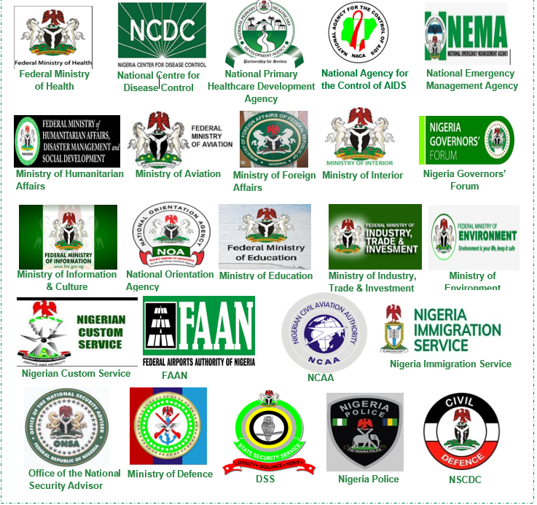
APPENDIX
Ministries, Departments and Agencies:
The multi-sectorial structure of the PTF allowed for the flexible participation of MDAs in the delivery of its mandate across all levels.
MDAs were responsible for various pillars and collaborated to ensure synergy and seamless implementation of policies and outlined activities.
The MDAs include but are not limited to the following:

Slide 158
APPENDIX
MDA Reports
Detailed information about the activities, achievements, challenges and score for MDAs are captured in the tables below.
DEPARTMENT OF STATE SERVICES
Brief Summary of MDA
The Department of State Services (DSS) is the foremost intelligence agency of the country and supported the PTF with the provision of timely situational awareness on key issues (daily reports on significant developments relating to COVID-19 across the country and other issues relating to containment efforts) concerning the pandemic in the country to enhance the Common Operational Picture (COP) with respect to the virus and aid decision making process. The DSS participated in various activities including resource mobilization, investigation of complacency by state response teams, protection of key sites/installations, enforcement of protocols, partnership with other agencies, contact tracing amongst others. To fulfil its duties, DSS issued daily and periodic assessment of the response strategy to the PTF and other relevant stakeholders.
MDA’s Approach to Response
DSS provided daily intelligence led reports relating to Covid-19 to the PTF. These reports covered areas including communication on new developments, approaches and assessments of issues across the Federation The Service supported the efforts of various states by ensuring the involvement of the Leadership of Service Commands in the coordination and management of response efforts The Service collaborated with State Surveillance teams to provide support with contact tracing of persons with COVID-19 and absconded patients from isolation/treatment The Service supported the coordinated National Response Strategy aimed at containing the spread of the virus by mobilizing service personnel and assets across the States and LGAs Provided service facility (Kapitul Klub apartments) in Abuja to serve as VIP Isolation Centre. This facility was also staffed with doctors and nurses Sensitized and created awareness campaigns for personnel at the National Headquarters, State Commands and other Service Formations Partnered with other agencies to support in flattening the COVID-19 curve through intelligence sharing, monitoring and protection of COVID-19 resources/assets, monitoring of international travelers/returnees and transport operators at the air and land borders Ensured compliance with enforcement protocols and measures declared by the PTF Monitored and provided intelligence led assessment of the enforcement protocols and advised
MDA’s Achievements:
Shared intelligence information with other response agencies to aid decision making Participated in COVID-19 response activities Sustained provision of situational awareness reports on the pandemic across the country Provided support; technical and manpower to aid contact tracing activities Conducted investigation on breaches reported at borders, facilities, installations etc. Managed perceptions of aggrieved health and union workers Managed recalcitrant groups insisting on violating protocols

Slide 159
APPENDIX
Provided physical security at isolation/treatment centres Supported in monitoring Points of Entry (POE)
Key Challenges Identified Since Inception
Challenges peculiar to the service Difficulty in enforcing lockdown measures in some areas due to religious, doctrinal and primitive inclinations Inaccurate information concerning the pandemic by subversive groups Lack of regulation within the social media space Difficulty in conducting contact tracing of suspected people High cost involved in tracking fake news peddlers Lack of jurisdiction to limit the discussions of social media influencers in the diaspora undermining government response effort Inadequate logistics and funding for activities
Lessons Learned
The impact of the pandemic on the economy has revealed the need for the development of contingency plans in the national economic plan Synergy among Government Agencies at all level is key to achieving a national response The advent of the novel coronavirus has shown the need to upgrade medical facilities across the country to mitigate the possible impact of future unexpected medical emergencies There is a need to put in place plans to ensure that Government agencies are prepared for possible future for emergencies Government agencies need to continue capacity building by maintaining regular training and simulations on crisis and disaster management
Recommendations for Improvement
The coordination of COVID-19 management and response efforts should rest with the NCDC under the supervision of the Federal Ministry of Health supported by other relevant agencies The NCDC should be continuously supported to ensure medical supplies, kits, equipment and other logistics are available The DSS medical facility should be equipped to perform sample collection and testing of the virus for the intelligence community and VIPs Efforts towards building testing capacity across the country should be intensified Synergy should be sustained between the State Governments and NCDC to ensure a unified response approach towards reducing the spread of the virus is maintained Evaluation of research for new therapeutics/vaccine for COVID-19 should be maintained Government should consider restocking the COVID-19 palliatives (medical items and food reserves) considering a possible second wave of the virus Optimise the DSS’s Geospatial intelligence capability to assist in the management of epidemics and pandemics in the country The Presidential Communication, Command and Control Centre (PC4) should be used for coordinating emergencies of this nature

Slide 160
APPENDIX
FEDERAL AIRPORTS AUTHORITY OF NIGERIA
Brief Summary of MDA
Federal Airports Authority of Nigeria (FAAN) is a service organization established by FAAN Act, Cap 5 Laws of the Federation of Nigeria, 2004. It is charged to manage all commercial airports in Nigeria and provide service to both passenger and cargo airlines. The Authority is responsible for creating conditions for the development of air transport and services connected with it, in the most economic and efficient manner In responding to the COVID-19, FAAN implemented projects and new initiatives to develop the airports, improve passenger experience and terminal operations. This was done in collaboration with the PTF in line with WHO, ACI, ICAO and IATA protocols and aviation best practices to facilitate seamless emergency and aids operations during the heat of the pandemic and thereafter.
MDA’s Approach to Response:
Developed a business continuity and operations sustainability program Adhered to protocols issued by WHO, ICAO, ACI, IATA and the PTF on Covid-19 to protect passengers and employees Enforced the use of face masks for passengers and employees in al public areas Limited the number of people in the terminals to only travelers flying and employees on duty Organized trainings for employees in line with WHO port health management protocols on COVID-19 and infectious diseases control Engaged the International Air Transport Association (IATA) to peer review the impact of COVID-19 on the capacity of the Lagos and Abuja terminals
MDA’s Achievements:
The achievements were Facilitated the successful evacuation of Nigerians from several countries abroad back to Nigeria Developed and implemented SOP for cleaning, disinfecting and decontaminating commonly used spaces, facilities aircraft and baggage in collaboration with PHS, NCAA, and Federal Ministry of Environment Participated in the WHO online courses on public health risk mitigation measures Procured temperature measuring equipment, baggage disinfectant equipment Ensured there were floor markings, seat stickers to ensure social distancing Installed glass shields at Check in counters for the protection of frontline workers at the airports Installed sensor taps and provided sanitizers, soaps and disinfectants Provided PPE such as facemask, shields, hand gloves and cover all for airport personnel Printed fliers, billboards, banners, and leveraged paid announcements on various media platforms to increase awareness and share information to the public on COVID-19 Constructed Danpalon canopy shed to accommodate extra passengers outside the terminal building to ensure social distancing
Key Challenges Identified Since Inception
The loss of funds due to the closure of commercial flight operations Lack of adequate health infrastructure, testing facilities and equipment at the airports Limitation of testing to only people exposed to COVID-19 patients and its high cost Spread of misinformation casing fear and panic in passengers Theft of soap and alcohol-based hand sanitizers stations at various points in the airport Lack of compliance with social distancing protocols by passengers

Slide 161
APPENDIX
False information provided by passengers about their address and telephone numbers to airport health desk officers Loss of jobs due to the pandemic as many airport concessionaries closed
Lessons Learned:
The following methods have been identified to mitigate and contain the spread of COVID-19 in the airports: Provision of adequate and timely information Maintaining and keeping to the rules and protocols Collaborating with other stakeholders with open mind Early response and intervention to adherence to physical distancing in airports to stem communicable diseases Fast-tracking the implementation of paperless process, thereby reducing overhead cost Meeting via Zoom and other virtual platforms, thereby reducing overhead costs
Recommendations for Improvement:
The need for Government intervention funds to airports to help facilitate rebound in order to continue its catalytic role in economic growth Commission a study to identify high-risk prone areas where infectious/communicable diseases can be easily found and spread in airports Identify mitigation measures to address those risks Provide practical guidance to help airports and aircraft operators use these measures to develop targeted strategies to respond to various types and level of disease threats Airport Master Plans should note the terminal capacity constraints due to physical distancing protocol imposed by infectious diseases that can break-out time after time. And in this regard, suggest flexible terminal spaces to contain more traffic density in such occasion/s. Ensure proper ventilation and cooling systems in high occupant density areas Ensure the availability, functionality and usage of hands-free tools at airports Ensure that high standards of cleaning the airport environments are in place and that concessionaires use high quality disinfectants in cleaning. Develop and implement a healthy work ethics. Ensure strict compliance to health advisory protocols Ensure highly visual signage near hand sanitizer points to encourage use Deploy ultraviolet disinfection technology in air conditioning systems and high-touch areas, such as escalator handrails, especially now there are possibilities of full opening of airport facilities Baggage carts should be sanitized before each use by fogging machines while check-in counters and baggage drops should be sanitized regularly. Regularly audit passenger’s compliance with physical distancing and facial mask requirements in the terminals and airport’s environment Provide prompt rapid testing facility capability at the airports

Slide 162
APPENDIX
FEDERAL MINISTRY OF EDUCATION
Brief Summary of MDA
Arising from the declaration by the World Health Organization of the COVID-19 Pandemic and the inauguration of the Presidential Task Force (PTF) for the control of the Pandemic in Nigeria, the Federal Ministry of Education in its response, directed the immediate closure of all schools, including Tertiary institutions. The closure was to ensure that our crowded schools were not turned to breeding grounds for the spread of the virus
MDA’s Approach to Response:
NCAA Established a Constitution of a Steering Task Team by the Honorable Minister of Education, comprising of representatives from all Federal Ministry of Education Parastatals; Development Partners and senior officers of the Ministry Developed an approach to coordinate the challenge with States Ministries of Education where information and experience sharing was provided virtually Deployed e-learning platforms for students to continue lessons mainly on www.education.gov.ng and other associated platforms Collaborated with Telecom service providers such as Airtel Nigeria and 9mobile in offering free bandwidth to access educational portals Collaborated with TV and Radio stations to provide teaching platforms in order to reach students in remote locations
MDA’s Achievements:
The achievements were Coordinated all stake holders including all States Ministry of Education and FCT Prompt closure of schools due to COVID-19 which prevented any casualty in our schools Sustained sensitization on the preventive Protocols to students while at home Consulted with critical stakeholders to establish the right course of action on matters that concerned the sector Rapid deployment of e-learning platforms for students to continue their lessons at home Developed guidelines for school reopening in line with NCDC guidelines and protocols Monitored and Implemented guidelines for schools reopening throughout the Federation
Key Challenges Identified Since Inception
High cost of funding of educational programmes via Radio and Television broadcast Inadequate IT infrastructure for accessing online educational resources; Non-availability of tablets to many students Poor network in remote communities to facilitate smooth e-learning; Difficulty in adhering to the physical distancing protocol due to overcrowded public schools Lack of content for e-learning hampered the mobile learning at home by pupils and students
Lessons Learned
e-learning is an efficient way for education across the globe Investment will need to be made in providing electronic platforms and improving ICT infrastructure The school structure will need to be reviewed to reflect the new challenges brought about by COVID-19 Reorientation of stakeholders in education is vital to facilitate adjustment to the current reality The education system needs to be prepared and innovation needs to be implemented

Slide 163
APPENDIX
Recommendations for Improvement:
Issue of health and education should be prioritized in the country as it is affecting a large number in the society E-learning platforms should be continued to serve as an alternative means of learning to complement the physical learning There should be massive deployment of broadband internet access and infrastructure to promote mobile learning even at the remotest area of the country There should be review of the policy in education to reflect the new norms Measures should be put in place to prevent and cope with future occurrences in the education system The synergy between the State Ministry of Educations (SMoEs), FCT Education Authority and Federal Ministry of Education (FME) should be sustained to improve mutual benefits by the pupils and students

Slide 164
APPENDIX
FEDERAL MINISTRY OF ENVIRONMENT
Brief Summary of MDA:
The Federal Ministry of Environment took steps in the containment of the COVID-19 pandemic. The Ministry activated the sanitation desks in all the 36 states of the federation and the FCT as well as the Environmental Health Surveillance System.
MDA Activities:
Conducted training for Federal Fire Service Personnel, Nigeria Police, Sanitation Desk Officers, Environmental Health Officers and volunteers on the appropriate use of PPE, response to the pandemic and burial of COVID-19 corpses Collaborated with relevant stakeholders to decontaminate/disinfect areas and equipment identified as high-risk exposures Conducted environmental surveillance of all 774 local governments areas in the nation Mobilised Environmental Health Officers in the states and local governments to participate in the nationwide response to the pandemic
MDA Achievements:
Decontaminated/disinfected over 200 public areas of high-risk exposure in the FCT, Kano, Kaduna, Lagos, Anambra and Edo states Provided capacity building programs for Environmental Health Officers and volunteers across the country on response to the pandemic Decontaminated/disinfected aircraft that flew in the Chinese medical professionals Mobilised Environmental Health Officers and Environmental Health Surveillance of all 774 local government areas
Key Challenges Identified
Inadequate funding for the Ministry’s Workplan Delay in the release of approved funds and in the payment of services Lack of defined role for the Ministry in the management of COVID-19 health care waste in the COVID-19 document
Next Steps:
Decontaminate/disinfect and disinfest schools Environmentally manage and monitor COVID-19 health care wastes from isolation and treatment centres Conduct Environmental Health Risk Assessment of isolation and treatment centres Improve the enforcement of relevant laws, guidelines and directives by Environmental Health Officers Provide intervention/support to states Continue to decontaminate/disinfect areas of high-risk exposures

Slide 165
APPENDIX
FEDERAL MINISTRY OF HEALTH
Brief Summary of MDA:
Prior to inauguration of the Presidential Task Force on COVID-19 on 17th March 2020, the Federal Ministry of Health (FMOH) and its Public Health Agency, Nigeria Centre for Disease Control (NCDC) had taken measures to align with the global response to the spread and scourge of the corona virus. Departments, Parastatals, Agencies as well as extra-Ministerial Departments under the Ministry embarked on risk assessment and situation analysis of the pattern of the disease spread. An Incident Action Plan was developed, and response pillars were identified to ensure coordination of activities. The pillars went into immediate action in accordance with their respective terms of reference: e.g. heightened screening at Points of Entry, continuous training at State level on IPC, etc.
MDA Activities:
Development of protocols and guidelines for case management and infection prevention and control Slow down and progressively interrupt the community transmission of COVID 19 in Nigeria through effective and efficient management of cases. The strategy involves early diagnosis and prompt treatment of cases in line with evidence based and updated treatment guidelines (as the cases are a reservoir of infection). Build the capacity of Health workers (Including frontline Health workers in the health system) to diagnose, treat and manage the complications of the COVID 19 cases in various Isolation/Treatment Centres through training and retraining in collaborations with partners such as UNICEF, WHO and CDC. Decrease the effect of COVID-19 pandemic on the health of families, communities and the nation by early transfer of confirmed cases through an efficient and effective evacuation plan of the National Ambulance Transport System for COVID-19 response (purposely set up as part of strengthening the Case Management Pillar). Strengthen the capability of the Nigerian health system using the Federal Tertiary Health Institutions to adapt to the fast-changing needs of the Nigerian population (as a result of the COVID-19 pandemic) while at the same time preparing the FTHIs to have the capacity and readiness to respond appropriately in the events of future outbreaks. Strengthened response base: Two well-attended inter-ministerial, multisectoral conferences were organized by the FMoH, to begin the process of aligning the various response organizations and MDA strategies. Subsequently facility assessment was carried out in FCT, Lagos and other states in March 2020, to establish Isolation and treatment centers. In furtherance of this, a stakeholders’ meeting on hospitals’ response chaired by Director, Department of Hospital Services, FMOH was held on 23rd March 2020, when all Federal Tertiary Hospitals in the country were mandated to create or provide Isolation wards and set up Task Teams to coordinate such activities. This led to the establishment of Isolation Centers at University of Abuja Teaching Hospital (UATH) and National Hospital Abuja (NHA).

Slide 166
APPENDIX
MDA Achievements:
Capacity building and accreditation for isolation/treatment centres: To ensure Ministerial approval, a national accreditation committee was established, Terms of Reference (TOR) of the Accreditation Team was developed. The Accreditation Team developed Protocols for accreditation and training of COVID-19 frontline health workers, based on which facility accreditation started with Isolation/Treatment centres in Lagos, Abuja and Edo states. and three levels were set up: Level One (1)– suspected cases on observation and contacts of confirmed positive cases; Level Two (2) – Management of confirmed but asymptomatic or mild cases; Level Three (3)-Management of severe cases and Level Four (4) critical cases in ICU Coordinating platforms: Concomitant Committees/teams of FMoH constituted by HMH to support mitigation processes: Ministerial Advisory Committee and Stakeholders’ Forum on Case Management Committee for the development of Health Sector Plan on COVID-19. Collaborations: A high level meeting was held by Federal Ministry of Health with Federal Ministry of Industry Trade & Investment in March 2020. Representatives of the Manufacturers Association of Nigeria, Consumer Protection Council & relevant Agencies were in attendance to deliberate on local sourcing of medical items & consumables in the COVID-19 containment process. The Hon. Minister continues to hold solidarity meetings and has received support from different Health Unions and Associations, while Federal Government has also supported States through scoping missions to identify gaps and areas of concerns and proffer solutions & technical assistance and supplies. In April, the PTF paid a solidarity visit to Lagos State and inspected some of the Isolation Facilities. The Ministerial Task Team deployment to Kano State was extended to Sokoto, Katsina, Jigawa, Gombe, Bornu states. Positive outcomes were recorded from the fact-finding visits with provision of technical support, capacity building & community confidence building. Joint Health Teams visited Kogi and Cross River States to assess, ascertain & support their covid19 preparedness where possible; with continuous dialogue and effort ongoing to forge common fronts on handling COVID-19 matters in these states.

Slide 167
APPENDIX
Key Challenges Identified
The Management of COVID-19 cases in private Health Care facilities against the guidelines and protocols on Assessment/ Accreditation. There is a shortage of human resources for health, especially those responsible for managing critical cases including Intensivists, Psychiatrists and Anaesthetists in the Federal Tertiary Health Institutions. Continuing health care worker infection and paucity of data and local research on IPC for decision making Shortage of personal protective equipment and contextual use of PPEs: A lot of myths and ideas about the appropriate PPE to use for COVID-19 prevention have being a controversy and a topic of discussion even among HCWs leading to increased HCWs infection. The common challenges facing Isolation/treatment centres are: Lack of Covid-19 testing capacity in the facility, lack of ancillary testing facilities to handle hazardous samples, limited ICU facilities such as ventilators, high flow nasal cannula, BiPAP systems, inadequate supply of oxygen and lack of body bags to safely dispose of corpses.
Next Steps:
To continue to provide guidelines, SOPs and protocols for clinicians managing COVID-19 cases. The key performance indicator is the proportion of treatment centres managing cases with guidelines, SOPs and approved protocols. To ensure the effective and efficient management of all cases by providing clinical support & advisory services to treatment centres and clinicians through monitoring of the proportion of clinical cases resolved per week by the clinical advisory team and proportion of recovered cases with co-morbidities. Continues collaboration with the Risk Communication Pillar to enlighten the public on IPC, rational use of PPE and other non-pharmaceutical measures such as wearing of face mask, hand hygiene and maintaining physical distancing. Federal Government is decentralizing & de-emphasizing engagement in the management of COVID-19 cases, so that States shoulder more responsibility, going forward, while focusing on community engagement as a necessary component, using NPHCDA structure to promote community ownership & scale up continuous education and awareness creation Identify IPC gaps in the testing laboratories and health facilities Deploy online IPC training programs for healthcare workers to improve IPC capacity and skills. Train healthcare and community workers on screening, Isolation and notification of suspected COVID-19 cases.

Slide 168
APPENDIX
FEDERAL MINISTRY OF HUMANITARIAN AFFAIRS, DISASTER MANAGEMENT AND SOCIAL DEVELOPMENT
Brief Summary of MDA
The ministry’s interventions focused on mapping and reaching the poor and vulnerable population; persons with disabilities, the elderly, orphans, internally displaces persons, victims of trafficking, refugees, low income earners, etc. during the pandemic To achieve this, the Ministry established an in-house Technical Working Group (TWG) to lead the operationalisation of the Ministry-led response on all matters relating to COVID-19 pandemic. This TWC comprised of all the Agencies and programs under the Ministry. The Ministry implemented various interventions through its agencies including: The North East Development Commission (NEDC), The National Commission for Refugee, Migrants and Internally Displaced Person (NCFRMI) and the National Agency for the Prohibition of Trafficking in Persons (NAPTIP) and through the modified National Social Investment Programs (NSIP) programs
MDA’s Approach to Response:
Modified existing social interventions to manage emergency crisis Leveraged technical expertise of agencies and parastatals under the Ministry within an in-house technical working group structure to reach vulnerable people Coordinated and supervised the humanitarian and social protection programs of its agencies Provided leadership to the Security Logistics and Mass Care Pillar through one of its agencies (National Emergency Management Agency- NEMA) to plan the handover of the grains to the State Government
MDA’s Achievements:
The achievements were Coordinated National Social Investment Programmes (National Home-Grown School Feeding Programme, Conditional Cash Transfer and Government Enterprise and Empowerment Programme) and achieved the following: Distributed 127,589 take home food rations to households Provided a 3-month advance cash transfer payment for 1,289,405 beneficiaries in 34 states and the FCT Sensitised over 5 million small scale traders captured on GEEP database regarding COVID-19 pandemic Communicated COVID-19 messages to 1.8 m beneficiaries with active loans Provided sensitisation messages to 2,678 beneficiary clusters Completed up to 99% disbursement target Constructed a 14-bed and 21-bed facility close to an IDP Camp in Maiduguri to serve as a COVID-19 isolation centre Conducted sensitisation for the populace using media jingles in major languages on both television and radio stations Conducted advocacy and sensitization campaigns in shelters across the country Organised webinars and seminars on sexual and gender-based violence Facilitated the evacuation of 60 vulnerable and stranded Nigerians in Lebanon Distributed food and non-food items (PPEs, economic empowerment materials) in 9 states Trained 30 women IDPs on the production of face mask at a skills acquisition workshop Coordinated stakeholders for an efficient National and Local level response to COVID-19 pandemic in security, logistics and mass care functional area Facilitated the movement of assorted grains from various silos to Lagos, Ogun, Kano, FCT and other states as palliatives

Slide 169
APPENDIX
Key Challenges Identified Since Inception
Provided logistics support in form of ambulances to personnel for COVID-19 response activities
Lessons Learned
Partnership with private sector agencies is essential in ensuring that expertise and resources are harnessed and leveraged to reach vulnerable persons There is a need to institutionalise ad-hoc and temporary programs into the MDAs for sustainability Continuous provision of protection, emergency relief and solutions to vulnerable communities is important during a pandemic to ensure sustained mitigation of the such pandemic Improved stakeholder engagement is important for efficient implementation of all interventions Increased use of technology and related tools as well as data driven solutions to address health and non-health hazards is important for obtaining accurate data Risk management strategies and sensitisation programs are important for successful response to COVID-19 and to disseminate fake news
Recommendations for Improvement
Media outlets should be held accountable for circulating information that is unverified and factually wrong Intensify data verification efforts to ensure beneficiaries of programs/interventions are properly identified and reached Enhance monitoring, evaluation and learning at the State level Engage stakeholders in program planning and implementation during pandemics Invest in sustainable projects and programs that provide durable solutions to systemic challenges affecting the Nigerian populace Leverage ICT based solutions to enable remote planning and execution to limit restrictions during the pandemic and to increase investment in digital surveillance of disease and emerging threats Eliminate bureaucracy that affect the timely release of COVID-19 intervention funds and enhance processes for disbursement to the public Strengthen coordination mechanisms to optimise private sector resources and effectively utilise resources of international and local humanitarian agencies

Slide 170
APPENDIX
MINISTRY OF AVIATION
Brief Summary of MDA
The goal of the Ministry of Aviation and the agencies was to prevent cross-border transmission of the COVID-19. The Ministry of Aviation provided guidance and directives to the aviation industry concerning flight restrictions and COVID-19 Health and Safety requirements, and granted several approvals for emergency, cargo and humanitarian flights. The Ministry engaged CEOs of various aviation agencies to ensure proper planning, installation of equipment and development of protocols for the restart of the aviation industry.
MDA’s Approach to Response:
Developed Public Health and safety protocols for the restart of the aviation industry Developed quarantine requirements for crew members and evacuees Collaborated with relevant stakeholders to develop guiding principles for the disinfection and decontamination of aircrafts and airports Validated and approved restart plans of various Industry stakeholders
MDA’s Achievements:
Ministry of Aviation Provided aircrafts for essential flights for PTF members and aviation parastatals and for the transportation of COVID-19 support materials Provided policy and guidance to support aviation parastatals in handling the COVID -19 pandemic issues Nigerian Civil Aviation Authority Issued 40 All Operator Letters (AOL) to provide guidance and directives to the Aviation Industry with regards to flight restrictions and COVID-19 Health and safety requirements Developed and issued several guidance materials for the disinfection and decontamination of airport facilities and aircraft Evaluated, validated and approved restart plans of various industry stakeholders Federal Airports Authority of Nigeria (FAAN) Facilitated the successful evacuation of Nigerians from several countries abroad back to Nigeria Developed and implemented SOP for cleaning, disinfecting and decontaminating commonly used spaces, facilities aircraft and baggage in collaboration with PHS, NCAA, and Federal Ministry of Environment Participated in the WHO online courses on public health risk mitigation measures Nigerian Airspace Management Agency Provided Air Traffic Management services at the nation’s federal, state and private airports Published and issued 11 Notices to Airmen (NOTAM) and Aeronautical information Circulars (AICs) for effective information and guidance of airmen during COVID-19 pandemic Developed a national contingency plan for air traffic management in compliance with PTF COVID-19 protocols and NCAA regulations Published 6 new regional routes in collaboration with IATA and ICAO to ensure cost effective and environmentally friendly flight operations under COVID-19 conditions Nigerian Meteorological Agency Provided temperature, rainfall and barometric weather information during essential flight operations during the lockdown

Slide 171
APPENDIX
Key Challenges Identified Since Inception
Inadequate number of PPE and hand hygiene materials for the protection of staff offering skeletal services during the lockdown Difficulty in meeting various obligations due to scarcity of funds Increased need for funds and technical expertise resulting from the redesign of airport infrastructure

Slide 172
APPENDIX
MINISTRY OF FOREIGN AFFAIRS
Brief Summary of MDA
The Ministry of Foreign Affairs supported the PTF in evacuating Nigerians stranded abroad amidst the COVID-19 pandemic. Presently, the Ministry of Foreign Affairs has successfully evacuated more than 3,218 Nigerians abroad.
MDA’s Approach to Response:
Supported in evacuating stranded Nigerians abroad during the COVID-19 Provided initial accommodation for returnees for the 14-day quarantine period
MDA’s Achievements:
The achievements are: Evacuated over four thousand Nigerians across the globe Evacuated fifty Nigerian ladies that were trafficked in Lebanon
Key Challenges Identified Since Inception
Inadequate funds for some Missions to arrange relevant logistics for the evacuation Lack of guidelines in the existing Evacuation Protocol for the repatriation of released prisoners from abroad Inability of Nigerian student abroad to pay the one-way ticket for the evacuation flights Lack of provision of evacuation flights to airlift diaspora Nigerians currently trapped in Nigeria Limited number of testing kits allocated to returnees resulting in prolonged testing exercise period

Slide 173
APPENDIX
MINISTRY OF INTERIOR
Brief Summary of MDA
The Ministry of Interior was responsible for formulating and implementing policies and programmes that enhanced internal security, public safety, created enabling environment for foreign investors and maintained citizenship integrity The Ministry of Interior contributed to the Federal Government response in confronting COVID-19 to keep Nigerians safe and assist in slowing the spread of the virus by joining other security agencies in enforcing the various guidelines and regulations including the lockdown of public places and restriction on interstate movements
MDA’s Approach to Response:
Nigeria Immigration Service (NIS) Total lockdown phase Suspended the issuance of entry visas in all Nigerian Missions abroad Closed the application portal for temporary work permit visa and visa on arrival application channel Supported in enforcing border closures, surveillance and ensure COVID-19 is not imported through the borders Suspended passport issuance both in Nigeria and Nigerian Missions abroad Provided water, soap dispenser and wash hand basin at strategic locations Easing of lockdown phase Phased resumption of passport issuance Granted waiver to allow resident migrants entry into Nigeria upon lifting of travel restrictions Conducted safety and seamless passenger clearance procedures workshop Nigerian Correctional Service (NCoS) Total lockdown phase Collaborated with relevant stakeholders for advises, screening and logistical support Developed preparedness and response strategies against the pandemic Fumigated custodial facilities Ease of lockdown phase Established isolation unit within designated Custodial Centres nationwide Conducted COVID-19 screening for newly admitted inmates and staff Nigerian Security & Civil Defence Corps (NSCDC) Conducted awareness and sensitization activities nationwide Supported in enforcing the lockdown order Conducted regular patrol to prevent large gatherings of people Provided protective security to medical personnel and relief material Provided security at the sample collection, testing and isolation centres

Slide 174
APPENDIX
Federal Fire Service (FFS) Collaborated with the Ministry of Environment to carry out disinfection and decontamination of government offices and environment
MDA’s Achievements:
Nigerian Correctional Service (NCoS) No reported case of COVID-19 among staff and inmates in Nigerian Custodial Centres Kept the Nigerian Custodial Centres safe, calm, and stable with no substantial complaints Dropped in the population of Custodial Centres Improved sanitary and hygienic condition of Nigeria Custodial Centres Nigeria Immigration Service (NIS) Enforced closures of borders and international travel restrictions No recorded cases of COVID-19 infection of NIS frontline officers and men at border posts Facilitated the evacuation operations through clearance of Nigerian and Non-Nigerian evacuees Intercepted stranded Nigerians and migrants in neighbouring countries attempting to enter Nigeria Nigerian Security & Civil Defence Corps (NSCDC) Supported the ease of movement of task force to accomplish their task Supported knowledge sharing between relevant teams Coordinated response to the COVID-19 pandemic Provided integrations to enhance management of future crisis Federal Fire Service (FFS) Supported in disinfecting communities and environs Coordinated response to the COVID-19 pandemic Released fire trucks for the use of disinfection purpose
Key Challenges Identified Since Inception
Nigerian Correctional Service (NCoS) Inadequate provision of intervention fund Insufficient number of PPE Varying prices and scarcity of testing equipment High cost involved in the provision and maintenance of isolation facilities Failure of the State governments in meeting obligations to effectively admit persons into the custodial centres Nigeria Immigration Service (NIS) High number of requests for permission to enter Nigeria during the lockdown Willingness of the border officials at the Benin Republic to allow landing and passage of Nigerians and Non-Nigerians through their land borders while our borders remain closed Difficulty in balancing the need for the entry of stranded Nigerian citizens across the world and enforcing the border closure

Slide 175
APPENDIX
Nigerian Security & Civil Defence Corps (NSCDC) Inadequate number of testing kits to conduct COVID-19 testing Inadequate number of PPE for responders Poor compliance of citizens to the COVID-19 precautionary measures Resurgence of criminalities across the country Federal Fire Service (FFS) Inadequate funding Insufficient personnel to perform required activities

Slide 176
APPENDIX
NIGERIAN CIVIL AVAITION AUTHORITY
Brief Summary of MDA
The Nigerian Civil Aviation Authority (NCAA) is the regulatory agency for Civil aviation in Nigeria. In responding to the COVID-19 pandemic, the NCAA issued several Advisory circulars, guidance materials, protocols and All Operators Letters (AOLs) to guide operators and stakeholders in the aviation industry and collaborated with public health authorities for the implementation of exit and entry public health screening at the Points of Entry. As the lockdown eased and economic activities began reopening, the NCAA collaborated with the Public Health Authorities, airlines, Federal Airports Authority of Nigeria (FAAN), Nigerian Airspace Management Agency (NAMA), Ground Handling companies, Nigerian Meteorological Agency (NIMET), and other stakeholders in the Aviation Industry to re-start aviation activities. To achieve this, NCAA relied on materials and advice from the International Civil Aviation Organization (ICAO), Airport Council International (ACI), International Air Transport Association (IATA), World Health Organization (WHO), and other ICAO contracting states in its response to the COVID-19 pandemic.
MDA’s Approach to Response:
NCAA communicated with public health authorities, airport operators, airlines and other stakeholders through various channels (guidelines, meetings website) NCAA collaborated with stakeholders in the aviation industry in decision making NCAA coordinated activities of the entire aviation industry under the supervision of the Ministry of Aviation NCAA collaborated with stakeholders in the aviation industry in the implementation of the COVID-19 protocols The Agency supported the public health authorities to enforce compliance to COVID-19 protocols and quarantine protocols of the authority and Federal Government of Nigeria The Agency adhered to guidance materials and practices on COVID-19 from relevant authorities in its response to the pandemic NCAA conducted training for industry personnel in Infection, Prevention and Control
MDA’s Achievements:
The achievements were Issued 40 All Operator Letters (AOL) to provide guidance and directives to the Aviation Industry with regards to flight restrictions and COVID-19 Health and safety requirements Developed and issued several guidance materials for the disinfection and decontamination of airport facilities and aircraft Evaluated, validated and approved restart plans of various industry stakeholders Issued several flight restrictions for international flight operations to reduce the importation of COVID-19 and spread in the country Developed and issued National Interim guidance on aircraft/aviation facilities cleaning in relation to COVID-19 Issued guidelines and advisory circulars to guide the resumption of aviation, air navigation and aerodrome operations Issued guidelines and public health protocols for the management of crew members for both regional and international flights in relation to COVID-19 pandemic Developed guidelines for the effective security and facilitation at the facilities of aviation service providers Communicated relevant information on COVID-19 with stakeholders in Nigeria, other ICAO contracting states, African Civil Aviation Commission (AFCAC), Banjul Accord Groups Safety Oversight Organization (BAGASOO) and Economic of West African States (ECOWAS)

Slide 177
APPENDIX
Inadequate number of PPE and hand hygiene materials for the protection of frontline personnel Difficulty in meeting various obligations due to scarcity of funds
Lessons Learned:
The multi-sectoral and multi-disciplinary approach proved efficient for the response to COVID-19 pandemic. The structure of the Presidential Task Force on COVID-19 was utilised to achieve this Sharing relevant information amongst stakeholders was key in the response to the pandemic Data gathering and analysis is important for the successful response to the pandemic
Recommendations for Improvement:
Partnership with Regional, Continental, and International agencies/bodies such as ICAO, ACI, WHO, IATA, AU, AFCAC and ECOWAS should continue for the development and growth of the Aviation Industry in Nigeria Post COVID-19. Enhance surveillance to ensure strict compliance by operators to the Public Health and safety protocols on COVID-19 The Public Health Emergency Management Teams (PHEMT) of the different Points of Entry (POE) should remain activated for the sustained implementation of COVID-19 Public Health protocols The ICAO Collaborative Arrangement for the Prevention and Management of Public Health Events in Civil Aviation (CAPSCA) framework should remain a useful resource for the collaborative engagement of relevant stakeholders in the Aviation sector to respond to COVID-19 and other emerging communicable diseases

Slide 178
APPENDIX
NIGERIA CENTRE FOR DISEASE CONTROL
Brief Summary of MDA
The Nigeria Centre for Disease Control is the country’s national public health institute with the mandate to lead the preparedness, detection and response to infectious disease outbreaks and public emergencies The NCDC ‘s main objective was to protect the health of Nigerians through evidence-based prevention, integrated disease surveillance and response activities, using a one health approach, guided by research and led by a skilled workforce. The NCDC leads the Infection Prevention and Control, Surveillance and Laboratory Pillars set up by the PTF
MDA’s Approach to Response:
Early detection and confirmation of cases. This included screening at Points of Entry (POE) prior to the confirmation of the first case and afterwards, building laboratory capacity in all states starting from states with POE (airports) and training and re-training of human resources. Develop and maintain capacity to effectively manage cases. This involved equipping treatment centres in priority states and developing sufficient and trained human resource with sufficient medical countermeasures. Coordination and communication with Nigerians. This included the establishment of a national multisectoral Emergency Operations Centre (EOC) in NCDC within hours of confirmation of the first case, transition to 24-hours connect center for the public, dissemination of guidelines standard operating procedures (SOP), and regular communication with the public. Prior to the COVID-19 pandemic, NCDC had supported states in establishing 22 Public Health Emergency Operation Centers (PHEOCs) and had deployed Surveillance Outbreak Response Management Analysis System (SORMAS) tool to 18 states.
MDA’s Achievements:
Infection Prevention and Control Pillar Education and Training: Capacity building: Cumulatively, about 34,500 persons trained on IPC (virtual and onsite), 6353 enrolled in NCDC online IPC course with 4191 (66%) completed IPC Program and Multimodal Strategy: Hand hygiene improvement program in place and being implemented across Thirty-three health facilities in The Orange Network- The Orange Network (TON)- 33 health facilities in a network being engaged with a view of becoming a model for multimodal strategy on IPC program implementation (support by ICAN, UNILAG CMUL, CDC) IPC Guidelines: Reviewed, developed and disseminated guidelines and safety protocols on IPC for COVID-19 diagnosis and management at health facilities Surveillance Pillar Implemented active case finding and contact tracing including HR support for response surge teams for case finding (180 across 6 states) Supported scale up of SORMAS to 4 new states with all states and the FCT having the SORMAS tool Supported set up 30 community sample collection sites and mobile sites in Kano, Lagos & FCT Developed guidelines and SOPs which include contact tracing guidelines, COVID-19 surveillance guidelines, case definitions (standard and community case definitions), strategy document to improve surveillance and case finding Conducted active case finding through house-to-house case search and engagement of HCWs underway in 20 hotspot LGAs Laboratory Pillar Activated COVID-19 testing in all states and the FCT in public and private laboratories Provided training and technical support to 36 states + FCT on specimen collection, packaging and transportation Improved sample turnaround time within the COVID-19 laboratory network -Developed a standardized national laboratory database and deployed to all testing facilities

Slide 179
APPENDIX
Logistics and supplies Distributed COVID-19 IPC materials and identified critical response materials in all testing laboratories and treatment centers Expanded warehouse capacity at the national level by hiring private warehouses and support from FMOH premier warehouse. Hired of surge staff to support warehouse operation to boost human resource capacity Received, verified and stored of donated and procured COVID-19 items Coordination Deployment of 301 rapid responders within 43 teams to the states. Deployment of Technical assistants to states to support implementation of the NCDC/REDISSE World Bank fund of N100million to each of 35 states Point of Entry Enhance Entry and Exit screening to mitigate the spread of COVID-19 Developed Nigeria International travelers’ portal for travelers to fill the health declaration form. Ensure that every inbound passenger visits the NITP to fill the self-health reporting form online, uploads a PCR negative result and pay for a post arrival test to be conducted after a 7days self-quarantine, data is warehoused on the Saferports portal -Saferports is linked to the NITP from where SORMAS extracts data -Digitised collected data and transmitted to key stakeholders in the NHSS (NCDC, SMOH, etc.) -Designated Data Management Teams at NAIA and MMIA to oversee above process.
Key Challenges Identified Since Inception
1. Inadequate human resources for a prolonged outbreak slowing down progress in other health security related activities 2. Inadequate sustainable capacity for health security at sub-national levels 3. Delays in deploying surveillance tools for effective data management 4. Increase in spread of misinformation among the public 5. Some of NCDC’s traditional technical partners in outbreak response devoted more of their time to response activities at the PTF, than to supporting operational activities involving the public health response. 6. Partner’s donation fatigue towards COVID-19 response 7. Difficulty getting funding support for research and COVID-19 research agenda 8. Inadequate case management data for decision making

Slide 180
APPENDIX
NIGERIA CUSTOMS SERVICE (NCS)
Brief Summary of MDA
The Nigeria Customs Service supported the PTF by ensuring only approved medicines and equipment as defined by World Customs Organization and World Health Organization were imported, expediting clearance of approved medicines and equipment, ensuring zero duty on items and ensuring counterfeits were identified promptly.
MDA’s Approach to Response:
In line with the Federal Government Fiscal Policy aimed at facilitating the importation of essential medical supplies to combat COVID-19 pandemic in Nigeria the NCS exempted health and safety items from import duty payment and Value Added Tax for a six-month period. The Service ensured prompt clearance of health and medical supplies related to COVID-19 response in line with standard operating procedures as recommended by WHO and World Customs Organisation for clearing humanitarian and relief materials The Service conducted nationwide sensitisation campaigns and awareness on COVID-19 The Service purchased and distributed Personal Protective Equipment (PPE) to officers and men in service
MDA’s Achievements:
The achievements were Facilitated expedited clearance of health and medical supplies; medicines and equipment related to COVID-19 response and implemented zero duty policy on those items Collaborated with the Federal Ministry of Finance to obtain a Presidential waiver for the clearance of COVID-19 related imports Examined all equipment with NAFDAC to ensure conformity with WCO/WHO checklist Identified and seized 3,900 expired PPE disposable clothing, 41,980 masks and hand gloves Seized about 3 million tablets of tramadol 225 mg and over 40 million tablets of counterfeit diclofenac potassium, dexamethasone and codeine syrup alongside NAFDAC
Key Challenges Identified Since Inception
Delay in obtaining waiver on ECOWAS Tax Liberalisation Scheme (ETLS) and Comprehensive Import Supervision Scheme (CISS) for import duties
Lessons Learned
The impact of the pandemic on the economy has revealed the need for contingency plans The health infrastructure in the country is inadequate Synergy and preparedness among Government agencies are key for effectively managing emergency response
Recommendations for Improvement
NCDC under the supervision of the Federal Ministry of Health and supported by other agencies should coordinate of COVID-19 management and response efforts The NCDC should be supported to ensure medical supplies, kits, equipment and other logistics are available Government will need to intensify COVID-19 testing across the country Risk communication, mobilization and engagement of traditional rulers, religious leaders and youth groups across the country should be maintained

Slide 181
APPENDIX
NIGERIA IMMIGRATION SERVICE (NIS)
Brief Summary of MDA
The Nigeria Immigration Service (NIS) supported the Point of Entry pillar and Security, Logistics and Mass Care pillar. The NIS contributed to the activities in curtailing the spread of COVID-19. The NIS was involved in the evacuation of flights from Nigeria to different countries, management of Nigerian returnees through the duration of international travel ban and also ensuring passports of returnees were withheld until they were certified to have completed mandatory quarantine and presented with discharge certificates by the Port Health Service and NCDC
MDA’s Approach to Response:
The Service embarked on collaborative synergy with stakeholders and partners in migration management to evolve strategies aimed at containing the spread of COVID-19. Some of these measures include: Capacity building and training of staff on the prevention, detection and preliminary response to COVID-19. Sensitization and awareness creation targeted at passengers and applicants for facilities issued by the Service in different formations and locations. Partnership with relevant PoE Agencies in the development of protocols and guidelines for quarantine of crew members and passengers arriving into the Country.
MDA’s Achievements:
The achievements were Created an online platform for Visa on Arrival, Temporary Work Permit applications as well enforced the use of the online platform for passport applications Installed glass barriers at 5 International Airports (MMIA, NAIA, MAKIA, PHIA and AIIA) for the protection of officers, men of service and passengers from COVID-19 Procured and distributed Personal Protective Equipment, disposable gowns, hand sanitizers, etc. Conducted risk management trainings and organised online meetings for officers Provided contact tracing support to the National Incidence Manager’s Office by providing details of travelers (entered of returned to the country) Collaborated with Point of Entry pillar members to ensure effective implementation of protocols during the institutional quarantine period
Key Challenges Identified Since Inception
Inadequate funding from the PTF for activities regarding COVID-19 response Lack of operational vehicles which limited the movement of officers posted for emergency response activities Inadequate PPE and protective glass barriers at airports
Lessons Learned
The expansion of online processes to grant facilities improved the delivery of the mandate of NIS Adopting virtual platforms for communicating with command and field operatives and key stakeholders reduced administrative and operational cost In the event of a major outbreak outside Nigeria, surveillance at Points of Entry to detect and prevent suspected cases should be implemented Provision should be made for funding to ensure successful management of health challenges

Slide 182
APPENDIX
Recommendations for Improvement
The PTF should make additional funds to enable NIS carry out its activities Utility vehicles should be provided to ensure prompt deployment of officers Funds should be provided for the installation of barriers and purchase of PPEs to ensure protection and safety of officers and port users

Slide 183
APPENDIX
MINISTRY OF INFORMATION AND CULTURE
Brief Summary of MDA
Since the outbreak of the COVID-19 pandemic in Nigeria, the Federal Ministry of Information and Culture has been driving the public sensitization on multi-media platforms through its media agencies namely: the Nigerian Television Authority, Federal Radio Corporation of Nigeria, News Agency of Nigeria and the Voice of Nigeria. It also works with the National Orientation Agency, one of its parastatals, for community mobilization against COVID-19, principally to promote behavior change among the people.
MDA’s Approach to Response:
The Federal Ministry of Information and Culture adopted public sensitization through the media and engagement with critical stakeholders in the media as well as community influencers for public sensitization and community mobilization against COVID-19. It ensures that there is adequate visibility for all the activities of the PTF through the traditional and social media. The National Orientation Agency also leveraged its structures in the 774 local government areas across the country to counter rumors and fake news in the national response against the COVID-19 pandemic.
MDA’s Achievements:
Mobilization of public and private information dissemination organs to drive public sensitization on COVID-19 safety protocol. Sustained production and broadcast of safety messages on COVID-19 by virtually all the broadcast channels in the country. Development of messages by creative influencers in Nollywood, Kannywood and the music industry. Sustained coverage of the PTF activities including live coverage of daily press briefings. Production of Information, Education and Communication materials with the traditional rulers, who leveraged on their influence to convey safety messages on COVID-19 to the general public. Safety Content Development: Production of 60 jingles in thematic areas such as General information of COVID-19, Use of Face Masks, Burial protocol, Testimonials by COVID-19 survivors as part of efforts to check stigmatization and Mass gathering. All the jingles in English have been translated and produced in Pidgin; Igbo, Hausa, Yoruba. The Ministry secured airtime in 10 television channels and 50 radio stations across the country for the dedicated broadcast of COVID-19 safety protocols in different languages Floating live discussion program: NTA, VON, FRCN created and dedicated air time live discussion program with health experts, religious and traditional rulers, community leaders, etc to engage the public in conversation on COVID-19. The Ministry also secured air time for live discussion program on Human Rights Radio, Abuja, Kano Radio, Correct FM Enugu and Wazobia Lagos for the live discussion shows on COVID 19 Engagement with Google and Facebook to check fake news and disinformation: The engagement with the technical companies ensured that fake news and misinformation on COVID-19 are promptly flagged and taken down the platforms.
Key Challenges Identified Since Inception
Non provision of special intervention funds by the PTF for the public information organs (NTA, FRCN, NAN, VON, NOA) hampered their ability to adequately mobilize the community against COVID-19 The regular changes on the case definition of COVID-19 because of its novelty made crafting of message to counter the virus a huge challenge. Despite the sustained public sensitization and community engagement as indicated in the result of the opinion polls, which showed that 99% of respondents are aware of COVID-19, compliance with safety protocol is very minimal. This is propelled by the conspiracy theory in some circles that COVID-19 is fake. The majority of the State Governments did not key into the PTF guidelines early, thereby fuelling the spread of the disease across the community due to lack of awareness. None enforcement of the observance of safety protocol such as use of face mask, avoidance of mass gathering, physical distancing, etc. Funding of community mobilization activities at the state level came very late from the Federal Government and the World Bank. ID-19

Slide 184
APPENDIX
Lessons Learned
Non-classification of hotspot local government areas early enough for precision lockdown gave rise to the spread of the disease across the community. The use of face mask was not identified early enough as a safety measures to be incorporated in the messages of communication. Engagement, especially with religious leaders and traditional rulers in the states, came late in the national response. Working early with critical community influencers such as traditional rulers, religious leaders, etc, could have addressed the challenge of disinformation on the reality of COVID-19.
Recommendations for Improvement
Sustained engagement with COVID-19 survivors, dependents of deceased COVID-19 victims and care givers will go a long way in addressing the deniability of COVID-19.

Slide 185
APPENDIX
NATIONAL ORIENTATION AGENCY
Brief Summary of MDA
The National Orientation Agency was established to raise awareness, provide timely and credible feedback, positively change attitudes, values and behaviours, inform and mobilise citizens to act in ways that promote peace, harmony and national development As part of the sensitisation efforts and processes, the Agency collaborated with policy and legal advocacy centre PLAC to sensitise Nigerians on the dangers of COVID-9 including the need to stay at home and stay safe to avoid community transmission and the various safety protocols as outlined by relevant authorities
MDA’s Approach to Response:
Conducted sensitisation campaign on COVID-19 for 19 states. NOA adopted the following strategy: Organised motorised campaigns Conducted street to street messaging/ sensitisation Organised advocacy visits to traditional heads Visited markets to conduct sensitisation Leveraged social media through its social media handles to create awareness on dangers pf COVID-19
MDA’s Achievements:
The achievements were Conducted in house awareness for NOA staff at the onset of the pandemic Engaged stakeholders in conversation on COVID-19 Organized street by street sensitization in the initial 19 states with COVID-19 recorded cases and later, the 20 most hit Local Government Areas Engaged religious and traditional leaders across the country Produced 30 TV and radio sensitization jingles and translation in key languages Produced 100,000 fliers and posters
Key Challenges Identified Since Inception
Lack of compliance of the citizens on the use of face masks, personal hygiene and social distancing Lack of belief in the existence of COVID-19 amongst community members Difficulty for some illiterate persons in understanding the information on COVID-19 distributed via bulk messaging Increased citizens fear about the insecurity and criminal activities in the communities without regards to COVID-19
Lessons Learned
The media demonstrated a high level of patriotism in the fight against COVID-19 through programming and various social responsibility messages
Recommendations for Improvement
There is a need for the media to intensify their activities by providing NOA free airtime to deepen and facilitate COVID-19 sensitization Sensitization and awareness creation should be the goal of government effort at the community level Collaboration between the PTF and the state task forces should be strengthened

Slide 186
APPENDIX
NATIONAL PRIMARY HEALTH CARE DEVELOPMENT AGENCY
Brief Summary of MDA
The National Primary Health Care Development Agency (NPHCDA) by mandate is responsible for the proving guidance and technical support for the operationalization of Primary Health Care across the country. The NPHCDA was established to implement strategic activities aimed at contributing to the reduction of the pandemic as well as building a pool of frontline health workers required to respond to the health system challenges imposed by this novel virus. Following the declaration of emergency for COVID-19 and the need to respond to safeguard the lives of Nigeria and ensure optimal service delivery across the over 36 thousand PHC facilities in the country, the NPHCDA through the command centre and oversight by Crisis Management Committee initiated a structured response to emergency pandemic created by the new strain of Novel Coronavirus
MDA’s Approach to Response
Supported risk communication and all aspects of the communication on COVID-19 Organised training for staff on response to COVID-19. A total of thirteen (13) Modules taught – Seven (7) for PHC Workers and Six (6) for the Community Volunteers spread across the 3- day training Conducted a post COVID-19 training monitoring and supervision to facilities across the 36 states and FCT, to assess the training quality and immediate effect of the training
MDA’s Achievements:
The achievements were Developed, printed and distributed COVID-19 preparedness and response guidelines Developed primary health care workers and community health workers manuals on COVID-19 Procured and distributed PPEs for training and service delivery Trained Primary Health care workers and community resource groups on COVID-19 across the 36 states and the FCT Coordinated the response of ensuring PHC services were sustained during the lockdown Supported the development and assessment of Knowledge Attitude Practices (KAP) studies in Kano state Trained over 70 CGPP focal staff in all supported states Organized regular and emergency meetings to provide technical support to the Government Participated in crisis management meetings Utilized the toll-free lines during the peak of the pandemic to provide support and guidance to staff and other community members Engaged traditional ad religious leaders on adherence to government guidelines on COVID-19 Deployed doctors, drivers and project vehicles to support the NCDC
Key Challenges Identified Since Inception
Difficulty in getting the required attendance resulting in several mock meetings Difficulty of participants in adjusting the virtual training methodology resulting in difficulty of with on-line registration of participants. Network challenges causing disruption of the training session for participants in affected areas. This also prevented some participants from watching the video clips. Lack of devices for participants which resulted in the sharing of devices Late arrival of training manuals in some states and supply of inadequate manuals to other states resulting in participants attending training without their manuals. Long training time causing devices to run out of power and interrupt training sessions.

Slide 187
APPENDIX
Non-inclusion of break periods for refreshment, prayers and biological needs causing exhaustion of participants Security challenges in some states like Borno resulting in delays in starting on the agreed date and some LGAs not being able to join the training. Non-production and supply of module 7, pre-test, post-test and attendance and evaluation sheets by the Agency to the states Difficulty in transporting training materials from State to LGAs and training sites because of lack of logistic funds. Lack of projectors and in-focus machines for showing the video clips to participants Inability of some participants to fill in the Health Facility profiling due to the lack of smart phones Poor feeding arrangements in some states. These meals were poorly prepared and often rejected Inadequate transport allowances for health workers and LGA facilitators leading to squabbles between State Coordinators and LGA teams. Lack of flipchart stands, cardboard papers and bold pens for facilitating the training Inadequate budgeting for several line items including transport resulting from the top-to-bottom budgeting for the training Delays with retirements resulting from banking difficulty in effecting bulk payments Inadequate training duration leading to difficulty in sharing all necessary information. No formal arrangements for volunteers to cascade the training to more community members Delay in commencement of training in some places due to heavy rains
Lessons Learned:
Overall Possibility to conduct an online training of certain cadres of health workers was demonstrated Capacity building of critical personnel is possible even during COVID-19 pandemic Distance is not a barrier to effective communication Online training methodology provides the opportunity to train large numbers of participants within a short time frame Less Resources are required to conduct an online training in terms of financial and Human resources Unprecedented technical support from development partners helped to boost availability of facilitators Leadership & Coordination Planning and coordination of the training should be limited to a single coordinating platform with clear accountability measures Development of a clear costed training plan and intimation of state coordinators on the training plan prior to disbursement of funds is required to guarantee seamless implementation and uniformity across States Communication with State Executive Secretaries and zonal directors on the Disbursement of funds to state coordinators prior to the funds being disbursed will help to check mate utilization General Administration Selection of Monitoring & Accountability (M&A) officers should objectively target versatile M&As that are fully available and grounded in basic computer skills, otherwise a separate training of M&A officers should be conducted before the actual training

Slide 188
APPENDIX
Facilitation Development of planning tool kit that includes all relevant pre training templates and tools will enhance efficiency of the planning process Selection of facilitators should be timely and should purposefully include only facilitators that would be fully available, officers involved in coordination of the training should be excluded from facilitating Facilitation tool kit should be finalized prior to commencement of training and should include a list of deliverables for the facilitators In depth orientation of Lead facilitators on the facilitation kit should be conducted with mandatory participation Clustered orientation of other facilitators by the lead facilitators will help to guarantee better participation, understanding, and accountability Monitoring & Evaluation Dedicated data team across all levels improved data quality and ensured timely reporting.
Recommendations for Improvement:
There is a need to conduct training outcome/impact evaluation to determine the on-the-job use of skills learned from training To ensure immediate practice/implementation of skills learned during the training, PPEs should be distributed to health workers immediately after the training. Monitoring of Compliance to Guidelines and PHC service provision should be conducted Provide essential commodities required to conduct routine PHC services such as immunization and RMNAC+ in their Health Facilities for health workers to be able to implement lessons learned during training There is a need to provide fund for stationary and other logistics support like offloading of materials (training manuals, PPEs) as the state felt it was the responsibility of the state coordinators. The innovative approach to training employed by the NPHCDA through a real time, internet based, virtual e-learning platform at the national and state level was very efficient and should be employed in other programs Involve the Zonal and State officers in planning and budgeting for future trainings Budget should be comprehensive and adequate and include all necessary line items including DTA, transport of materials and supplies from State to LGAs/Health facilities, distance to various locations and transportation cost Supplies of all materials must be completed early and ahead of all trainings to avoid unnecessary delays Agency should consider supply of projectors to all LGAs and advocate to State PHCDAs to support provision of android phones to all their PHCs for easier data sharing. NPHCDA and SPHCDAs should continue to support PHC workers with PPEs to protect them from COVID-19 while carrying out their duties The Agency should pay advocacy to state governments and partners ahead of future trainings to solicit their buy-in-and support The Agency should also consider granting permission to State Officers to open current accounts for ease of banking transactions when the need arises

Slide 189
APPENDIX
The Agency should pay advocacy to state governments and partners ahead of future trainings to solicit their buy-in-and support The Agency should also consider granting permission to State Officers to open current accounts for ease of banking transactions when the need arises

Slide 190




































APPENDIX
Partner/Donor Support
To achieve its objectives, the PTF partnered with key players in the private sector and leveraged Nigeria’s relationship with several International Development Organizations. The Partners and Donors spanned across different agencies, countries and sectors. These donors provided financial, technical and intellectual support to the PTF. Support was provided in line with stipulated guidelines as well as with the collaboration of MDAs across various levels.
Partners/Donors include but were not limited to the following:
Jack Ma

Slide 191
APPENDIX
The table below summarises Donor/Partner contributions and Coverage:
S/N | Name | Area of Support/Initiative | Implementing Partner(s)/ Collaborating partner | States Supported | Fund Released
1 | United Nations High Commission for Refugees | Point of Entry | Save the Children Family Health International (FHI360) Nigeria Red Cross Society Grassroots Initiative for Strengthening Community Resilience (GISCOR) Caritas Foundation for Justice, Development and Peace Jesuit Refugee Services | Cross River Benue Taraba Borno | N151,259,000 ($1 = N361: CBN Rate @ 30-June-2020)
2 | United Nations | The One UN Nigeria – UN COVID-19 Basket Fund Resource Mobilisation | The Nigeria UN The United Nations Country Team (UNCT) | National Level | NA
3 | Aliko Dangote Foundation | Epidemiology & Surveillance Laboratory Point of Entry Infection, Prevention and Control Case Management Socio-economic | NCDC 54gene Kano State Government | Kano Jigawa | N750m
4 | World Health Organization | Epidemiology & Surveillance Laboratory Point of Entry Research Infection, Prevention and Control Case Management Risk Communication State Coordination | FMoH NCDC UN agencies Bilateral: EU, USG,DFID | National Level 36 states & FCT | NA

Slide 192
APPENDIX
Donor and Partner Contributions and Coverage
S/N | Name | Area of Support/Initiative | Implementing Partner(s) | States Supported | Fund Released
5 | Bill and Melinda Gates Foundation | Epidemiology & Surveillance Laboratory Infection, Prevention and Control Case Management Risk Communication State Coordination | Kaduna State Primary Health Care Board Clinton Health Access Initiative Inc Kano State Government Health Systems Consult Limited Centre for Communication and Social Impact Mobihealth International McKinsey & Company Tony Blair Institute for Global Change eHealth Africa United Nations Development Programme University College London Vesta Healthcare Partners Nigeria | All states supported with nationwide programs Specific state funding to: Kano, Kaduna and Lagos | N1.4b ($1 = N361 CBN Rate @ 30-June-2020)
6 | Coalition against COVID-19 (CACOVID) | Epidemiology & Surveillance Laboratory Point of Entry Infection, Prevention and Control Case Management Socio-economic Risk Communication | NCDC UNICEF / UNDP DRASA Jakins | 36 states & FCT | N28b

Slide 193
APPENDIX
Donor and Partner Contributions and Coverage
S/N | Name | Area of Support/Initiative | Implementing Partner(s) | States Supported | Fund Released
7 | Canada | Laboratory Infection, Prevention and Control Socio-economic Risk Communication State Coordination | Clinton Health Access Initiative, Save the Children, Plan International, Oxfam Lagos and Jos biological laboratories World Bank Action Aid Nigeria | Zamfara Katsina Kano Kaduna Bauchi Gombe Yobe Borno | N1.1b (amount was received in CAD) (CAD 1 = N 285.23 CBN Rate @ 30-June-2020)
8 | Global Fund | Laboratory Infection, Prevention and Control Risk Communication State Coordination | Nigeria Centre for Disease Control (NCDC) National Tuberculosis and Leprosy Control Programme (NTBLCP) Catholic Relief Services (CRS) Management Sciences for Health (MSH) Family Health International (FHI360) Lagos State Ministry of Health (LSMOH) | 36 states & FCT | N2.24b ($1 = N361 CBN Rate @ 30-June-2020)
9 | Clinton Health Access Initiative | Laboratory Infection, Prevention and Control Case Management State Coordination | Clinton Health Access Initiative | Adamawa FCT Kaduna Kano Katsina Lagos Nasarawa Niger Rivers Yobe | N705, 394,000

Slide 194
APPENDIX
Donor and Partner Contributions and Coverage
S/N | Name | Area of Support/Initiative | Implementing Partner(s) | States Supported | Fund Released
10 | European Union | Epidemiology & Surveillance Infection, Prevention and Control Security, Logistics and Mass Care | Various participating UN Organisations as multiple consortia GIZ IRC UNODC UNICEF FIIAPP Landell Mills WHO INGOs | FCT Borno Sokoto Anambra Kebbi Bauchi Adamawa Borno | N27.2b (EUR 1 = N404.23 CBN Rate @ 30-June-2020)
11 | International Organization for Migration | Point of Entry Infection, prevention and Control Case Management Risk Communication Security, Logistics & Mass Care | NIS Port Health Services Ministry of Humanitarian Affairs | Borno, Adamawa Yobe Lagos Benin Edo | N7.3b (reprogrammed) N902,500,000 (Basket Fund) ($1 = N361 CBN Rate @ 30-June-2020)
12 | United Kingdom | Epidemiology & Surveillance Laboratory Point of Entry Infection, Prevention and Control Case Management Risk Communication State Coordination | Public Health England (PHE) Department of International Development (DFID) WHO Palladium (Lafiya Programme) | Lagos Kano Jigawa Borno Yobe Kaduna Katsina Zamfara | N292,690,800 (to WHO) N439,679,145 (to Palladium) (GDP 1 = N442.8 CBN Rate @ 30-June-2020)

Slide 195
APPENDIX
Summary of some Donor and Partner Contributions and Coverage
S/N | Name | Area of Support/Initiative | Implementing Partner(s) | States Supported | Fund Released
13 | United Nations Development Programme | Epidemiology & Surveillance Laboratory Research Infection, Prevention and Control Case Management Risk Communication State Coordination | UNDP UNAIDS UNFPA UNICEF UNWOMEN WHO: (UN agencies whose projects have been approved by the Basket Fund Project Board for implementation) PricewaterhouseCoopers (PwC) | 36 states & FCT | N22.6b (Basket fund) N3615.4b (Approved Basket fund projects): N794,200,000 (UN Procurement through UNDP Systems - worth of medical supplies) N4.7b (Advance procurement through UNDP Systems: funded by the EU through the Basket Fund) ($1 = N361 CBN Rate @ 30-June-2020)
14 | UN Women | Risk Communication | Federal Ministry of Women Affairs State Ministries of Women Affairs in 15 states Federation of Muslim Women National Council of Women Societies Women Wing of Christian Association of Nigeria | Lagos Kano FCT Sokoto Bauchi Gombe Edo Ebonyi Oyo Rivers Ogun Kaduna Delta Akwa-Ibom Borno Delta | N502,151,000 ($1 = N361 CBN Rate @ 30-June-2020)

Slide 196
APPENDIX
Donor and Partner Contributions and Coverage
S/N | Name | Area of Support/Initiative | Implementing Partner(s) | States Supported | Fund Released
15 | United Nations Population Fund | Research Infection, Prevention and Control Coordination | Federal Ministry of Health National Bureau of Statistics Ministry of Finance, Budget and National Planning Federal Ministry of Women and Affairs Abia State Planning Commission Adamawa State Ministry of Health Borno State Ministry of Health Lagos State Ministry of Health Kaduna State Ministry of Health Yobe State Ministry of Health FCT Health Secretariat | Abia Adamawa Akwa-Ibom Benue Borno Cross River Ebonyi FCT Gombe Imo Kaduna Lagos Ogun Ondo Sokoto Yobe | N263,486,400

Slide 197
APPENDIX
Donor and Partner Contributions and Coverage
S/N | Name | Area of Support/Initiative | Implementing Partner(s) | States Supported | Fund Released
16 | United States Government | Epidemiology & Surveillance Laboratory Point of Entry Research Infection Prevention and Control Case Management Risk Communication Security, Logistics & Mass Care State Coordination | AFENET Caritas Chemonics Creative Associates Deloitte Consulting FHI 360 IFRC IOM JHPIEGO Mercy Corps Palladium Pro Health International Research Triangle Institute UNICEF University of Maryland-Baltimore WFP WHO World Vision Alliance for International Medical Action Catholic Relief Services The Danish Refugee Council | All 36 States and FCT | N19.8b ($1 = N361 CBN Rate @ 30-June-2020)
17 | World Bank | Epidemiology & Surveillance Laboratory Point of Entry Research Infection Prevention and Control Case Management Risk Communication Security, Logistics & Mass Care State Coordination | NCDC Federal Ministry of Finance Federal Ministry of Health All State Governments Ministry of Humanitarian affairs | 36 states & FCT | N25.9b (REDISSE) ($1 = N361 CBN Rate @ 30-June-2020)

Slide 198
APPENDIX
Partner/Donor Reports
Detailed information about the activities, achievements, challenges and score for partners and donors s are captured in the tables below.
AFRICA CDC
Pillar/Sector Supported:
Infection Prevention and Control Laboratory Surveillance/Point of entry Risk Communication Coordination Logistics
Support Activities:
Infection Prevention and Control 1)Training of 6 NCDC staff in IPC 2) Step down IPC trainings in Lagos, Ogun, Kebbi, Katsina and Kaduna States 3) Two IPC expert sent to support NCDC 4) Supply of PPEs Laboratory: Procure sample collection material, diagnostic kits, laboratory consumables including PPE. Three NCDC laboratory experts trained on COVID diagnostics. Major categories of Laboratory and IPC supplies provided are: Items (Quantity) Mask of different Category (686652) Protective suits (49277) Face shield (35837) Eye google (1169) Disinfectant tablet (870) Thermo-scanner Machine (10) Gun Thermometer (403) Medical ventilator (91) Laboratory tests (434526) VTM and Swab (80500) | 1)Training of 6 NCDC staff in IPC 2) Step down IPC trainings in Lagos, Ogun, Kebbi, Katsina and Kaduna States 3) Two IPC expert sent to support NCDC 4) Supply of PPEs
Surveillance/Point of Entry: Training of two experts from Nigeria in Nairobi, Kenya Risk Communication: Training of two communication officers in public health risk communication in Tunis, Tunisia Coordination: Supporting National and Sub national EOCs | Training of two experts from Nigeria in Nairobi, Kenya
Epidemiology: Fifteen (15) Epidemiologist deployed to support state EOC for COVID-19 response. Deployed 1210 Community Health workers to 35 states and FCT,1200 Community Health workers recruited and deployed in 35 states and the FCT | Fifteen (15) Epidemiologist deployed to support state EOC for COVID-19 response. Deployed 1210 Community Health workers to 35 states and FCT 1200 Community Health workers recruited and deployed in 35 states and the FCT
Logistics: Africa CDC facilitated and funded the distribution of three consignment of Jack Mal donations to Nigeria consisting of large quantity of bundled laboratory test and consumables, IPC Materials and case management equipment | Africa CDC facilitated and funded the distribution of three consignment of Jack Mal donations to Nigeria consisting of large quantity of Bundled laboratory test and consumables, IPC Materials and case management equipment
States Supported: | All the states and the FCT (Except Kogi)

Slide 199
APPENDIX
AFRICAN FIELD EPIDEMIOLOGY NETWORK(AFENET)
Pillar/Sector Supported
Epidemiology and surveillance Rapid response deployment and management Points of entry Research and documentation Coordination/EOC Logistics – NCDC, Kano, Lagos Support IPC training COVID PHC work- maintaining essential services, IPC, and monitoring
Support Activities:
Epidemiology and surveillance – pre-outbreak TWG that developed pre-IAP and simulation, deployment of SORMAS for effective surveillance(all 774 LGAs covered), DQIP for Sormas for CQI on data and utilization, data analysis and synthesis , epidemiology think tank, hot spot strategy development and implementation, rapid mortality surveillance to establish excess deaths , data /surveillance/epi harmonization , PTF surveillance pillar documents, guidelines and SOPs, dashboards Coordination – EOC at national and state levels, High level PTF /NCDC meeting to address specific thorny issues, state operations and coordination for deployment. State level operational strengthening POE surveillance and screening in POE – Abuja, Kano, Lagos, and Port Harcourt Deployment of > 300 RRT across the country even in security compromised areas. Insurance and Personal accident cover, training, logistics, resources Research and documentation. FFX, vaccines perceptions. description of first 5000 cases published Logistics pillar – national, Lagos and kano. Vehicles and commodities, PPE management IPC support- logistics and training
Implementing Partners:
AFENET with support from US CDC
States Supported
All states and national level
Total Budget/Fund Released
USD 1.3 million
Key Challenges Identified
Missed opportunities of containment after the first few importations Sub-nation health security challenges in HR, lab, response, coordination, and isolation facilities Case management gaps – isolation facilities, HR, PPE, IPC Sustaining the investments from COVID with public sector funding – how do we sustain the lab and surveillance architecture with internal government resources Security Balancing economic and livelihood issues with health challenges General distrust of government Essential health services severely affected Industrial action by health care workers Risk communication and perception limitations and gaps

Slide 200
APPENDIX
ALIKO DANGOTE FOUNDATION
Pillar/Sector Supported
Laboratory Pillar Epidemiology & Surveillance Pillar Security, Logistics & Mass Care Pillar
Support Activities:
Established Molecular Laboratory in Kano with the required staff and provided 20,000 test kits Donated 10 Ambulances to the Kano State COVID-19 Task Force Donated 2 units of SUV to the Kano State Task Force to improve surveillance Donated 2 units of Ambulances to the Jigawa State Government Donated PPEs to support the Kano State frontline workers Provided food palliatives in Dangote Group Host Communities across Ogun, Edo, Kogi & Lagos Provided daily food palliatives in Lagos & Kano States
Implementing Partners:
NCDC 54gene Kano State Government
State Supported:
Kano State Government Jigawa State Government
Budget/Fund Released
N750 million
Key Challenges Identified
/A

Slide 201
APPENDIX
BILL AND MELINDA GATES FOUNDATION
Pillar/Sector Supported
Epidemiology and Surveillance Pillar Risk Communication and Community Engagement Pillar Case Management Pillar Security, Logistics & Mass Care Pillar National Reference Laboratory Kano State Primary Healthcare Development Agency NCDC National Public Health Emergency Operations Federal Ministry of Health Multi-sectoral Civil Society Organizations across the following categories: Health Education Agriculture Governance Human rights Nutrition Gender and gender-based violence Poverty alleviation Women and youth empowerment sectors
Support Activities:
Support provided to Multi-Sectoral Civil Society Organisations Strengthened engagement platforms through in-person and virtual meetings Developed advocacy materials and joint advocacies with key government actors, policy makers, and citizen groups. Carried out a state situation assessment through rapid policy scan to identify the existing COVID-19 coordination mechanism in the states and curate their epidemic control strategies. Improved policy engagement and Influence by embedding at least one CSO into the state’s COVID-19 coordinating mechanism Ensured CSO capacity development by empowering CSOs through learning and sharing of best practices and local innovations Carried out COVID -19 policy and impact tracking Carried out landscape analysis of COVID-19 response innovations to identify community level initiatives that have been implemented to curb the spread of the pandemic and cushion the socio-economic impact on communities. Embarked on CSO Risk Communication Intervention Facilitated two-way strategic communications between the policy and grassroots levels for adaptive strategies and messaging Fostered accountability and public discourse on national/subnational preparedness, response and health systems resilience Support Provided to the Risk Communication and Community Engagement Pillar

Slide 202
APPENDIX
Provided technical and operational communications design support to the Risk Communication and Community Engagement Pillar inform of the following activities: Supported the development and finalization of the RCCE strategy for COVID-19 Supported the design and production of 227 jingles, 10 animation videos, and 2,500 braille materials and 8 deaf friendly videos and its distribution on Television in collaboration with the Federal Ministry of Information and CCSI. Leveraged the Network of Deaf and Sign Writers Association of Nigeria and the Center for Citizens with Disability to facilitate the distribution of materials targeted at persons living with disability Supported the development of additional creatives for the Education in Emergencies Working Group Nigeria’s (EiEWGN). The support was delivered alongside art visualization in 2.5D clay render images. Provided support for the development and review of some national protocols and advisories developed by other stakeholders such as NNPC, IPPG and NOA Participated at the first quarterly meeting of the National Risk Communication Technical Working Group and the weekly Risk Communication Partners meetings and all other sector meetings. Supported the engagement of Journalists across 6 states for monthly COVID-19 feature stories Supported Strategic reporting carried out on the impact of COVID-19 lockdown on people living with disabilities in 3 high impact states in Lagos, Kano and F.C.T. Supported the creation of a government response blog and social media campaign in collaboration with NOA, NPHCD and MSLCN. Supported the amplification of social media campaigns, online monitoring and documentation of audience reaction to NCDC communication materials on social media platforms and established content creation team across the COVID-19 partner network Supported the mining of existing data for communications action in all stages of the pandemic Supported an audience perception survey to understand the levels of perceived threat and efficacy to COVID-19 in the country Support Activities Funded by Tony Blair Institute for Global Change (TBI) Supported the Emergency Operations Centre (EOC) leadership to develop the health sector (NCDC led) pandemic level Incident Action Plan, progress reporting templates, KPIs and dashboards to track progress and outcomes Supported the development and review of the Incident Action Plan (IAP), the IAP (health operations) budget and workplan for the NCDC Identified KPIs and developed a reporting tool/ template to track the implementation of the IAP Developed a digital dashboard to track performance of the outbreak response in line with the NCDC IAP Supported the NCDC Emergency Operations Centre meetings with reporting templates and daily presentations for the pillars Led the development of the first IAP progress report Led the migration of the COVID-19 dashboard from TBI platform to NCDC platform (In collaboration with Georgetown University (GU) and eHealth) Supported in delivering the crisis and risk communications strategy at NCDC and the FMOH Supported the delivery of communications outputs for the NCDC in addition to weekly messaging priorities to drive NCDC messages across different platforms Supported the daily data collation and announcement of NCDC’s COVID-19 cases Supported in the draft of responses for media enquiries Identified and facilitated the engagement of a filmmaker to document NCDC’s response Coordinated the filming and editing of the COVID-19 survivor stories Engaged radio stations in 3 states and a TV station to disseminate messages on COVID-19 Coordinated the NCDC comms team to liaise with Kano state government, the PTF and UNDP to strategize on addressing COVID-19 public mistrust in Kano state and the FCT Liaised with MacArthur Foundation and Open Society Initiative for West Africa on behavioral change communications messaging and dissemination support for NCDC Supported development and announcement of Guidelines for elections in COVID-19 context Organised a stakeholder mapping exercise for the COVID-19 communications response Liaised with donor partners from the private sector to amplify their messages on support to the COVID-19 response Coordinated communications and development of FAQs for the Nigeria International Travel portal Facilitated the strategic engagement with Health Beat reporters to debunk rumors and misinformation Supported in delivering the crisis and risk communications strategy at the FMOH
States Supported

Slide 203
APPENDIX
Supported the delivery of communications outputs for the FMOH Facilitated a media training for the Honorable Minister of Health (HMH) Organized Facebook Live BBC interview for Honorable Minister of State for Health Facilitated strengthening of media monitoring system and capacity building on the use of data derived at FMOH Facilitated the strategic engagement of the FMOH with key communications stakeholders (PTF, Media Executives and Health Beat Reporters) Deployed campaigns and messages for key national and world events: Eid ul Fitr, Children’s Day, World Health Assembly, World Health Day World Drug Day, World Sickle Cell Day, World Blood Donor Day, World Hypertension Day, Hand Hygiene Day, Nigeria’s 60th Anniversary and International Nurses Week Organised print media engagement interview for HMH Facilitated the strategic engagement with Facebook on strengthening the capacity of the Public Relations Unit of the Federal Ministry of Health and its agencies Supported the DG, the EOC leadership and the heads of the EOC technical Pillars with problem solving and operational support to implement the overall action plan Set up a strategic advisory group to support the DG on problem solving, recommendations and decision making for the COVID-19 response Supported the development of phased Implementation guidelines for gradual easing of lockdown restrictions Supported the development of advisories for reopening different economic sectors Developed report on state response activities for the Office of the Secretary to the Government of the Federation Supported development of data metrics for evaluating Phase 2 of the eased lockdown Supported the development of the “End of Phase” report to the PTF Drafted NCDC DG's recommendation to the PTF and Presidency on the different phases of the easing of the lockdown Developed a paper and presentation on the resumption of international air travel, with recommendations on suitable measures to curtail further spread of the disease Supported the rollout of the Nigeria International Travel portal Drafted Terms and Conditions guiding the use of the NCDC COVID-19 online result collection platform Drafted reports on NCDC’s response for the monthly Interim Reports of the PTF Supported the development of documents on the proposed reopening of schools for the PTF and Federal Ministry of Education Organised and facilitated top management meeting to evaluate NCDC’s response and initiate discussions on the transition plan Supported the EOC leadership and the heads of the EOC technical Pillars with problem solving and operational support to implement the overall action plan Supported the EOC pillars on the implementation of their IAP activities; development of workplans, assessment tools Co-led the Mid Action Review (MAR) of the NCDC-led EOC response Supported the development of new strategic directions for the pillars of the NCDC EOC following the MAR and identified new KPIs and developed a reporting template for the newly identified strategic directions Revised the Rapid Response Team (RRT) deployment process and information flow with the states Developed an activity and budget tracking tools to support the NCDC EOC leadership to track spending of the PTF approved health operations funds Supported the development of presentations for the EOC leadership Supported the development of Post-Lockdown strategy for the Surveillance pillar of the NCDC EOC Facilitated the development of a quarantine plan for evacuees re-entering the country Supported the analysis and development of the daily and weekly Situation Reports for the NCDC Provided support to the NCDC led pillars (from the National Pandemic Response Plan) reporting to the Presidential Task Force

Slide 204
APPENDIX
Supported the NCDC led pillars at the PTF (Surveillance, Infection Prevention & Control, and Laboratory pillar) with reporting template, routine analysis and presentations to the PTF Supported the development of the PTF Mid Action Review reports for the three NCDC-led pillars at the PTF Conducted data analysis and set criteria for categorization of hotspot LGAs across the country Supported the development of high-level intervention to mitigate transmission in hotspot LGA (“Hotspot Strategy”) Supported the NCDC partnership team in partner engagement (especially non health Supported the NCDC partnerships team to liaise with newly identified NCDC partners Supported the development of presentations on NCDC partners’ support Developed proposal for Ford Foundations support to NCDC to document response Support Activities Funded by University College London and other partners Coordinated Evidence Synthesis and Modelling Group in collaboration with the Nigeria Centre for Disease Control, Imperial College London, GRID3, World Bank, DFID, Flowminder, UCL, National Bureau of Statistics, National Primary Health Care Development Agency, National Institute for Medical Research. Worked with local mathematical modelers to support capacity development. Produced national policy briefs and 22 state level briefs in specific areas of need to the PTF, NCDC and the States. These briefs are published on the PTF website Conducted Sero-epidemiological study with NIMR in Lagos in close collaboration with NCDC and US CDC (in progress) Conducted First-few hundred study led by NCDC (completed) Initiated contact study at Bayero University Kano (in Progress) Carried out maternal and child health modelling (with John Hopkins and Ministry of Health) in progress Other Support Activities Response planning for the COVID-19 pandemic: Collaborated with State teams, to define strategic levers and conducted targeted analyses across the key response dimensions including testing, isolation, treatment, risk communications, and community engagement Coaching and capability building for State response teams: Provided extensive coaching and how-to tools to build capacity across State response teams to collect relevant data, conduct analyses and generate insights that inform decision-making and response priorities Funding: Mapped funding landscape, defined funding gap for a range of possible scenarios and scoped available resources to meet the gap Improved NCDC’s Stock Management of COVID-19 Commodities through LoMIS platform which enabled users to get real-time visibility of: COVID-19 commodity inventory Commodity wastage, stock out, utilization Status of facilities where COVID-19 commodities are stored Developed COVID-19 IPC eLearning Training Materials: Developed an eLearning course (including updating existing materials and producing 11 instructional videos) on the IPC measures for COVID-19 Deployed the eLearning course on NCDC LMS and monitored users through online assessments. By 30th September 2020, 5,649 enrolled on the course and 1,641 completed the course Developed an automated Case Screening & Reporting System Deployed a Customized Laboratory Information Management System (LIMS) Supported the Set-up & Management of Kano State’s Call Center Held daily consultative meetings with the Risk Communications working group to increase sensitization to the grassroots through the development of communications products. Planned national polls to provide data that guided the development of strategic messaging to the public Consulted with representatives of the UK Cabinet Office to develop a communications framework and strategy for the PTF’s emergency response in collaboration with related donor groups. Engaged the donor groups and various partners on strategic communications support areas as a way to expand grassroots sensitization.

Slide 205
APPENDIX
of COVID-19 Commodities through LoMIS platform which enabled users to get real-time visibility of: COVID-19 commodity inventory Commodity wastage, stock out, utilization Status of facilities where COVID-19 commodities are stored Developed COVID-19 IPC eLearning Training Materials: Developed an eLearning course (including updating existing materials and producing 11 instructional videos) on the IPC measures for COVID-19 Deployed the eLearning course on NCDC LMS and monitored users through online assessments. By 30th September 2020, 5,649 enrolled on the course and 1,641 completed the course Developed an automated Case Screening & Reporting System Deployed a Customized Laboratory Information Management System (LIMS) Supported the Set-up & Management of Kano State’s Call Center Held daily consultative meetings with the Risk Communications working group to increase sensitization to the grassroots through the development of communications products. Planned national polls to provide data that guided the development of strategic messaging to the public Consulted with representatives of the UK Cabinet Office to develop a communications framework and strategy for the PTF’s emergency response in collaboration with related donor groups. Engaged the donor groups and various partners on strategic communications support areas as a way to expand grassroots sensitization. Distributed Ramadan protocol videos for social media and disseminated same across the state and community television stations to guide compliance during Ramadan. Media Monitoring – Developed daily media monitoring reports on public perception and media headlines on COVID-19. Sample Collection and Testing: EHA Clinics were subcontracted by eHealth Africa to collect and test COVID-19 samples in Abuja and Kano: Provided sample collection booths (and training on use) in Kano and Abuja to increase the number of samples collected/tested by NCDC. Set up drive through sample collection at EHA Clinics and acquired additional PCR machines at EHA Clinics to increase the number of tests. Facilitated the collection and testing of a total of 3,672 in Kano and Abuja under the grant. As at September 2020, the donated tests conducted by EHA Clinics in Kano amounted to 17.78% of the total tests run for the state In FCT, donated tests conducted by EHA Clinics between March and July 2020 averaged 1% of total tests run for FCT during this period
Implementing Partners
Health Sector Reform Coalition of Nigeria Women Advocates for Vaccines Access Preston Associates Health Systems Consult Limited NIMR National Bureau of Statistics NPHCDA Boston Consulting Group Imperial College London UCL GRID3 AFENET eHealth Africa | Tony Blair Institute for Global Change Centre for Communication and Social Impact (CCSI) Nigeria Health Watch NCDC John Hopkins University LSHTM World Bank FlowMinder Mckinsey & Company Vesta Healthcare Credo Advisory

Slide 206
APPENDIX
States Supported:
All 36 states including the FCT
Total Budget/Fund Released
Provision of support to Multi Sectoral Civil Society Organizations: Amount spent $117,246 Activities supported by University College London and Partners Budget: $400,000 Risk Communication and Community Engagement Pillar Support Activities Amount Spent: $269,955 Health Sector Support Activities ( NCDC, National Reference Laboratory, Kano State Primary Healthcare Development Agency) Budget: $381,378.71 Personnel Cost: $160,428.77 Consultant Fees: $82,000 Other Direct Costs: $89,204.88 Indirect Cost: $49,745.05 PTF Support Activities Budget: $559,325 Personnel Cost: $30,000 Monthly Consultants Fee:$195,500 Sub-Awards Fees: $260,870 Indirect Costs: $72,955 Additional support provided to NCDC and Kano State Primary Healthcare Development Agency Budget: $300,533 Payment to EHA Clinics for Drive-Through Sample Collection: $69,333 Payment to EHA Clinics for At Home Sample Collection: $63,200 Payment to EHA Clinics for SARS-COV-2 PCR Lab Test: $168,000
Key Challenges Identified
Difficulty in conducting interviews due to delayed approval by government stakeholders Disruption in State Level Accountability Dialogue interview schedules due to ENDSARS protests Difficulty in obtaining ethical approvals for Small Sample Survey (SSS) Inability to support the implementation of time sensitive activities due to delayed implementation of funds Slow availability of data from DHIS2 Bottlenecks arising from setting up contracts between multiple organizations Dearth of local capacity and technical skills required to carry out modelling exercises Lack of access to telecommunications data Revision of work plan and modification of materials due to novelty of the virus Delays in securing approval for blind friendly materials Challenges with data collection, aggregation and dissemination to stakeholders in Lagos state for resource mapping, scenario planning and decision making Dearth of technical capacity of human resources across the country COVID-19 exposure risk for NCDC personnel Delays in execution of activities due to disruptions caused by the pandemic e.g. procurement delays, movement of staff, access to stakeholders. Difficulty in sustaining recurrent monthly and annual expense e.g. monthly cloud hosting costs for automated cased screening (NGN60,000), monthly line credit payments (NGN5,375), monthly hosting payments (NGN580,000), Annual LoMIS service subscription (NGN2,965,380.24), Kano call center maintenance costs (NGN200,000)

Slide 207
APPENDIX
Dissemination of fake news Stigmatization of COVID-19 survivors Counter messaging from state governments on social distancing (e.g. Kogi, Katsina, Cross Rivers) Inactive Social Mobilization Committee in certain states (e.g. Sokoto) Flouting of lock down orders Violation of health and safety measures Misalignment between Federal and State Government response activities Public apathy and fatigue on COVID 19 response Insufficient enforcement measures with respect to COVID 19 advisory Low number of samples for testing at EHA clinics in Kano State

Slide 208
APPENDIX
COALITION AGAINST COVID-19 (CACOVID)
Pillar/Sector Supported
Laboratory Pillar Case Management Pillar Risk Communication and Community Engagement Pillar
Support Activities:
Provided 4 Ambulances in Lagos Deployed Contact Tracing Mechanism Donated various quantities of different testing component items Donated 10 PCR Laboratory Systems: 4 to States and 6 to NCDC Funded NCDC logistics for national sample transportation Built/converted & equipped 4 temporary isolation centres, donated various equipment & consumables including PPEs to 35 isolation centres commissioned by CACOVID Provided hot Food palliatives to 60,000 individuals in Lagos State during the lockdown Provided Capacity building for Kano State (39 LGA, 213 HCWs) Developed Risk Communication, Awareness and Social Behaviour Change across the country
Implementing Partners:
NCDC UNICEF/ UNDP DRASA (IPC Training) Jakins (Lagos food palliatives)
State Supported:
All 36 states & FCT
Budget/Fund Released
N28 Billion
Key Challenges Identified
Steep learning curve with respect to effective response due to novel nature of the virus. Lack of existing response framework Global non health disruptions caused by the virus

Slide 209
APPENDIX
CLINTON HEALTH ACCESS INITIATIVE (CHAI)
Pillar/Sector Supported
Laboratory Pillar Case Management Pillar Infection Prevention and Control Pillar Coordination
Support Activities:
National-level support: Infection Prevention and Control (IPC): Provided technical and secretarial assistance to the Nigeria Centre for Disease Control (NCDC)’s IPC pillar Laboratory Pillar: Donated 15,000 SARS-CoV2 diagnostic tests and 15,000 sample collection kits; developed the National COVID- 19 Laboratory Information Management System (LIMS) for high-throughput molecular testing laboratories (Prong number 2); supported the training of 25 data entry clerks, 41 medical laboratory scientists and 4 supervisors across NRL, DRL and NIMR on the National COVID-19 LIMS.; provided technical assistance and support to NCDC with respect to the implementation of the National testing strategy and participated in virtual trainings on the use of GeneXpert platforms for COVID-19 testing Case Management Pillar: provided technical and secretarial assistance to NCDC and FMoH case management pillars; supported FMoH with national coordination for oxygen and respiratory care Coordination: provided technical and secretarial support to the Resource Mobilization and Coordination Office and to the Procurement and Supply Management Unit of the National Pandemic Response Team of the Presidential Task Force on COVID-19. State-level support: Provided technical assistance to state Emergency Operation Centers: Conducted rapid assessments on state preparedness for COVID-19 response across 9 states; provided technical assistance for the development and update of COVID-19 Response Incident Action Plans in the states; supported the states to develop standard operating procedures, monitored dashboards and other relevant response tools and tracking systems, provided technical assistance on HIV service delivery in light of the COVID-19 pandemic.
Implementing Partners:
Clinton Health Access Initiative
State Supported:
Nine (9) states and the FCT: Adamawa, Federal Capital Territory, Kaduna, Kano, Katsina, Lagos, Nasarawa, Niger, Rivers, and Yobe
Budget/Fund Released
Funding released: US$1.954k (UNITAID and BMGF)
Key Challenges Identified
Limited visibility of available resources for procurement and distribution of supplies Decision making delays due to bureaucratic bottlenecks Response approach was not client-centered and this was evidenced by poor awareness and sensitization of the general public on available sample collection centers across the country in addition to the absence of a publicly available National Operational Plan for COVID-19 which prioritizes populations (e.g. health care workers, first response teams, and security personnel etc.)

Slide 210
APPENDIX
EUROPEAN UNION
Pillar/Sector Supported
Epidemiology & Surveillance Pillar Laboratory Pillar Point of Entry Pillar Research Pillar Infection, Prevention and control Pillar Case Management Pillar Risk Communication and Community Engagement Pillar Security, Logistics & Mass Care Pillar Coordination Socio-economic Activities
Support Activities:
Support to COVID-19 isolation/treatment facilities, case management, IPC (Borno State) WaSH infrastructure strengthening, RCCE, IPC Procurement COVID-19 supplies and equipment (medical and PPE), RCCE – Nationwide Support to SPRP COVID-19 response, incl. procurement of equipment and supplies (medical and PPE) – Nationwide Reorientation of resources to COVID-19 response within ongoing actions - RCCE, procurement of PPE, support to IPC and case management (Borno State) Strengthen access to timely, accurate and trusted information on COVID-19 at national and local level Work with official actors, communities and conflict parties to support UNSG appeal for a global ceasefire and prevent an escalation of violence in the middle belt region and thus allowing for a more effective response to COVID-19 pandemic Support to the United Nations ‘One UN Response Plan to COVID-19 in Nigeria’ Support to health workers through the distribution of PPE to EU funded and 17 IRC supported HFs Support foreseen for COVID-19 Research through the Regional Centre for Disease Control and Surveillance portfolio Nigeria Energy support Program (solar panels for National Reference lab NCDC) Additional support to health sectors in Adamawa, Bauchi, Kebbi, Sokoto and Anambra States to deal with COVID-19 crisis Support to ECOWAS for the purchase of emergency health equipment and supplies, to be distributed by WAHO in ECOWAS member states Support to ECOWAS for the delivery of PPE and testing kits to four corridors covering points of entry in the sub region

Slide 211
APPENDIX
Support Activities:
15 Food security interventions in the framework of PRO-ACT 16. Additional support to Yobe State Government for the mitigation of socio-economic impact of COVID-19 17. Training and cash for work on mask production for vocational training students in Borno State Technical Assistance for improving the Social registry, used for rolling out social safety nets to the most vulnerable households 19. Support to learning during school closure in Borno State through radio and TV program and community mobilization 20. At regional level, support foreseen for the textiles and garments value chain in West-Africa could be directed to the production of facemasks and other protective gear 21. Support to mitigation of sexual and gender-based violence 22. Support to the Media Distribution of food packages by the EU Delegation to 2,150 vulnerable households in FCT affected by the economic lockdown
Implementing Partners:
ALIMA/SI SI, UNICEF, NRC, IOM UNICEF WHO SI, ACF, ACTED, IRC, MDM, PLAN Search for Common Ground The Centre for Humanitarian Dialogue (CHD) UN agencies via UNDP IRC WHO and NCDC GIZ UNICEF, WHO
13 GIZ
14 UN
15 INGOs, UNODC, UNICEF, FIIAPP, others
Save the Children and Mercy Corps
UNICEF
ILO
UNICEF and Plan International
UNIDO/WHO
UN agencies, British Council
BBC Media Action, Institute for Media and Society (IMS)
Landell Mills

Slide 212
APPENDIX
States Supported:
Nationwide
Total Budget/Fund Released:
0.75MEUR - Support to COVID-19 isolation/treatment facilities, case management, IPC (Borno State) 3.25MEUR - WaSH infrastructure strengthening, RCCE, IPC 1.2MEUR - Procurement COVID-19 supplies and equipment (medical and PPE), RCCE – Nationwide 0.895MEUR - Reorientation of resources to COVID-19 response within ongoing actions - RCCE, procurement of PPE, support to IPC and case management (Borno State) 0.15MEUR - Strengthen access to timely, accurate and trusted information on COVID-19 at national and local level 0.07MEUR - Work with official actors, communities and conflict parties to support UNSG appeal for a global ceasefire and prevent an escalation of violence in the middle belt region and thus allowing for a more effective response to COVID-19 pandemic 50MEUR - Support to the United Nations ‘One UN Response Plan to COVID-19 in Nigeria’ 0.6MEUR - Support to health workers through the distribution of PPE to EU funded and 17 IRC supported HFs 0.75MEUR - Nigeria Energy support Programme (solar panels for National Reference lab NCDC) 3MEUR - Additional support to health sectors in Adamawa, Bauchi, Kebbi, Sokoto and Anambra States to deal with COVID-19 crisis 4M - Support to ECOWAS for the purchase of emergency health equipment and supplies, to be distributed by WAHO in ECOWAS member states 0.2MEUR - Technical Assistance for improving the Social registry, used for rolling out social safety nets to the most vulnerable households 0.1MEUR - Distribution of food packages by the EU Delegation to 2,150 vulnerable households in FCT affected by the economic lockdown
Key Challenges Identified
Coordination of activities and not just of partners or institutions Linking beneficiaries with the States and National Social registry Being sufficiently flexible and able to adapt program to field demands/realities Inability to effectively monitor program implementation in the field Deteriorating security in the north east limiting program implementation

Slide 213
APPENDIX
GAVI, THE VACCINE ALLIANCE
Pillar/Sector Supported
Primary health care
Support Activities:
Conducted hygiene and infection control training for health workers Provided infection control supplies Carried out surveillance activities Provided laboratory testing materials Carried out Risk communication and Community Engagement Embarked on coordination and oversight activities
Implementing Partners:
PTF NCDC UNICEF WHO
State Supported:
14 priority states: Lagos, Kano, FCT, Osun, Oyo, Akwa Ibom, Ogun, Kaduna, Edo, Bauchi, Enugu, Ekiti, Benue, Rivers and Ondo), with work also being done to prepare other states for effective response Work was also done in other states to prepare them for an effective response
Total Budget/Fund Released:
Activity | Disbursed Amount
PPE/lab testing & reagent procurement | $ 1,987,320.41
PPE/lab testing & reagent procurement | $ 4,943,185.81
Hygiene and infection control training, surveillance activities | $ 554,198.00
Surveillance activities, sample collection and transportation, risk communication and community engagement, coordination and oversight | $ 300,280.00
PPE/lab testing & reagent procurement | $ 3,019,304.82
PPE/lab testing & reagent procurement | $ 760,151.85
Coordination & oversight | $ 116,999.00
Total | $ 11,681,439.89
Key Challenges Identified:
Delays in procurement activities such as cost estimate development and approval Underestimation of needs Inability to track the use of commodities procured with Gavi funds

Slide 214
APPENDIX
GLOBAL FUND TO FIGHT AIDS, TUBERCULOSIS AND MALARIA
Pillar/Sector Supported
Laboratory Infection Prevention and Control Risk Communication Coordination Security, Logistics and Mass Care Case Management Point of Entry
Support Activities:
Procured and installed 26 units of laboratory biosafety equipment (Biosafety Cabinets and Autoclave) for COVID-19 testing using GeneXpert machines in 36 states and FCT (Prong three of National COVID-19 Testing Strategy) Procured reagents and test kits for COVID-19 testing for 1 million tests Procured PPEs to support COVID-19 testing and uninterrupted provision of HIV, TB and malaria services Facilitated IDEC waiver and NAFDAC import permit for COVID-19 related test kits and reagents Supported the development of National COVID-19 Testing Strategy
Implementing Partners:
Nigeria Centre for Disease Control (NCDC) National Agency for the Control of AIDS (NACA) National Tuberculosis and Leprosy Control Programme (NTBLCP) Catholic Relief Services (CRS) Management Sciences for Health (MSH) Family Health International (FHI360) Lagos State Ministry of Health (LSMOH)
State Supported:
36 States and the Federal Capital Territory
Total Budget/Fund Released:
Total amount released to support Nigeria’s COVID-19 response : USD51 Million Mitigating COVID-19 impact on HIV, TB, malaria programs Procurement of Personal Protective Equipment for TB DOT sites, Long Lasting Insecticidal Nets (LLIN) mass campaign and Seasonal Malaria Chemotherapy (SMC): $19,509,649. Reinforcing national COVID-19 response Procurement of COVID-19 test kits and reagents for National COVID-19 laboratories: $21, 900, 000 Procurement of Personal Protective Equipment for National COVID laboratories: $3,602,868 Procurement of equipment for isolation centers for Lagos State and incinerators Port of Entry Screening points :$4,032,247 Urgent improvements in health and community systems Procurement of 24 Mobile Clinics and Ambulances for Oyo, Lagos and Kano: $1,988,126
Key Challenges Identified:
Delayed allocation of reagents and test kits to Nigeria via the WHO led Global Consortium on COVID-19 commodities management Delayed delivery timeline for test kits and reagents owing to global logistics challenges Slow turnaround time for processing IDEC waivers and other waivers from government regulatory authorities

Slide 215
APPENDIX
GOVERNMENT OF CANADA
Pillar/Sector Supported
Health / sexual and reproductive health Livelihoods Sexual and gender-based violence Agriculture/rural economic growth Education (reducing barriers to girls’ education)
Support Activities:
COVID-19 Basket Fund ($3M) and related activities. Procured PPEs, IPC, safety equipment and other materials for PHC facilities. Conducted training on prompt and effective management of COVID-19 at PHC level. Conducted IPC training and distributed communication materials and relevant guidelines for maintaining SRH services. Carried out Risk Communication and Community Engagement on COVID-19. Supported Women's Rights Organizations to promote more gender-responsive COVID-19 interventions and to respond to an increase in SGBV during the pandemic. Provided testing and other laboratory support (through previous support for the design and construction of biological containment facilities for Lagos State and at Nigeria’s National Veterinary Research Institute at Vom).
Implementing Partners:
UNDP and broader UN system (COVID-19 Basket Fund). Plan International Clinton Health Access Initiative Save the Children Action Aid Nigeria Oxfam UN OCHA Country Pooled Fund
State Supported:
Sokoto, Zamfara, Katsina, Kano, Kaduna, Bauchi, Gombe, Yobe, Borno, Kwara, Cross River, Plateau, Lagos, Enugu, Ebonyi.
Total Budget/Fund Released:
A total of $6.27 million was released and it is broken down as follows: UNDP and broader UN system (COVID-19 Basket Fund): $3 million Plan International: $968,000 Clinton Health Access Initiative: $402,000 Action Aid Nigeria: $910,000 Oxfam: $458,000 Save the Children: $131,000 UN OCHA Country Pooled Fund: $400,000
Key Challenges Identified:
Insufficient awareness levels of communities with respect to COVID-19 risks and prevention measures. Inadequate Infection, Prevention, and Control supplies at project sites/health facilities. Apathy of vulnerable population towards accessing essential health services due to the lockdowns/fears about COVID-19 transmission at health facilities. Inconsistent application of Federal COVID-19 guidelines across states and the need to adapt accordingly.

Slide 216
APPENDIX
INTERNATIONAL ORGANISATION FOR MIGRATION (IOM)
Pillar/Sector Supported
Point of Entry Pillar Infection Prevention and Control Pillar Case Management Pillar Security, Logistics, and Mass Care Pillar Risk Communication and Community Engagement Pillar Socio-Economic Activities
Support Activities:
PoEs – Collected data and established flow monitoring points IPC - Strengthened the provision of critical WASH facilities and services in IDP camps and displacement settings Case Management - Provided technical and operational support to governments. This was in addition to the provision of access to life-saving primary health care, continuation of essential health services, procurement of critical medicines, personnel, diagnostics, medical supplies and infrastructure support. RCCE- Ensured that communities in displaced settings had access to timely, contextually specific and correct information. Socio-economic Activities- Assessed the impact of the pandemic on migrant and host communities in terms of their financial and socio-economic well-being and development.
Implementing Partners:
Borno, Adamawa, Yobe state governments and other INGOs responding to the NE humanitarian response Lagos, Benin and Edo state governments and related MDAs NIS Port Health Services Ministry of Humanitarian Affairs
State Supported:
Borno, Adamawa and Yobe states Lagos Benin Edo
Total Budget/Fund Released:
Funding released(reprogrammed): $ 20,2 million New funding (pipeline/applied for): $18 million Basket Fund: $2,5 million
Key Challenges Identified:
N/A

Slide 217
APPENDIX
JAPAN INTERNATIONAL COOPERATION AGENCY (JICA)
Pillar/Sector Supported
Health Sector Infectious Disease Control and Laboratory Systems Strengthening Nigeria Centre for Disease Control (NCDC) Federal Ministry of Health (FMOH)
Support Activities:
Collaborated with the National Institute for Infectious Diseases (NIID) in Japan, Tokyo to enhance the capacity of NCDC in responding to public health events through the Technical Cooperation Project on infectious disease control. Embarked on the construction of a Biosafety level 3 laboratory on the grounds of NCDC NRL. The project is currently in progress. Carried out preliminary activities with respect to Network Laboratory Grant Aid Project: JICA will be supporting NCDC to strengthen the capacity of its network laboratories. A BSL 2 laboratory will be built in Central Public Health Laboratory (CPHL), Lagos and support will be provided in equipping and maintaining 8 network laboratories across Nigeria which are located in Lagos (CPHL/ LUTH), Edo (UBTH/Irrua), Kwara (UITH), FCT (NHA), Oyo (UCH), Enugu (UNTH). The project is expected to be completed in early-mid 2023
Implementing Partners:
N/A
State Supported:
FCT (Abuja) Lagos Kwara Edo Enugu Oyo
Total Budget/Fund Released:
Total spent for PPE and PCT reagent support (April 2020): $18, 907.45 Technical Cooperation Project: $1.7 million BSL3 Lab construction (Grant Aid): $14.7 million Network lab Project (Grant Aid): $19.2 million Estimated amount to be spent on additional PCR reagent support: $430,000 ( JICA rate for Nov. 2020; USD1 = JPY 104.45)
Key Challenges Identified:
Delay in project implementation due to COVID-19. Delay in acquisition of supporting land documents and design drawings handled by NCDC.

Slide 218

APPENDIX
JOINT UNITED NATIONS PROGRAM ON HIV/AIDS (UNAIDS)
Pillar/Sector Supported
Epidemiological & Surveillance Pillar Risk Communication Socio-economic Activities Research
Support Activities:
Social mobilization and awareness raising, about COVID 19 and associated protection risks for women and girls (GBV, HIV etc.). Provision of hygiene kits and protective supplies. Provision of cash transfers for vulnerable women/ girls & other people living with HIV and Key Populations. Active case finding and event-based surveillance. Community-led monitoring (CLM) of COVID-19 &HIV, and best practices documentation. Engagement in modelling and think-thank support.
Implementing Partners:
National Agency for the Control of AIDS (NACA) Network of People Living with HIV/AIDS (NEPHWAN) Association of Women living with HIV/AIDS in Nigeria (ASHWAN) Key population Secretariat NCDC
State Supported:
Lagos, FCT, Kano, Oyo, Edo, Rivers, Ogun, Kaduna, Borno, Gombe, Bauchi, Delta, Ebonyi, Sokoto, Akwa Ibom
Total Budget/Fund Released:
Key Challenges Identified:
The long processing time for project fund release. Inadequate technical capacity of some of the networks of People Living with HIV. Delay in generating and validating a beneficiary list for the cash transfer activity by the Networks. Further delay in procuring items and equipment for the various activities by the Implementing partners.

Slide 219
APPENDIX
THE WORLD BANK
Pillar/Sector Supported
Laboratory Epidemiology & Surveillance Pillar Research Infection, Prevention and control Pillar Case Management Pillar Risk Communication Security, Logistics & Mass Care Pillar Socio-economic Activities
Support Activities:
Provided financing for NCDC and State response Provided fiscal support to states and federal government Provided livelihood support for State governments Transferred cash to relevant parties Supplied energy to health facilities
Implementing Partners:
NCDC, Federal Ministry of Finance, Federal Ministry of Health All State Governments including the FCT Ministry of Humanitarian affairs
State Supported:
All the 36 states including the FCT
Total Budget/Fund Released:
Funding released: $ 72 million (REDISSE) Funding in pipeline/applied for: $ 3.1 billion
Key Challenges Identified:
Complicated government approval processes Complicated stakeholder coordination environment Fragmented and complex financing landscape

Slide 220
APPENDIX
UNITED NATIONS (UN)
Pillar/Sector Supported
Laboratory Pillar Case Management Pillar
Support Activities:
Supported the set up of the PTF Supported the response to bridge the health, humanitarian and socio-economic issues of the Pandemic. Ensured high-level commitment to briefing the Nigerian media and public. Engaged with the UN and set- up the Basket Fund in addition to inclusion of WHO in the PTF which allowed for timely and seamless integration of best global normative guidance, evidence and best practices. Engaged the private sector actors and high net-worth individuals Recognised and rewarded the proactive efforts of Lagos State as the epicentre of the pandemic
Implementing Partners:
European Union Aliko Dangote Foundation Government of Switzerland Bill and Melinda Gate Foundation AP Maersk MacArthur Foundation
State Supported:
Cross River Benue Taraba States
Total Budget/Fund Released:
US$ 62,725,635
Key Challenges Identified:
Limited visibility of available resources for procurement and distribution of supplies Decision making delays due to bureaucratic bottlenecks Response approach was not client-centered and this was evidenced by poor awareness and sensitization of the general public on available sample collection centers across the country in addition to the absence of a publicly available National Operational Plan for COVID-19 which prioritizes populations (e.g. health care workers, first response teams, and security personnel etc.)

Slide 221
APPENDIX
UNITED NATIONS DEVELOPMENT PROGRAMME (UNDP)
Pillar/Sector Supported
Epidemiology & Surveillance Pillar Laboratory Pillar Research Infection, Prevention and control Pillar Case Management Pillar Risk Communication Coordination
Support Activities:
Procured the first bulk of COVID-19 medical supplies to support the Laboratory, Case Management, IPC, and Epidemiology and Surveillance pillars Managed the One UN COVID-19 Response Basket Fund Provided technical support including resource tracking support to the PTF Resource Mobilisation and Coordination Committee Provided Epidemiologist support; data analysis and visualisation to the NCDC Provided policy/technical assistance to the socio-economic pillar of the COVID-19 response
Implementing Partners:
UNDP, UNAIDS, UNFPA, UNICEF, UNWOMEN, WHO: (UN agencies whose projects have been approved by the Basket Fund Project Board for implementation) PricewaterhouseCoopers (PwC) – (To provide financial management and audit services to the PTF
State Supported:
Nationwide
Total Budget/Fund Released:
Funds mobilised through the One UN COVID10 Response (Basket fund): $62,725,635 Funding released (Approved Basket fund projects): $42,767,450.16 UN Procurement through UNDP Systems: $2.2Million worth of medical supplies Advance procurement through UNDP Systems: $13.1Million (funded by the EU through the Basket Fund) Basket Fund pipeline: Government of Switzerland – $400,000 MacArthur Foundation – $400,000 Bill and Melinda Gates Foundation - $1,000,000
Key Challenges Identified:

Slide 222
APPENDIX
UNITED NATIONS HIGH COMMISSIONER FOR REFUGEES (UNHCR)
Pillar/Sector Supported
Points of Entry Pillar Risk Communication Epidemiological & Surveillance Pillar
Support Activities:
Ensured the continuity of essential health services by integrating COVID training, IPC and RCCE into existing programming Supported the biological laboratories in Lagos and Jos Supported to the West African Disease Surveillance Program Supported to address heightened SGBV risks linked to COVID
Implementing Partners:
Save the Children – WASH (Cross River and Benue) Family Health International (FHI360) – Health (Cross River and Benue) Nigeria Red Cross Society – Health (Taraba) Grassroots Initiative for Strengthening Community Resilience – Protection Monitoring (Borno) Caritas – Protection Monitoring (Cross River) Foundation for Justice, Development and Peace – Protection Monitoring (Benue) Jesuit Refugee Services – Protection Monitoring (Taraba
State Supported:
Cross River Benue Taraba Borno
Total Budget/Fund Released:
US$ 419,000
Key Challenges Identified:
Access to illegal points of entry by refugees/returnees Slow procurement process partly due to competition for available PPEs / Sanitation materials

Slide 223
APPENDIX
UNITED NATIONS INTERNATIONAL CHILDREN’S EMERGENCY FUND (UNICEF)
Pillar/Sector Supported
Points of Entry Pillar Risk Communication Epidemiological & Surveillance Pillar Laboratory Pillar Infection, prevention and control pillar Coordination pillar
Support Activities:
Provided technical inputs in strategy, guidelines, workplans etc for each of the pillars supported Provided support to inventory, situation analysis and fact finding at decentralized levels for the pillars to better understand issues and bottlenecks and find solutions quickly Embarked on resource mobilization activities through completion of funding requests, proposals – GF, GAVI, IDB, WB, UN Basket fund, ECHO etc to fully support the response Provided field level support in 17 States with field presence and in all States through the network of field offices and ensured full support to the State EOCs for the response Provided fast tracked and decentralized support towards completing various activities including training, mentoring, reviewing and analysing data, mobilizing all consultants, community platforms etc for the response Supported coordination and linking of various initiatives together to avoid duplication Supported procurement, quantification and facilitated movement of supplies into the country in addition to local procurement support Supported risk communication and community engagement, mobilised all available platforms and expertise, as well as partnership towards the response
Implementing Partners:
FMoH NCDC NPHCDA State Governments
State Supported:
All States for the State EOC support Active engagement and support to 17 states with a field presence
Total Budget/Fund Released:
Funding released: $15 million Funding in pipeline/applied for: $50 million
Key Challenges Identified:
Poor data management e.g. synchrony of data coming in from the field Inadequate coordination across pillars Lack of clarity in supply, procurement, distribution, planning and management of resources

Slide 224
APPENDIX
UNITED KINGDOM (DFID, UKAID & PUBLIC HEALTH ENGLAND)
Pillar/Sector Supported
Points of Entry Pillar Risk Communication Epidemiological & Surveillance Pillar Laboratory Pillar Infection, prevention and control pillar Coordination pillar Case management pillar
Support Activities:
The UK supported through Public Health England (PHE) and Department for International Development (DFID). These interventions made up the UK support. PHE support covered the following: Engaged with the national EOC Provided strategic laboratory support Communicated lessons from UK on IPC/PPE Conducted laboratory testing for COVID19 Developed and revised IAP Performed Mid-Term Action review Support through WHO: Performed rapid identification and management of suspected cases and ill travellers at points of entry Identified and followed up on contacts (priority to high-risk settings) Established Infection prevention and control practices at POEs Strengthened compliance with the IHR (2005) core capacities Strengthened capacity for early detection, active case finding, contact tracing and monitoring in health facilities and communities Sustained laboratory capacity for testing of COVID-19 Sustained risk communication and community engagement Developed capacity for health workers in case management and IPC Provided support through the Lafiya program (Palladium contract) across 8 states and at Federal level. This was designed to support the strategic areas in line with components of the National COVID-19 Multisectoral Pandemic Response Plan and response plans developed by targeted states. Support was provided according to the identified gaps. At Federal level: The Technical Advisor developed the Health sector coordinated COVID-19 plan approved at the last National Council on Health Provided support to the NPHCDA training for PHC workers on provision of essential services within the COVID-19 context

Slide 225
APPENDIX
Provided financial assistance for the printing and dissemination of COVID-19 IEC material developed by the NPHCDA and part of the RCCE strategy at the federal and state level At state level: The Technical Advisor provided review of state response plans which have been submitted for additional funding to the World Bank Provided financial and technical assistance to train over 3000 health workers on IPC and case management in targeted states Collaborated with US CDC and Imperial College to adapt an ongoing model that supports tools used for projecting COVID-19 requirements at state level Provided TA to strengthen data management in state EOCs Conducted training on Infection Prevention and Control (through Lafiya, W4H, SUNMAP2, HeRoN) Provided PPE at primary health facilities through Palladium and Lafiya
Implementing Partners:
On the PHE side: EOC and various pillars (technical advice) NCDC (institutional strengthening) On the DFID side: WHO and Palladium (Lafiya programme)
State Supported:
Lagos Kano Jigawa Borno Yobe Kaduna Katsina Zamfara
Total Budget/Fund Released:
Funding released: £661,000 to WHO and £992,952 to Palladium Funding in pipeline/applied for: £969,312 (PPE support through Palladium)
Key Challenges Identified:
Difficulty for partners with respect to the implementation of activities within the COVID-19 context

Slide 226
APPENDIX
US GOVERNMENT – USCDC, USAID AND DOD (WALTER REED PROGRAM)
Pillar/Sector Supported
Points of Entry Pillar Risk Communication Laboratory Pillar Infection, Prevention and Control pillar Coordination pillar Case Management pillar Routine Essential Services Resource Mobilization Pillar Security, Logistics & Mass Care pillar
Support Activities:
Support to the PTF Provided staff to offer direct technical assistance to the Presidential Task Force (Secretariat and Pillars), NCDC, FMOH, and the Nigerian Ministry of Defence on establishment and operationalization of Emergency Operations Centers (EOCs), supply chain management (quantification, forecasting and supply planning) of COVID commodities, logistics of warehousing and distribution planning for COVID commodities, disaster management, operational response, infection prevention and control, risk communication/rumor mitigation and technical assistance. Also upgraded telecommunications and audiovisual capacity of EOCs across the country using ECHO/Zoom technology; procurement of mobile tablets to facilitate reporting of issued commodities and real-time risk information sharing between NCDC and subnational levels. Coordination Upgraded and expanded nine state emergency operations centers (EOCs) Designed, developed and deployed online COVID-19 training modules onto the NCDC website. Upgraded audio visual capacity of Emergency Operations Centers (EOCs) across the country using ECHO/Zoom technology. Fourteen licenses were deployed to the Executive Secretary, NPHCDA, Federal Capital Territory (FCT), Kaduna, Lagos (State and National EOCs), Anambra, Osun, Bauchi, Enugu, Rivers, Benue, Zamfara, Niger and Katsina State EOCs. Laboratory Expanded COVID sample transport network leveraging PEPFAR’s National Integrated Sample Referral Network to move over 50,000 COVID samples from Kaduna, Kano, Plateau, Niger and Oyo states Procured and delivered laboratory consumables including DNA extraction machine and kits, naso/oral pharyngeal swabs, a medium scale incinerator, Viral Transport Medium (VTM), medium and large scale for increased testing capacity. Donated COVID-19 open platform test kits from the U.S. Army Medical Research Institute of Infectious Disease. Results to feed into the NCDC system and provision of RNA extraction kits to bolster capacity in two testing sites under the Nigerian military.

Slide 227
APPENDIX
Supported COVID-19 testing at Defense Reference Laboratory (DRL) in Abuja and additional labs in Lagos (NIMR), Calabar (LHM), and Makurdi (FMC) through direct staffing, infrastructural modifications, material and equipment procurement, documentation development and training. Provided sanitation support inform of water, sanitation and hygiene (WASH) to internally displaced persons (IDP) in the North-East Infection Prevention and Control (IPC) Supported NPHCDA in the development of and facilitation of the virtual and in-person training of primary healthcare workers and community volunteers on COVID-19 infection prevention and control measures across all 36 states and the FCT. Utilized and built upon innovative infection control platforms Strengthened health system capacities in the development of training curriculums, standard operating protocols, monitoring and evaluation dashboards and IPC centers of excellence. Strengthened the capacity of the NCDC IPC unit to prevent transmission and respond to outbreaks of emerging infectious diseases in healthcare settings. Donated PPEs including face shields, surgical masks, gowns and gloves to military health facilities, isolation centers and laboratories and supported IPC training of military health facilities, isolation centers and laboratories. Specifically, trained 308 military healthcare workers in IPC and Case Management for state response teams in Abuja, Borno, Cross River, Rivers, Enugu, Lagos and Benue. Trained over 40 Almajiri schoolteachers on hygiene and COVID protocols and provision of branded water tanks to promote hand washing and 114 primary healthcare workers on infection prevention and control measures. Supported food supplementation and support through the UN Humanitarian Air Service Provided support to health facilities in the form of electricity supply where it was needed Supported women’s associations and cooperatives to produce non-medical face masks Supported the Presidential Taskforce to manage partner coordination and advocacy efforts Epidemiology and Surveillance Deployed rapid response teams to conduct contact tracing, case investigation, and strengthened EOCs in Bauchi, Kaduna, Lagos and Osun. Other activities performed include the training local health care workers on surveillance and referral of suspected cases, supporting of NCDC’s move to a single electronic information system Surveillance Outbreak Response Management Analytic System (SORMAS) to improve data quality. Provided disease surveillance at health facilities and community messaging on health and hygiene Used existing polio structures to enhance active case finding, contact tracing and community surveillance Case Management Procured and delivered 200 ventilators to 88 health facilities in the 36+1 states. Each ventilator came with a two-year warranty and a one-year service agreement. Also, USG provided trainings to both Master Trainers and end-users. Trained 1,350 healthcare workers comprising of Anesthetics, Doctors, Nurses, and Biomedical Engineers on ventilator installation and use

Slide 228
APPENDIX
Collaborated with US CDC and Imperial College to adapt an ongoing model that supports tools used for projecting COVID-19 requirements at state level Established the Community Care and Response networks across state wards and IDP camps in north-eastern Nigeria and supported hygiene supply distribution and improved access to water for IDPs in north-eastern Nigeria and 54,000 Cameroonian refugees in southern Nigeria Established fever tents and screening centers across hospitals and detention centers in northern and southern Nigeria (U.S. Department of State) Equipped isolation centres in north-eastern Nigeria and supported the military’s last mile delivery of PPE, supplies, reagents, and equipment to 18 proposed NMOD-supported isolation centers and testing laboratories. Supported IPC services at four international airports (Kano, Lagos and Rivers States and the FCT) including procurement of IPC and IEC materials. Developed a mobile application using Near Field Communication (NFC) Technology to enhance customer service and promote social distancing by reducing queueing time for clients. Conducted social mobilisation campaigns and transmitted prevention and rumour mitigation messages using Airtel’s, a mobile phone company, 3-2-1 partnership program and several other social media platforms. Additionally, conducted community awareness campaigns such as door-to-door sensitisation efforts, radio campaigns and the provision of hand sanitizers in various communities and communicated through radio programming to mitigate violence and extremism during the lockdown period and beyond. Provided non-clinical support to ensure ongoing essential healthcare activities, including tuberculosis care services, measles campaigns, antenatal care (ANC), malaria prevention and care, and infection prevention and control interventions in healthcare settings, continue despite the COVID-19 pandemic. Ensured continuity of HIV/TB service delivery through community drug drops for those who could not reach facilities; provided transportation assistance to health providers; conducted training of health providers; invested in digital platforms to facilitate data collection and reporting; and procured additional patient care supplies for those health facilities overwhelmed by critical COVID-19 patients. Logistics Procured mobile tablets for deployment to state public health store officers to support the reporting of issued commodities on the Logistics Management Information System platform and Local Government Area Health Educators for real-time two-way risk information sharing between NCDC and subnational levels and functional comprehensive rumour management. National Youth Service Corps (NYSC) Orientation Camp Testing Support: Deployed resources for COVID sample referral from NYSC camps across the 36+1 states to transport collected samples from staff and Corps members from the camp to designated Labs in each state. Point of Entry Established a call center to follow up on thousands of passengers of interest from international flights the onset of the COVID 19 outbreak. At the time this was initiated, passengers were not being followed up. This support continued up until all international flights into the country were halted and the last set of passengers that arrived Nigeria had reached the end of their two-week quarantine period.

Slide 229
APPENDIX
Implementing Partners:
African Field Epidemiology Network Alliance for International Medical Action Catholic Relief Services Chemonics Creative Associates Danish Refugee Council Deloitte FHI 360 IFRC IOM INTERSOS Johns Hopkins Center for Communication Programs Mercy Corps National Orientation Agency Palladium Pro-Health International Research Triangle Institute UN Humanitarian Air Service UNICEF University of Maryland-Baltimore WFP WHO World Vision Global Health Supply Chain – Procurement and Supply Management Project
State Supported:
All 36 +1 states across the country
Total Budget/Fund Released:
Funding released: $57.4 million
Key Challenges Identified:
Sub optimal ownership at state

Slide 230
APPENDIX
WORLD HEALTH ORGANIZATION
Pillar/Sector Supported
Coordination Case Management Epidemiology and Surveillance Point of Entry Infection Prevention and Control Risk Communication Laboratory Logistics
Support Activities:
Technical leadership: WHO as the lead UN agency for Health ensured that technical guidelines, Standard Operating Procedures, guidance for prevention and response was constantly updated and shared with the different response pillars for adaptation for country use. WHO will continue to play this role and collate evidence as they become available to ensure that the prevention and response is hinged firmly on scientific evidence with a view to containing the pandemic in the shortest possible time. WHO also ensured that partners, UN agencies and the diplomatic community were appraised on the situation in the country while highlighting response gaps and soliciting the support of partners and the diplomatic community to address those gaps. Coordination: WHO played a critical role in coordinating, planning, and monitoring of the response to COVID-19 pandemic in Nigeria. Robust multi-sectoral and multi-partner coordination was established and strengthened through the following initiatives. Supported the activation of a Public Health Emergency Operations Centre (EOC) at the national level and in the 36 states and FCT. These EOCs hosted representatives of ministries of health and other ministries and parastatals outside the health sector as well as partners. Strengthened coordination by supporting the establishment/strengthening of LGA coordination structures and mechanisms in many LGAs. WHO strongly promoted adherence to physical measures. Internet access and support were provided to the State government for virtual meetings for the response Technical guidance was provided to the SMoH in developing incident action plans (IAPs) and operational planning guidelines such as home-based case management protocol, School reopening protocol etc. WHO facilitated the monitoring of response and key Performance Indicators (KPIs) and supported preparing and publishing daily COVID-19 situation reports in all States Supported joint monitoring and supervision across all response pillars. Supportive supervision of the decentralized response activity at the LGA levels across all PHEOC pillars Engaged stakeholders and partners at State and LGA levels to ensure increased testing at the community level. Case Management: Supported the assessment of 2 isolation centers in Niger state and strengthened IPC and case management capacity of healthcare workers in the isolation centers Supported Ondo state government in building capacity of case managers resulting in improved quality of standardized care at the isolation centers and effective implementation of national updated guidelines and protocols Improved supervision of patients on home-based care through the engagement of case management officers to facilitate feedback of test results to cases and monitoring of patients not on hospital admission. Improved data management and reporting of case management data through capacity building workshops for case managers and providing internet access for data transfer. Supported Katsina state government in establishing an isolation center and trained 25 health care workers on case management

Slide 231
APPENDIX
Support Activities:
Epidemiology and Surveillance: Supported the Oyo state government in implementing case finding strategies, there was greater than 25% increase in the number of COVID-19 cases tested in the past three months following the intervention while greater than 95% contacts of confirmed cases were traced Supported the training of DSNOs and ADSNOs in about 15 states on using SORMAS platform, facilitated the integration of COVID-19 surveillance in to the existing IDSR resulting in improved identification and reporting of cases Supported intensive active case search, leveraged on existing AVADAR informants and EPI surveillance structures in hard-to-reach locations including the 48 international border settlements of Republic Benin with Kwara State Supported about 15 States with resources and logistics for contact tracing and follow-up. WHO personnel at the State and LGA levels were engaged to support active case search, sample collection, contact tracing at community level Produced and distributed surveillance data tools such as Case Investigation forms, contacts line listing forms contacts follow-up forms, electronic platforms and tools were also developed to improve the investigation process, documentation and tracing of cases and their contacts Supported expanded PHEOC bi-weekly virtual meeting involving the LGA RRT and the State EOC Supported Ondo state government to conduct both Community Active Case Search and HF Retroactive Case search for COVID-19 cases integrated with AFP case search in 64,335 House Holds in 32 wards in 3 LGAs, over 630 clinicians in 50 Health Facilities across 18 LGAs were sensitized on COVID-19 surveillance and referral to sample collection sites Supported Ogun state government in development of ODK tools to monitor community testing, trained DSNOs and Assistants the use of electronic reporting platforms Point of Entry: Supported capacity building of PHS staff on screening and infection prevention and control at the points of entry in Lagos (Airport, Seaport and Land crossing) Sensitization efforts at international land border communities reduced incidence of COVID-19 infections by > 30% in border communities in Oyo state Sensitized Immigration, Customs and FRSC officials on improved PHMS practices, collaborated with Port Health Service to report COVID-19 cases especially among the migrant populations in Ogun state Infection Prevention and Control: Supported NCDC IPC Pillar in review of guidelines and training slides Provided technical support and funds for the conduct of National training of Trainers on IPC Procured PPE at different instances during the response with which the FGN was supported to distribute as needed to States across the country Supported the Niger state government in strengthening IPC capacity of health workers at LGAs and health facilities (public and private health facilities) leading to improved IPC practices at health facilities. Provided needed technical support in conducting IPC and waste management assessments at health facilities and isolation centers in States and improved IPC and waste management infrastructure at health facilities Trained Healthcare workers on IPC in private, primary, secondary, and tertiary hospitals in Kwara, Ondo, Niger, Oyo, Delta and Ogun states: Continuous training and refreshers training of public and private health care workers contributed to the reduction of HCWs infection Supported decontamination of Health Facilities, Laboratories, Vehicles, EOC, homes of confirmed cases and any other institution as required Supported the IPC response pillar in assessment of health facilities to monitor level of IPC compliance Procured and distributed PPEs to frontline health and humanitarian workers in northeast Nigeria

Slide 232
APPENDIX
Support Activities:
Risk Communication Strengthened RCCE through targeted activities and utilizing the traditional polio structures in 62 LGAs located in 11 states (10 of which are hotspot LGAs) Reached affected populations in hotspot locations with messages on COVID 19 preventive and protective measures with compliance to NPIs and voluntary testing through house-to-house sensitization by over 700 AVADAR community informants. The AVADAR informants are also supporting with surveillance for COVID-19 and community testing Supported PTF to identify 360 COVID 19 survivors in 17 states and set up a network of Survivors to create awareness and drive the campaign to demystify COVID and change the narrative around stigmatization. Launched and conducted the Heroes and Heroine campaign to reduce stigma involving COVID 19 survivors in 3 states, Borno, Yobe and Adamawa. Strengthened capacity of 200 community health workers on Risk Communication and COVID 19 preventive and protective measures. Trained over 120 Journalist in Abuja & Borno on timely/credible reporting and to address challenges of infodemics, roles and responsibilities in the containment of the virus. Sensitized 1,000 religious and traditional leaders at community level in 10 hotspot LGAs in 3 states (Lagos, FCT and Kwara). Provided technical support to the National Risk Communication pillar to review messages being disseminated on COVID-19 and incorporated threat and efficacy element into future messages. Laboratory: Strengthened capacity for sample collection and transportation at State level; 1,248 people trained in 36 States plus FCT (30 states trained virtually and 8 states physically) Strengthened diagnostic capacity through technical assistance and deployment of 21 external quality assurance panels to 21 laboratories in the COVID-19 network Provided technical assistance to develop national testing strategy and supported its implementation nationwide, 100% geographic coverage and decentralization to LGA level achieved Provided technical assistance to coordinate resource mobilization in which over 50million USD was raised for procurements Procured diagnostic reagents and laboratory supplies; 197,000 kits have been delivered and further 500,000 swabs, 60,000 molecular kits and 400,000 RDTs are to be shipped Technical assistance was provided to implement operational research, oversee kit validations, and develop national policies which include national laboratory guidance, sample collection and sample management training, national use of RDTs Technical assistance provided to implement the rollout of antigen based RDTs Provided technical assistance to the NCDC National Reference Laboratory, Abuja to improve operational efficiencies and sample management and monitoring of consumables and supplies for sample collection, packaging, and transportation. Supported Lagos State Government to expand COVID-19 diagnosis from 3 to 5 laboratories Logistics: Provided technical support to the PTF supply chain pillar for forecasting, planning, gap-analysis and coordination of logistics activities. Provided technical support to the logistics pillar of covid-19 response in the area of supplies forecasting, distribution and general stock management. Provided coordination of supplies through the covid-19 multi-agency partners portal. The service provided codes for commonly used items including PPE, diagnostics and medical equipment. Supported procurement of supplies of supplies, import clearance procedures including distribution and storage to various destinations. Provided logistics and vehicular support during contact tracing activities in all states and FCT. Provided supported for waste management procedures at the covid-19 treatment centers. Supported building capacity of personnel offering supplies management, waste management and stock management. Provided guidance in installation of covid-19 treatment and isolation centers various settings. Provided coordination support for transport of confirmed cases to isolation and treatment facilities in Lagos.

Slide 233
APPENDIX
Implementing Partners:
NCDC, NPHCDA, AFENET, CHAI, RED CROSS, UNICEF,BMGF, NSTOP, Rotary International, Break through Action Nigeria-BAN, Malaria Consortium, Palladium, US CDC, FIND, USAID, NCDC, UKaid Lafiya project, New Incentive/All babies are equal, Port Health (FMOH), SMOH and PHC Agencies of all 36 States
State Supported:
36 states and FCT
Total Budget/Fund Released:
A total of 12 grants were received by WHO from BMGF, DFID, China, ECHO, USAID, CERF, KBFUS, UNDP, GIZ, UNBF, GAVI, and UNOCHA for COVID-19 totaling to $16,602,588 and earmarked for the following activities: Laboratory services and supplies; Leadership and Coordination; Surge Support and Management; RCCE; Surveillance; RRT; POE; OCR Procurement; IPC; Case Management; and Delivering of Essential Services to FCV settings.
Key Challenges Identified:
Low risk perception amidst competing priorities such as socio-economic demands Insecurity in some communities’ limits scale up of community sensitization, ACS, contact tracing and testing Negative perception results in resistance in some communities for contact tracing due to fear of stigmatization Shortage of face masks/PPEs for use by health facilities Delay in release of funds by the state task force for pillar activities at the beginning of the pandemic Inadequate screening at POEs Insufficient waste management infrastructure at health facilities Low capacity of laboratory at Federal Medical Center, Owo to process large number of samples due to lack of basic sample processing tools. Inadequate designated laboratory for COVID-19 sample processing in some states. Non-compliance to use of IPC items including face mask in communities Inadequate sample collection Kits at testing sites. Lack of functional ventilator at the COVID-19 treatment centers in Ondo state. Inadequate monitoring and supervision of response activities by state and local governments for grassroots mobilization Measuring behavior change in short timeframe, need to develop proxy indicators Inadequate community ownership of the RCCE activities to ensure continuity and long-tern impact Trust issues whereby the vast majority questions veracity of information due to infodemics Poor adherence/lack of enforcement measures to non-pharmaceutical interventions. Fatigue on the side of the population because of protracted response. Inadequate resources to implement intensified RCCE activities in all 20 hotspot LGAs EndSARS protest likely to push back months gained for prevention and protection from COVID through RCCE activities Though Homebased care has started there are no clear regulations on eligibility, standard based precautions and client accountability.

Slide 234
APPENDIX
Benchmarking
WHO COVID-19 Global Response Standard
Following the declaration of COVID-19 as a global pandemic on 30 January 2020, the WHO established a Strategic Preparedness and Response Plan (SPRP). The SPRP is a set of operational planning guidelines to support country preparedness and response to COVID-19.
The purpose of the SPRP was to translate the lessons and experiences learned from managing the pandemic into strategic action to guide the efforts of various countries when developing a national response/operational plan.
The SPRP outlined priority steps and actions in developing a response plan to include:
Country-level Coordination
Planning and Monitoring
Risk Communication and Community Engagement
Rapid-response Teams and Case Investigation
Surveillance
Points of Entry
National Laboratories
Infection Prevention and Control
Case Management
Operations Support and Logistics
NOTE: The Nation Response Plan developed by the PTF took into consideration the key steps outlined by the WHO
WHO Estimated Resource Requirement
The WHO also developed an estimate of resources required by countries to prepare for and respond to cluster of local transmissions of up to 100 cases. This was developed to help countries plan towards training (healthcare workers, laboratory staff, support staff, IPC staff etc.), testing requirements and infrastructure requirements (specifically equipment):
TRAINING:

Slide 235
APPENDIX
Considering the estimated population of Nigeria (at 200m) and the current transmission trends of the COVID –19 pandemic, a number of factors were used to estimate the required number of HCW that needs to be trained over a three-month period to prepare for and respond to the number of cases.
Key Assumptions | Data Source | Sub-Total | Total
Estimated number of resources required to be trained for up to 100 cases | WHO guidelines | 428
Number of confirmed cases in Nigeria | NCDC @ December 2, 2020 | 69,255
Total number of inactive cases | PwC Analysis - Total Death recorded + total recovered (NCDC @ December 2, 2020) | 65,959 (Which represents 95% of total confirmed cases)
Average Daily Cases (July – November) | Worldometer.info & CoronaTracker | 270
Estimated Number of cases over the next 90 days | PwC Analysis - Average Daily Cases * 90 | 24,300
Estimated number of cases over a three-month period (Scaling up the estimated number to accommodate second wave) | PwC Analysis - (Number of estimated cases + confirmed cases) Scale up by 15% | 107,588
Estimated number of inactive cases over a three-month period | PwC Analysis - 95% * Estimated number of cases over a three-month period |  | 102,208
Estimated number of active cases over a three-month period | PwC Analysis - Estimated number of active cases – Total number of inactive cases |  | 5,379
Estimated number of HCW expected to be trained | PwC Analysis - (WHO estimates resources/100 cases) * estimated number of active cases over a three-month period | 23,024

Slide 236
APPENDIX
INFRASTRUCTURE:
Given the estimate number of active cases in Nigeria over a three-month period above at 5,588 and WHO’s assumption of up to 100 cases, total number of medical equipment required for Nigeria will be 26,822
Key Assumptions | Data Source | Total Number Required
Number of Medical equipment required | PwC Analysis: (number of equipment estimated by WHO * number of estimated active cases) / number of WHO estimated cases | 1,614
Number of case management setup kit required |  | 16,137
Number of Lab equipment required |  | 8,069
Total Number of Equipment required |  | 25,819
Scorecard
WHO Indicator |  | Status |  | Score (1 = Below 2 = Partially below, 3 = Avg, 4 = Partially meets, 5 = Meets)
Requirement | WHO Standard (per 100 cases) | % Achieved | Breakdown
Capacity Building | 428 | Over 35,500 | Doctors Nurses Cleaners Lab Technicians Others | 5
Infrastructure | 480 | 131 | Medical Equipment Case Management setup kit Laboratory Equipment | 3

Slide 237
APPENDIX
Detailed List of Medical Equipment, Consumable, Buildings and Infreastructure
Medical Equipment
S/N | Description | Donors | Quantity | Unit
1 | Airway Guedel (Sterile Single Use (Range Size) | UNDP | 400 | Pieces
2 | Ambulance | NNPC/Aieto | 5 | Vehicles
 |  | GAC Motors | 1
 |  | Nigerian Maritime Administration and Safety Agency | 1
 |  | IHS Towers | 4
 |  | Nigerian Oil and Gas Industry | 26
 |  | UNDP | 5
 |  | The Securities and Exchange Commission | 1
3 | Anesthetic /Ventilator | JAMB | 1 | Pieces
4 | Autoclave | Government of Japan |  | Pieces
5 | BiPAP Respirators | Dangote | 127 | Pieces
6 | Bipap Respirators (Pasteur) | Dangote | 50 | Pieces
7 | Bus | GIGM | 1 | Vehicles
8 | Clinical thermometer | UNICEF | 765 | Pieces
9 | Digital thermometer | CCECC | 1500 | Pieces
 |  | REDISSE (loan to NCDC) | 10000 | Pieces
10 | Finger Pulse Oximeter with Lanyard | NAPPSA | 100 | Pieces
11 | Double Cabin Pick-Up Vehicles | Nigerian Breweries Plc | 5 | Vehicles
12 | Hiace Toyota 18-seater bus | NACA | 2 | Vehicles
13 | Hospital beds and accessories | Nigerian Oil and Gas Industry | 16 | Pieces
14 | ICU Beds fitted with Ventilators | RCCG Christian Social Responsibility | 11 | ICU beds with ventilators
15 | ICU Ventilator | JAMB | 1 | Pieces
16 | Infrared Digital No-touch Thermometer | UNDP | 20016 | Pieces
17 | Infrared digital Thermometer | GAVI |  | Pieces
18 | Infrared thermal detection machines | Jack Ma | 10 | Pieces

Slide 238
APPENDIX
Medical Equipment
S/N | Description | Donors | Quantity | Unit
19 | Infrared thermometer | REDISSE (loan to NCDC) | 100 | Pieces
 |  | Living Faith | 3
 |  | Africa CDC | 123
 |  | CHINA AID | 350
 |  | Jack Ma | 252
 |  | Fosun Pharma | 300
 |  | Meheco ltd | 500
 |  | Rotary | 29
 |  | Shanghai Fosun Foundation | 2
 |  | Changzhou Sang Ma Education Foundation | 150
 |  | North East Development Commission | 192
20 | Laboratory equipment | Nigerian Oil and Gas Industry | 1 | Lot
21 | Medical Oxygen Concentrators 96% high purity | Webb Fontaine | 50 | Pieces
22 | Mobile Ventilators | JAMB | 1 | Pieces
23 | Oxygen concentrators | UNICEF | 995 | Pieces
 |  | WHO | 545
 |  | Nigerian Maritime Administration and Safety Agency | 6
 |  | CCECC | 5
 |  | Webb Fontaine | 70
24 | Oxygen Concentrators Secondary filters | Webb Fontaine | 1050 | Pieces
25 | Oxygen generator | CCECC | 5 | Pieces
26 | Oxgygen generating plant | Nigerian Oil and Gas Industry | 1 | Pieces
27 | Oxygen Regulator | CCECC | 1 | Pieces
28 | Oxygenated Gun Head (50 - 1000ul) | CCECC | 96 | Pieces
29 | PAP Ventilator | Jack Ma | 31 | Pieces
30 | Patient monitor | Nigerian Oil and Gas Industry | 10 | Pieces
 |  | Dangote | 10 | Pieces

Slide 239
APPENDIX
Medical Equipment
S/N | Description | Donors | Quantity | Unit
31 | Philips Efficia CM10 Patient Monitor | CPL Medical Group Ltd | 5 | Pieces
32 | Philips Triology EV300 Ventilator | CPL Medical Group Ltd | 4 | Pieces
33 | Philips Ventilators | UNDP | 50 | Pieces
34 | Pulse Oximeters | Living Faith | 10 | Pieces
 |  | UNDP | 10
 |  | CyberSpace
35 | Racks | INTERNATIONAL ATOMIC ENERGY AGENCY (IAEA) | 4 | Boxes
36 | Resuscitator (Adult) | UNDP | 1,000 | Pieces
37 | Resuscitator (Child) | UNDP | 600 | Pieces
38 | Sharp container | Africa CDC | 76 | Pieces
39 | Split unit air conditioner | Nigerian Oil and Gas Industry | 16 | Pieces
40 | Sputum Aspirator | CCECC | 5 | Pieces
41 | Syhygmomanometer, aneroid | Dangote | 6 | Pieces
42 | Thermometer | Jack Ma | 36 | Pieces
 |  | Dangote | 150
43 | Toyota Hilux | NACA | 1 | Pieces
44 | Toyota Hiace Bus (36-Seater) | Nigerian Maritime Administration and Safety Agency | 2 | Pieces

Slide 240
APPENDIX
Medical Equipment
S/N | Description | Donors | Quantity | Unit
45 | Ventilators | Jack Ma | 55 | Pieces
 |  | CCECC | 10
 |  | Nigerian Oil and Gas Industry | 33
 |  | SIL Foundation | 2
 |  | North East Development Commission | 12
 |  | NIGERIAN DOWNSTREAM OIL & GAS INDUSTRY | 86
 |  | AfricaMed Group | 1
 |  | Messrs OCEA S.A | 20
 |  | Nigerian Maritime Administration and Safety Agency | 2
 |  | USAID | 200
 |  | WAHO/ECOWAS | 2
 |  | UNILEVER | 6
46 | Ventilators Trolley | WAHO/ECOWAS | 2 | Pieces
47 | Ventilator Consumables | USAID | 6 months use for the 200 Ventilators | Month

Slide 241
APPENDIX
Medical Consumables
S/N | Description | Donors | Quantity | Unit
1 | Mattress & Pillows to the Isolation centers | Vitafoam | 100 | Mattresses with pillows
2 | Disposable medical masks | CCECC | 250,000 | Pieces
3 | Disposable Gloves Non-Powder | INTERNATIONAL ATOMIC ENERGY AGENCY | 25 | Cartons
4 | Knapsack Sprayers for Disinfection (pcs) | JUBAILI AGROTEC | 50 | Pieces
5 | Face Shield | UNDP | 10000 | Pieces
6 | Gloves(Examination) | UNDP | 415000 | Pieces
7 | Goggles (Protective) | UNDP | 240 | Pieces
8 | Surgical Mask | UNDP | 20000 | Pieces
9 | Gown (Single use Fluid Resistant Disposable) | UNDP | 8000 | Pieces
10 | Alcohol -Base Hand rub (Bottle 100ml & 500ml) | UNDP | 960 | Pieces
11 | Soap (Liquid, Powder & Bar) | UNDP | 720 | Pieces
12 | Surgical Gloves (length to Forearms) | UNDP | 60000 | Pieces
13 | Scrubs Tops | UNDP | 360 | Pieces
14 | Scrubs Pants | UNDP | 360 | Pieces
15 | Chlorine (NaDCC, granules, !kg 65 to70% dossage spon) | UNDP | 100 | Pieces
16 | Laundry Soap (Cartons) | HEAD OF SERVICE & BODY OF PERMANENT SECRETARIES | 100 | Cartons
17 | Detergent (Ariel) Bags | HEAD OF SERVICE & BODY OF PERMANENT SECRETARIES | 100 | Bags
18 | Dettol Antibacterial Soap (Cartons) | HEAD OF SERVICE & BODY OF PERMANENT SECRETARIES | 100 | Cartons
19 | Dettol Antiseptic Liquid (Cartons) | HEAD OF SERVICE & BODY OF PERMANENT SECRETARIES | 80 | Cartons
20 | Coveralls | NIGERIAN DOWNSTREAM OIL & GAS INDUSTRY | 1500 | Pieces

Slide 242
APPENDIX
Medical Consumables
S/N | Description | Donors | Quantity | Unit
21 | Face Mask | JACK MA | 39310 | Pieces
22 | Face Shield | Jack Ma | 20196 | Pieces
23 | Overall Gown | Jack Ma | 25112 | Pieces
24 | N95 Face Mask | Jack Ma | 6300 | Pieces
25 | Medical Gloves | Jack Ma | 1230 | Pieces
26 | Medical Disposable Protective Clothing | Jack Ma | 3800 | Pieces
27 | Face Shield | CCECC | 499 | Pieces
28 | Protective Mask | CCECC | 5000 | Pieces
29 | Medical Protective Mask | CCECC | 24480 | Pieces
30 | Disposable Medical Mask | CCECC | 250040 | Pieces
31 | Medical Rubber Glove | CCECC | 59500 | Pieces
32 | Medical glasses | CCECC | 1400 | Pieces
33 | Medical Protective Suit | CCECC | 3000 | Pieces
34 | Medical Masks | TECNO Foundation | 100000 | Pieces
35 | Medical Gloves | TECNO Foundation | 10000 | Pieces
36 | Medical protective clothing | TECNO Foundation | 1000 | Pieces
37 | Goggles | TECNO Foundation | 5000 | Pieces
38 | COVERALL | Nigerian Maritime Administration and Safety Agency | 200 | Pieces
39 | GOGGLES | Nigerian Maritime Administration and Safety Agency | 200 | Pieces
40 | BOOT COVER | Nigerian Maritime Administration and Safety Agency | 200 | Pieces
41 | Face Shield | UNDP | 500000 | Pieces
42 | Goggles (Protective) | UNDP | 240 | Pieces
43 | Surgical Mask | UNDP | 19260 | Pieces

Slide 243
APPENDIX
Medical Consumables
S/N | Description | Donors | Quantity | Unit
44 | Gown (Single use Fluid Resistant Disposable) | UNDP | 7700 | Pieces
45 | Alcohol -Base Hand rub (Bottle 100ml & 500ml) | UNDP | 960 | Pieces
46 | Soap (Liquid, Powder & Bar) | UNDP | 720 | Pieces
47 | Surgical Gloves (length to Forearms) | UNDP | 60000 | Pieces
48 | Scrubs Tops | UNDP | 360 | Pieces
49 | Scrubs Pants | UNDP | 360 | Pieces
50 | Bio-Hazardous Bag (disposable bag for bio-hazardous waste 30x50cm Autoclavable polyproppylene) | UNDP | 2815 | Pieces
51 | Chlorine (NaDCC, granules, !kg 65to70% dossage spon) | UNDP | 240 | Pieces
52 | Coverall | REDISSE (loan to NCDC) | 32000 | Pieces
53 | Emzor Sterilink Hand Sanitizer Gel-24*500ml | Pharmaceutical Manufacturers Group | 24 | Pieces
54 | Goggles | REDISSE (loan to NCDC) | 8000 | Pieces
55 | N95 Face Mask | REDISSE (loan to NCDC) | 8000 | Pieces
56 | Examination Hand Gloves | REDISSE (loan to NCDC) | 5000 | Pieces
57 | Heavy duty protection aprons | REDISSE (loan to NCDC) | 3000 | Pieces
58 | Latex surgical gloves | REDISSE (loan to NCDC) | 1000 | Pieces
59 | Heavy duty gloves | REDISSE (loan to NCDC) | 400 | Pieces
60 | White body bag | REDISSE (loan to NCDC) | 400 | Pieces
61 | Coverall | WHO | 800 | Pieces
62 | Face shield | WHO | 550 | Pieces
63 | Tunic surgical (woven) | WHO | 242 | Pieces
64 | Rubber boots | WHO | 110 | Pieces
65 | Examination Hand Gloves | WHO | 40 | Pieces
66 | Sprayer 1L | WHO | 34 | Pieces
67 | Sprayer (16L) | WHO | 16 | Pieces
68 | Examination Hand Gloves | Living Faith | 500 | Pieces

Slide 244
APPENDIX
Medical Consumables
S/N | Description | Donors | Quantity | Unit
69 | N95 Face Mask | Living Faith | 120 | Pieces
70 | Coverall | Living Faith | 10 | Pieces
71 | Latex surgical gloves | Axa Mansard | 150 | Pieces
72 | N95 Face Mask | Axa Mansard | 150 | Pieces
73 | Coverall | Axa Mansard | 150 | Pieces
74 | Shoe cover | Axa Mansard | 150 | Pieces
75 | Goggles | Axa Mansard | 50 | Pieces
76 | Examination Hand Gloves | Axa Mansard | 10 | Pieces
77 | Face mask | Chinese Association | 800 | Pieces
78 | Examination Hand Gloves | Chinese Association | 10 | Pieces
79 | Coverall | Chinese Association | 5 | Pieces
80 | Hypochlorite 3.5L | Hypo-home care products | 800 | Pieces
81 | Face mask | Africa CDC | 1750 | Pieces
82 | N95 Face Mask | Africa CDC | 1450 | Pieces
83 | Heavy duty apron | Africa CDC | 500 | Pieces
84 | Isolation gown | Africa CDC | 100 | Pieces
85 | Microfiber cleaning clothes | Africa CDC | 60 | Pieces
86 | Disinfectant dry wipes | Africa CDC | 56 | Pieces
87 | Disinfectant spray | Africa CDC | 50 | Pieces
88 | Hand sanitizer | REDISSE (loan to NCDC) | 10000 | Pieces
89 | Goggles | Africa CDC | 39 | Pieces
90 | Latex surgical gloves | Africa CDC | 30 | Pieces
91 | Bucket 14L | Africa CDC | 30 | Pieces
92 | Mops | Africa CDC | 20 | Pieces
93 | White body bag | Africa CDC | 12 | Pieces
94 | Detergent | Africa CDC | 8 | Pieces
95 | Chlorine Sprayers 1.2L | Africa CDC | 4 | Pieces
96 | Granula calcium hypochlorite | Africa CDC | 2 | Pieces
97 | Coverall | Church of Nigeria (Anglican Communion) | 130 | Pieces

Slide 245
APPENDIX
Medical Consumables
S/N | Description | Donors | Quantity | Unit
98 | Axiom Examination Gloves | Church of Nigeria (Anglican Communion) | 20000 | Pieces
99 | Examination Gloves (Powdered) | Church of Nigeria (Anglican Communion) | 10000 | Pieces
100 | Face Mask | Church of Nigeria (Anglican Communion) | 930 | Pieces
101 | Hand sanitizer | Nigerian Maritime Administration and Safety Agency | 100 | Pieces
102 | Hand sanitizer | Africa CDC | 50 | Pieces
103 | Antiseptic Liquid (100ml) | Church of Nigeria (Anglican Communion) | 1680 | Pieces
104 | Boot cover | UNICEF | 922 | Pieces
105 | Rubber boots | UNICEF | 100 | Pieces
106 | Face shield | UNICEF | 1462 | Pieces
107 | Gloves, heavy duty | UNICEF |  | Pieces
108 | Gloves, w/o powder | UNICEF | 1120 | Pieces
109 | Gown (Single use Fluid Resistant Disposable) | UNICEF | 10000 | Pieces
110 | Medical Masks | UNICEF | 1050 | Pieces
111 | Respiratory Masks | CHINA AID | 1500 | Pieces
112 | Surgical Masks | CHINA AID | 11500 | Pieces
113 | Disposal surgical gowns | CHINA AID | 1750 | Pieces
114 | Medical goggles | CHINA AID | 1799 | Pieces
115 | Gloves | CHINA AID | 19500 | Pieces
116 | Shoe covers | CHINA AID | 9750 | Pieces
117 | Civilian N95 mask | Jack Ma | 63000 | Pieces
118 | Medical N95 masks | Jack Ma | 12650 | Pieces
119 | Surgical masks | Jack Ma | 504000 | Pieces
120 | Gloves | Jack Ma | 126000 | Pieces
121 | Face shield | Jack Ma | 23940 | Pieces
122 | Goggles | Jack Ma | 1169 | Pieces
123 | Protective clothing | Jack Ma | 25112 | Pieces
124 | Protective suits | Nigerian Oil and Gas Industry | 1000 | Pieces

Slide 246
APPENDIX
Medical Consumables
S/N | Description | Donors | Quantity | Unit
125 | N95 respiratory masks | Nigerian Oil and Gas Industry | 500 | Pieces
126 | safety goggles | Nigerian Oil and Gas Industry | 1000 | Pieces
127 | Protective suits | Nigerian Oil and Gas Industry | 2000 | Pieces
128 | N95 Respiratory masks | Nigerian Oil and Gas Industry | 1000 | Pieces
129 | Safety goggles | Nigerian Oil and Gas Industry | 2000 | Pieces
130 | Protective suits | Nigerian Oil and Gas Industry | 1000 | Pieces
131 | N95 Respiratory masks | Nigerian Oil and Gas Industry | 500 | Pieces
132 | safety goggles | Nigerian Oil and Gas Industry | 1000 | Pieces
133 | Protective suits | Nigerian Oil and Gas Industry | 1000 | Pieces
134 | N95 respiratory masks | Nigerian Oil and Gas Industry | 500 | Pieces
135 | safety goggles | Nigerian Oil and Gas Industry | 1000 | Pieces
136 | Protective suits | Nigerian Oil and Gas Industry | 1000 | Pieces
137 | N95 respiratory masks | Nigerian Oil and Gas Industry | 500 | Pieces
138 | safety goggles | Nigerian Oil and Gas Industry | 1000 | Pieces
139 | Protective suits | Nigerian Oil and Gas Industry | 1000 | Pieces
140 | N95 respiratory masks | Nigerian Oil and Gas Industry | 500 | Pieces
141 | safety goggles | Nigerian Oil and Gas Industry | 1000 | Pieces
142 | Respiratory Masks | Nigerian Oil and Gas Industry | 10000 | Pieces
143 | Coverall PPE | Nigerian Oil and Gas Industry | 528 | Pieces
144 | Medical face masks | Fosun Pharma | 40000 | Pieces
145 | Nitrile Powder free examination gloves | Fosun Pharma | 40000 | Pieces
146 | Disposable protective clothing | Meheco ltd | 3000 | Pieces
147 | Medical protective googles | Meheco ltd | 3000 | Pieces
148 | Protective face mask for medical use | Meheco ltd | 3000 | Pieces
149 | Sterile gloves | Rotary | 250 | Cartons
150 | Latex examination gloves | Rotary | 250 | Cartons
151 | Facemasks with shield | Rotary | 150 | Pieces
152 | Surgical face mask | Rotary | 350 | Pieces
153 | N95 facemask | Rotary | 500 | Pieces
154 | KN95 facemask | Rotary | 300 | Pieces
155 | Disposable theatre gowns | Rotary | 500 | Pieces

Slide 247
APPENDIX
Medical Consumables
S/N | Description | Donors | Quantity | Unit
156 | Waterproof aprons | Rotary | 700 | Pieces
157 | Safety goggles | Rotary | 400 | Pieces
158 | Theatre caps | Rotary | 500 | Pieces
159 | Shoe covers | Rotary | 400 | Pieces
160 | Hand Sanitizer (110 L) | Church of Nigeria (Anglican Communion) | 4000 | Pieces
161 | Protective gowns (Water resistance) | GAVI | 10 | Packs
162 | Examination gloves, ambidextrous, Nitrile non-sterile, disposable, pack of 100 | GAVI | 100 | Packs
163 | Gloves, surgical, length to forearm large, pack of 100 | GAVI | 100 | Pack
164 | Heavy duty non-woven apron, carton of 10 pieces | GAVI | 10 | Pieces
165 | Medical mask patient, pediatric, box of 50 | GAVI | 50 | Box
166 | Hand sanitizer (300mls) | Rotary | 240 | Pieces
167 | Coveralls | UNICEF | 32250 | Pieces
168 | Goggles | UNICEF | 3600 | Pieces
169 | Face shield | UNICEF | 3820 | Pieces
170 | N95 Face mask | UNICEF | 25800 | Pieces
171 | Hand Sanitizer (500 mL) | Church of Nigeria (Anglican Communion) | 1080 | Pieces
172 | Esocee Syrup 100ML (24*100ML00015) | Pharmaceutical Manufacturers Group | 10 | Cartons
173 | Malquit Tablets (400 Boxes) | Pharmaceutical Manufacturers Group | 5 | Cartons
174 | Jawaron (100ML 9035T) | Pharmaceutical Manufacturers Group | 10 | Cartons
175 | Rexall tablets | Pharmaceutical Manufacturers Group | 49 | Cartons
176 | Mantra SY 00IH | Pharmaceutical Manufacturers Group | 10 | Cartons
177 | Zoxine *24 (BN19012)10*120 | Pharmaceutical Manufacturers Group | 10 | Cartons
178 | Cifran Infusion | Pharmaceutical Manufacturers Group | 100 | Bottles
179 | Acenac Tablets | Pharmaceutical Manufacturers Group | 150 | Packs
180 | Glucored Forte | Pharmaceutical Manufacturers Group | 200 | Packs
181 | Ranophage G2 | Pharmaceutical Manufacturers Group | 300 | Packs
182 | Xolstat 20MG | Pharmaceutical Manufacturers Group | 160 | Packs

Slide 248
APPENDIX
Medical Consumables
S/N | Description | Donors | Quantity | Unit
183 | Lirapyn 75MG | Pharmaceutical Manufacturers Group | 100 | Packs
184 | Revital Caps | Pharmaceutical Manufacturers Group | 95 | Packs
185 | Storvas 20mg | Pharmaceutical Manufacturers Group | 200 | Packs
186 | Cilentra 20mg | Pharmaceutical Manufacturers Group | 100 | Packs
187 | Neofylin 100ml | Pharmaceutical Manufacturers Group | 120 | Bottles
188 | Supermag 100ml | Pharmaceutical Manufacturers Group | 60 | Bottles
189 | Multivitamin 100ml | Pharmaceutical Manufacturers Group | 120 | Bottles
190 | Vitamin B Complex 100ml | Pharmaceutical Manufacturers Group | 120 | Bottles
191 | Hand Sanitizer (60cc) | UNICEF | 52500 | Pieces
192 | M&B Paracetamol | Pharmaceutical Manufacturers Group | 20 | Cartons
193 | Orfe-c White *100 (Asorbic acid) | Pharmaceutical Manufacturers Group | 4 | Cartons
194 | Orfe-c Coloured *100 (Asorbic acid) | Pharmaceutical Manufacturers Group | 4 | Cartons
195 | Faith Methylated Spirit 200ml | Pharmaceutical Manufacturers Group | 3 | Cartons
196 | Faith Vitamin C Srup 100ml | Pharmaceutical Manufacturers Group | 3 | Cartons
197 | Clearcuf expectorant 100ml | Pharmaceutical Manufacturers Group | 3 | Cartons
198 | Faith Chloroquine Scrup 60ml | Pharmaceutical Manufacturers Group | 3 | Cartons
199 | Hand sanitizer (small) | Africa CDC | 190 | Pieces

Slide 249
APPENDIX
Medical Consumables
S/N | Description | Donors | Quantity | Unit
200 | Unisal 500ml Sodium Chloride (Normal saline) | Pharmaceutical Manufacturers Group | 1 | Cartons
201 | Unisal 500ml Sodium Chloride (Normal saline) | Pharmaceutical Manufacturers Group | 24 | Cartons
202 | Unidexal-9 500ml 5% Dextrose in 0.9% Saline | Pharmaceutical Manufacturers Group | 30 | Cartons
203 | Unidexal-5 500ml 5% Dextrose in water | Pharmaceutical Manufacturers Group | 30 | Cartons
204 | Unihart 500ml Hartman's solution | Pharmaceutical Manufacturers Group | 10 | Cartons
205 | Lotemp Caplets-1* 100 | Pharmaceutical Manufacturers Group | 5 | Cartons
206 | Vasoprin Tab. 10*10 | Pharmaceutical Manufacturers Group | 150 | Pieces
207 | Asco-J*1000 | Pharmaceutical Manufacturers Group | 50 | Pieces
208 | Flu-J Non-Drowsy 10*10 | Pharmaceutical Manufacturers Group | 80 | Pieces
209 | Cipro-J Tab *10 | Pharmaceutical Manufacturers Group | 400 | Pieces
210 | Hand sanitizer 70ml | BMZ | 5000 | Pieces
211 | Emzor Sterilink Hand Sanitizer Gel-16*1litre | Pharmaceutical Manufacturers Group | 1 | Pieces
212 | EM-VIT C Chewable (Vitamin C) 14400 Tab in 48 packs of 30*10s | Pharmaceutical Manufacturers Group | 2 | Cartons
213 | EMVIT Tablet (Multivitamin)-72000 Tab in 72 jars*1000's | Pharmaceutical Manufacturers Group | 2 | Cartons
214 | Emzor Paracetamol Tablets *96 -19200 Tab in 200Packs of 96 | Pharmaceutical Manufacturers Group | 2 | Cartons
215 | emzor Chloroquine Tablets -2000 Tab in 20Packs of 10*10 | Pharmaceutical Manufacturers Group | 1 | Cartons
216 | Emzor Cares Customized Face Mask | Pharmaceutical Manufacturers Group | 100 | Pieces
217 | Medical face masks | UNDP | 500,000 | Pieces
218 | GOWN (M) | UNDP | 800 | Pieces
219 | GOWN (L) | UNDP | 1200 | Pieces
220 | Face shield | UNDP | 5000 | pieces
221 | Biohazard bag | UNDP | 1000 | Pieces
222 | Hand sanitizer Gel | NAPPSA | 2000 | Pieces
223 | Surgical masks | Shanghai Fosun Foundation | 20 | Cartons
224 | Disposable Latex Examination Gloves | Shanghai Fosun Foundation | 40 | Cartons

Slide 250
APPENDIX
Medical Consumables
S/N | Description | Donors | Quantity | Unit
225 | Gowns | Nigerians in Diaspora Commission (Association of Physicians in the Americas) | 3600 | Pieces
226 | N95 masks | Nigerians in Diaspora Commission (Association of Physicians in the Americas) | 3500 | Pieces
227 | Aprons | Nigerians in Diaspora Commission (Association of Physicians in the Americas) | 5000 | Pieces
228 | Masks | Nigerians in Diaspora Commission (Association of Physicians in the Americas) | 3000 | Pieces
229 | Face shields | Nigerians in Diaspora Commission (Association of Physicians in the Americas) | 1000 | Pieces
230 | Gloves | Nigerians in Diaspora Commission (Association of Physicians in the Americas) | 3000 | Pieces
231 | Face masks | Lee Group | 900,000 | Pieces
232 | Complete coverall with reusable shoe covers | Nigerians in Diaspora Commission (Association of Physicians in the Americas) | 27 | Pieces
233 | Reusable face shield | Nigerians in Diaspora Commission (Association of Physicians in the Americas) | 100 | Pieces
234 | Hand gloves | Nigerians in Diaspora Commission (Association of Physicians in the Americas) | 500 | Pieces
235 | Face mask | Nanjing Sinovatio Technology Co. Ltd | 2000 | Pieces
236 | Face mask N95 | Secure ID | 420 | Pieces
237 | Face shield | Secure ID | 400 | Pieces
238 | Eye google | Secure ID | 300 | Pieces
239 | Scrubs | Dangote | 5000 | Pieces
240 | Gowns | Dangote | 5000 | Pieces
241 | Face Masks (Fabric) | Nigerians in Diaspora COVID-19 support group | 3700 | Pieces
242 | Face Shields | Nigerians in Diaspora COVID-19 support group | 3700 | Pieces
243 | Face Shields | ANPA | 997 | Pieces
244 | Aprons (disposable) | ANPA | 5000 | Pieces
245 | Face Mask with eye shield | ANPA | 3000 | Pieces
246 | Goggles | ANPA | 2004 | Pieces
247 | Examination gloves | ANPA | 3000 | Pieces
248 | Surgical Gowns | ANPA | 3600 | Pieces
249 | N95 Face Masks | ANPA | 3490 | Pieces
250 | Safety Boots | UNICEF | 300 | Pieces
251 | Body Bag | UNICEF | 200 | Pieces
252 | Apron | UNICEF | 80 | Pieces
253 | PPEs | Secure ID | 50 | Pieces

Slide 251
APPENDIX
Medical Consumables
S/N | Description | Donors | Quantity | Unit
254 | Goggles | WAHO/ECOWAS | 10000 | Pieces
255 | Gloves, S | WAHO/ECOWAS | 50000 | Pieces
256 | Gloves, M | WAHO/ECOWAS | 100000 | Pieces
257 | Gloves, L | WAHO/ECOWAS | 144000 | Pieces
258 | Gowns, M | WAHO/ECOWAS | 5050 | Pieces
259 | Gowns, L | WAHO/ECOWAS | 5050 | Pieces
260 | Gowns, S | BMZ | 13120 | Pieces
261 | Coveralls | BMZ | 8190 | Pieces
262 | Goggles | BMZ | 2800 | Pieces
263 | Full Face shield | BMZ | 1600 | Pieces
264 | N95 Face Masks | BMZ | 12000 | Pieces
265 | Surgical Face mask | BMZ | 10000 | Pieces
266 | Medical Surgical masks | GEIDCO | 25 | Cartons (50,000 pieces)
267 | Dettol soap | Reckitt Benckiser | 98861 | Pieces
268 | Dettol Antiseptic Liquid | Reckitt Benckiser | 699900 | Pieces
269 | Jik | Reckitt Benckiser | 10004 | Pieces
270 | Coverall | Reckitt Benckiser | 1000 | Pieces
271 | Face Shield | Reckitt Benckiser | 1000 | Pieces
272 | Nose Mask | Reckitt Benckiser | 1000 | Pieces
273 | Protective Eye Wear | Reckitt Benckiser | 1005 | Pieces
274 | Gloves | Reckitt Benckiser | 1000 | Pieces
275 | Surgical Face mask | Changzhou Sang Ma Education Foundation | 120000 | Pieces
276 | Examination gloves | Changzhou Sang Ma Education Foundation | 200000 | Pieces
277 | Protective Mask | Changzhou Sang Ma Education Foundation | 5000 | Pieces
278 | Disposable 3ply masks | Webb Fontaine | 50000 | Pieces
279 | Biohazard Bag (bulk order 2) | UNDP | 10000 | Pieces
280 | safety box (bulk order 2) | UNDP | 14000 | Pieces
281 | Goggles (bulk order 2) | UNDP | 200000 | Pieces
282 | Nitrile examination Gloves | NAPPSA | 10000 | Pieces
283 | Hand Sanitizers 100ml | Pharmaceutical Manufacturers Group | 3600 | Bottles
284 | Regular Face Mask | NAPPSA | 2000 | Pieces
285 | KN95 facemask | NAPPSA | 1000 | Pieces
286 | Face shield (anti-fog, anti-splash) | NAPPSA | 1000 | Pieces

Slide 252
APPENDIX
Medical Consumables
S/N | Description | Donors | Quantity | Unit
287 | Protective eye goggles | Niropharm (Association of Nigerian Representatives of Overseas Pharmaceutical Manufacturers) | 200 | Pieces
288 | Face shields | Niropharm (Association of Nigerian Representatives of Overseas Pharmaceutical Manufacturers) | 500 | Pieces
289 | KN95 facemask | Niropharm (Association of Nigerian Representatives of Overseas Pharmaceutical Manufacturers) | 1000 | Pieces
290 | Surgical Face mask | Niropharm (Association of Nigerian Representatives of Overseas Pharmaceutical Manufacturers) | 70 | Pieces
291 | Hospital gowns | Dangote | 4420 | Pieces
292 | Hospital scrubs | Dangote | 3265 | Pieces
293 | Bedding | Dangote | 600 | Pieces
294 | Coverall | Dangote | 1700 | Pieces
295 | Face mask (medical) | Dangote | 100000 | Pieces
296 | Face mask (fabric) | Dangote |  | Pieces
297 | Face shield | Dangote | 750 | Pieces
298 | Hand sanitizers Gel (500ml) | Dangote | 2000 | Pieces
299 | Hospital gowns | Dangote | 1530 | Pieces
300 | Chlorine Dioxide Disinfectant 15kg.Carton | Africa CDC | 870 | Pieces
301 | Coverall | WHO | 1000 | Pieces
302 | KN95 Mask-PM2 | Africa CDC | 7000 | Pieces
303 | N95 MASK | Africa CDC | 57840 | Pieces
304 | VISORS (PROTECT MAX) Face mask | Africa CDC | 3600 | Pieces
305 | FACE SHIELD PF1 | Africa CDC | 3200 | Pieces
306 | SURGICAL MASK | Africa CDC | 36000 | Pieces
307 | PROTECTIVE SUIT (PSI) | Africa CDC | 2360 | Pieces
308 | PROTECTIVE SUIT (PS4) | Africa CDC | 16800 | Pieces
309 | COAT SINGLE USE (PS2/3) | Africa CDC | 240 | Pieces
310 | HYGIENE CAPS | Africa CDC | 4800 | Pieces
311 | MEDICAL GLOVES | Africa CDC | 86000 | Pieces
312 | Hospital scrubs | Dangote | 2110 | Pieces
313 | Coveralls | UNICEF | 190 | Pieces
314 | Cap,surgical,bouffant,non-woven,box/100 | UNICEF | 84 | Pieces
315 | WOSAN HAND SANITIZER(50*70ML113HW) | Pharmaceutical Manufacturers Group | 950 | Pieces
316 | Biohazard bag | UNICEF | 25400 | Pieces

Slide 253
APPENDIX
Medical Consumables
S/N | Description | Donors | Quantity | Unit
317 | Waste bin colour coded with covered | UNICEF | 50 | Pieces
318 | Chlorine, HTH, 70%, 1L/Container, each | UNICEF | 2300 | Pieces
319 | Mopping bucket with sticks (three color) | UNICEF | 30 | Pieces
320 | Detergent 1kg | UNICEF | 40 | Pieces
321 | Backpack sprayer ( Goizper IK-12BS, capacity 12Ltr) | UNICEF | 30 | Pieces
322 | BOOTS, rubber, dark colour (green or black),size 43, 44 pair | UNICEF | 960 | Pieces
323 | Bucket with tap (10L) | UNICEF | 50 | Pieces
324 | Liquid soap (1 liter) | UNICEF | 2000 | Pieces
325 | Sodium Hypochlorite (1 ltr container) | UNICEF | 250 | Pieces
326 | BOOTS, rubber, dark colour (green or black),size 43, 44 pair | UNICEF | 300 | Pieces
327 | Coverall PPE | JICA | 30 | Pieces
328 | 3M nose mask | JICA | 60 | Pieces
329 | Hand sanitizer | JICA | 350 | Pieces
330 | Hand Sanitizer SKG | JICA | 100 | Pieces
331 | Face mask | JICA | 2 | Pieces
332 | Face shield (Nalgenic) | JICA | 80 | Pieces
333 | Disposable surgical gown | JICA | 800 | Pieces
334 | Powdered free hand gloves | JICA | 800 | Pair
335 | Apron | JICA | 180 | Pieces
336 | Nurse cap | JICA | 6 | Pieces
337 | Hospital gowns | Dangote | 1000 | Pieces
338 | Hospital scrubs | Dangote | 2000 | Pieces
339 | Automatic Sanitizer Dispenser | Dangote | 200 | Pieces
340 | Sanitizer | Dangote | 10000 | Pieces
341 | Latex Hand Gloves | Dangote | 100000 | Pieces
342 | Face Shield | Dangote | 2000 | Pieces
343 | Face Masks | Dangote | 500000 | Pieces
344 | PPE (Protective Reinforced Gown) | Dangote | 1000 | Pieces
345 | Transparent Security Packing Nylon Bags | Dangote | 200000 | Pieces
346 | Chlorine | Dangote | 10000 | Pieces
347 | Liquid Handwash | Dangote | 10000 | Pieces

Slide 254
APPENDIX
Medical Buildings and Infrastructure
S/N | Description | Donors | Quantity | Unit
1 | Laboratory construction | GAC | 1 | Buildings
2 | Refurbishing, upgrading, equipment supply, modernization and management of six pilot teaching hospitals, one per geopolitical | CPL Medical Group Ltd | 6 | Buildings
3 | Donation of facilities at Onne Seaport | Intels | 2 | Buildings
4 | ICU Facilities | UBA Heirs Holdings Healthcare Subsidiary Avon Medical Hospital | 2 | Buildings
5 | MEDICAL FACILITIES ACROSS 57 DIOCESES | CATHOLIC BISHOPS CONFERENCE OF NIGERIA | 453 | Buildings
6 | 1000 BED MEDICAL FACILITIES | Dangote | 1 | Buildings
7 | 500 BED MEDICAL FACILITIES | Dangote | 1 | Buildings
8 | 210 BED MEDICAL FACILITIES | Dangote | 1 | Buildings
9 | 200 BED MEDICAL FACILITIES | Dangote | 1 | Buildings
10 | Refurbishing, upgrading, equipment supply, modernization and management of six pilot teaching hospitals, one per geopolitical | Dangote | 1 | Buildings
11 | Walk-thru booths | KOICA | 10 | Buildings
12 | Handwashing stations | Procter and Gamble |  | Other structures
13 | Handwashing stations | IOM | 1040 | Other structures

Slide 255

APPENDIX
The PTF wishes to thank all partners and donors that have supported Nigeria’s COVID-19 response efforts. Below is a list of partners and donors who contributed at least N500,000 (Listed in alphabetical order)

Slide 256
APPENDIX
The PTF also wishes to thank all the Secretariat staff, the DG and staff of the National Intelligence Agency, the MDAs, and all partners who supported the Mid-Term Review (Listed in alphabetical order)
NCRC Leadership
Mr. Saleh Adamu
Mr. Samuel Luka
Dr. Samuel Jacob Ngobua
Mr. Shamsudeen Mohammed
Mr. Sylvanus Stephen
Mr. Ugwu Oliver
Mr. Usman Ibrahim
Mr. Yakubu Jibrin
Dr. Sani Aliyu
Dr. Omotayo Bolu
Dr. Mukhtar Muhammad
Dr. Ibrahim Atta
Dr. Abdulwahab Ahmad
Dr. Assad Hassan
NCRC Secretariat
Permanent Secretaries
Mr. Abdul Jabbar Umar
Mrs. Aderonke Ajibade-Oderinde
Ms. Adeyelu Asekun
Ms. Adunyi Lydia Abbah
Mr. Agbenyi Abraham
Mr. Agbo Monday Benard
Ms. Aisha Ibrahim
Mr. Akinyemi Atobatele
Mr. Akinwumi Adedibu
Mr. Ako Abbah
Dr. Amede Osakwe
Mr. Aromeh Okwoli
Mr. Asuquo Akpan
Mr. Audu Babao
Ms. Awele Okigbo
Mr. Babatunji Odelola
Mr. Chigbundu Emelogu
Dr. Emeka F. Okechukwu
Ms. Emma D. Ekpo
Mr. Emmanuel Abiodun Ogunmefun
Dr. Emmanuel Agogo
Mrs. Eweje
Mr. Gali Zakari
Dr. Gbenga Ijaodola
Ms. Grace O. Okechukwu
Ms. Hajara Idris
Mr. Isa Buba Mubi
Mr. Isaac Okorie
Mr. Johnson Oboni
Mr. Lawrence Njoku
Ms. Lilian Ukaegbu
Ms. Lydia Abbah
Dr. Mukhtar Aji
Mr. Nnaji Emmanuel
Dr. Nuhu Maksha
Mr. Olufemi Sani
Mr. Omotayo Hamzat
Mr. Onyebuchi Okoro
Dr. Reward Nsirim
Mr. Olusegun A. Adekunle, former PS General Services Office, OSGF
Mr. AA Mashi, PS Health
Engr. A Musa, PS Aviation
Mr. David Adejo Andrew, PS Political and Economic Affairs Office, OSGF
Mr. Jalal Arabi, former PS, State House/Federal Ministry of Humanitarian Affairs, Disaster Management and Social Development
Dr. Maurice Nnamdi Mbaeri, PS General Services Office, OSGF
Mr. Bashir Alkali, PS FMHADMSD
OSGF Secretariat
Mr. Ako Abbah
Mr. Chibundum Emelogu
Mrs. Olalade Eweje
Mr. Arome Okwoli
Ms. Hajara Idris
Mr. Johnson Oboni
Ms. Becky Dakahap
Mr. Sylvanus Stephen

Slide 257


Disclaimer
This document has been prepared for the Presidential Task Force in accordance with the terms of our Contract and for no other purpose. We do not accept or assume any liability or duty of care for any other purpose or to any other person to whom this document is shown or into whose hands it may come save where expressly agreed by our prior consent in writing.
This document contains information obtained or derived from a variety of sources, as indicated within the document. PwC has not sought to establish the reliability of those sources or verified the information so provided. Accordingly, no representation or warranty of any kind (whether express or implied) is given by PwC to any person (except to our client under the relevant terms of the Contract) as to the accuracy or completeness of the document.
© 2020 PricewaterhouseCoopers Limited. All rights reserved. “PricewaterhouseCoopers” refers to PricewaterhouseCoopers Limited or, as the context requires, the PricewaterhouseCoopers global network or other member firms of the network, each of which is a separate and independent legal entity."

